Slide 1
Engineering and Applied Science Tribunal
General Meeting
Feb 24th , 2014

Slide 2
Tribunal Officers
President: |  | Mason Stout
Vice President: |  | Scott Blincoe
Associate Vice President: |  | Nathan Ball
Treasurer: |  | John Lewnard
Secretary: |  | Carlo Perottino
Senators: |  | Andrew Griggs Hannah Kenny

Slide 3
Tribunal Executives
Career Fair: |  | Tim Schafermeyer, Andrew Griggs
Collegiate Affairs: |  | Mark Gruenbacher
EWeek: |  | Maggy Zorc, Alison Hayfer
FELD: |  | John Lewnard
Luau: |  | Chris Katuscak
Recognition: |  | Ken Okoye
Public Affairs: |  | Maddie Adams
SOCC: |  | Nathan Ball
Special Events: |  | Scott Blincoe
Technology: |  | Tim Schafermeyer

Slide 4
Meeting Agenda
The Brandery
SG candidates for at large senator
Mr. Engineer
Order of the Engineer

Slide 5
February 26th – Startup Grind 5-7 PM
Office Hours: March 7th from 4-6PM
brandery.org/jobs
alex@brandery.org
859.466.9563

Slide 6
Johnathan Avant

Slide 7
Matthew Goldenberg
#YourGoldenTicket
@goforgoldenberg

Slide 8
Emily Heine
www.facebook.com/HeineforSenate

Slide 9
Tobi Akomolede
senatortobi.com

Slide 10
Sean Gleason
@UC_Gleason

Slide 11
Mitchell Phelps
Twitter: @MitchellPhelps
#PhelpsHelps

Slide 12
Andrew Naab
Twitter: @AndrewNaab
Facebook: Re-elect Andrew Naab as your At Large Senator

Slide 13
Alex Shelton
#SHELTON4SENATOR

Slide 14
Jessie Gearhart
Jessie had a last minute work conflict
4th Year Biomedical Engineer
Former CEAS Senator, Current At-large

Slide 15
Beer Shah

Slide 17
Order of the Engineer
What’s this all about?
Foster a spirit of pride and responsibility in the engineering profession.
Bridge the gap between training and experience.
Present to the public a visible symbol identifying the engineer.
Any engineer is eligible for induction if he or she has graduated/within one academic year of graduation from an EAC of ABET program or holds a license as a Professional Engineer.
Got Questions? Want to help?
connelmt@mail.uc.edu

Slide 18
Officer Reports

Slide 19
Senators’ Report
Gameday X2
Watch party at noon at Catskellar for Mens vs Ucon
Women’s vs Louisville at 2:00
Free teeshirt
Student Government Elections
Voting on Blackboard Wednesday through Friday
METRO CWEST Talent Show
Thursday 7:00, Zimmer Auditorium
Tickets $5 available before or at door

Slide 20
Secretary
Carlo Perottino
Please sign in at the back of the room
Must attend and sign in at minimum of 4 meetings each semester to having voting rights

Slide 21
Committee Reports

Slide 22
Sponsors

Slide 23
Eweek Results
Scores:
1st Place- CEAS Ambassadors
2nd Place- Frack Ditches, Get Money
3rd Place- Triangle Fraternity
If you are on the winning teams, please come get your t-shirt after meeting

Slide 24
Eweek Results
13th Annual Charity Date Auction:
Raised $2, 285 for Circle K International’s Project Eliminate
King- Thaddeus Voss
Queen- Maggie Connell
Hoxworth Blood Drive:
Collected 24 units of blood
74 lives saved!

Slide 25
SOCC
Committee Chair:
Nathan Ball
Flyers
Help take down flyers after meeting
Counts as ½ of committee requirement
If you want to put up flyers that do not meet the posting board requirements
Put the flyers in the Tribunal Office to be stamped
Email me at ballnn@mail.uc.edu

Slide 26
Recognition
Chair:
Ken Okoye
Congratulations to our winners!
Professor of the Year: Ahmed Elgafy
Outstanding Senior – College: Kerry O’Connell
Outstanding Senior – University: Aaron Sykes
Outstanding Senior – Community: Matthew Menche
Still time to join our committee and help choose Professor of the Semester and Freshman and Junior of the Year!

Slide 27
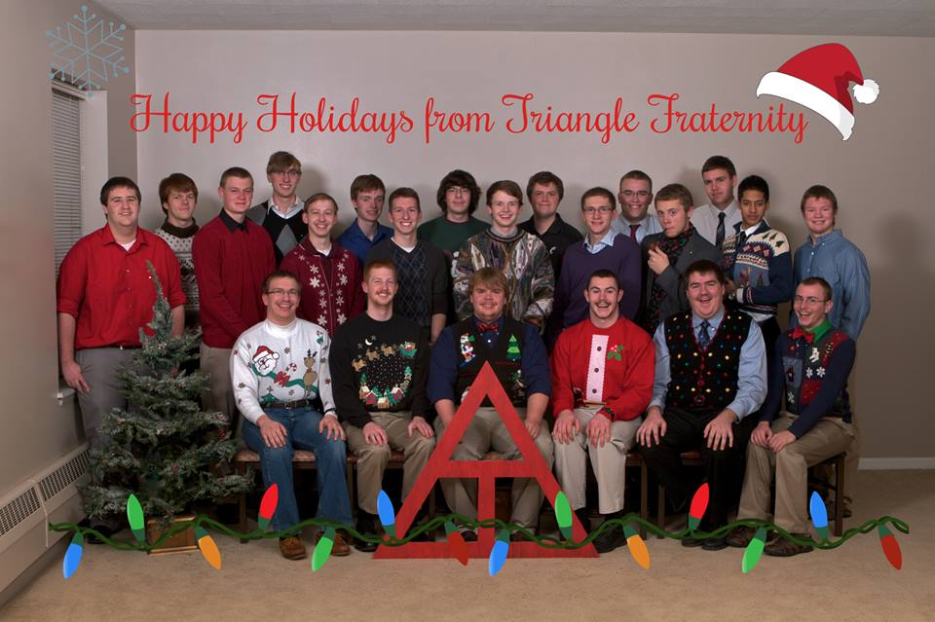
CEAS Student Organization Photo Contest
Winner: Triangle Fraternity Pizza party at next meeting

Slide 28
Special Events
Matthew 25 Ministries
Service opportunity: Saturday, March 22, 11 AM – 1 PM
Jetts Egg Drop
Wednesday, March 5
Relay For Life – Help fight Cancer!
Friday, April 4 - Saturday, April 5
9 potential service hours!
Talk to me after meeting or email me at:
blincosv@mail.uc.edu

Slide 29
FELD
President:
Dane Sowers
Next Meeting:
Thursday, February 27th from 7:30-8:30
643 Baldwin
Upcoming events:
Habitat for Humanity – this Saturday from 8am-4pm.
Email sowersdd@mail.uc.edu with questions or to be added to the email list.

Slide 30
Next Meeting
March 10th, 2014
Location: 525 Old Chem 5:30 PM
Visit us at our office – 652 Baldwin
www.tribunal.uc.edu
(513) 556-5439

