Slide 1
Engineering and Applied Science Tribunal
General Meeting
Apr 7th, 2014

Slide 2
https://www.youtube.com/watch?v=Z27QTeWRzUo&sns=tw

Slide 3
Tribunal Officers
President: |  | Alison Hayfer
Vice President: |  | Scott Blincoe
Associate Vice President: |  | Nathan Ball
Treasurer: |  | John Lewnard
Secretary: |  | Carlo Perottino
Senators: |  | Andrew Griggs Hannah Kenny

Slide 4
Tribunal Executives
Career Fair: |  | Tim Schafermeyer, Andrew Griggs
Collegiate Affairs: |  | Mark Gruenbacher
EWeek: |  | Maggy Zorc, Alison Hayfer
FELD: |  | John Lewnard
Luau: |  | Chris Katuscak
Recognition: |  | Ken Okoye
Public Affairs: |  | Maddie Adams
SOCC: |  | Nathan Ball
Special Events: |  | Scott Blincoe
Technology: |  | Tim Schafermeyer

Slide 5
Meeting Agenda
Officer Elections

Slide 6
VP
Maggie Connell

Slide 7
AVP
Sarah Deutsch

Slide 8
Sarah Deutsch
1st year Mechanical Engineer
Future Goals:
Advertising Tribunal Opportunities
Make it known what the committees do and what Tribunal can do for you
Re-establish the “committee” aspect
Break out sessions
Leadership roles in each committee
i.e. Secretary, Treasurer, etc.
Everyone is important and has an impact
More Accessible
- Drop-box
- Universal Email
- Office Hours
Current Positions:
Tribunal:
-Co-chair for Order of the Engineer
-Senator Intern
SWE:
-Mr. Engineer Pageant Committee
-Nomination Committee
Past Leadership Experience:
-President of Youth Group
-Vice President of Youth Group
-Club Soccer Team Captain
-Food Drive Organizer

Slide 9
Treasurer
John Lewnard

Slide 10
Secretary
Emily Demjanenko

Slide 11
Officer Reports

Slide 12
Secretary
Carlo Perottino
Please sign in at the back of the room
Must attend and sign in at minimum of 4 meetings each semester to having voting rights

Slide 13
Committee Reports

Slide 14
FELD
Next Meeting:
Thursday, April 10th from 7:30-8:30
643 Baldwin
Free pizza!
Upcoming events:
Sky Zone Trip: 4/12,11:30am – 2pm
Still 2 spots available – cost is only $8
Email sowersdd@mail.uc.edu with questions or to be added to the email list.

Slide 15
Special Events
Thanks to everyone who came out and helped. We raised over $2,300!
blincosv@mail.uc.edu

Slide 16
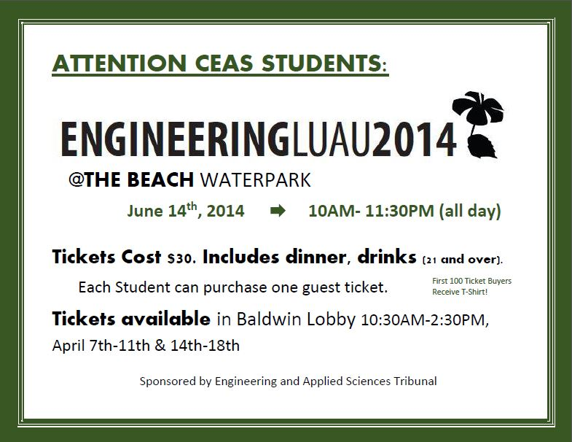

Slide 17
Sigma Sigma Carnival
Food, Fun, Fireworks!
Help us man the CEAS Tribunal and Ambassadors’ “Guess Your BAC” and Cotton Candy Stand on April 12th!
Check email for signups
blincosv@mail.uc.edu

Slide 18
SOCC
Committee Chair:
Nathan Ball
Flyers
Help take down flyers after meeting
If you want to put up flyers that do not meet the posting board requirements
Put the flyers in the Tribunal Office to be stamped
Email me at ballnn@mail.uc.edu

