Slide 1
Engineering and Applied Science Tribunal
General Meeting
January 12th , 2014

Slide 2
Purpose
What we are: CEAS Branch of Student Government
What we do:
Host programs for the college
Input on curriculum, grievances, and student/faculty relations
Improve student experience in the college

Slide 3
President
CEAS TRIBUNAL EXECUTIVE STRUCTURE
Secretary
Treasurer
Vice President
Associate Vice President
Senators (X2)
Technology
Career Fair
Public Affairs
FELD
EWeek
SOCC
Luau
Recognition
Special Events
Collegiate Affairs
OFFICERS are in black. COMMITTEE CHAIRS are in red.

Slide 4
Tribunal Officers
President: |  | Alison Hayfer
Vice President: |  | Carlo Perottino
Associate Vice President: |  | Matt Kitchen
Treasurer: |  | OPEN
Secretary: |  | Jared Wood
Senators: |  | Madeline Adams Hannah Kenny

Slide 5
Tribunal Executives
Career Fair: |  | Dane Sowers, Nick Stelzer
Collegiate Affairs: |  | Mark Gruenbacher
EWeek: |  | Alison Hayfer, Kitty DiFalco
FELD: |  | Alexis Conway
Luau: |  | Chris Katuscak
Recognition: |  | Christian Lipa
Public Affairs: |  | Logan Buck
SOCC: |  | Nathan Ball
Special Events: |  | Scott Blincoe
Technology: |  | Charlie Hinton

Slide 6
Officer Reports

Slide 7
President
Officer:
Alison Hayfer
Nominations
Christian Lipa
Max Inniger
Chris Katuscak
Office hours:
Mondays 6:30-7:30
Baldwin 652

Slide 8
Vice President
Officer:
Carlo Perottino
Office Hours:
Wednesdays 1:30-2:30 PM
Baldwin 652

Slide 9
Associate Vice President
Officer:
Matt Kitchen
Office Hours:
Tuesday/ Thursday 12:45-1:45 PM
Baldwin 652

Slide 10
Secretary
Officer:
Jared Wood
Please sign in at the back of the room
Must attend and sign in at minimum of 4 meetings each semester to having voting rights

Slide 11
Officer:
Maddie Adams
Hannah Kenny
Senators
Committee Meeting Times have changed for this semester
Election Packets will be available next Tuesday (January 20th)
Maddie Adams’ office hour will be 11-12 Mondays

Slide 12
JOKE OF THE WEEK
What do you get when you cross a mountain-climber with a mosquito?

Slide 13
Committee Reports

Slide 14
EWeek
Chairs:
Kitty DiFalco
Alison Hayfer
February 22nd -28th
Date Auction will be Friday @ The Brass Tap
Proceeds request form will open to student groups Jan 26th
Banquet will be Saturday @ Newport Syndicate
Tickets will go on sale Feb. 16th
First 100 will receive tshirts
Event and Date Auction registration will open January 26th
Questions? Email uc.eweek@gmail.com

Slide 15
EWeek
Chairs:
Kitty DiFalco
Alison Hayfer
Competition for Eweek T-Shirt Design!
Needs to incorporate Harry Potter theme
Submit designs to uc.eweek@gmail.com
Due Feb. 4th
Winner gets free ticket to banquet!
YOUR
DESIGN
HERE!

Slide 16
Special Events
Great opportunity to get involved and gain leadership experience
Open coordinator positions:
Community Service
High School Egg Drop Competition
Relay for Life
Sigma Sigma Carnival
Or any event you would like to put on!
All help wanted!

Slide 17
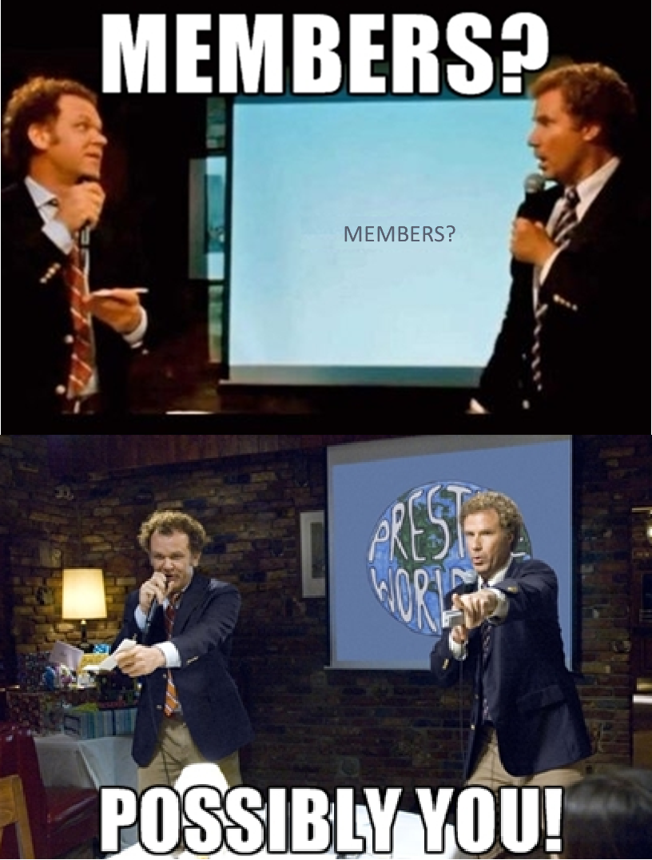
How Can You Get Involved?
See me after the meeting!
Or email Scott Blincoe
blincosv@mail.uc.edu

Slide 18
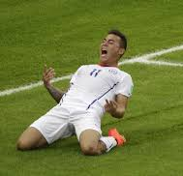
Current Events to Look Out For!
Community Service Events – Throughout Spring
Intramural Soccer – Season begins in February
Egg Drop – March
Relay for Life – Early April
Sigma Sigma Carnival – Mid April
Clean Up Cincy – Mid April

Slide 19
Other Announcements

Slide 20
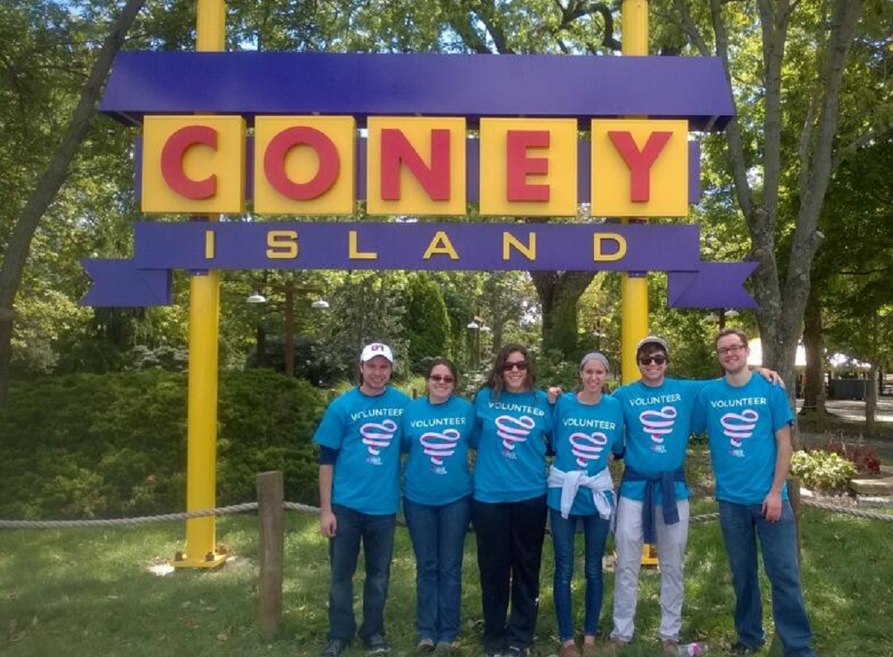
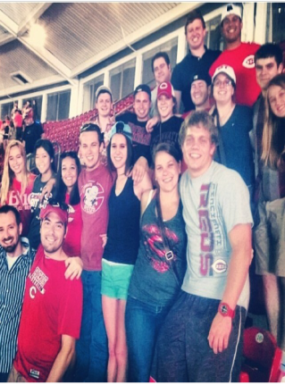
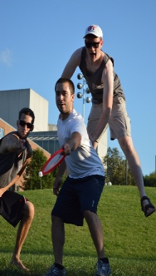
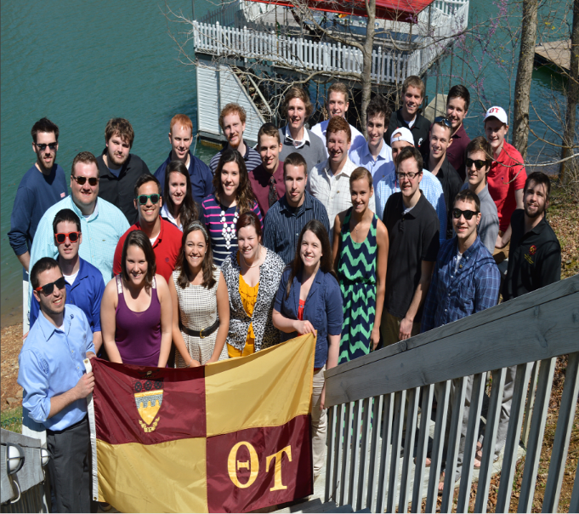
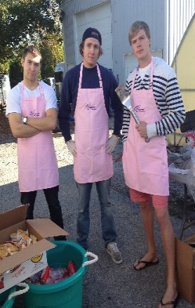
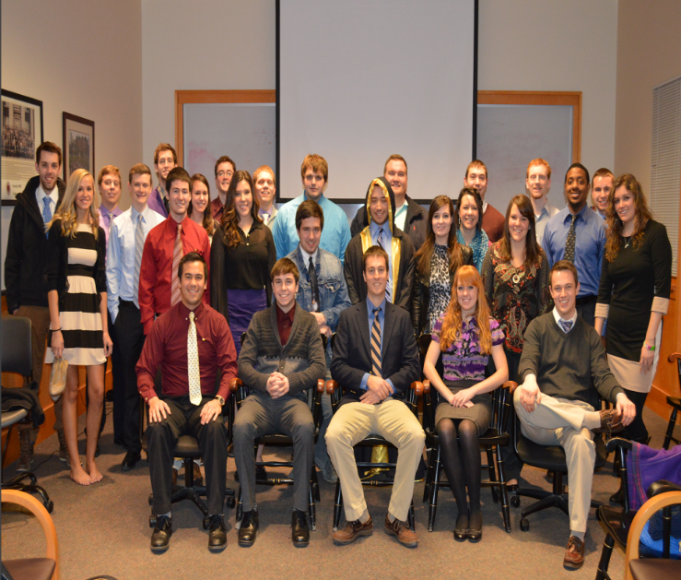
Community Service Professional Development Brotherhood
Special Events this Semester:
Formal
Retreat
Intermural Sports
Relay for Life

Slide 21
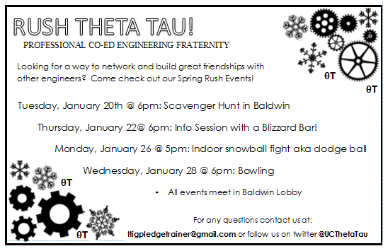

Slide 22
RAFFLE!

Slide 23
Constructive Criticism
What do you like/dislike about the college?
Comments / Questions?
questions.ceastribunal@gmail.com
What would you like to see Tribunal do next?

Slide 24
Next Meeting:
Monday, January 26th
525 Old Chem
5:30

