Slide 1
Engineering and Applied Science Tribunal
General Meeting
Mar 24th, 2014

Slide 2
Tribunal Officers
President: |  | Mason Stout
Vice President: |  | Scott Blincoe
Associate Vice President: |  | Nathan Ball
Treasurer: |  | John Lewnard
Secretary: |  | Carlo Perottino
Senators: |  | Andrew Griggs Hannah Kenny

Slide 3
Tribunal Executives
Career Fair: |  | Tim Schafermeyer, Andrew Griggs
Collegiate Affairs: |  | Mark Gruenbacher
EWeek: |  | Maggy Zorc, Alison Hayfer
FELD: |  | John Lewnard
Luau: |  | Chris Katuscak
Recognition: |  | Ken Okoye
Public Affairs: |  | Maddie Adams
SOCC: |  | Nathan Ball
Special Events: |  | Scott Blincoe
Technology: |  | Tim Schafermeyer

Slide 4
Meeting Agenda
Revolution UC
Year long Officer Nominations
Questions for upcoming Dean visit

Slide 5
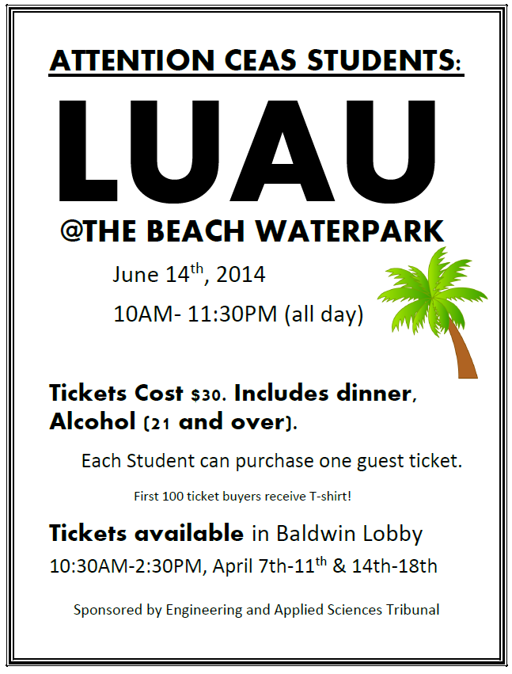

Slide 6
[REDACTED] ENGINEER
How to Become A
@ShyRuparel

Slide 7
Help UC Students acquire the tools, skills, & connections that they need to be AWESOME.
(or at least substantially [redacted])

Slide 12
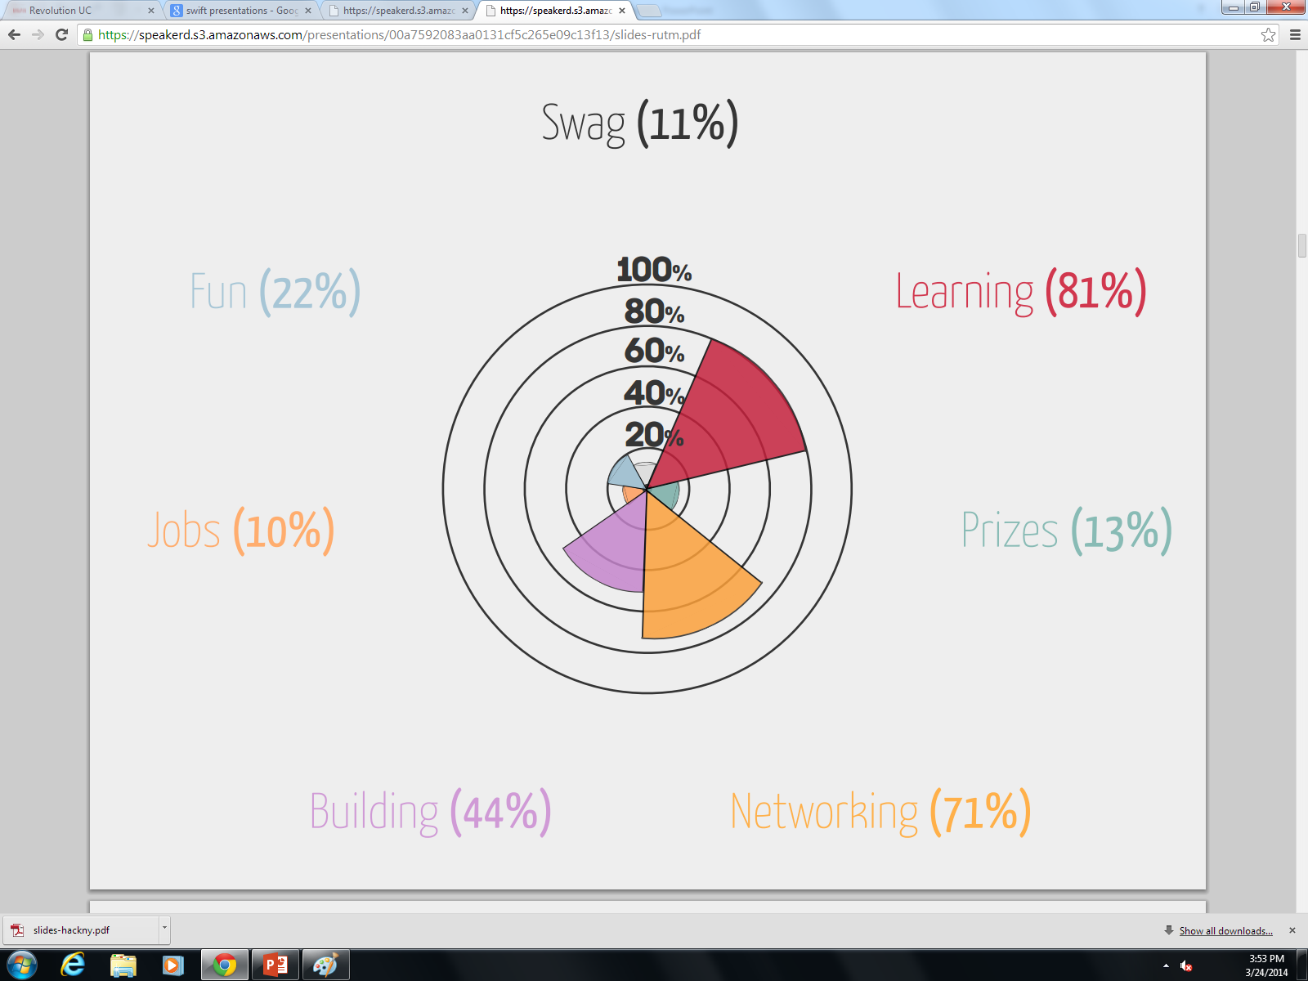

Slide 14
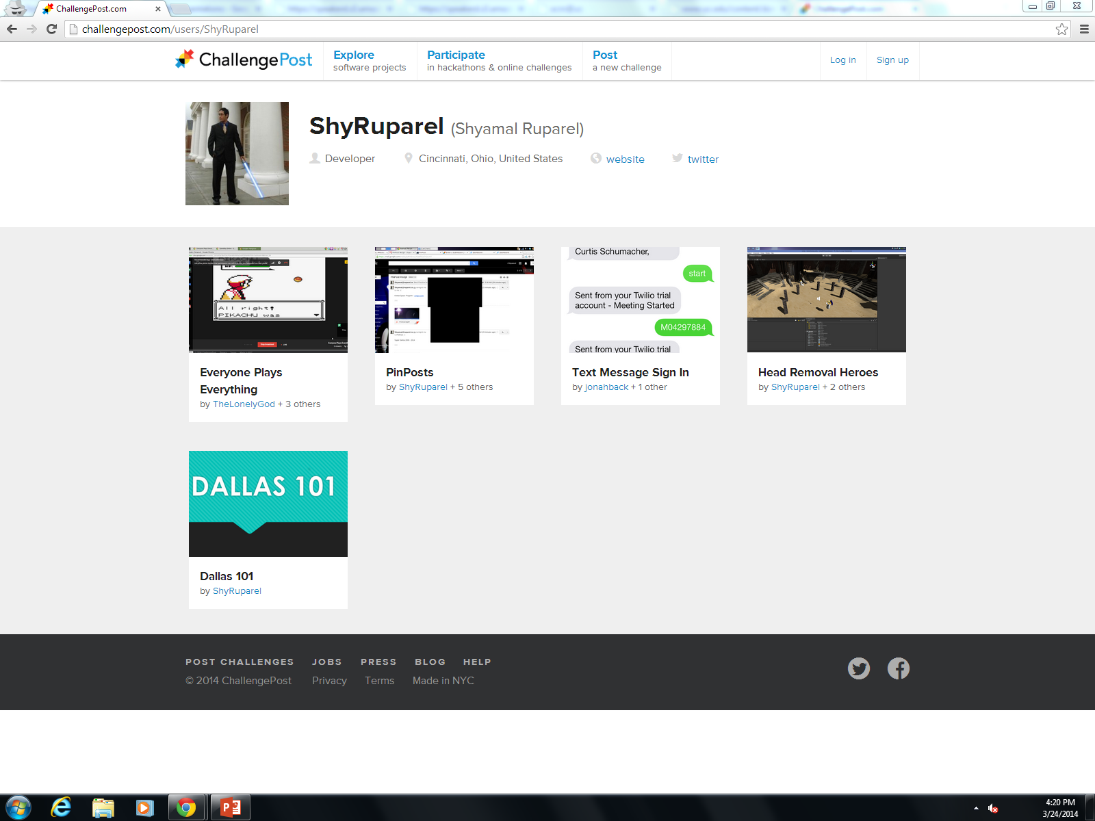

Slide 15
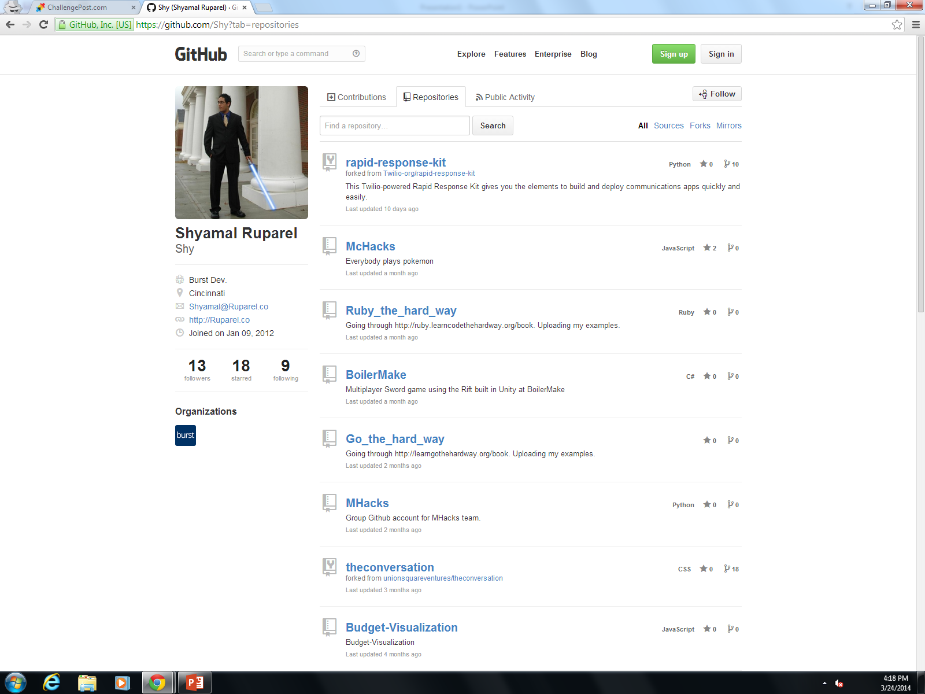

Slide 24
April 5th/6th
REVOLUTIONUC.COM
@ShyRuparel

Slide 25
President
Alison Hayfer
Julianne Leny

Slide 26
Senator
Hannah Kenny
Andrew Griggs
Sean Gleason
Thaddaeus Voss
Maddie Adams

Slide 27
Questions for Dean Lim
Next Monday, 31 March 5:30 pm in 525 Old Chem.
Email to stoutmg@mail.uc.edu

Slide 28
Officer Reports

Slide 29
Secretary
Carlo Perottino
Please sign in at the back of the room
Must attend and sign in at minimum of 4 meetings each semester to having voting rights

Slide 30
Senator
Hannah Kenny
Andrew Griggs
Generation Waking Up
Sustainability/social justice interactive seminar
Saturday, 12p-3p @ Lindner Center 450
Great American Cleanup Event
Saturday, 10a-2p @ Rhinegeist Brewery
Ballin’ for Abilities
Wheelchair basketball tournament
Sunday, 3p-7p @ 5/3 Arena
Registration starts at 2p, suggested donation $10/person
Cabinet Positions for 2014-2015
Apply via Campuslink
Applications due April 4

Slide 31
Committee Reports

Slide 33
Recognition
Chair:
Ken Okoye
Professor and TA of the Semester nominations
Due April 9th
tribunal.uc.edu/recognition
Freshman and Junior of the Year– Applications available NOW!
Need people to serve on recognition committee.
Read POTS and TAOTS nominations help select winner. Read scholarship applications. Help choose Outstanding Seniors. Help with keeping records and publicizing our winners.
MINIMUM commitment. Easy committee requirement!

Slide 34
Special Events
Relay For Life – Help fight Cancer!
Friday, April 4 - Saturday, April 5
9 potential service hours!
Talk to me after meeting or email me at:
blincosv@mail.uc.edu

Slide 35
Order of the Engineer
Ring sizing NEXT WEEK! (March 31st – April 4th)
Monday – Thursday 1:30pm – 3:30pm
Friday 8am- 10am
10$ cash or check made out to “CEAS Tribunal” to pay for ring
Ceremony will be on Friday, April 25th
Can’t make these times:
Email Maggie Connell: connelmt@mail.uc.edu

Slide 36
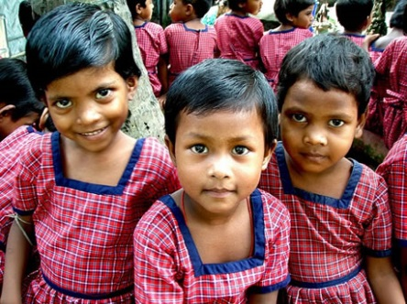
Rotaract Fundraiser
With who? Potbelly
When? April 2nd 5pm-8pm
Benefiting who? Promise of Assurance to Children Everywhere (PACE)
**PACE focuses on the holistic development of girls. PACE engages the entire community to ensure sustainable and successful impact. PACE creates a blueprint for poverty eradication that can be implemented worldwide.
25% of proceeds go to the organization

Slide 37
What can your donation do?
$175 Provides a Woman:
Adult education and literacy classes
Stationery and learning supplies
Vocational training in either:
Sewing & tailoring
Jewelry making
Co-op farming
All materials and supplies for the training course
Micro-loan training and a loan after course completion
On-site childcare services

Slide 38
Next Meeting
March 31st, 2014
Location: 525 Old Chem 5:30 PM
Visit us at our office – 652 Baldwin
www.tribunal.uc.edu
(513) 556-5439

