Slide 1
Engineering and Applied Science Tribunal
General Meeting
Feb 24th , 2014

Slide 2
Tribunal Officers
President: |  | Mason Stout
Vice President: |  | Scott Blincoe
Associate Vice President: |  | Nathan Ball
Treasurer: |  | John Lewnard
Secretary: |  | Carlo Perottino
Senators: |  | Andrew Griggs Hannah Kenny

Slide 3
Tribunal Executives
Career Fair: |  | Tim Schafermeyer, Andrew Griggs
Collegiate Affairs: |  | Mark Gruenbacher
EWeek: |  | Maggy Zorc, Alison Hayfer
FELD: |  | John Lewnard
Luau: |  | Chris Katuscak
Recognition: |  | Ken Okoye
Public Affairs: |  | Maddie Adams
SOCC: |  | Nathan Ball
Special Events: |  | Scott Blincoe
Technology: |  | Tim Schafermeyer

Slide 5
Order of the Engineer
What’s this all about?
Foster a spirit of pride and responsibility in the engineering profession.
Bridge the gap between training and experience.
Present to the public a visible symbol identifying the engineer.
Any engineer is eligible for induction if he or she has graduated/within one academic year of graduation from an EAC of ABET program or holds a license as a Professional Engineer.
Got Questions? Want to help?
connelmt@mail.uc.edu

Slide 6
Officer Reports

Slide 7
Senators’ Report
Christina Beer & Shivam Shah – your new Student Body President & Vice President
Cabinet applications out, due April 4th at 5pm
https://campuslink.uc.edu/form/start/38893

Slide 8
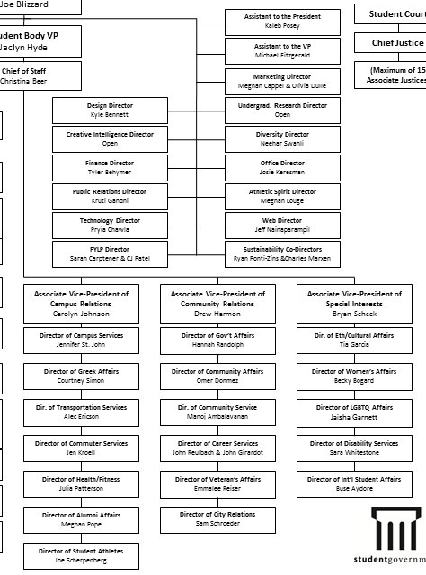
Senators’ Report

Slide 9
Secretary
Carlo Perottino
Please sign in at the back of the room
Must attend and sign in at minimum of 4 meetings each semester to having voting rights

Slide 10
Committee Reports

Slide 11
SOCC
Committee Chair:
Nathan Ball
Flyers
Help take down flyers after meeting
Counts as ½ of committee requirement
If you want to put up flyers that do not meet the posting board requirements
Put the flyers in the Tribunal Office to be stamped
Email me at ballnn@mail.uc.edu

Slide 12
Recognition
Chair:
Ken Okoye
Congratulations to our winners!
Professor of the Year: Ahmed Elgafy
Outstanding Senior – College: Kerry O’Connell
Outstanding Senior – University: Aaron Sykes
Outstanding Senior – Community Matthew Menche
Still time to join our committee and help choose Professor of the Semester and Freshman and Junior of the Year!

Slide 13
Special Events
Service hour from Mathew 25
11 am to 1 pm on Saturday March 22
Transportation provided
Email diehmgr@mail.uc.edu if interested

Slide 14
Special Events
Relay For Life – Help fight Cancer!
Friday, April 4 - Saturday, April 5
9 potential service hours!
Talk to me after meeting or email me at:
blincosv@mail.uc.edu
NCAA Men’s Basketball Bracket Challenge!
Visit us in Baldwin lobby Wed. or Thurs. from 10:00 – 1:00 to donate $2+ to enter pool

Slide 15
FELD
President:
Dane Sowers
Next Meeting:
Thursday, March 13th from 7:30-8:30
643 Baldwin
Free pizza!
Potentially having a student co-op panel
Upcoming events:
Sky Zone Trip – date and other details TBD
Email sowersdd@mail.uc.edu with questions or to be added to the email list.

Slide 16
Next Meeting
March 10th, 2013
Location: 525 Old Chem 5:30 PM
Visit us at our office – 652 Baldwin
www.tribunal.uc.edu
(513) 556-5439

