Slide 1
Engineering and Applied Science Tribunal
General Meeting
Mar 31st, 2014

Slide 2
Tribunal Officers
President: |  | Mason Stout
Vice President: |  | Scott Blincoe
Associate Vice President: |  | Nathan Ball
Treasurer: |  | John Lewnard
Secretary: |  | Carlo Perottino
Senators: |  | Andrew Griggs Hannah Kenny

Slide 3
Tribunal Executives
Career Fair: |  | Tim Schafermeyer, Andrew Griggs
Collegiate Affairs: |  | Mark Gruenbacher
EWeek: |  | Maggy Zorc, Alison Hayfer
FELD: |  | John Lewnard
Luau: |  | Chris Katuscak
Recognition: |  | Ken Okoye
Public Affairs: |  | Maddie Adams
SOCC: |  | Nathan Ball
Special Events: |  | Scott Blincoe
Technology: |  | Tim Schafermeyer

Slide 4
Meeting Agenda
Order of the Engineer
Presentation by Dean Lim
President Election
Senator Election

Slide 5
Order of the Engineer
Ring sizing THIS WEEK!
Monday – Thursday 1:30pm – 3:30pm
Friday 8am- 10am
10$ cash or check made out to “CEAS Tribunal” to pay for ring
Ceremony: Friday, April 25th at 5pm
Can’t make these times:
Email Maggie Connell: connelmt@mail.uc.edu

Slide 6
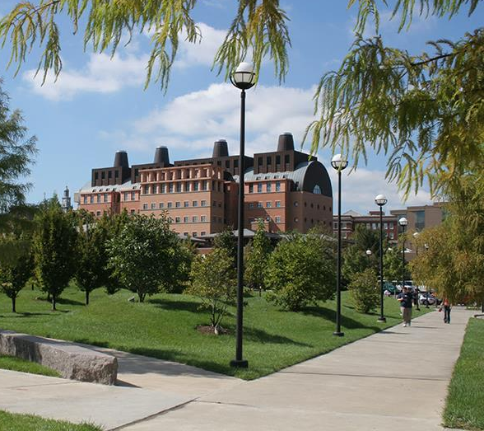
Teik C. Lim, Dean COLLEGE OF ENGINEERING & APPLIED SCIENCE
3rd Century
Faculty hiring, 50 in 5 plan
Improve lab capabilities and capacities
Steady-state, 4000 undergrads & 1000 grads
Enhance students’ experience
Diversity
Global strategy, JCI, FUE, etc. – more resources for CEAS
Learning communities
Budget
Computer Science (and all other programs)

Slide 7
President
Alison Hayfer

Slide 8
Senator
Hannah Kenny
Maddie Adams

Slide 9
Hannah Kenny for CEAS Senator
03/31/2014

Slide 10
Background & Experience
Biomedical Engineering
3rd Year Student
Non-SG Involvement
CEAS Ambassadors
ROAR Tour Guides
Phi Sigma Rho sorority
Current CEAS Senator
Present and Vocal
Elections Facilitation
Project Unbreakable
Constitution Review
CEAS Tribunal
Involved with Exec since 1st year
Multiple committees/positions

Slide 11
Goals
Tribunal Collaboration
Tribunal Leadership Council
Learn from others and share our wisdom
Engagement with Cabinet to support projects
Career Services
Community Service
Campus Services
Affordability?
Consistent Open Office Hours

Slide 12
Thanks! Questions?

Slide 13
Madeline Adams
For CEAS Senator
COLLEGE OF
ENGINEERING & APPLIED SCIENCE

Slide 14
CEAS Experience
3rd year Mechanical Engineering student (4th year at UC)
Current CEAS Tribunal Public Affairs Chair
Executive in CEAS Ambassadors (Recruitment, Creative, Secretary, Vice President Elect)
COLLEGE OF
ENGINEERING & APPLIED SCIENCE

Slide 15
Student Government
Student Government Outreach Week volunteer
Student Experience Interest
Continue Tribunal Networking Events
COLLEGE OF
ENGINEERING & APPLIED SCIENCE

Slide 16
Questions?
COLLEGE OF
ENGINEERING & APPLIED SCIENCE

Slide 17
Officer Reports

Slide 18
Secretary
Carlo Perottino
Please sign in at the back of the room
Must attend and sign in at minimum of 4 meetings each semester to having voting rights

Slide 19
Committee Reports

Slide 20
Special Events
blincosv@mail.uc.edu

Slide 21
Sigma Sigma Carnival
Food, Fun, Fireworks!
Help us man the CEAS Tribunal and Ambassadors’ “Guess Your BAC” and Cotton Candy Stand on April 12th!
More info to come, but see me after meeting or email me at:
blincosv@mail.uc.edu

Slide 22
SOCC
Committee Chair:
Nathan Ball
Flyers
Help take down flyers after meeting
Counts as ½ of committee requirement
If you want to put up flyers that do not meet the posting board requirements
Put the flyers in the Tribunal Office to be stamped
Email me at ballnn@mail.uc.edu

Slide 23
Next Meeting
April 7th, 2013
Location: 525 Old Chem 5:30 PM
Visit us at our office – 652 Baldwin
www.tribunal.uc.edu
(513) 556-5439

Slide 24
VP
Maggie C
Scott Blincoe
Juliann Leny

Slide 25
AVP
Nick Stelzer
Sarah Deutsch
Emily Demjanenko
Kitty Difalco

Slide 26
Treasurer
John Lewnard
Courtney Dolla Do$$a Bills

Slide 27
Secretary
Thaddaeus Voss
Danny Nolan
Andrew Griggs
Dane Sowers
Sam Dunker

