Slide 1
Engineering and Applied Science Tribunal
General Meeting
March 28, 2016

Slide 2
Agenda:
President Elections
Senator Elections
Committee Reports
Raffle

Slide 3
President Elections
John Lewnard
Dane Sowers

Slide 4
John Lewnard

Slide 5
Dane Sowers for President
My Experience
Vice President (Spring 2016)
Career Fair Coordinator (Summer 2014 – Fall 2015)
Associate Vice President (Summer 2015)
FELD President (Fall 2013 – Fall 2014)
Technology Intern (Fall 2013 - Spring 2014)
My Goals and Initiatives
Engineering Student Government Conference
Special Events Expansion
Collegiate Affairs Liaison Program
Strategic Goal Setting
Pre-Semester “Orientation” for Officers and Exec
Re-Evaluation of Marketing Techniques
Increased Variety of Food at Meetings
Involvement in Freshman Orientation
Facilities Repair Reporting Pipeline

Slide 6
Senator Elections
Emily Demjanenko
Tim Kemper
Lillian Ashworth
Khaled Aboumerhi
Himadri Pandey

Slide 7
Emily Demjanenko

Slide 8
Tim Kemper
Experience
Career Fair Coordinator (Fall 2015 and Spring 2016)
CEAS Senator (December 2015 – Present)
Funding CEAS Student Groups
Career Education Initiative Task Force
E-Textbook Learning Platform Committee
SG Restructure
SG Exec Elections
Going Grey UC

Slide 9
Tim Kemper
Student Government
Represent CEAS student interests
Come to table informed
Educate CEAS students on issues
Make senate & SG more accessible for students
Tribunal
Represent CEAS student interests at Tribunal exec
Report exec activities to general body
Revamp the “intern program” – best practices from different orgs.

Slide 10
LILLIAN ASHWORTH
for CEAS tribunal senator

Slide 11
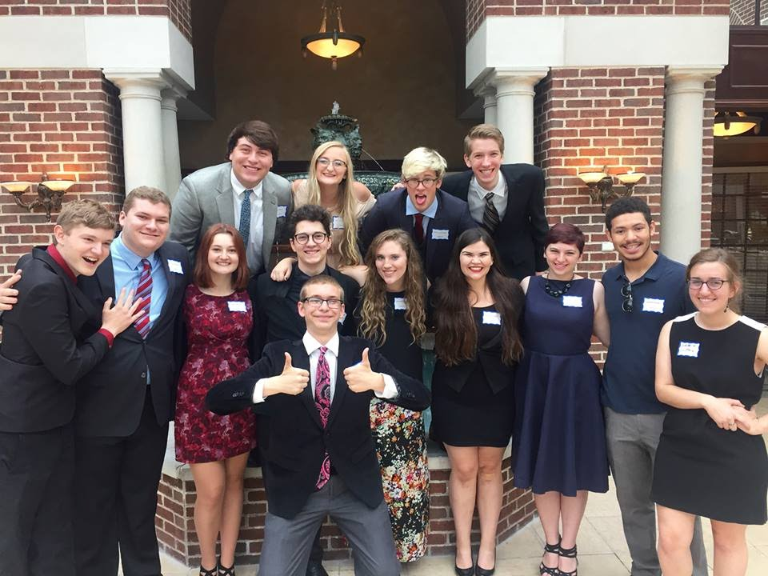
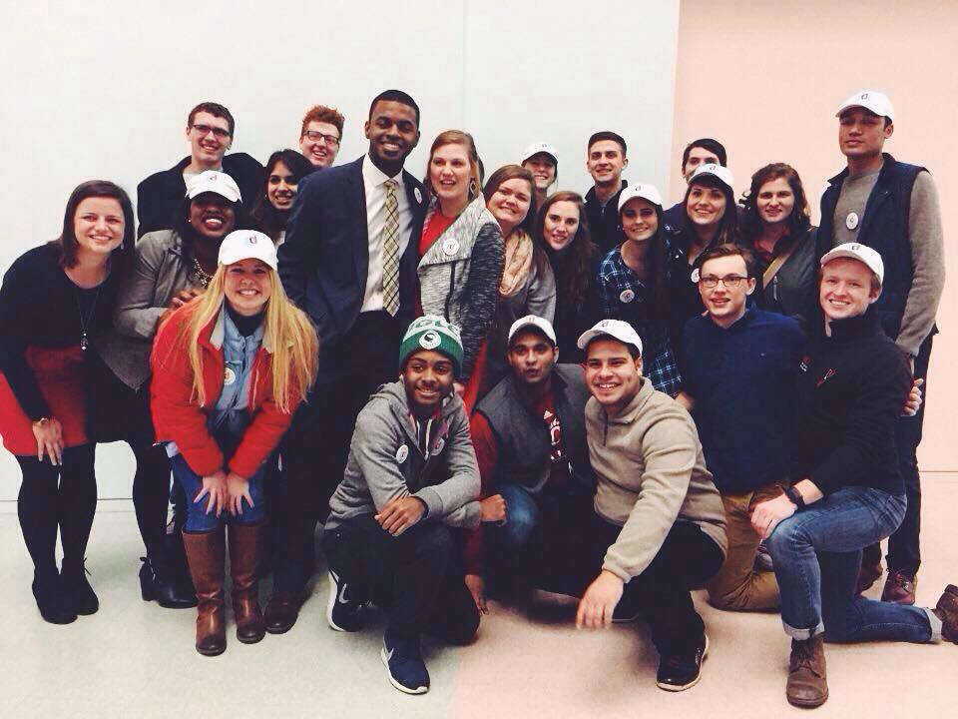
EXPERIENCE
in the community
ODP/ WCDP
community service event organization
as a founder / executive
Chemistry Club
Drama
Creative Writing
Vegan and Vegetarian
W.A.N.T. Arts and Activism
in student government
on the campaign team of Mitchell and Brooke
regular attendee at senate meetings
passion for policy and legislation
as a member
UC Sustainability
LEAP
AIChE
Phi Sigma Rho

Slide 12
VISION
Open Communication
Mental Health Ambassador Implementation
Streamline and Enhance Information Pathways

Slide 13
Khaled Aboumerhi for CEAS Senator
My background in CEAS
Collegiate Affairs Chair
Represent students at College Curriculum Meeting & Committee on Academic Affairs
Worked with faculty and department heads to ensure necessary changes were implemented
My Platform
Represent YOU
Execute ideas that are already proposed by the 8 newly elected senators and cabinet

Slide 14
Himadri Pandey
Major - Computer Science
Graduation year – 2019
On-campus involvement:
UC ASSE – Co-President
UC CubeCats – Ambassador
ACM-W
IEEE
SWE

Slide 15
What I propose to do?
Voice of CEAS students at the senate
Be a part of the Academic Issues Committee of Student Government
Work in the academic and career interests of students of CEAS

Slide 16
Questions?

Slide 17
Officer Reports

Slide 18
Office Hours
650 Baldwin
President - Carlo Perottino
Thursdays: 11:30am - 1:30pm
V. President - Dane Sowers
Mondays: 10:30am - 11:30am
A.V. President - McKenzie Kinzbach
Tuesdays: 6:30pm - 7:30pm
Treasurer - Max Inniger
Tuesdays: 11:00am - 12:00pm
Secretary - Frazier Baker
Wednesdays: 6:00pm - 7:00pm
Senator - John Lewnard
Wednesdays: 4:30pm - 5:30pm
Senator - Tim Kemper
Wednesdays: 12:00pm - 1:00pm

Slide 19
Senator Report
Officer:
Tim Kemper
John Lewnard

Slide 20
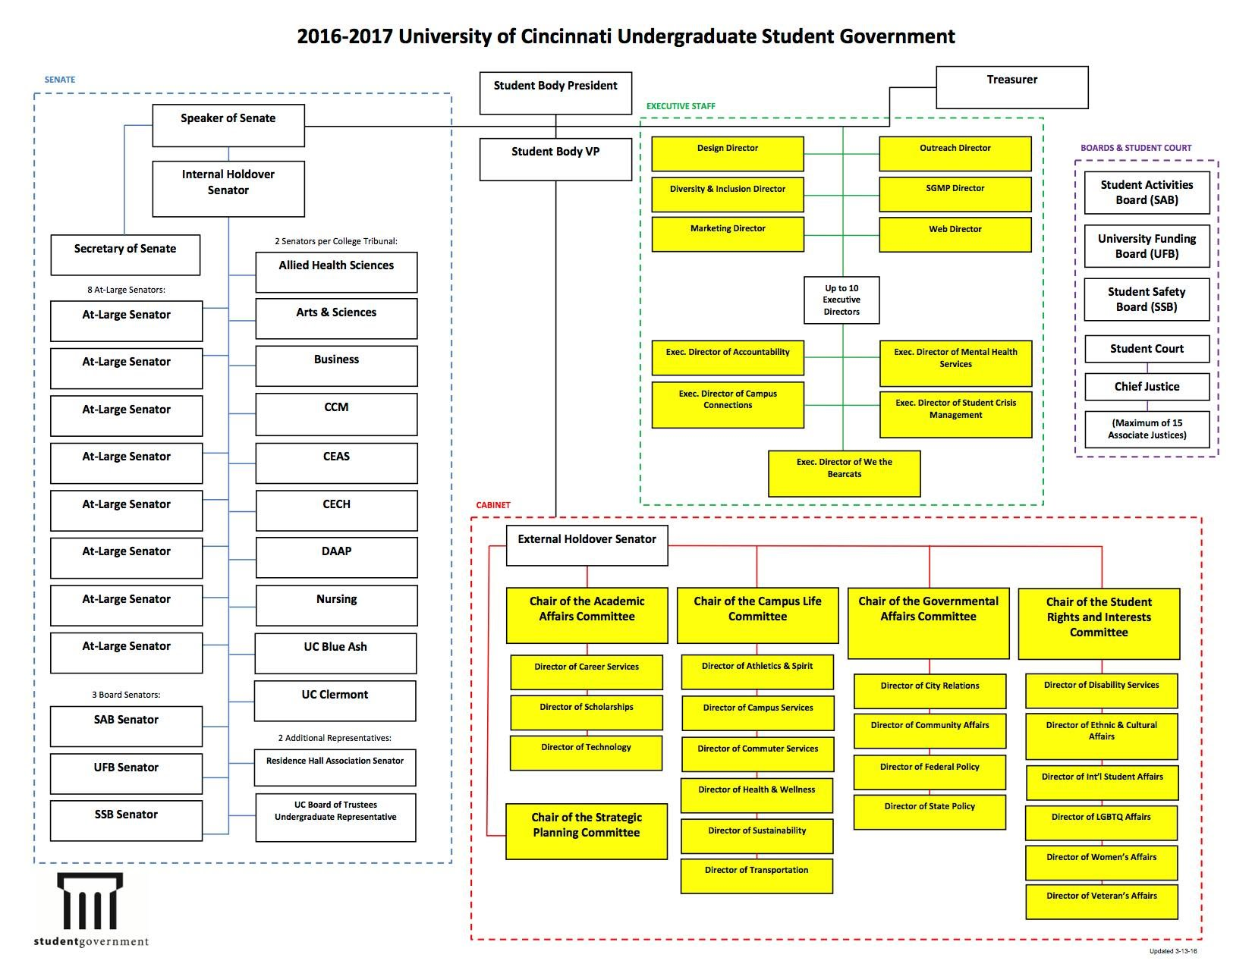
Senator Report
Officer:
Tim Kemper
John Lewnard

Slide 21
Committee Reports

Slide 22
Special Events
Committee Chair:
Emma Lowe
Upcoming Events:
VA Hospital - Mon, Tues, & Thurs.
Intramurals - Monday Nights
Cyclones Game - Mar. 31st
Relay for Life - Apr. 1st-2nd
Clean Up Cincy - Apr. 2nd
Matthew 25 Ministries - Apr. 13th
Sigma Sigma Carnival - Apr. 16th
RevolutionUC - Apr. 16th-17th
Senior Design Expo - Apr. 18th

Slide 23
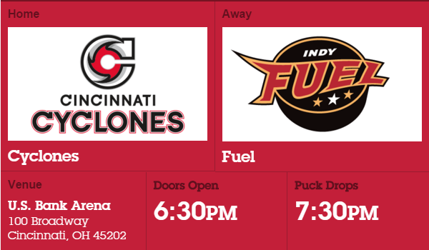
Cyclones Game
Date: Thursday, March 31st
Theme: Fan Choice Night
Game against: Indy Fuel
DOLLAR BEER NIGHT!
Questions? Email Sam Dunker
at dunkerse@mail.uc.edu.
Link to sign up: https://docs.google.com/spreadsheets/d/1X-G26vddjotcYxpQ2qvt-atDiT-wE1yNZLGCUW4JllY/edit?usp=sharing

Slide 24
Relay For Life!
Help fight cancer and sign up for the CEAS Tribunal Relay For Life team!
Date: April 1st - 2nd
Time: 6:00pm - 6:00am
Where: McMicken Commons
Pancake Sale this Wednesday!
Counts for extra Cincinnatus Hours!
Questions? Email Hao Tran at tranno@mail.uc.edu.
Sign up: http://main.acsevents.org/goto/ceastribunal

Slide 25
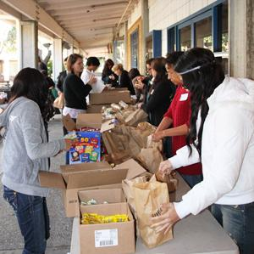
Community Service
VA Hospital:
Date: Mon, Tues, & Thurs in March
Time: 5:30pm - 8:15pm
Where: 3200 Vine St.
Matthew 25 Ministries:
Date: Wednesday, April 13th
Time: 5:30pm - 7:30pm
Where: ERC Circle
More service events to come! All events count for service hours (i.e. Cincinnatus)!
If you have any questions, please email Steven Ankney at ankneysb@mail.uc.edu.

Slide 27
SOCC
Chair: Heath Palmer
Student Organization Communication Committee
Planning meeting with SAB
Regarding Campus Link update
Not informed that contacts list would disappeared
Potential recommendation box for group leaders
Integrating 25 live? Or something else
Other questions
Next meeting –29th at 7pm, 405 ERC
SAB
What topics do you want to see this Summer?
Please email palmerha@mail.UC.edu if you have any questions.

Slide 28
Innovation Committee
Committee Chair:
Emily Demjanenko
Responsible for initiating projects and ideas to better the college and support CEAS students
Projects:
Finals week stress relief: April 18-April 22
CEAS Alumni Night: Thursday April 14
Next meeting: Tuesday, March 14 from 5:30-6:00 pm in the Tribunal office
demjanes@mail.uc.edu

Slide 29
Other Announcements

Slide 30
RAFFLE!

Slide 31
Constructive Criticism
What do you like/dislike about the college?
Comments / Questions?
questions.ceastribunal@gmail.com
What would you like to see Tribunal do next?

Slide 32
Next Meeting:
April 11, 2016
5:30pm
525 Old Chem

