Slide 1
Engineering and Applied Science Tribunal
General Meeting
February 8, 2016

Slide 2
Agenda:
Officer Introductions & Reports
Committee Introductions & Reports
Raffle
Open Forum After the Meeting

Slide 3
Purpose
What we are: CEAS Branch of Student Government
What we do:
Host programs for the college
Input on curriculum, grievances, and student/faculty relations
Improve student experience in the college

Slide 4
President
CEAS TRIBUNAL EXECUTIVE STRUCTURE
Secretary
Treasurer
Vice President
Associate Vice President
Senators (X2)
Technology
Innovation
Career Fair (X2)
Constitution & Bylaws
Public Affairs
Order of the Engineer
FELD
EWeek (X2)
SOCC
Luau
Recognition
Special Events
Collegiate Affairs
OFFICERS are in black. COMMITTEE CHAIRS are in red.

Slide 5
Tribunal Officers
President: |  | Carlo Perottino
Vice President: |  | Dane Sowers
Associate Vice President: |  | McKenzie Kinzbach
Treasurer: |  | Max Inniger
Secretary: |  | Frazier Baker
Senators: |  | John Lewnard Tim Kemper

Slide 6
Tribunal Executives
Career Fair: |  | Tim Kemper Nathan Hamit
Collegiate Affairs: |  | Khaled Aboumerhi
Constitution and Bylaws |  | Jared Wood
EWeek: |  | Alison Hayfer Andrew Bachus
FELD: |  | Paige Johnson
Innovation: |  | Emily Demjanenko
Luau: |  | Andrew John Droesch
Order of the Engineer: |  | Sean Gleason
Public Affairs: |  | Matt Morgann
Recognition: |  | Rugved Mavidpalli
SOCC: |  | Heath Palmer
Special Events: |  | Emma Lowe
Technology: |  | Michael Santacroce

Slide 7
Officer Reports

Slide 8
Office Hours
650 Baldwin
President - Carlo Perottino
Cancelled due to Career Fair
V. President - Dane Sowers
Mondays: 10:30am - 11:30am
A.V. President - McKenzie Kinzbach
Tuesdays: 12:30pm - 1:30pm
Treasurer - Max Inniger
Tuesdays: 11:00am - 12:00pm
Secretary - Frazier Baker
Wednesdays: 6:00pm - 7:00pm
Senator - John Lewnard
Wednesdays: 4:30pm - 5:30pm
Senator - Tim Kemper
Wednesdays: 12:00pm - 1:00pm

Slide 9
Officer:
Carlo Perottino
President
Dean Lim will be speaking at the next general meeting.
He has asked for specific questions and topics so we can increase the productivity of this talk.
Please fill out a “Question / Topic” slip!

Slide 10
Officer:
Frazier Baker
Secretary
Don’t forget to sign in!
You need to sign in to 4 meetings to earn voting privileges.

Slide 11
Senator Report
Officer:
Tim Kemper
John Lewnard
Senate Overview:
Senate voted down Fossil Free UC Bill (7-24-0)
Senate allocated money towards sound speakers for tabling
Student Government Elections coming up:
Campaigning starts Monday, February 15th
If campaign teams contact your student organization, we encourage that you either permit all or that you permit based off of position – NOT their platform
Be on the look out for “dinner and dialogue” sessions – food and distinguished speakers

Slide 12
Committee Reports

Slide 13
Career Fair
Coordinators:
Tim Kemper
Nathan Hamit
WHAT: Technical Career Fair
WHERE: Campus Recreation Center
WHEN: Tuesday Feb. 11th, 10AM-4PM
WHY: Get a co-op or full time job!!
Volunteers – email to come out with assignments tomorrow morning!

Slide 14
EWeek
Committee Chair:
Alison Hayer
Andy Bachus
What is it? A nationally celebrated week to celebrate engineers and all that we do!
What do we do? Have a fun week of competition and games and end the week with a banquet
When is it? February 21-27th
Questions? Email uc.eweek@gmail.com
Follow us on Twitter @UC_Eweek
Through the Herman Schneider Foundation, the first 85 seniors get free tickets for the banquet
Next committee meeting : Friday at 1PM in 650 Baldwin!

Slide 15
Special Events
Committee Chair:
Emma Lowe
Upcoming Events:
Jungle Jim’s Cheese Festival - Feb. 13th
Matthew 25 Ministries - Feb. 17th
Habitat for Humanity ReStore - Feb. 27th
Intramurals - Feb. 28th
Egg Drop - Mar. 2nd
Habitat for Humanity Restore - Mar. 12th
Cyclones Game - Mar. 31st
Relay for Life - Apr. 1st-2nd
Senior Design Expo - Apr. 19th (Tentative)

Slide 16
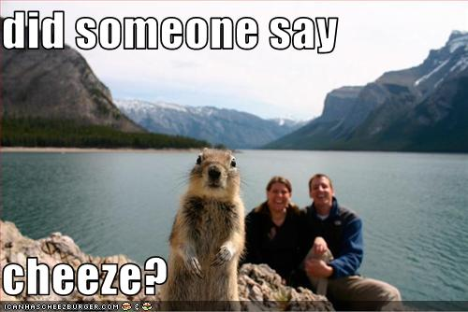
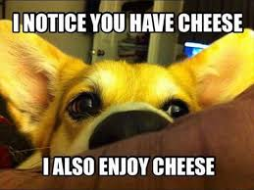
Jungle Jim’s Cheese Festival
Date: This Saturday!! February 13th
Time: 12:30pm
Where: ERC Circle
If you have any question, please email Andy Droesch at droescaj@mail.uc.edu.

Slide 17
Community Service Events
Matthew 25 Ministries:
Date: Wednesday, February 17th
Time: 5:00pm
Where: Meet in ERC circle.
Habitat for Humanity ReStore (FULL):
Date: Saturday, February 27th
Time: 8:30am or 12:30pm
Where: Meet in ERC circle
And so many more service opportunities to come!
If you have any questions, please email Steven Ankney at ankneysb@mail.uc.edu.

Slide 18
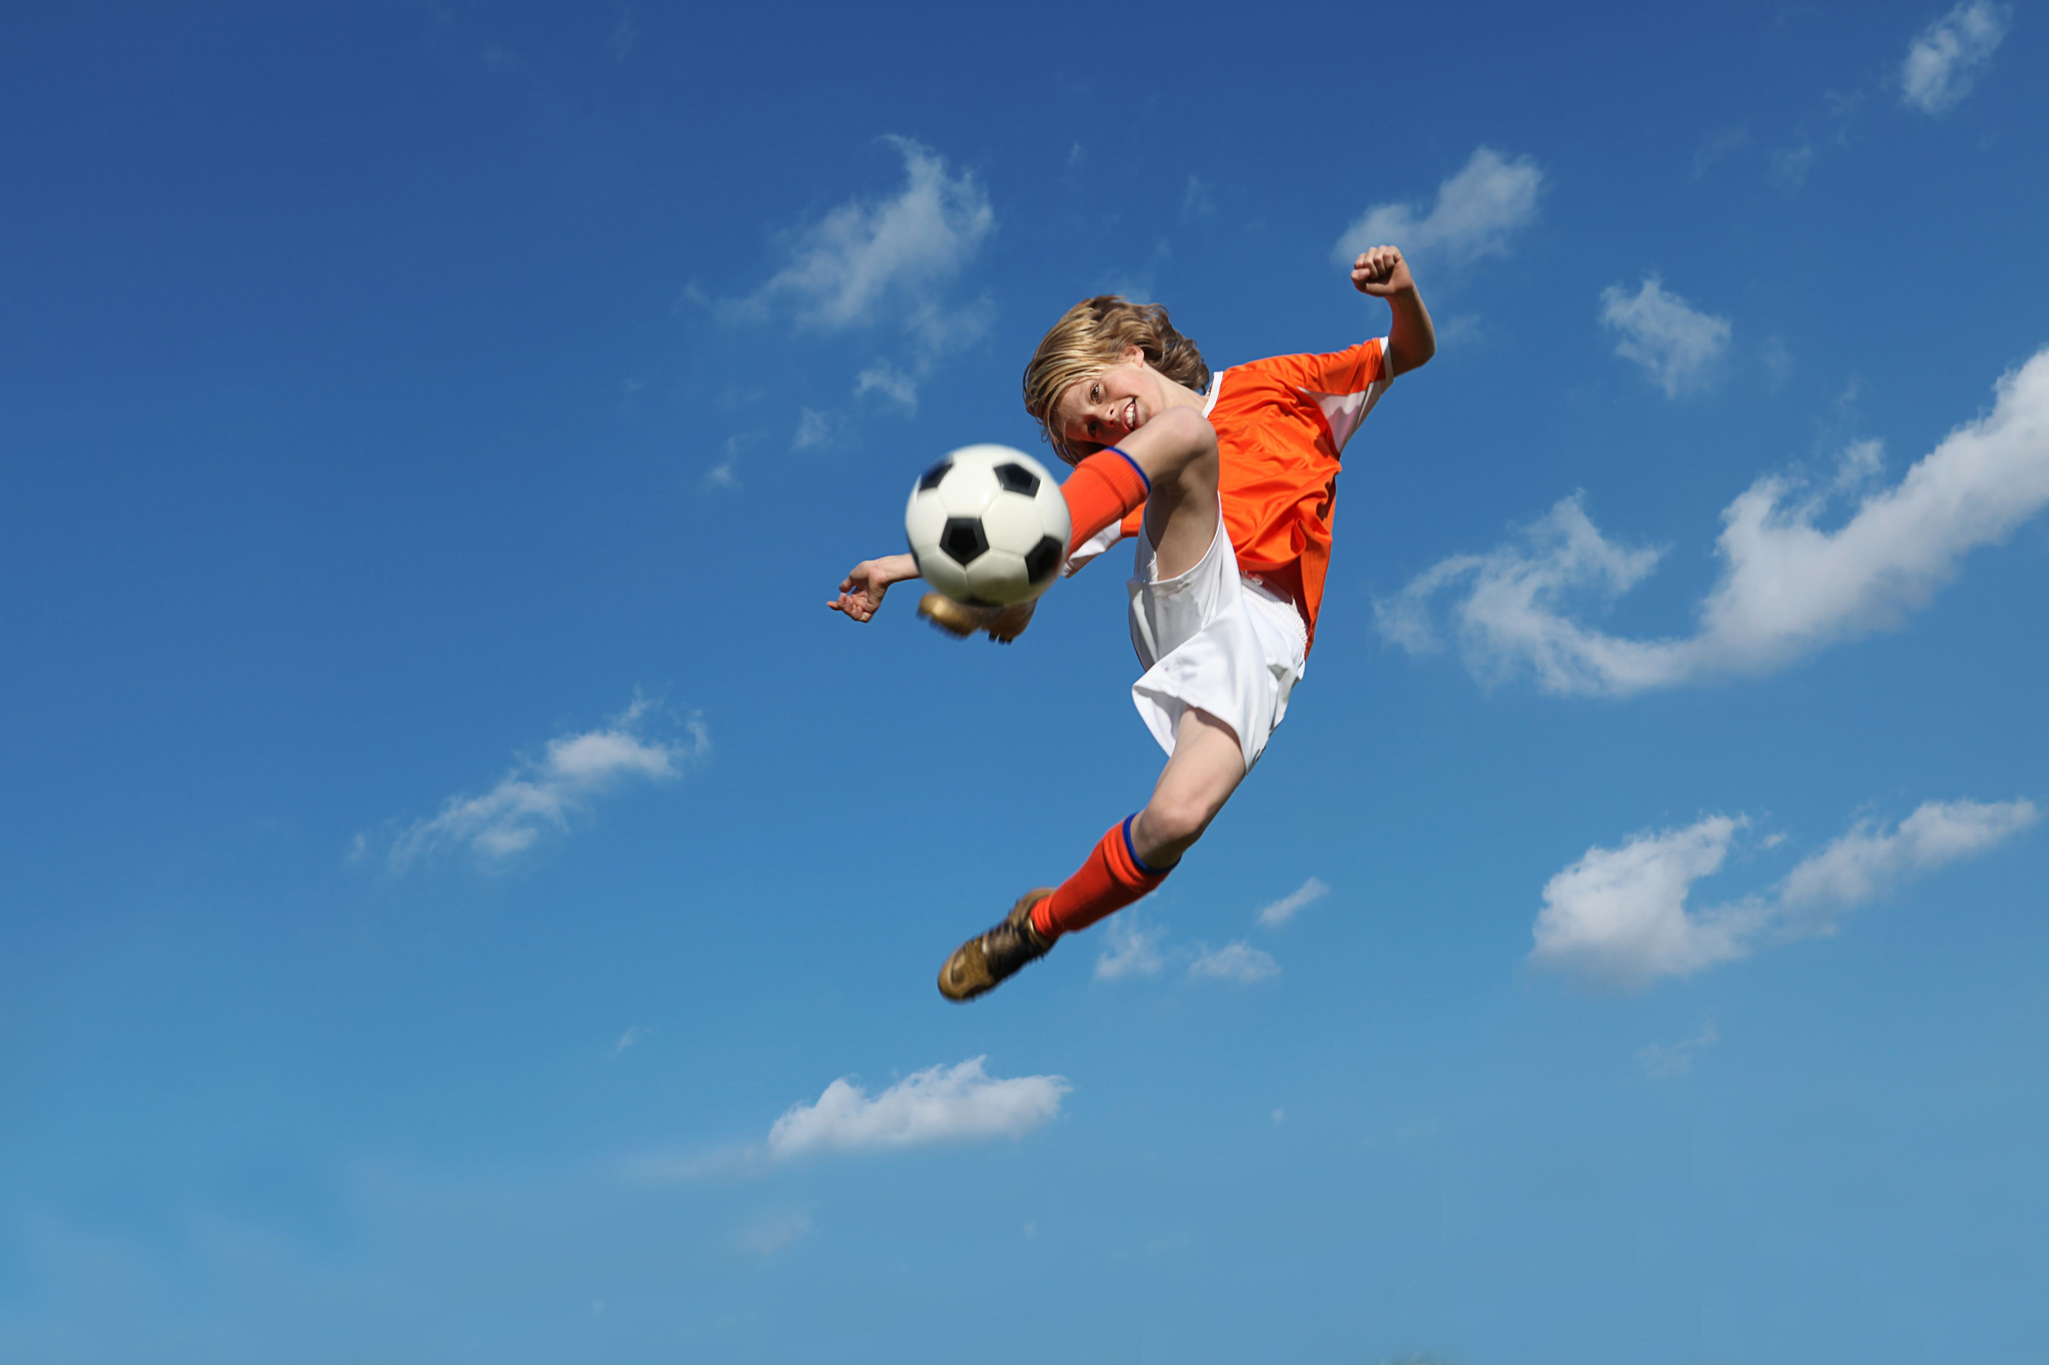
Intramural
CEAS Tribunal is going to have 3 teams!!
Teams:
Co-ed Soccer
All-Male Soccer
Volleyball
Sign ups will go out later tonight.
You may only sign up for ONE team.
Students on co-op MUST have a rec pass or have paid the student life fee to participate!
If you have any questions, please email Sam Dunker at dunkerse@mail.uc.edu.

Slide 19
Senior Design Expo
What: A forum for 5th year students to display their Capstone projects and to help fellow undergraduate students get a better idea of the process.
When:Tuesday, April 19th (Tentative)
Available Spots:
4 Committee Co-Chair Positions
Committee Volunteers
Day of Volunteers
If you’re interested, please email Emma Lowe at loweea@mail.uc.edu.

Slide 20
SOCC
Chair: Heath Palmer
Student Organization Communication Committee
Example of meeting topics:
SAB presentation and Q/A session
Hope to get UFB in for Q/A session regarding professional dues
SAB will be in two meeting in March
Please email palmerha@mail.uc.edu if you have any info regarding meeting times.

Slide 21
SOCC
Chair: Heath Palmer
Group | Time
ACM-W | Every other Monday 5-6
AICHE | Every other Wednesday 5-6
SPE | Every other Wednesday 5-6
Chem E Car | Mondays & Wednesdays at 6
ASME | Every other Monday at 7
ASQ | Every Other Thursday @ 5:30
IEEE | "Socc Calendar"
SEE | Every Other Thursday @ 5:00
CSA | Once a Month
NSBE | Every other Tuesday @ 6pm
Eng Ambasadors | Every other Wednesday 5-6
FELD | Every Other Thursday 7-8
Theta Tau | Sundays 5pm
UC Robotics | Wednesdays 7:15
SWE | Every other Monday
Cube Cats
Rocketry Club

Slide 22
EAS Tribunal 2016 Student Group of the Year
Any student group in CEAS
Will be posted on e-bulletin for one year and also a free pizza party.
Applications can be found and submitted on http://tribunal.uc.edu/recognition and due February 15th 11:59 pm.

Slide 23
Collegiate Affairs
Committee Chair:
Khaled Aboumerhi
Open Forum after General Body TONIGHT
Problems with curriculum, course load, professors, facilities etc.
Opinions? Comments? Concerns? Contact Khaled Aboumerhi @ aboumekd@mail.uc.edu

Slide 24
FELD
Chair:
Paige Johnson
Deadpool Movie this Friday at 9:45pm! Check the GroupMe for meet up time!
Next FELD Meeting, Thursday, February 18th from 7pm-8pm
648 Baldwin
Free Food
Email johnsp8@mail.uc.edu with questions or to be added to the mailing list.

Slide 25
Innovation Committee
Committee Chair:
Emily Demjanenko
Responsible for initiating projects and ideas to better the college and support CEAS students
Projects:
Course surveys
3D Printer
Rhodes/Baldwin microwaves
Exploratory Week
Next meeting: Tuesday February 9th, 5:30 pm in the Tribunal office
demjanes@mail.uc.edu

Slide 26
Other Announcements

Slide 27
RAFFLE!

Slide 28
Constructive Criticism
What do you like/dislike about the college?
Comments / Questions?
questions.ceastribunal@gmail.com
What would you like to see Tribunal do next?

Slide 29
Next Meeting:
February 22, 2016
5:30pm
525 Old Chem

Slide 30
Association of Fundraising Professionals
University of Cincinnati Collegiate Chapter

Slide 31
Background and Mission
AFP
An international organization of professionals working to promote and grow the field of advancement and fundraising.
Mission Statement
To promote the field of advancement and educate our peers on the impact and importance of philanthropy at the University of Cincinnati.
Vision Statement
Our mission will be fulfilled by providing students with the best educational, professional and social experiences as they relate to the field of advancement and philanthropy.
Notes:
Brief synopsis of history, mainly focus on mission statement. 35 for the first semester 15 for the 2nd (Put dues on handout!); Read out the mission statement. Make sure people know that we are both undergraduate and graduate members. We are the only organization focusing on philanthropy. Also, discuss Greater Cincinnati Foundation, The Hail Foundation, Fifth Third Foundation, and The Otto M. Budig and Family Foundation.

Slide 32
What is…
Fundraising
Advancement
The act or process of raising funds
Services that protect and advance the missions of their respected organizations.
Supporting these goals is achieved through education of mission, fundraising, and inspiration.
Charities & Non-Profit Organizations with Advancement Services
Universities/colleges
Political action committees
Social Service organizations
Red Cross
Habitat for Humanity
American Cancer Society
Hospitals
Organizations that promote Fine Arts
Churches & Religion based structures
Notes:
Mention the UC Foundation and the work that they do, they provide scholarships and other awards by reaching out the donors for UC. Be big on endowments. We are only concerned with the educational and the non-profit portion; just this particular chapter.

Slide 33
Role on Campus
External
Serve as a resource for student organizations in regards to their philanthropic efforts
Have access to special events, professional networks and contacts, case for support assistance, etc.
Further promote a spirit of philanthropy across campus
Time
Talent
Treasure
Internal – Chapter Members
Educate our members on the field of advancement
Provide the resources needed to practice philanthropy right here at UC
Assist in professional growth
Notes:
Brief overview of the value that we would bring to campus; EXTERNAL; Mention, again, the Greater Cincinnati Chapter; we are not just out to fundraise and get money from people, we are people who want to give back and that we are about having a diverse group of people (different majors); think of an example of how we have assisted other organizations
Reach out to the organization to get to know them so we can apply the presentation to them; do your research! Get in touch with the president.

Slide 34
Impact on Campus
Events and Programs
National Philanthropy Day – hosted by the professional AFP chapter
Thank-A-Giver Day (TAG Day): Dedicated to thanking donor
Collaborations
Student Alumni Council (SAC)
College of Law: Dhani Jones Bow Tie Cause
Professional Workshops
ONECCM
Notes:
TAG Day is the Thank-A-Giver Day where we write thank you cards for those who have gave and talk about how it has helped you grow in an area; National Philanthropy Month is in February and it is a collaboration with SAC, dinner with 12 Bearcats with the Auto and Budick Family Foundation; Briefly talk about the AFP Shark Tank, though it is not on the list, that is a new initiative but we’re still working on it (people pitching their philanthropic ideas, we’ll have judges, and we decide who we’ll want to allocate our resources to); Touch on One CCM, started by our education chair, Steve, who is deeply passionate about encouraging his peers to start giving back with students;

Slide 35
Benefits of Being an AFP Member
For a minor membership fee of $35*, you get the benefits of being a collegiate member of AFP International!
Access to exclusive networking events with community leaders
Access to educational and professional development events
Internship, co-op, and post grad opportunities across the globe
Membership apparel
Opportunity to work with campus leaders
…and more!
*paid to the international AFP organization. Not our collegiate chapter.
Notes:
SELL, SELL, SELL! Mention the Network Breakfast, talk about the membership apparel (t-shirts, hats), mention the Round Table, tie in being a member of AFP National, talk about how some of the philanthropies Downtown turned to AFP for internship and co-op opportunities; MOST IMPORTANT; scholarships, internships, opportunities

Slide 36
Professional Testimonials
“My membership has strengthened my professional abilities every step of the way.”- Rod Grabowski, President, University of Cincinnati Foundation
“Had it not been for the connections I made at AFP, I don’t know if I would be in the completely satisfying career that I’m in now.“- Adrienne McDade, Director of Diversity, AFP Greater Cincinnati

Slide 37
Why join AFP-UC?
Networking opportunities
Professional chapter educational events
Access to community leaders and corporate leaders
Ability to view webinars, engage in seminars, and attend conferences
Members can have access to scholarships to fund these opportunities
Develop key professional skills
Communication
Job preparation
Presentation and planning skills
Impact our campus and the chance to leave a legacy
Notes:
Giant recap, highlight the scholarships, networking, and professional development and workshops.

Slide 38
Questions?
Mike Huber – President
huberm6@mail.uc.edu
Chelsea Hicks – Membership Chair
afpucmemeber@gmail.com
Adrienne McDade – Advisor
adrienne.mcdade@uc.edu

