Slide 1
Engineering and Applied Science Tribunal
General Meeting
February 22, 2016

Slide 2
Agenda:
Dean Lim Presentation
SG Election Speeches
Officer Reports
Committee Reports
Raffle

Slide 3
Dean Teik Lim
Chipotle provided by the Dean’s office

Slide 4
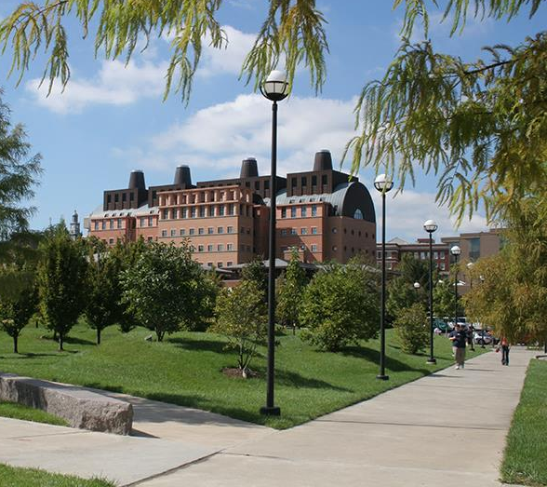
Teik C. Lim, Dean COLLEGE OF ENGINEERING & APPLIED SCIENCE
Questions from Tribunal
Grade inflation
Reverse (Flipped) Classrooms
Influence over required courses in other colleges
CEAS rankings
Honors retention
Faculty hiring, 50 in 5 plan
29 hired, and 20 open searches
Department Head searches – BME and DEE
Grad school, scholarships/fellowships/assistantships
See handout (http://ceas.uc.edu/Graduate_Studies/AdmissionsFAQ.html)
Rindsberg
GPA 3.80+ (preferred), applicants may be considered with a 3.5+
For 2 years - $30,000 stipend, standard UGS and $4,400 additional tuition per year

Slide 5
Student Government Election Speeches!
Voting opens on the 24th and closes on the 26th
Notes:
Speaking Order:
Mitchell Phelps and Brooke Duncan
Tobi and Akshayaa
Casmir Thornberry
Dane
Dana

Slide 6
Purpose
What we are: CEAS Branch of Student Government
What we do:
Host programs for the college
Input on curriculum, grievances, and student/faculty relations
Improve student experience in the college

Slide 7
President
CEAS TRIBUNAL EXECUTIVE STRUCTURE
Secretary
Treasurer
Vice President
Associate Vice President
Senators (X2)
Technology
Innovation
Career Fair (X2)
Constitution & Bylaws
Public Affairs
Order of the Engineer
FELD
EWeek (X2)
SOCC
Luau
Recognition
Special Events
Collegiate Affairs
OFFICERS are in black. COMMITTEE CHAIRS are in red.

Slide 8
Tribunal Officers
President: |  | Carlo Perottino
Vice President: |  | Dane Sowers
Associate Vice President: |  | McKenzie Kinzbach
Treasurer: |  | Max Inniger
Secretary: |  | Frazier Baker
Senators: |  | John Lewnard Tim Kemper

Slide 9
Tribunal Executives
Career Fair: |  | Tim Kemper Nathan Hamit
Collegiate Affairs: |  | Khaled Aboumerhi
Constitution and Bylaws |  | Jared Wood
EWeek: |  | Alison Hayfer Andrew Bachus
FELD: |  | Paige Johnson
Innovation: |  | Emily Demjanenko
Luau: |  | Andrew John Droesch
Order of the Engineer: |  | Sean Gleason
Public Affairs: |  | Matt Morgann
Recognition: |  | Rugved Mavidpalli
SOCC: |  | Heath Palmer
Special Events: |  | Emma Lowe
Technology: |  | Michael Santacroce

Slide 10
Officer Reports

Slide 11
Office Hours
650 Baldwin
President - Carlo Perottino
Thursdays: 12:00pm - 2:00pm <- This Week Only
V. President - Dane Sowers
Mondays: 10:30am - 11:30am
A.V. President - McKenzie Kinzbach
Tuesdays: 6:30pm - 7:30pm
Treasurer - Max Inniger
Tuesdays: 11:00am - 12:00pm
Secretary - Frazier Baker
Wednesdays: 6:00pm - 7:00pm
Senator - John Lewnard
Wednesdays: 4:30pm - 5:30pm
Senator - Tim Kemper
Wednesdays: 12:00pm - 1:00pm

Slide 12
Officer:
Frazier Baker
Secretary
Don’t forget to sign in!
You need to sign in to 4 meetings to earn voting privileges.

Slide 13
Senator Report
Officers:
Tim Kemper
John Lewnard
Senate News:
Appropriation for Midwest Dhamaka
Show: SCPA Cincinnati, 3/5, 6 PM-9 PM
After Party: MYNT Cincinnati, 3/5, 10 PM – 2:30 PM
http://midwestdhamaka.com/
Student Government campaigns are happening now!
Voting is from Wednesday to Friday!
PLEASE GO VOTE!

Slide 14
Senator Report
Officers:
Tim Kemper
John Lewnard

Slide 15
Committee Reports

Slide 16
Recognition
Many of the awards coming out soon stay tuned.
Looking for committee members.
Interested members can fill the following form http://goo.gl/forms/Cgh79m6Qur
The form is due on Monday 29th 2016

Slide 17
EWeek
Committee Chair:
Alison Hayer
Andy Bachus
What is it? A nationally celebrated week to celebrate engineers and all that we do!
What do we do? Have a fun week of competition and games and end the week with a banquet
When is it? THIS WEEK!
Questions? Email uc.eweek@gmail.com
Follow us on Twitter @UC_Eweek
Through the Herman Schneider Foundation, the first 85 seniors get free tickets for the banquet
Next committee meeting : TBD!

Slide 18
Innovation Committee
Committee Chair:
Emily Demjanenko
Responsible for initiating projects and ideas to better the college and support CEAS students
Projects:
Course surveys
3D Printer
Rhodes/Baldwin microwaves
Exploratory Week
Finals week stress relief
CEAS Alumni Night
Next meeting: Tuesday February 23, 5:30 pm in the Tribunal office
demjanes@mail.uc.edu

Slide 19
Special Events
Committee Chair:
Emma Lowe
Upcoming Events:
Habitat for Humanity ReStore - Feb. 27th
Intramurals - Feb. 28th
Egg Drop - Mar. 2nd
Habitat for Humanity Restore - Mar. 12th
Cyclones Game - Mar. 31st
Relay for Life - Apr. 1st-2nd
Sigma Sigma Carnival - Apr. 16th
RevolutionUC - Apr. 16th-17th
Senior Design Expo - Apr. 19th (Tentative)

Slide 20
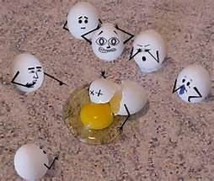
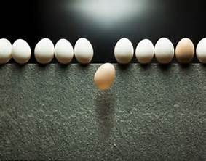
Volunteer for Egg Drop!
Help CEAS run an on campus high school Egg Drop Competition!
Date: Wednesday, March 2nd
Times:
Registration: 7:30am - 9:00am
Competition: 12:00pm - 2:30pm
Clean-Up: 2:30pm - 3:00pm
Counts for service hours!
Questions? Email Tom Burns at burnst3@mail.uc.edu.

Slide 21
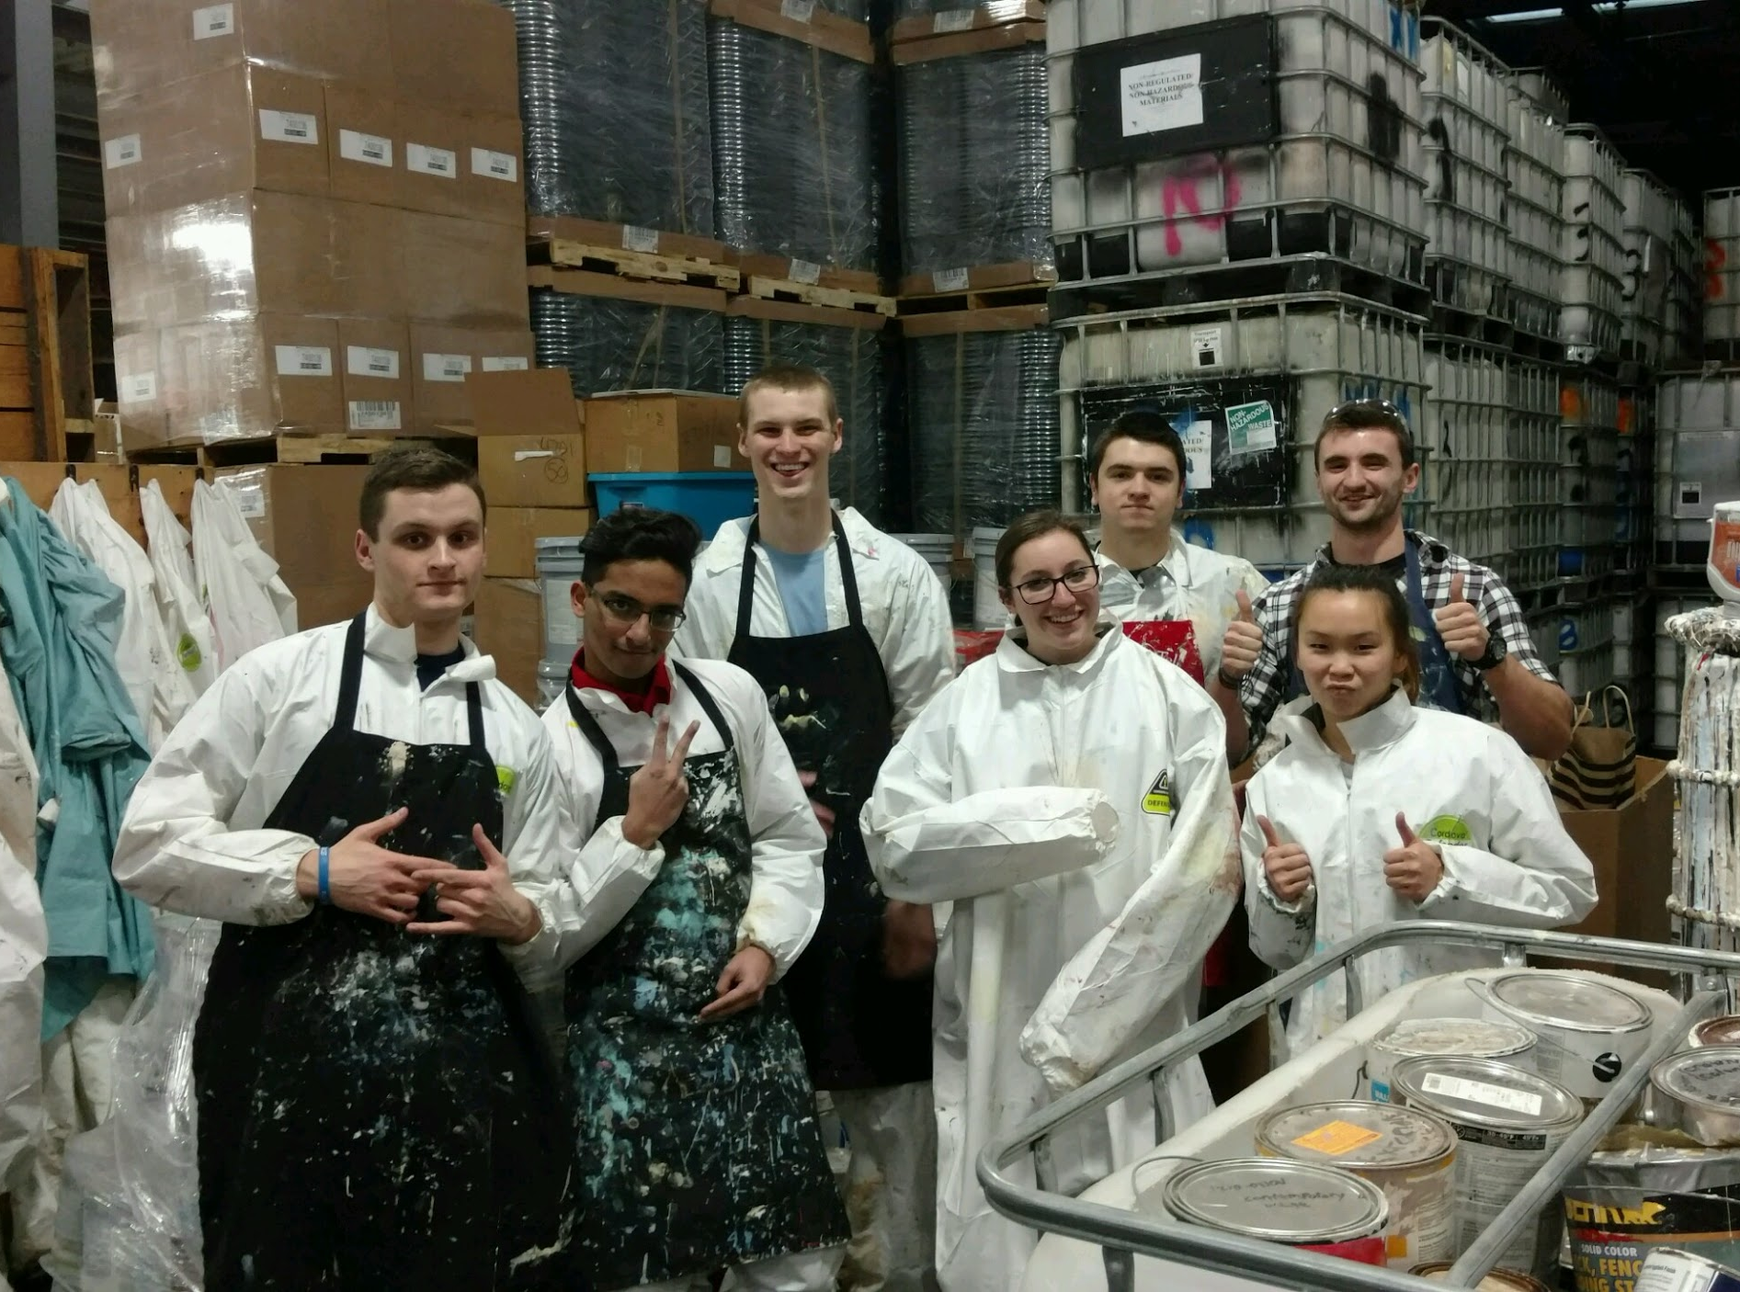
Community Service
Habitat for Humanity Restore:
Date: Saturday, February 27th
Time: 8:30am or 12:30pm
Where: ERC Circle
Matthew 25 Ministries:
Date: Wednesday, March 2nd
Time: 5:30pm - 7:30pm
Where: ERC Circle
More service events to come! All events count for service hours!
If you have any questions, please email Steven Ankney at ankneysb@mail.uc.edu

Slide 22
Public Affairs
Diversity and Inclusion Committee Undergraduate Representatives
Spring 2016 and Fall 2016
Vaishnavi Kolimi
Kyla Killinger
Summer 2016 and Spring 2017
Deepansh Pahwa
Pardyida Mensah

Slide 23
FELD
Chair:
Paige Johnson
Next FELD Meeting, Thursday, February 3rd from 7pm-8pm
648 Baldwin
Free Food
Email johnsp8@mail.uc.edu with questions or to be added to the mailing list.

Slide 24
SOCC
Chair: Heath Palmer
Student Organization Communication Committee
Had a meeting last Thursday
Acquired a few new questions for UFB
Next meeting – Tonight at 8pm in 405 ERC
SAB will be in two meetings in March
Please email palmerha@mail.uc.edu if you have any info regarding meeting times.

Slide 25
Other Announcements

Slide 26
RAFFLE!

Slide 27
Constructive Criticism
What do you like/dislike about the college?
Comments / Questions?
questions.ceastribunal@gmail.com
What would you like to see Tribunal do next?

Slide 28
Next Meeting:
March 7, 2016
5:30pm
525 Old Chem

