Slide 1
Engineering and Applied Science Tribunal
General Meeting
March 14, 2016

Slide 2
Agenda:
Constitution & Bylaw Edits
President & Senator Nominations
Socially Responsible Investment Forum
Officer Reports
Committee Reports
Raffle

Slide 3
Constitution and Bylaws
Chair:
Jared Wood
Consistency and Grammar corrections
Innovation Committee
Committee chair term lengths
Committee selection
Presidential election/eligibility
College Wide Voting
Executive removal process
Executive compression
Constitution Ratification

Slide 4
2016-2017 President & Senator Nominations
President Nominations
Max Inniger
John Lewnard
Scott Blincoe
Dane Sowers
Senator Nominations
Emily Demjanenko
Tim Kemper
Lillian Ashworth
Khaled Aboumerhi
Himadri Pandey
Sarah Baryluk
Varun Nagarajan

Slide 5
2016-2017 President & Senator Nominations Cont.
Nominations will stay open till 3/21/2016.
Nominations can be emailed to perottca@mail.uc.edu
All nominations are conditional till eligibility is checked.

Slide 6
Socially Responsible Investment Forum
Forum to discuss the pros & cons of divestment.
Have questions for the presenters? Check your email!
Event Details:
March 16th
TUC Great Hall
5:30pm

Slide 7
Purpose
What we are: CEAS Branch of Student Government
What we do:
Host programs for the college
Input on curriculum, grievances, and student/faculty relations
Improve student experience in the college

Slide 8
President
CEAS TRIBUNAL EXECUTIVE STRUCTURE
Secretary
Treasurer
Vice President
Associate Vice President
Senators (X2)
Technology
Innovation
Career Fair (X2)
Constitution & Bylaws
Public Affairs
Order of the Engineer
FELD
EWeek (X2)
SOCC
Luau
Recognition
Special Events
Collegiate Affairs
OFFICERS are in black. COMMITTEE CHAIRS are in red.

Slide 9
Tribunal Officers
President: |  | Carlo Perottino
Vice President: |  | Dane Sowers
Associate Vice President: |  | McKenzie Kinzbach
Treasurer: |  | Max Inniger
Secretary: |  | Frazier Baker
Senators: |  | John Lewnard Tim Kemper

Slide 10
Tribunal Executives
Career Fair: |  | Tim Kemper Nathan Hamit
Collegiate Affairs: |  | Khaled Aboumerhi
Constitution and Bylaws |  | Jared Wood
EWeek: |  | Alison Hayfer Andrew Bachus
FELD: |  | Paige Johnson
Innovation: |  | Emily Demjanenko
Luau: |  | Andrew John Droesch
Order of the Engineer: |  | Sean Gleason
Public Affairs: |  | Matt Morgann
Recognition: |  | Rugved Mavidpalli
SOCC: |  | Heath Palmer
Special Events: |  | Emma Lowe
Technology: |  | Michael Santacroce

Slide 11
Officer Reports

Slide 12
Office Hours
650 Baldwin
President - Carlo Perottino
Thursdays: 11:30am - 1:30pm
V. President - Dane Sowers
Mondays: 10:30am - 11:30am
A.V. President - McKenzie Kinzbach
Tuesdays: 6:30pm - 7:30pm
Treasurer - Max Inniger
Tuesdays: 11:00am - 12:00pm
Secretary - Frazier Baker
Wednesdays: 6:00pm - 7:00pm
Senator - John Lewnard
Wednesdays: 4:30pm - 5:30pm
Senator - Tim Kemper
Wednesdays: 12:00pm - 1:00pm

Slide 13
Officer:
Frazier Baker
Secretary
Don’t forget to sign in!
You need to sign in to 4 meetings to earn voting privileges.

Slide 14
Senator Report
Officer:
Tim Kemper
John Lewnard
Senate Overview:
Honoraria was decreased by $34,000 -> $34,000 increase to Senate Budget.
Allocated $2,000 to LGBTQ center to update resources for students.
Allocated $345 to Going Grey UC – increases awareness on sex trafficking.
UFB Issue Resolved for CEAS Student Orgs!
Tribunal Exec Board voted to create an emergency funding committee
This body will have $15,000 available to allocate to CEAS student groups
Email will be sent to SOCC Listserv tonight
Contact Tim Kemper (kemperta@mail.uc.edu) with questions

Slide 15
Committee Reports

Slide 16
Recognition
Chair:
Rugved Mavidipalli
Freshman of the Year
Sophomore of the Year
Pre-Junior of the Year
Junior of the Year
-Co-op of The Year - Freshmen will be able to vote.
- The winners of each award get $1000!
- All applications are due on April 10th 2016
- Applications can be found at https://tribunal.uc.edu/recognition

Slide 17
Special Events
Committee Chair:
Emma Lowe
Upcoming Events:
VA Hospital - Mon, Tues, & Thurs.
Intramurals - Monday Nights
Cyclones Game - Mar. 31st
Relay for Life - Apr. 1st-2nd
Sigma Sigma Carnival - Apr. 16th
RevolutionUC - Apr. 16th-17th
Senior Design Expo - Apr. 18th

Slide 18
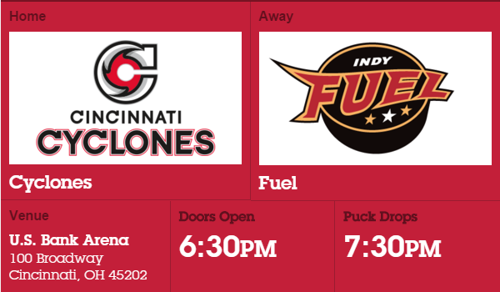
Cyclones Game
Date: Thursday, March 31st
Theme: Fan Choice Night
Game against: Indy Fuel
DOLLAR BEER NIGHT!
Questions? Email Sam Dunker
at dunkerse@mail.uc.edu.
Link to sign up: https://docs.google.com/spreadsheets/d/1X-G26vddjotcYxpQ2qvt-atDiT-wE1yNZLGCUW4JllY/edit?usp=sharing

Slide 19
Relay For Life!
Help fight cancer and sign up for the CEAS Tribunal Relay For Life team!
Date: April 1st - 2nd
Time: 6:00pm - 6:00am
Where: McMicken Commons
Pancake Sale this Wednesday!
Counts for extra Cincinnatus Hours!
Questions? Email Hao Tran at tranno@mail.uc.edu.
Sign up: http://main.acsevents.org/goto/ceastribunal

Slide 20
Community Service
VA Hospital:
Date: Mon, Tues, & Thurs in March
Time: 5:30pm - 8:15pm
Where: 3200 Vine St.
Matthew 25 Ministries:
Date: Wednesday, April 13th
Time: 5:30pm - 7:30pm
Where: ERC Circle
More service events to come! All events count for service hours (i.e. Cincinnatus)!
If you have any questions, please email Steven Ankney at ankneysb@mail.uc.edu.

Slide 21
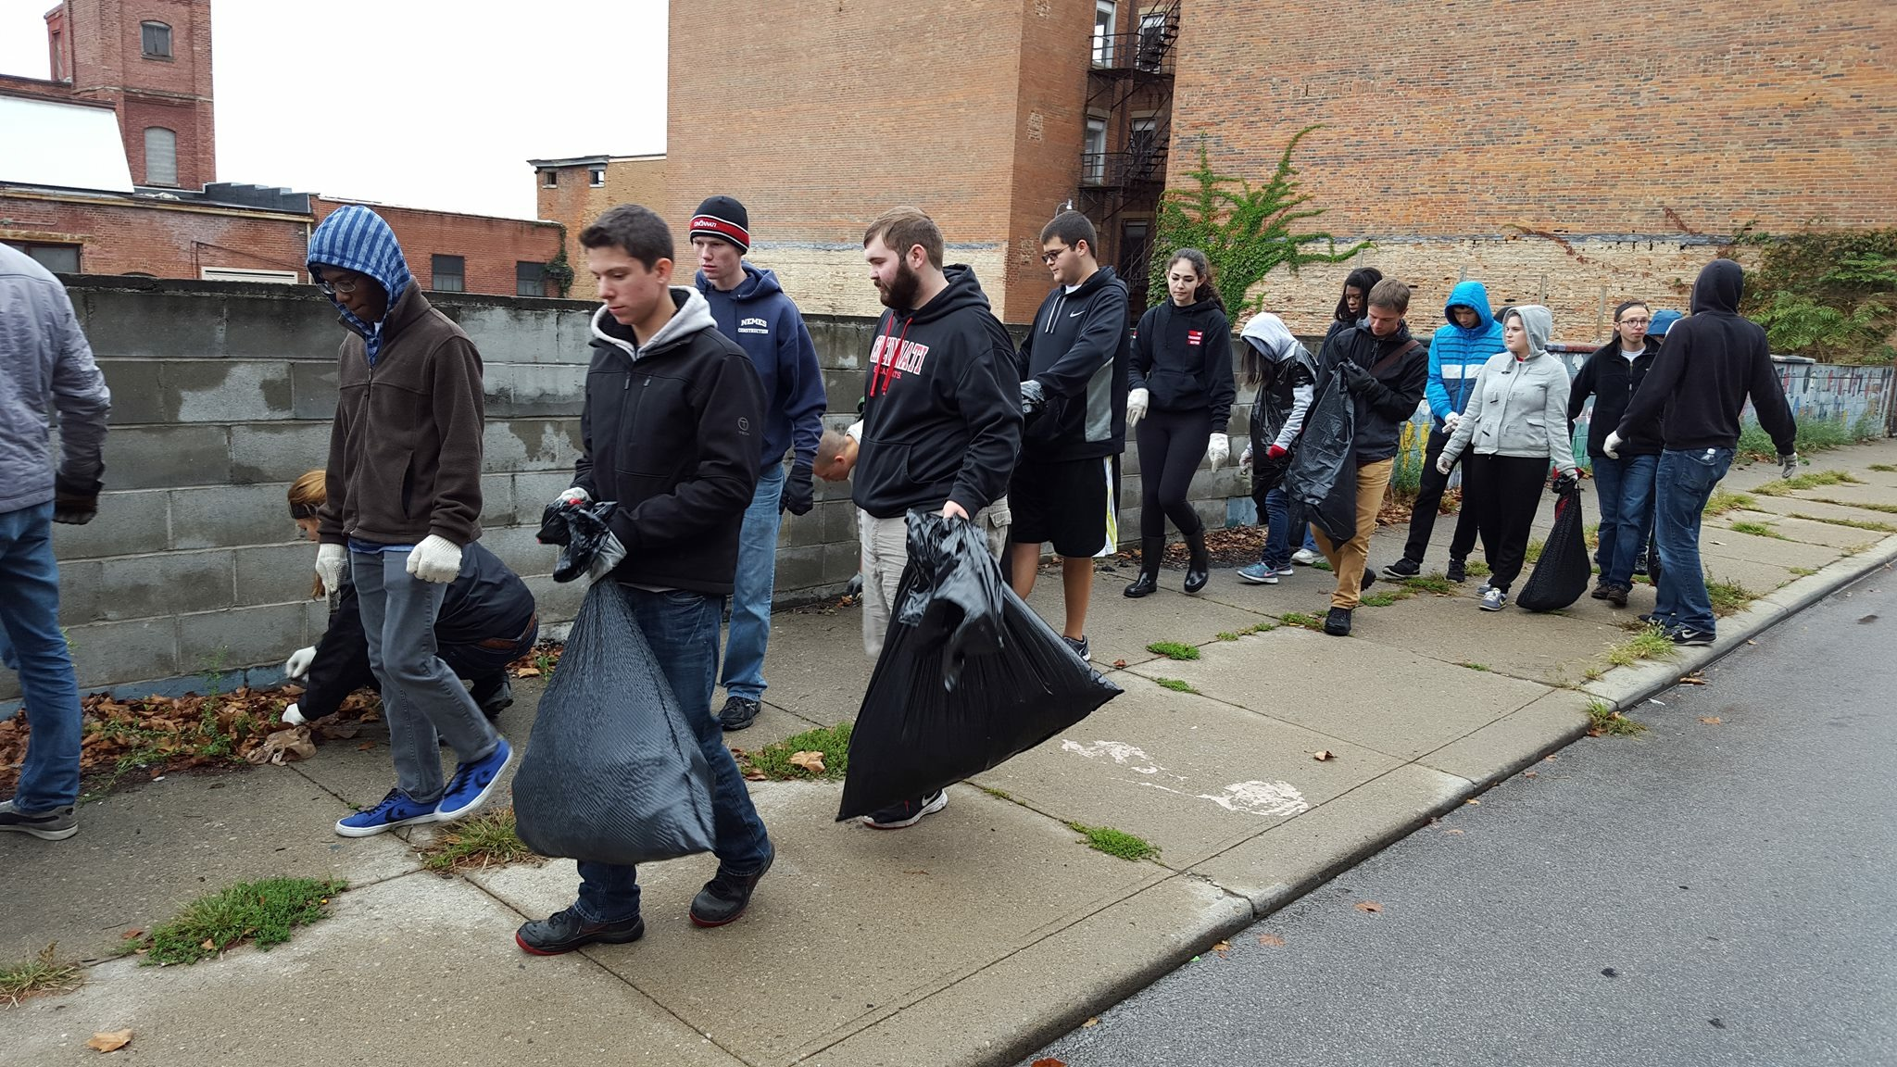
Clean Up Cincy!
Counts for
Cincinnatus Hours!
Want to make an impact on the communities around UC?
Join Clean Up Cincy!
Be a part of the largest student-led beautification program on April 2nd at 8:30am!
Sign Up: https://tinyurl.com/cleanupcincy16

Slide 23
E-Week
Committee Chair:
Andy Bachus
Alison Hayfer
Thanks to everyone who participated!
Please fill out the E-Week survey by Friday (3/18)

Slide 24
Order of the Engineer
Ring sizing is taking place in Baldwin Lobby
Right table
$10 gets you a ring, certificate, and post-ceremony reception

Slide 25
Innovation Committee
Committee Chair:
Emily Demjanenko
Responsible for initiating projects and ideas to better the college and support CEAS students
Projects:
Exploratory Week: Huge success; thanks to all who participated!
3D Printer: PO has been submitted
Rhodes/Baldwin Microwaves: Planning logistics: cleaning, usage policy, responsibilities of Tribunal
Finals week stress relief: April 18-April 22
CEAS Alumni Night: Thursday April 14
Next meeting: Tuesday, March 14 from 5:30-6:00 pm in the Tribunal office
demjanes@mail.uc.edu

Slide 26
Other Announcements

Slide 27
RAFFLE!

Slide 28
Constructive Criticism
What do you like/dislike about the college?
Comments / Questions?
questions.ceastribunal@gmail.com
What would you like to see Tribunal do next?

Slide 29
Next Meeting:
March 28, 2016
5:30pm
525 Old Chem

