Slide 1
Engineering and Applied Science Tribunal
WELCOME!!!!!!
August 22, 2016

Slide 2
Agenda
Our Purpose
Brief Committee Explanation
Breakout Sessions

Slide 3
What is a tribunal?
“Any person or institution with authority to judge, adjudicate on, or determine claims or disputes”
- Wikipedia
“A court of justice” or “A place or seat of judgement”
- Dictionary.com

Slide 4
What are we?
The CEAS Branch of Student Government
What we do:
Academic Representation (Judge)
Fun Programs and Events
Initiatives that better student experience in CEAS

Slide 5
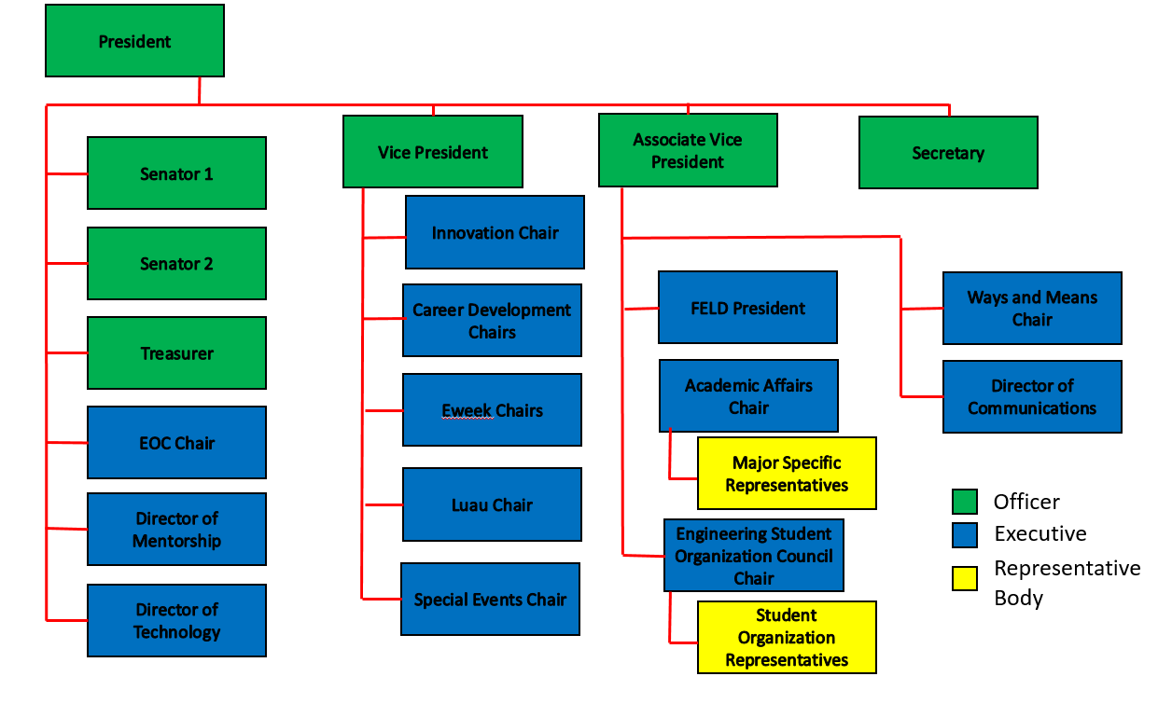
CEAS TRIBUNAL EXECUTIVE STRUCTURE

Slide 6
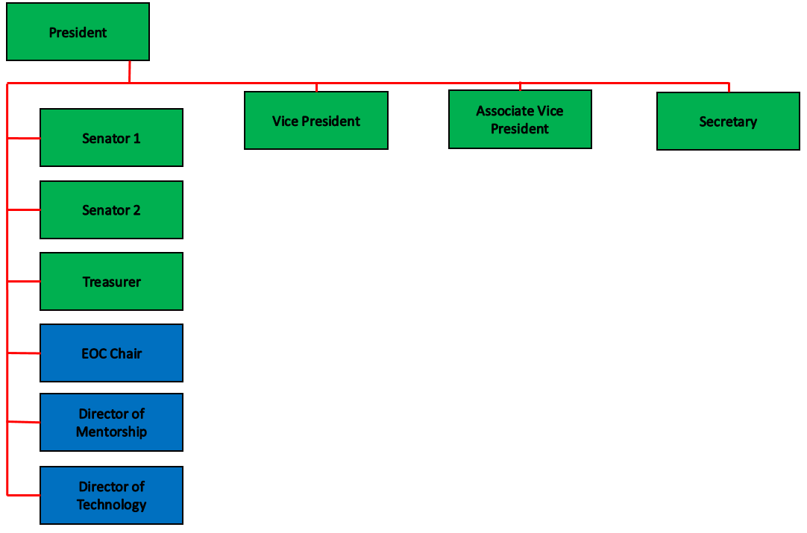
Exec Introductions
President: John L.
VP: Nathan B.
AVP: McKenzie K.
Senators: Tim K. & Khaled A.
Treasurer: Jim O.
EOC Chair: Midhun S.
Mentorship: Emily D. & Dane S.
Technology: Michael S.
Secretary: Ashley R.

Slide 7
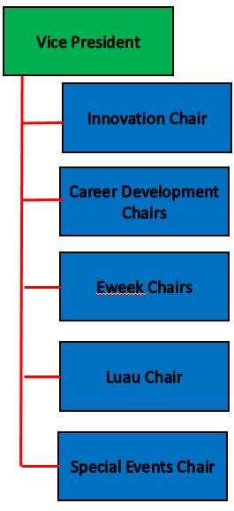
Exec Introductions
VP: Nathan B.
Innovation: Max I.
Career Development: Tim K. & Nathan H.
EWeek: Irene M. & Nathan T.
Luau: To be filled in spring
Special Events: Hao T.

Slide 8
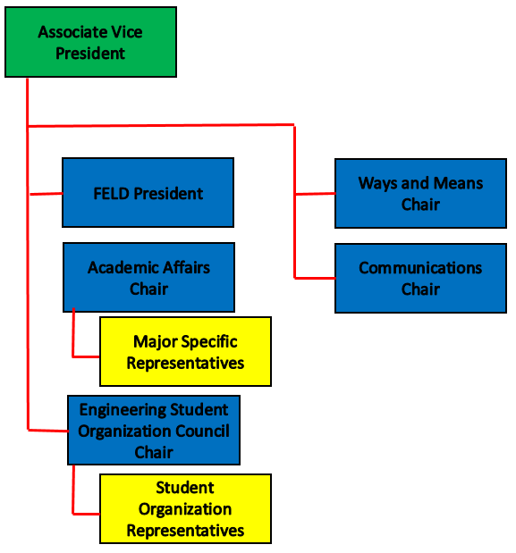
Exec Introductions
AVP: McKenzie K.
FELD President: Paige J.
Academic Affairs: Dane S.
ESOC: Chris Stone
W&M: Filled as necessary
Communications: Demetri B.

Slide 9
Resources Available to You
Tutoring Center
Baldwin 860 B
Women’s Center
Steger Student Life Center, Suite 571
Title IX Office
3115 Edwards 1
LGBTQ Center
565 Steger Student Life Center
AACRC
60 W. Charlton St
RAPP
455 Steger Student Life Center
Ethnic Programs and Services
555 Steger Student Life Center
Disability Services
210 University Pavilion
Veterans Programs and Services
230 University Pavilion
Wellness Center
Steger Student Life Center Room 675

Slide 10
Next Meeting: August 29th
Talking about Resume Review Day and Career Fair!

