Slide 1
WELCOME to the
Engineering and Applied
Science Tribunal!
October 24, 2016

Slide 2
Agenda
Our Purpose
Presentation and Q&A w/ Dean Lim
CEAS Tribunal Events

Slide 3
What are we?
The CEAS Branch of Student Government
What we do:
  Academic Representation
  Fun Programs and Events
  Initiatives that better student experience in CEAS

Slide 4

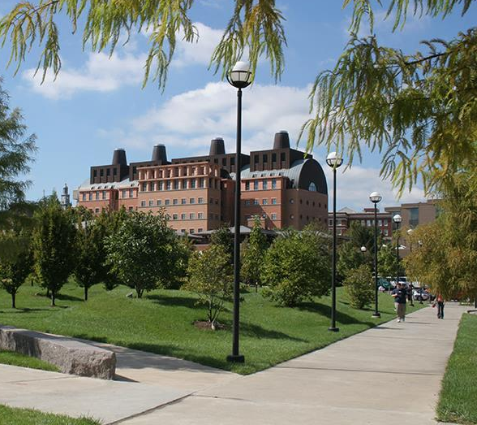
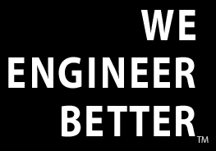
Teik C. Lim, Dean COLLEGE OF ENGINEERING & APPLIED SCIENCE
Siemens PLM Simulation Technology Center
Enrollment
  Record-breaking enrollment of >5,700
  Increased quality of first-yr students
  First-yr class is more diverse than ever with increases in both ethnic minority and female students
Dpt of Biomedical Engineering
Faculty Hiring
  41 new faculty hires, 40% are female and/or underrep minority
Department Heads
  DEE & EECS
New CEAS Web Mngr
JCI Students – Fall 2017
ABET – 2017

Slide 5
Community Service Events
Upcoming Events!
Social Events
      Ice Skating at Fountain Square
      Date: 12/3/16
      Time: TBD
      Sign-up Link: https://goo.gl/forms/K0LWuRfGKuF1tKcn2
Habitat for Humanity
Enjoy a fun build day and earn six hours of community service!
Date: 11/19/16
Time: 8:30am -4:00pm
Location: 1055 Wells St
Sign up: https://goo.gl/dYpuZt
***Interested in organizing an event? Join Special Events Committee. Meetings are Thurs at 5:00pm in 650 Baldwin.***

Slide 6

Committees!

Slide 7
Resources Available to You
Tutoring Center
  Baldwin 860 B
Women’s Center
  Steger Student Life Center, Suite 571
Title IX Office
  3115 Edwards 1
LGBTQ Center
  565 Steger Student Life Center
AACRC
  60 W. Charlton St
RAPP
  455 Steger Student Life Center
Ethnic Programs and Services
  555 Steger Student Life Center
Disability Services
  210 University Pavilion
Veterans Programs and Services
  230 University Pavilion
Wellness Center
  Steger Student Life Center Room 675
CAPS
  225 Calhoun Street, Suite 200

Slide 8
Next Meeting: Nov. 21st

