Slide 1
Engineering and Applied Science Tribunal
General Meeting
July 11, 2016

Slide 2
Agenda:
Officer Introductions & Reports
Committee Introductions & Reports

Slide 3
Purpose
What we are: CEAS Branch of Student Government
What we do:
Host programs for the college
Input on curriculum, grievances, and student/faculty relations
Improve student experience in the college

Slide 4
President
CEAS TRIBUNAL EXECUTIVE STRUCTURE
Secretary
Treasurer
Vice President
Associate Vice President
Senators (X2)
Election Oversight
Technology
Mentorship
Innovation
Collegiate Affairs
Public Affairs
Career Fair (X2)
EWeek (X2)
Luau
Special Events
Constitution & Bylaws
SOCC
FELD
OFFICERS are in black. COMMITTEE CHAIRS are in red.

Slide 5
Tribunal Officers
President: |  | John Lewnard
Vice President: |  | Nick Stelzer
Associate Vice President: |  | Heath Palmer
Treasurer: |  | Jared Wood
Secretary: |  | Nick Oslin
Senators: |  | Tim Kemper Khaled Aboumerhi

Slide 6
Tribunal Executives
Career Fair: |  | Tim Kemper Nathan Hamit
Collegiate Affairs: |  | Emma Lowe
Constitution and Bylaws |  | Troy Le
EWeek: |  | Irene Mysonhimer Nathan Tiffany
FELD: |  | Paige Johnson
Innovation: |  | Max Inniger
Luau: |  | Andrew Droesch
Public Affairs: |  | Demetri Bardis
SOCC: |  | Chris Stone
Special Events: |  | Steven Ankney
Technology: |  | Michael Santacroce
Election Oversight Committee: |  | Midhun Shanmuganathan
Mentorship: |  | Emily Demjanenko Dane Sowers

Slide 7
Officer Reports

Slide 8
President
Officer:
John Lewnard
Office Hours:
Out of town for co-op
Please call at anytime:
(513) 377-6054

Slide 9
Vice President
Officer:
Nick Stelzer
Office Hours:
Monday’s 10:30-11:30 am

Slide 10
AVP Report
Officer:
Heath Palmer
Office Hours:
Mondays 3-4pm (subject to change)
Baldwin 650

Slide 11
Treasurer
Officer:
Jared Wood
If you need to ask me about anything Tribunal related feel free to email me at jtwood31@gmail.com

Slide 12
Secretary
Officer:
Nick Oslin
Don’t forget to sign in! You need to sign in to 4 meetings to earn voting privileges.

Slide 13
Senator Report
Officer:
Tim Kemper
Khaled Aboumehri
Summer Office Hours
Tim:
Mondays: 6:30 (end of meeting) – 8:00 PM
Wednesdays: 6:30 – 7:30PM
Arent available then? Just reach out! kemperta@mail.uc.edu
Khaled:
Mondays: 6:30 – 8:00 PM
Other evenings as needed.

Slide 14
New Interim Senior VP/Provost Assignment
Officers:
Tim Kemper
Khaled Aboumerhi
Beverly Davenport is now the Interim President
Peter Landgren, College-Conservatory of Music Dean, will serve as Interim Senior Vice President for Academic Affairs and Provost
What does the Provost do?
In-charge of university-wide academics and budgetary affairs
Decide university academic pursuits and how to fund those pursuits

Slide 15
Committee Reports

Slide 16
Collegiate Affairs
Committee Chair:
Emma Lowe
Open Forum Next Monday!
Where: Baldwin 649
When: 4:30pm
Why: To improve your college experience!
Come voice your concerns about professors, courses, etc.!

Slide 17
Innovation Committee
Committee Chair:
Max Inniger
Summer Projects!
Learning Community Support
3D Printer
Committee meeting time
7/12/16 at 6:00 in Baldwin 650
See Max Inniger to get involved

Slide 18
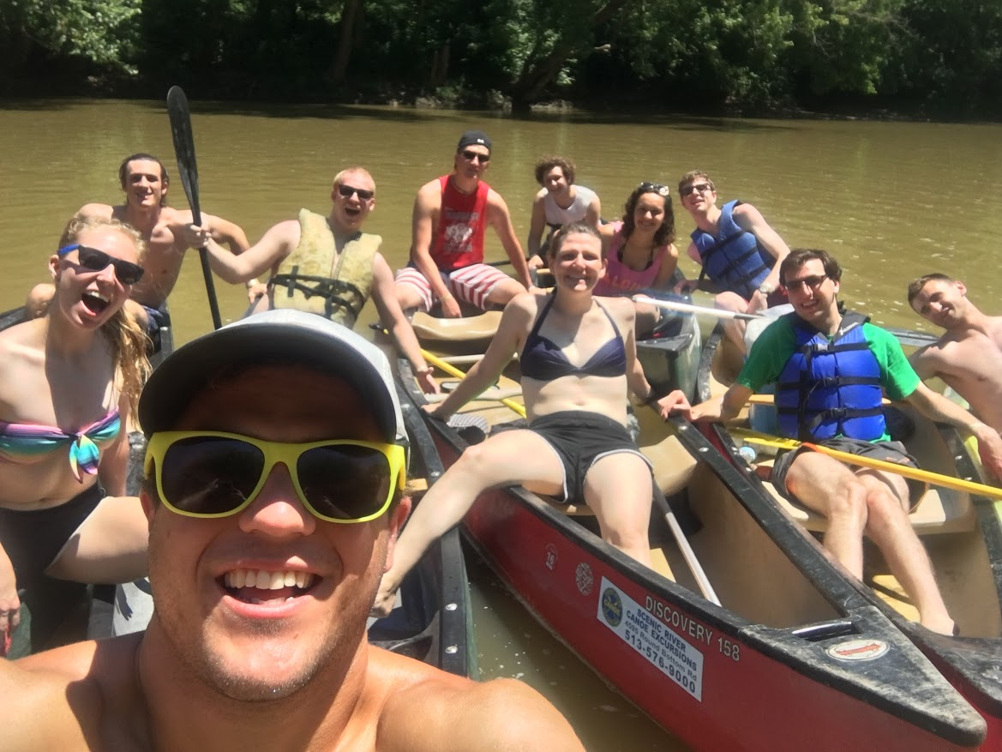
EAS Tribunal Canoe Trip

Slide 19
Special Events
Committee Chair:
Steven Ankney
Events Left This Summer
Kings Island Day Saturday July 23rd
Exam Week Breakfast (Exam Week)
Goetta Fest Aug 6th til Aug 8th

Slide 20
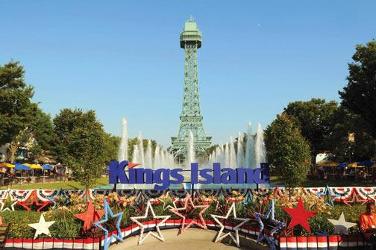
Kings Island Day
When: Saturday July 23rd
Cost: $10 (Tickets are originally $62) . Bring money for lunch.
Signup Deadline: This Friday July 15th
Any questions: Email Event Coordinator Samantha Dunker at:
dunkerse@mail.uc.edu

Slide 21
Constitution and Bylaws
Committee Chairs:
Troy Le
Last meeting, went contrary to our bylaws - C&B changes cannot be voted on at the same meeting they’re proposed.
We will be discussing Constitution and Bylaw changes today and voting on July 18th

Slide 22
Other Announcements

Slide 23
Constructive Criticism
What do you like/dislike about the college?
Comments / Questions?
questions.ceastribunal@gmail.com
What would you like to see Tribunal do next?

Slide 24
Next Meeting:
July 18, 2016
5:30pm
644/544 Baldwin

