Slide 1
Engineering and Applied
Science Tribunal
General Meeting
August 25th, 2014

Slide 2
Purpose
What we are: CEAS Branch of Student Government
What we do:
  Host programs for the college
  Input on curriculum, grievances, and student/faculty relations
  Improve student experience in the college

Slide 3
President
CEAS TRIBUNAL EXECUTIVE STRUCTURE
Secretary
Treasurer
Vice President
Associate Vice President
Senators (X2)
Technology
Career Fair
Public Affairs
FELD
EWeek
SOCC
Luau
Recognition
Special Events
Collegiate Affairs
OFFICERS are in black. COMMITTEE CHAIRS are in red.

Slide 4
Tribunal Officers
President: |  | Alison Hayfer
Vice President: |  | Maggie Connell
Associate Vice President: |  | Sarah Deutsch
Treasurer: |  | John Lewnard
Secretary: |  | Emily Demjanenko
Senators: |  | Madeline Adams Hannah Kenny

Slide 5
Tribunal Executives
Career Fair: |  | Andrew Griggs, Nick Stelzer, Dane Sowers
Collegiate Affairs: |  | Mark Gruenbacher, Nathan Draper
EWeek: |  | Alison Hayfer, Kitty DiFalco
FELD: |  | Dane Sowers
Luau: |  | Chris Katuscak
Recognition: |  | Christian Lipa
Public Affairs: |  | OPEN
SOCC: |  | Nathan Ball
Special Events: |  | Sam Dunker
Technology: |  | Charlie Hinton

Slide 6
Officer Reports

Slide 7
President
Officer:
Alison Hayfer
Office Hours:
  Tuesday 1:30-2:30 PM
  Baldwin 652

Slide 8
Vice President
Officer:
Maggie Connell
Office Hours:
  Wednesdays 6-7 PM
  Baldwin 652

Slide 9
Associate Vice President
Officer:
Sarah Deutsch
Office Hours:
  Mondays 2:30-3:30 PM (subject to change)
  Baldwin 652

Slide 10
Secretary
Officers:
Emily Demjanenko
Please sign in at the back of the room
Must attend and sign in at minimum of 4 meetings each semester to having voting rights

Slide 11
Senators
Officers:
Maddie Adams
Hannah Kenny
Committees- Open to Anyone
Academic Issues
Mondays 8pm, SG Conference Room
Campus Life
Mondays 6pm, SG Conference Room
Governmental Affairs
Tuesdays at 4pm, SG Conference Room
Students Rights and Interests
Wednesdays 4pm, SG Conference Room
SG Conference Room is in 655 Steger

Slide 12
Senators
Officers:
Maddie Adams
Hannah Kenny
RallyCats and SG Bus Trip Miami (FL)
-$155
Leaves October 8, returns after the game

Slide 13
Senators
Officers:
Maddie Adams
Hannah Kenny
FYLP
First year leadership program through student government
Pairs you with a active member Student Government members to help complete initiatives
Applications can be found on Campus Link under Student Government First Year Leadership under forms
Applications deadline: September 3rd at 5pm

Slide 14
Committee Reports

Slide 15
Public Affairs
Chair: OPEN
Oversee social media accounts
Take pictures at events
Manage bulletin boards, Baldwin table reservations and eBullet
Interested? Email: hayferac@mail.uc.edu

Slide 16
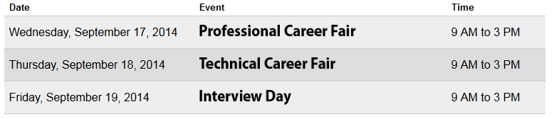
Career Fair
Chairs:
Andrew Griggs
Dane Sowers
Nick Stelzer
All fairs in the Rec Center, on the basketball courts
173 companies signed up for Technical Career Fair
Be prepared:
  Visit the company listing
  Research companies & apply online
  Go to information sessions & prep events
Dress is business casual – no jeans or tennis shoes

Slide 17
























Some companies…

Slide 18
We Need Volunteers!
Setup for career fair
  Tuesday & Wednesday, September 16 & 17, late afternoon
Coat/bag check, helping companies, student sign-in
  Thursday, September 18, 7am-4pm
Coordinating interviews, cleanup/tear-down
  Friday, September 19, 8am-4pm
Why?
  Fulfill committee requirement
  Meet and interact with company reps
  Get to know Tribunal execs, gateway to getting more involved
Meet at back of room after meeting for sign-up

Slide 19
Resume Review Day
Friday, September 12th
9a-3p
8th floor Rhodes Hall
Sit down with a professional of your choice
  Example backgrounds: GE, Duke Energy, Patriot Engineering, Turner Construction, Messer Construction
20 minute resume critique and discussion
Student sign-up opens this Friday (limit 2 spots)
Great opportunity to network
and prepare for the career fair!
Questions? Contact Dane Sowers at sowersdd@mail.uc.edu

Slide 20

Attention Ladies!
Join us for…
WOMEN in STEM
Evening with Industry
September 17, 2014
6:00 – 8:30 pm
Be among the first to speak with hiring representatives from various companies attending the career fair. All female CEAS students invited to attend this FREE networking dinner but space is limited, so please register early. For more information, please contact Becky Tudor (becky.tudor@uc.edu – 513.556.0025 – 653 Baldwin). Additional information will be emailed to all female CEAS students.

Slide 21
FELD
Chair:
Dane Sowers
  Freshman Engineering Leadership Development (FELD) is a Tribunal committee open exclusively to freshmen students. It is great way to meet new people from your college and make a positive impact on your college and community as well.
  Last year: Reds game, Lazer Kraze, Sky Zone, Habitat for Humanity
  FELD Intern Program – serve as an intern for a Tribunal officer or committee chair – Applications due Friday, September 5th
  First meeting: Friday, September 5th from 3:15pm-4:15pm in Swift 816.
  Email sowersdd@mail.uc.edu or see Dane after the meeting with questions or to be added to the mailing list.

Slide 22
SOCC
Chair: Nathan Ball
Student Organization Communication Committee
Committee of student group presidents working to
  Make student groups more effective
  Increase collaboration within CEAS student groups
  Make the student experience better
If interested in holding a position within SOCC email me at ballnn@mail.uc.edu

Slide 23
Technology
Chair:
Charlie Hinton
Committee Director
Career Fair Technologist
Website Administrator
Technology Intern
Hardware Specialist
Career Fair Technologist - Works with Career Fair Committee (joint member) and is in charge of all the technology needs for the Career Fair
Technology Intern - FELD Intern
Website Administrator – In charge of the Tribunal website
Hardware Specialist – In charge of maintaining all Tribunal Technological Assets
Open Positions
Notes:
Talking points
Cft- currently Filled by Dane Sowers, tends to be one of the co-chairs of the career fair committee, but also will help with other projects as needed based on their skill set
Intern- Freshman, needs to be very willing to sign his life away, and also hopefully has strong back round in web based coding languages
Web admin-needs to make sure that site is kept up to date, as well as manage any changes that other Executives need to their related content
Hardware specialist – Need to help keep track of our hardware and maintaining it to current technology levels and help keep the a modern infrastructure.

Slide 24
Collegiate Affairs
Chairs:
Mark Gruenbacher, Nathan Draper
Represent students in following committees
  Professional Standards Review Committee
  Curriculum Review Board
  Academic Standards Board
  Academic Misconduct Hearings
  Grievance Hearings

Slide 25
EWeek
Chairs:
Alison Hayfer
Kitty DiFalco
What it is: A nationally celebrated week for Engineers and all that we do
What we do: Have a week of friendly competition between teams of students ending with a Date Auction and Banquet
When is it: February 22-28th

Slide 26
Recognition
Chair:
Christian Lipa
Need people to serve on recognition committee.
  Go over Professor of the Semester and TA of the Semester nominations and help select winner.
  Read scholarship applications.
  Help choose Outstanding Seniors.
  Help with keeping records and publicizing our winners.
  Low time commitment.
  -Email Christian Lipa at lipacc@mail.uc.edu with any questions

Slide 27
Luau
Chair:
Chris Katuscak
What it is: Our yearly celebration for engineers at the beach waterpark that includes a day at the beach waterpark, food, and drinks for those of you of age
When is it: Summer 2015
Want to help: katuscca@mail.uc.edu

Slide 28
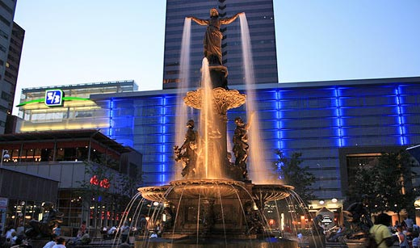
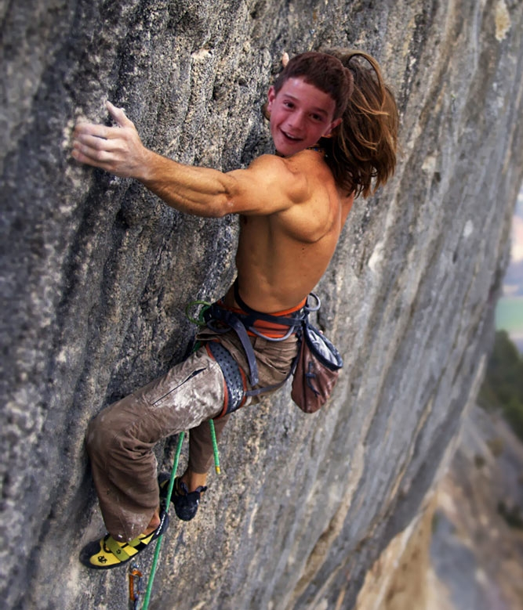
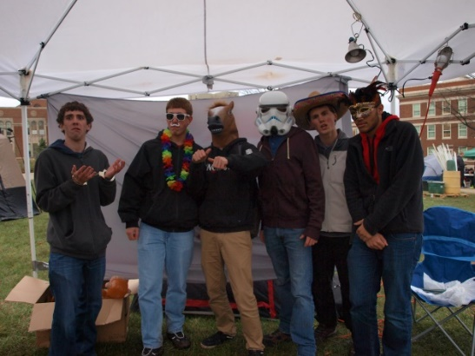
Special Events
Chair:
Sam Dunker
Do you want to run an event?
Community service
UC events
Non-UC events
Email dunkerse@mail.uc.edu

Slide 29
RAFFLE!

Slide 30
Constructive Criticism
What do you like/dislike about the college?
Comments / Questions?
questions.ceastribunal@gmail.com
What would you like to see Tribunal do next?

Slide 31
Next Meeting:
Monday, September 8th
Zimmer Auditorium
5:30

