Slide 1
Engineering and Applied Science Tribunal
General Meeting
October 6th, 2014

Slide 2
SAC Presentation

Slide 3
Purpose
What we are: CEAS Branch of Student Government
What we do:
Host programs for the college
Input on curriculum, grievances, and student/faculty relations
Improve student experience in the college

Slide 4
President
CEAS TRIBUNAL EXECUTIVE STRUCTURE
Secretary
Treasurer
Vice President
Associate Vice President
Senators (X2)
Technology
Career Fair
Public Affairs
FELD
EWeek
SOCC
Luau
Recognition
Special Events
Collegiate Affairs
OFFICERS are in black. COMMITTEE CHAIRS are in red.

Slide 5
Tribunal Officers
President: |  | Alison Hayfer
Vice President: |  | Maggie Connell
Associate Vice President: |  | Sarah Deutsch
Treasurer: |  | John Lewnard
Secretary: |  | Emily Demjanenko
Senators: |  | Madeline Adams Hannah Kenny

Slide 6
Tribunal Executives
Career Fair: |  | Andrew Griggs, Nick Stelzer, Dane Sowers
Collegiate Affairs: |  | Mark Gruenbacher, Nathan Draper
EWeek: |  | Alison Hayfer, Kitty DiFalco
FELD: |  | Dane Sowers
Luau: |  | Chris Katuscak
Recognition: |  | Christian Lipa
Public Affairs: |  | Matt Morgan
SOCC: |  | Nathan Ball
Special Events: |  | Sam Dunker
Technology: |  | Charlie Hinton

Slide 7
Officer Reports

Slide 8
President
Officer:
Alison Hayfer
Office Hours:
Thursday 10:00-11:00 AM
Baldwin 652

Slide 9
Vice President
Officer:
Maggie Connell
Office Hours:
Wednesdays 6-7 PM
Baldwin 652

Slide 10
Associate Vice President
Officer:
Sarah Deutsch
Office Hours:
Tuesdays 12:30-1:30 PM
Baldwin 652

Slide 11
Secretary
Officers:
Emily Demjanenko
Please sign in at the back of the room
Must attend and sign in at minimum of 4 meetings each semester to having voting rights

Slide 12
Senators
Officers:
Maddie Adams
Hannah Kenny
Committees- Open to Anyone
Academic Issues
Mondays 8pm, SG Conference Room
Campus Life
Mondays 6pm, SG Conference Room
Governmental Affairs
Tuesdays at 4pm, SG Conference Room
Students Rights and Interests
Wednesdays 4pm, SG Conference Room
SG Conference Room is in 655 Steger

Slide 13
Committee Reports

Slide 14
FELD
Chair:
Dane Sowers
Next meeting will be the week of October 20th – watch your email for the exact date and time! We will be holding elections for President, Treasurer, Secretary, and Special Events.
Remember to fill out the event survey that was sent out on Friday. The survey can be accessed at tribunal.uc.edu/feld/eventsurvey.
Email sowersdd@mail.uc.edu with questions or to be added to the mailing list.

Slide 15
Special Events
Fours ways to have fun and get involved:
Pick Up Games
Community Service rotation
Rock Quest
Cyclones Game
Questions or want to get involved?
Email dunkerse@mail.uc.edu

Slide 16
Pick-up Games
Pick-up ultimate or soccer on Sheakley
Next date: Sunday, October 12th at Noon
Sign up on the Google Doc
Questions? Email ballnn@mail.uc.edu

Slide 17
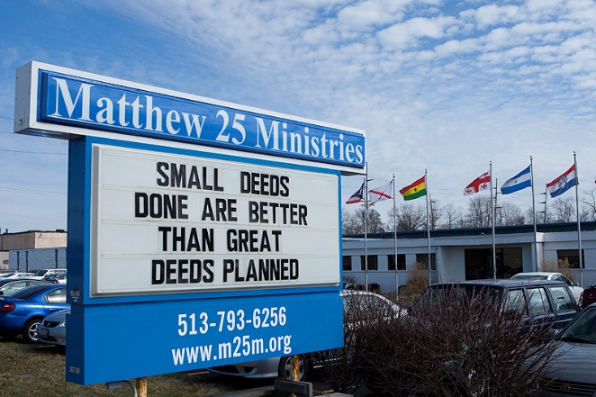
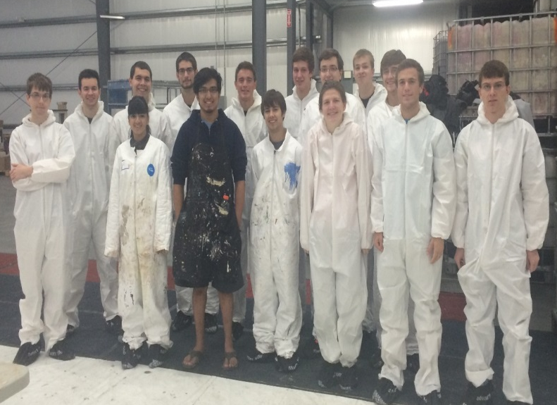
Community Service
Matthew 25 Ministries
Next date: Saturday, October 18th at 11-1pm
Sign up on Google Doc
Questions? Email benitoje@mail.uc.edu

Slide 18
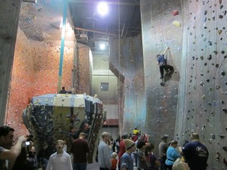
Rock Quest Overnight
Rock Climb till 10pm then play games
How many people: 35 spots (it’s first come, first serve)
Date: November 7th
Sign up on Google Doc
Questions? Email bowmancj@mail.uc.edu

Slide 19
Cyclones Game
On November 15th at 7:30
Against the Fort Wayne Komets
It is STAR WARS NIGHT
Sign up on Google Doc
Questions: email stonec5@mail.uc.edu

Slide 20
SOCC
Chair: Nathan Ball
Open Positions:
Secretary
Take attendance at meetings
Take meeting minutes
If interested in holding a position within SOCC email me at ballnn@mail.uc.edu

Slide 21
Public Affairs
Chair: Matt Morgann
Follow us on Twitter: @UCTribunal
Tweet about

Slide 22
EWeek
Chairs:
Alison Hayfer
Kitty DiFalco
What it is: A nationally celebrated week for Engineers and all that we do
What we do: Have a week of friendly competition between teams of students ending with a Date Auction and Banquet
When is it: February 22-28th

Slide 23
Recognition
Chair:
Christian Lipa
What Recognition Does:
Professor and TA of the Semester and Year
Freshman of the Year
Junior of the Year
Outstanding Senior of the Year
Student Group of the Semester and Year
Announcements:
Need people to serve on recognition committee – easy commitment so email lipacc@mail.uc.edu if interested in joining!
Nomination applications for Professor and TA of the Fall 2014 Semester are due November 21 -> submit applications/access to application template at http://tribunal.uc.edu/recognition
Class of the winning professor and TA will receive a special prize on behalf of tribunal -> pizza/ice cream party

Slide 24
Collegiate Affairs
Chairs:
Mark Gruenbacher, Nathan Draper
Represent students in following committees
Professional Standards Review Committee
Curriculum Review Board
Academic Standards Board
Academic Misconduct Hearings
Grievance Hearings

Slide 25
Other Announcements

Slide 26
Notes:
Sam
introduce name/position of Sam, Anton, Christian

Slide 27
Notes:
Sam
Non-profit/Local/international
Mission

Slide 28
Notes:
Sam
Service based (service hours)
UC chapter committees
external: fundraise, recruit, social,
internal: cultural, design

Slide 29
Notes:
Christian
Project mission, where, how many people affected, completion?

Slide 30
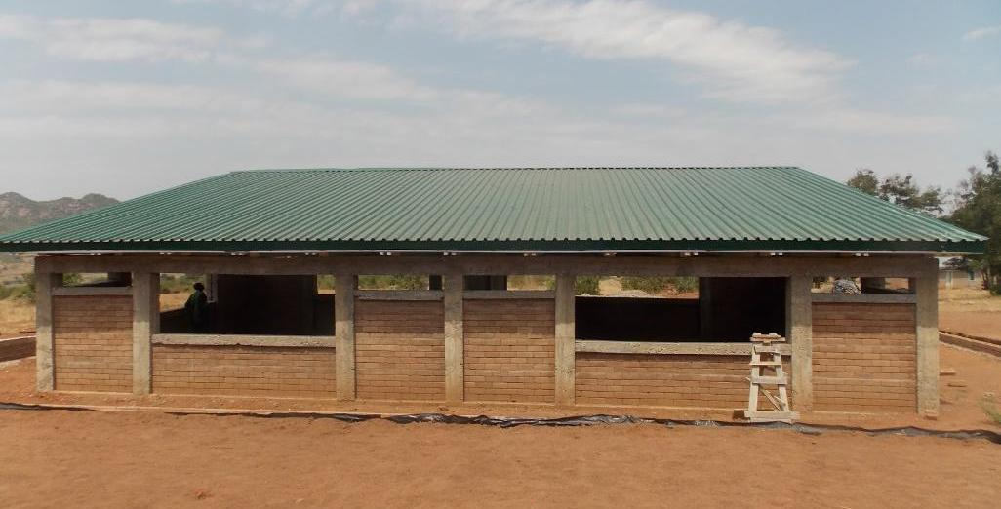
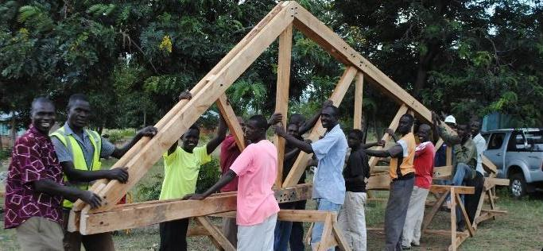
Notes:
Christian
Project mission, where, how many people affected, completion?

Slide 31
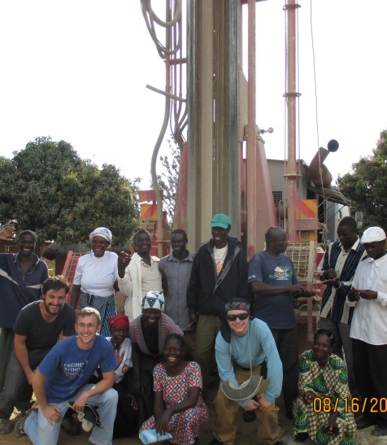
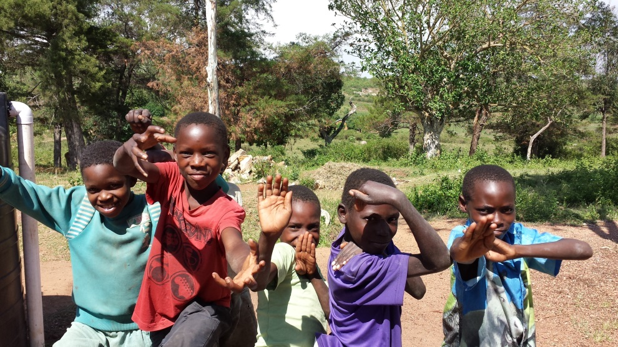
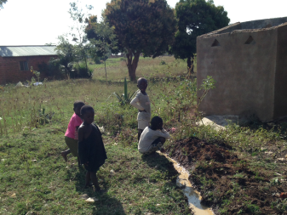
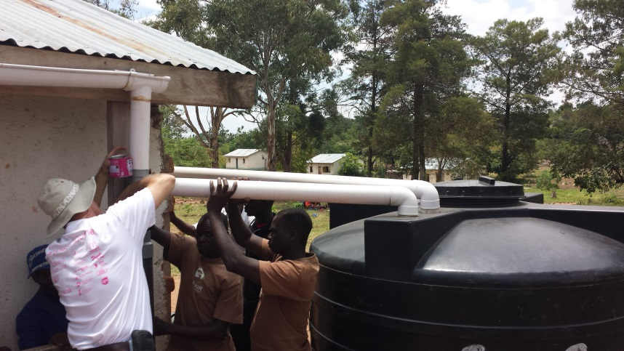
Notes:
Christian
Project mission, where, how many people affected, completion?
NEW PROJECT OPPORTUNITY (many projects take years and we need members who are dedicated to stick around. Mention that Anton started off with Nyambogo from the beginning and became president?)>> this can flow right into Anton’s part.

Slide 32
Notes:
NOT JUST FOR ENGINEERS***
Anton, share a story

Slide 33
Meetings every Wednesday 645 Baldwin @ 6pm
Notes:
Anton
*we will stay until the end of the meeting for anyone who has any questions

Slide 34
RAFFLE!

Slide 35
Constructive Criticism
What do you like/dislike about the college?
Comments / Questions?
questions.ceastribunal@gmail.com
What would you like to see Tribunal do next?

Slide 36
Next Meeting:
Monday, October 20th
Zimmer Auditorium
5:30

