Slide 1
Engineering and Applied Science Tribunal
General Meeting
September 8th, 2014

Slide 2
What: UC’s Annual Homecoming Dance
The night will be filled with dancing, food, & fun
Includes a shuttle that will run all night to & from Bogart’s
When: Thursday, September 18th
8pm-1am
@ Bogarts on Short Vine
Price:​ Tickets are -
$5 for a group of 25 tickets
Closes on Wednesday, September 10th
$10 for individual tickets
Contact Becky Schmidt to purchase tickets
schmidrc@mail.uc.edu

Slide 3
Purpose
What we are: CEAS Branch of Student Government
What we do:
Host programs for the college
Input on curriculum, grievances, and student/faculty relations
Improve student experience in the college

Slide 4
President
CEAS TRIBUNAL EXECUTIVE STRUCTURE
Secretary
Treasurer
Vice President
Associate Vice President
Senators (X2)
Technology
Career Fair
Public Affairs
FELD
EWeek
SOCC
Luau
Recognition
Special Events
Collegiate Affairs
OFFICERS are in black. COMMITTEE CHAIRS are in red.

Slide 5
Tribunal Officers
President: |  | Alison Hayfer
Vice President: |  | Maggie Connell
Associate Vice President: |  | Sarah Deutsch
Treasurer: |  | John Lewnard
Secretary: |  | Emily Demjanenko
Senators: |  | Madeline Adams Hannah Kenny

Slide 6
Tribunal Executives
Career Fair: |  | Andrew Griggs, Nick Stelzer, Dane Sowers
Collegiate Affairs: |  | Mark Gruenbacher, Nathan Draper
EWeek: |  | Alison Hayfer, Kitty DiFalco
FELD: |  | Dane Sowers
Luau: |  | Chris Katuscak
Recognition: |  | Christian Lipa
Public Affairs: |  | OPEN
SOCC: |  | Nathan Ball
Special Events: |  | Sam Dunker
Technology: |  | Charlie Hinton

Slide 7
Officer Reports

Slide 8
President
Officer:
Alison Hayfer
Office Hours:
Thursday 10:00-11:00 AM
Baldwin 652

Slide 9
Vice President
Officer:
Maggie Connell
Office Hours:
Wednesdays 6-7 PM
Baldwin 652

Slide 10
Associate Vice President
Officer:
Sarah Deutsch
Office Hours:
Tuesdays 12:30-1:30 PM
Baldwin 652

Slide 11
Secretary
Officers:
Emily Demjanenko
Please sign in at the back of the room
Must attend and sign in at minimum of 4 meetings each semester to having voting rights

Slide 12
Senators
Officers:
Maddie Adams
Hannah Kenny
Committees- Open to Anyone
Academic Issues
Mondays 8pm, SG Conference Room
Campus Life
Mondays 6pm, SG Conference Room
Governmental Affairs
Tuesdays at 4pm, SG Conference Room
Students Rights and Interests
Wednesdays 4pm, SG Conference Room
SG Conference Room is in 655 Steger

Slide 13
Senators
Officers:
Maddie Adams
Hannah Kenny
IT Showcase: September 11th 10-2 in Great Hall
SAB Applications due today
Dress for Success September 29th – October 3rd
Collecting donations of women’s professional clothing throughout campus
SG Conference Room is in 655 Steger

Slide 14
Committee Reports

Slide 15
Public Affairs
Chair: OPEN
Oversee social media accounts
Take pictures at events
Manage bulletin boards, Baldwin table reservations and eBullet
Interested? Email: hayferac@mail.uc.edu

Slide 16
Career Fair
Chairs:
Andrew Griggs
Dane Sowers
Nick Stelzer
All fairs in the Rec Center, on the basketball courts
173 companies signed up for Technical Career Fair
Be prepared:
Visit the company listing
Research companies & apply online
Go to information sessions & prep events
Dress is business casual – no jeans or tennis shoes

Slide 17
Some companies…

Slide 18
We Need Volunteers!
Setup for career fair
Tuesday & Wednesday, September 16 & 17, late afternoon
Coat/bag check, helping companies, student sign-in
Thursday, September 18, 7am-4pm
Coordinating interviews, cleanup/tear-down
Friday, September 19, 8am-4pm
Why?
Fulfill committee requirement
Meet and interact with company reps
Get to know Tribunal execs, gateway to getting more involved
Meet at back of room after meeting for sign-up
https://docs.google.com/forms/d/1-lyfE6kpqBH5-5mCgLVM5JTbIRoSDyznoyaDpmNlYcE/viewform?usp=send_form​

Slide 19
Resume Review Day Friday, September 12th 9a-3p 8th floor Rhodes Hall
Sit down with a professional of your choice
Example backgrounds: GE, Duke Energy, Patriot Engineering, Turner Construction, Messer Construction
20 minute resume critique and discussion
Student sign-up opens this Friday (limit 2 spots)
Great opportunity to network
and prepare for the career fair!
Questions? Contact Dane Sowers at sowersdd@mail.uc.edu

Slide 20
Attention Ladies!
Join us for…
WOMEN in STEM
Evening with Industry
September 17, 2014
6:00 – 8:30 pm
Be among the first to speak with hiring representatives from various companies attending the career fair. All female CEAS students invited to attend this FREE networking dinner but space is limited, so please register early. For more information, please contact Becky Tudor (becky.tudor@uc.edu – 513.556.0025 – 653 Baldwin). Additional information will be emailed to all female CEAS students.

Slide 21
FELD
Chair:
Dane Sowers
Freshman Engineering Leadership Development (FELD) is a Tribunal committee open exclusively to freshmen students. It is great way to meet new people from your college and make a positive impact on your college and community as well.
Last year: Reds game, Lazer Kraze, Sky Zone, Habitat for Humanity
FELD Intern Program – serve as an intern for a Tribunal officer or committee chair – Applications due Monday, September 22nd
First meeting: Monday, September 29th from 3:15pm-4:15pm in TBD (More details to come at next general meeting
Email sowersdd@mail.uc.edu or see Dane after the meeting with questions or to be added to the mailing list.

Slide 22
SOCC
Chair: Nathan Ball
Student Organization Communication Committee
Committee of student group presidents working to
Make student groups more effective
Increase collaboration within CEAS student groups
Make the student experience better
If interested in holding a position within SOCC email me at ballnn@mail.uc.edu

Slide 23
Technology
Chair:
Charlie Hinton
Committee Director
Career Fair Technologist
Website Administrator
Technology Intern
Hardware Specialist
Career Fair Technologist - Works with Career Fair Committee (joint member) and is in charge of all the technology needs for the Career Fair
Technology Intern - FELD Intern
Website Administrator – In charge of the Tribunal website
Hardware Specialist – In charge of maintaining all Tribunal Technological Assets
Open Positions
Notes:
Talking points
Cft- currently Filled by Dane Sowers, tends to be one of the co-chairs of the career fair committee, but also will help with other projects as needed based on their skill set
Intern- Freshman, needs to be very willing to sign his life away, and also hopefully has strong back round in web based coding languages
Web admin-needs to make sure that site is kept up to date, as well as manage any changes that other Executives need to their related content
Hardware specialist – Need to help keep track of our hardware and maintaining it to current technology levels and help keep the a modern infrastructure.

Slide 24
Recognition
Chair:
Christian Lipa
Oversees the following awards:
Professor and TA of the Semester and Year → Nomination submissions start September 2nd at http://tribunal.uc.edu/recognition
Freshman of the Year
Junior of the Year
Outstanding Senior of the Year
Need people to serve on recognition committee.
Read award nominations to help select winner. Read scholarship applications. Help with keeping records and publicizing our winners.
Low time commitment. No meetings!
**Email Christian Lipa at lipacc@mail.uc.edu if you are interested in joining**

Slide 25
Collegiate Affairs
Chairs:
Mark Gruenbacher, Nathan Draper
Represent students in following committees
Professional Standards Review Committee
Curriculum Review Board
Academic Standards Board
Academic Misconduct Hearings
Grievance Hearings

Slide 26
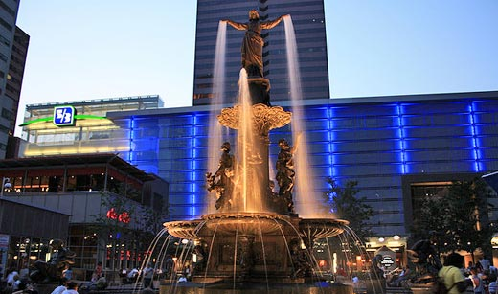
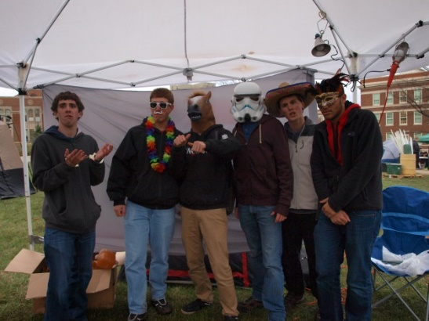
Special Events
Chair:
Sam Dunker
Do you want to run an event?
Community service
UC events
Non-UC events
Email dunkerse@mail.uc.edu

Slide 27
Special Events
Chair:
Sam Dunker
Into the Streets—Service Opportunity
When: September 13th from 8:30am-2:30pm
Where: meet at McMicken Commons and dispersed across Cincinnati
Sign up through campus link: http://www.uc.edu/cce/student/programs/ITS.html
Questions?? Email dunkerse@mail.uc.edu

Slide 28
EWeek
Chairs:
Alison Hayfer
Kitty DiFalco
What it is: A nationally celebrated week for Engineers and all that we do
What we do: Have a week of friendly competition between teams of students ending with a Date Auction and Banquet
When is it: February 22-28th

Slide 29
Other Announcements

Slide 33
uctriangle.org/events
kimbrojr@mail.uc.edu

Slide 34
Phi Sigma rho
A social sorority for women in engineering.

Slide 35
A little bit about us…
The UC chapter (Alpha Beta) became a colony in March 2011, and officially became a chapter in November 2011
Our philanthropies are The Girl Scouts of America and The American Cancer Society
We participate in events such as Homecoming, Socials, our Annual Fall Retreat, Greek Week, and Relay for Life
We strive for three things: friendship, scholarship, and encouragement

Slide 36
Contact Us
President – Becky Schmidt
ucphirho.president@gmail.com
VP of Expansion – Brenna Robinson
ucphirho.expansion@gmail.com
Director of Recruitment – Leah Kahne
ucphirho.recruitment@gmail.com

Slide 37
RAFFLE!

Slide 38
Constructive Criticism
What do you like/dislike about the college?
Comments / Questions?
questions.ceastribunal@gmail.com
What would you like to see Tribunal do next?

Slide 39
Next Meeting:
Monday, September 22nd
Zimmer Auditorium
5:30

