Slide 1
Engineering and Applied Science Tribunal
General Meeting
November 17th , 2014
http://youtu.be/GU58KLdIbkM

Slide 2
President
CEAS TRIBUNAL EXECUTIVE STRUCTURE
Secretary
Treasurer
Vice President
Associate Vice President
Senators (X2)
Technology
Career Fair
Public Affairs
FELD
EWeek
SOCC
Luau
Recognition
Special Events
Collegiate Affairs
OFFICERS are in black. COMMITTEE CHAIRS are in red.

Slide 3
Tribunal Officers
President: |  | Alison Hayfer
Vice President: |  | Maggie Connell
Associate Vice President: |  | Sarah Deutsch
Treasurer: |  | John Lewnard
Secretary: |  | Emily Demjanenko
Senators: |  | Madeline Adams Hannah Kenny

Slide 4
Officer Reports

Slide 5
President
Officer:
Alison Hayfer
Elections for Summer Semester positions!
Vice President
Associate Vice President
Treasurer
Secretary

Slide 6
VP
Maggie Connell
Joe Willie Frees

Slide 7
AVP
Sarah Deutsch
Haley Inniger
Dane Sowers

Slide 8
Treasurer
CJ Bowman
Max Inniger
Christian Lipa

Slide 9
Secretary
Jared Wood
Tim Kemper

Slide 10
Senators
Officers:
Maddie Adams
Hannah Kenny
Open Committees
Academic Affairs
Mondays 7:30pm, 655 Steger Student Life Center
Campus Life
Mondays 6pm, 655 Steger Student Life Center
Governmental Affairs
Tuesdays at 4pm, 655 Steger Student Life Center
Students Rights and Interests
Wednesdays 5pm, 655 Steger Student Life Center

Slide 11
Officers:
Maddie Adams
Hannah Kenny
Wednesday, Dec 10-Sunday, Dec 14
Free rides to CVG at the end of the semester!
Reservations open
now: tribunal.uc.edu/airport_ride/ar.php

Slide 12
Committee Reports

Slide 13
FELD
Chair:
Dane Sowers
Next meeting: This Wednesday from 5pm-6pm in 750 Baldwin.
We will be holding elections for the FELD officer positions for this spring and next fall.
Food will be provided as always!
Email sowersdd@mail.uc.edu with any questions!

Slide 14
Special Events
Exam week breakfast next Monday
Free noms In Baldwin!
What too look forward to next semester
Clean Up Cincy
Relay for Life
Intramural sports, and much more!
Have an idea for an event or want to get involved?
Contact Scott Blincoe at:
blincosv@mail.uc.edu

Slide 15
Recognition
Chair:
Christian Lipa
Congratulations to Dr. Aimee Frame for being chosen as this semester’s Professor of the Semester and Dane Sowers as this semester’s TA of the Semester!!
Thank you to everyone on the Recognition Committee that took time out of their Thanksgiving Break to vote.

Slide 16
EWeek
Chairs:
Alison Hayfer
Kitty DiFalco
What it is: A nationally celebrated week for Engineers and all that we do
What we do: Have a week of friendly competition between teams of students ending with a Date Auction and Banquet
When is it: February 22-28th
Questions? Email uc.eweek@gmail.com
Committee breakout after meeting

Slide 17
Other Announcements

Slide 18
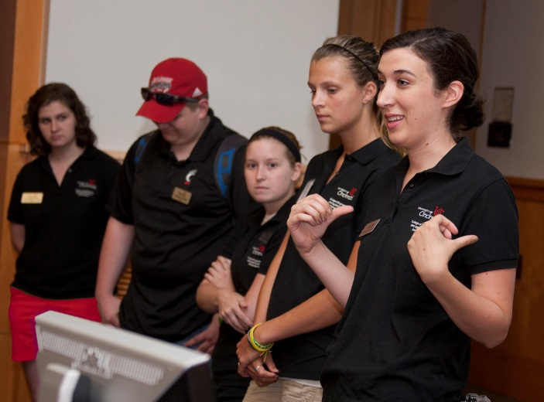
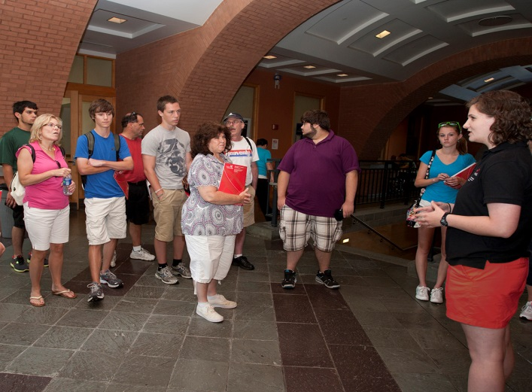
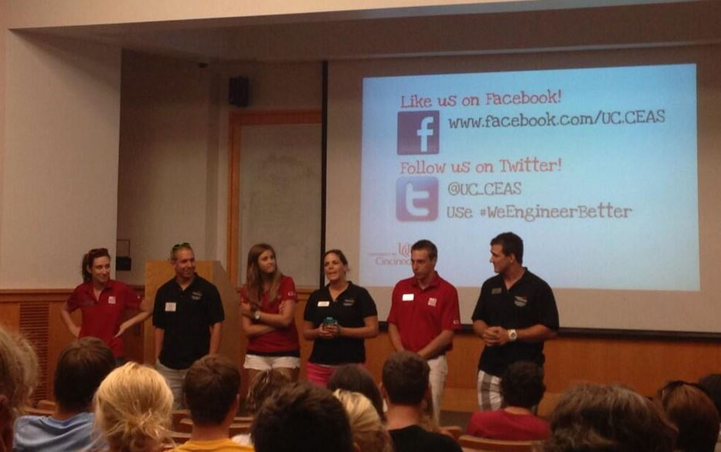
CEAS Ambassadors
-Give tours to prospective students
-Sit in on department talks
-Help w/ open houses & class shadows
-Meet faculty and staff
-Bi-weekly meetings w/ food
-Be the face of CEAS
https://ucceasambassadors.com/apply

Slide 19
SOL Presentation

Slide 20
Constructive Criticism
What do you like/dislike about the college?
Comments / Questions?
questions.ceastribunal@gmail.com
What would you like to see Tribunal do next?

Slide 21
Next Meeting:
Monday, January 12th
Location TBD
5:30

