Slide 1
Engineering and Applied Science Tribunal
General Meeting
June 30th, 2014

Slide 2
Purpose
To represent the students of the College of Engineering & Applied Science on all relevant issues, specifically with curriculum, academic and professional standards, and computing services. Engineering & Applied Science Tribunal will also attempt to assist the students with non-academic issues whenever possible.

Slide 3
Tribunal Officers
President: |  | Alison Hayfer
Vice President: |  | Juliann Leny
Associate Vice President: |  | Maggie Connell
Treasurer: |  | John Lewnard
Secretary: |  | Danny Nolan
Senators: |  | Madeline Adams Hannah Kenny

Slide 4
Tribunal Executives
Career Fair: |  | Andrew Griggs
Collegiate Affairs: |  | Nathan Draper
EWeek: |  | Alison Hayfer, Sam Dunker
FELD: |  | Dane Sowers, Matt Kitchen
Luau: |  | Chris Katuscak
Recognition: |  | Christian Lipa
Public Affairs: |  | Logan Buck
SOCC: |  | Nathan Ball
Special Events: |  | Sam Dunker
Technology: |  | Dane Sowers, Charlie Hinton

Slide 5
Officer Reports

Slide 6
President
Officer:
Alison Hayfer
Bearcat Bite: P&G’s stackable Pringles potato chip shape was designed by former UC astronomer and alumnus Paul Herget

Slide 7
Secretary
Please sign in at the back of the room
Must attend and sign in at minimum of 4 meetings each semester to having voting rights

Slide 8
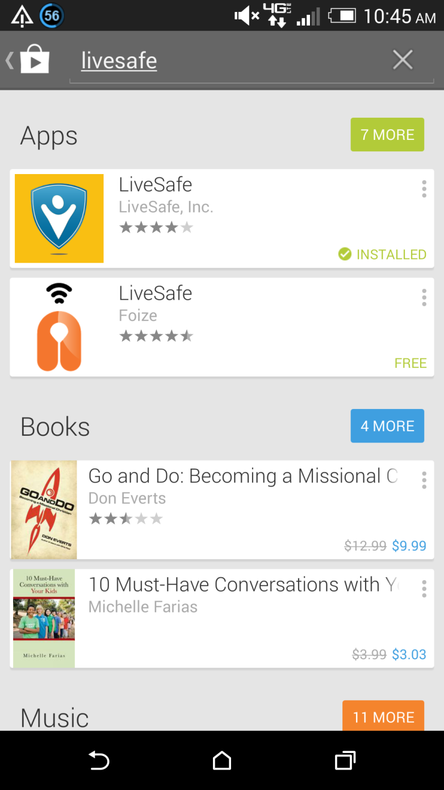
Senators:
Hannah Kenny
Maddie Adams

Slide 9
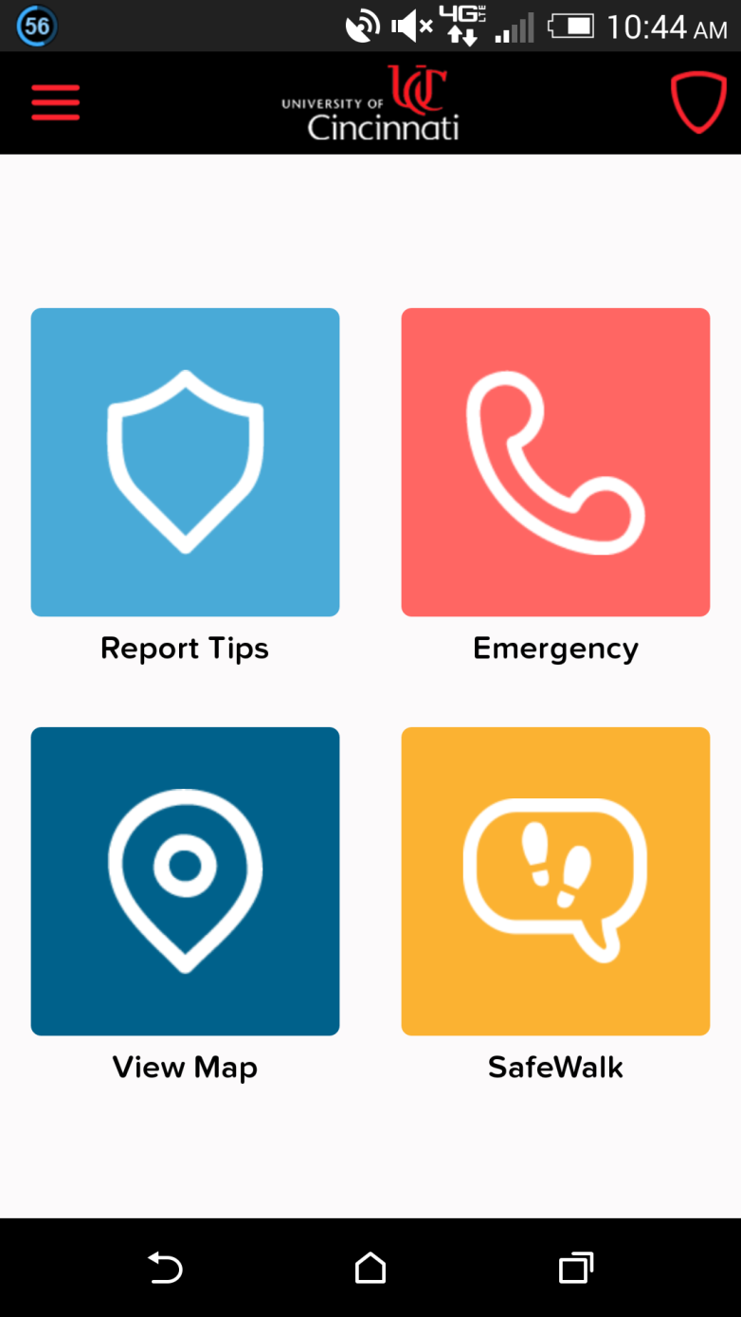

Slide 10
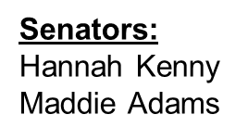
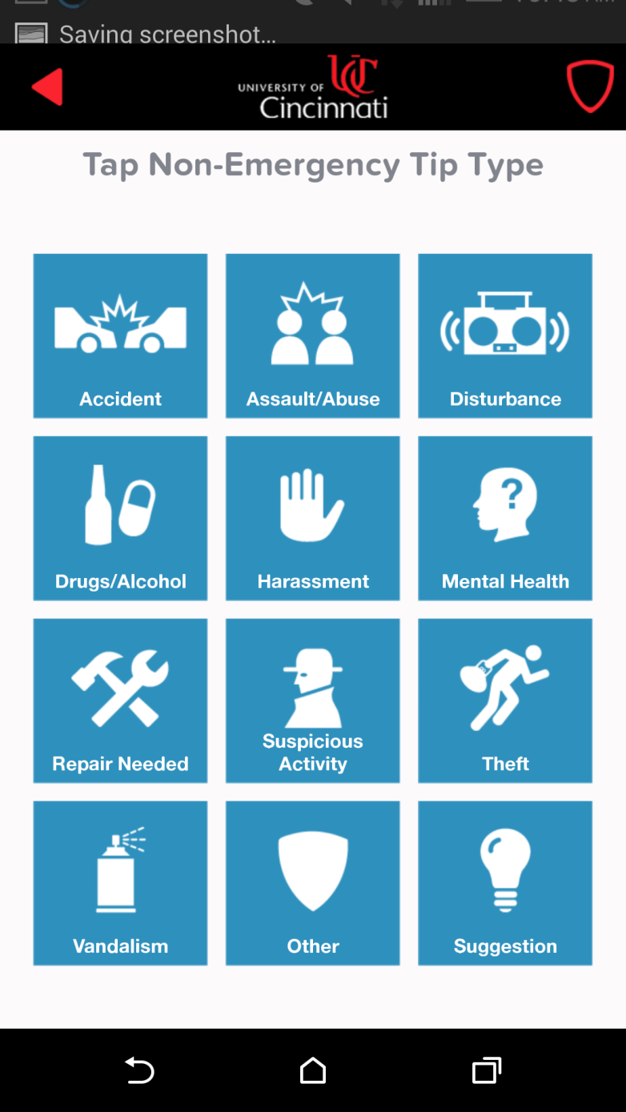

Slide 11
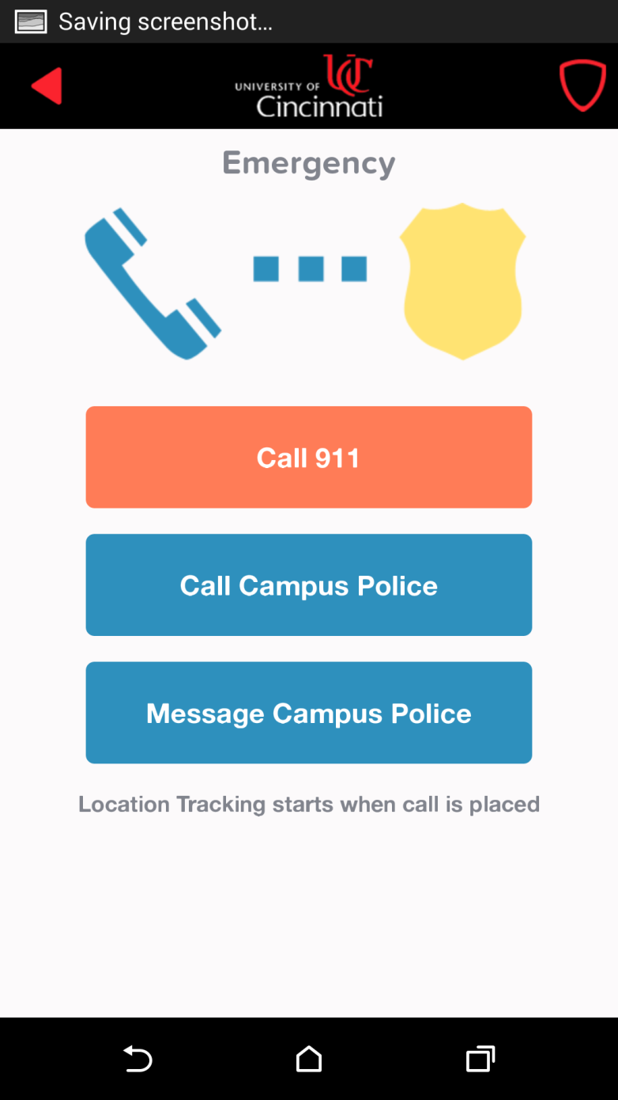

Slide 12
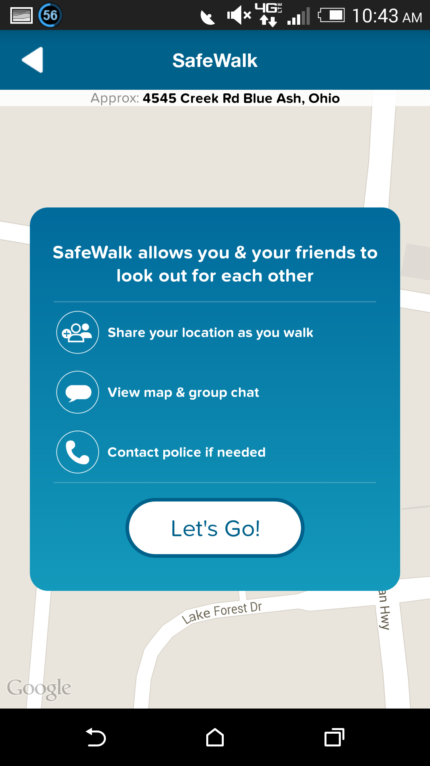

Slide 13
Committee Reports

Slide 14
Technology
Chair:
Dane Sowers
Charlie Hinton
Dr. Kumar Vemaganti (from the department of Mechanical and Materials Engineering) is looking for a student to aid in the construction and development of a website.
Any student is welcome to take on this project, which could help demonstrate and develop important technology skills.
For more information or if you have any questions, please contact Dane Sowers (sowersdd@mail.uc.edu) and Carlo Perrottino (perrotca@mail.uc.edu)

Slide 15
Recognition
Chair:
Ken Okoye
Christian Lipa
Professor and TA of the Semester nominations
Due July 16th
tribunal.uc.edu/recognition
Need people to serve on recognition committee.
Read POTS and TAOTS nominations help select winner. Read scholarship applications. Help choose Outstanding Seniors. Help with keeping records and publicizing our winners.
MINIMUM commitment. Easy committee requirement!

Slide 16
FELD
Chairs
Matt Kitchen
Dane Sowers
Want to be on the committee?
Will help plan and run FELD Fest
Will help schedule events for freshmen
Can go to different LC’s to talk to and advise freshmen

Slide 17
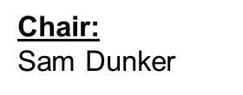
Special Events
Matthew 25—July 12th from 11am-1pm
Location: 11060 Kenwood Rd. Blue Ash, OH 45242 (which is about 15-20 minutes from UC)
What we would be doing: sorting clothes, mixing paint cans, creating basic necessity bags
Carpool meeting spot: in front of ERC at 10:30
Sign up sheet: google doc or talk to me
They are 20 spots so feel free to bring a friend!!
Sign up Sheet​

Slide 18
Other Announcements?

Slide 19
Constructive Criticism
What do you like/dislike about the college?
Comments / Questions?
What would you like to see Tribunal do next?

Slide 20
Next Meeting:
Monday, July 14th
525 Old Chem
5:30

