Slide 1
Engineering and Applied Science Tribunal
General Meeting
October 19, 2015

Slide 2
Recognition
Chair:
Jared Wood
Marathon Scholarship
$1500
Applications are available at tribunal.uc.edu/recognition
Professor and TA of the Semester
Nominations open November 9th
Looking for committee members
Email me at wood2jt@mail.uc.edu if interested

Slide 3
Agenda:
Presentation and Q&A From Dean Lim
Ambassadors UC Trivia Night
Officer Reports
Committee Reports
Raffle

Slide 4
Dean Teik Lim!

Slide 5
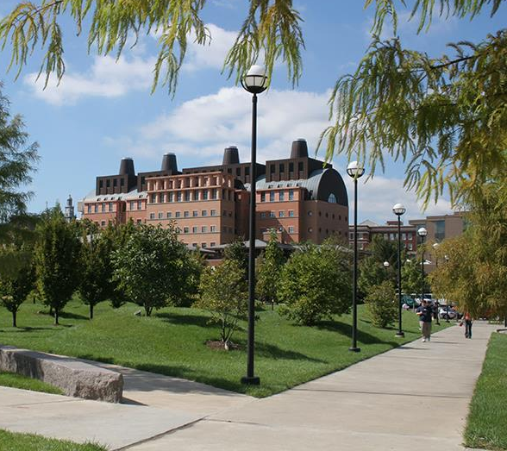
Teik C. Lim, Dean COLLEGE OF ENGINEERING & APPLIED SCIENCE
Enhancing Students’ Experience
President’s 3rd Century initiative
Faculty hiring, 50 in 5 plan
25 started, 2 to start soon, and 19 open searches
ASSET (Advancing Student Success in Engrg & Tech)
Improve lab capabilities and capacities
Hiring more advisors and support staff
Expanding Honors
International Opportunities
ICP – 8 months co-op in Germany and Japan
Coop/TA – Joint Engrg Coop Institute in Chongqing, China
‘Experience’ programs in Singapore, Hong Kong & Toronto
CEAS students can work with ProPel and UC International offices to find their own co-op job abroad
There are many approved study abroad programs and dozens of exchange programs. Most offer scholarships and grants. For example, 3 study tour courses to Japan, Italy/Spain, Finland, etc.

Slide 7
Recent Senate Activity
Officer:
John Lewnard
Varun Nagarajan
Student Government Senate passed a resolution to support the input of language regarding Counseling and Psychological Services (CAPS) and Title IX into every class course material
Student Senate voted to monetarily support the Black Male Luncheon which brings high school underprivileged black males to network with UC students and professionals

Slide 8
Elect Her
Officer:
John Lewnard
Varun Nagarajan
Elect her both encourages and trains college women to run for student government and future leadership positions.
It is a one day 4.5 hour training on Nov. 7th
If you are interested in participating, sign up at the link below:
http://www.uc.edu/ucwc/we/ElectHer.html

Slide 9
Homecoming October 19th – 25th
Officer:
John Lewnard
Varun Nagarajan
Monday: Paint Uptown http://goo.gl/forms/57fUTjs8lz More details after sign up! Tuesday: T-Shirt Scavenger Hunt – Follow the clues and you will receive a Homecoming T-Shirt!
Wednesday: Cincinnatus Nearly Naked Mile – Dress up in a nearly naked outfit and race through campus
Thursday:
Car smash – Smash a car on Mainstreet with UCONN logo on it!
Sigma Phi Ball – All students welcome to come to Bogarts on Short Vine and celebrate homecoming with dancing and festivities
Friday: Pep Rally on Main Street
Saturday: Homecoming Football game against UCONN

Slide 10
Committee Reports

Slide 11
Homecoming 2015
Come celebrate the Bearcats 100th year at Nippert with Tribunal and the College of Engineering and Applied Science!
Where: The Grid Sections 106 & 107
When: THIS SATURDAY Starts at 12:30
Why: Free food, Bearcats Football
Homecoming means alumnus!
YOU + ENGINEERING ALUM = NETWORKING
80% of jobs are landed through networking
Service Hour Opportunity:
Help set up and break down the tailgate
Contact: burnst3@mail.uc.edu

Slide 13
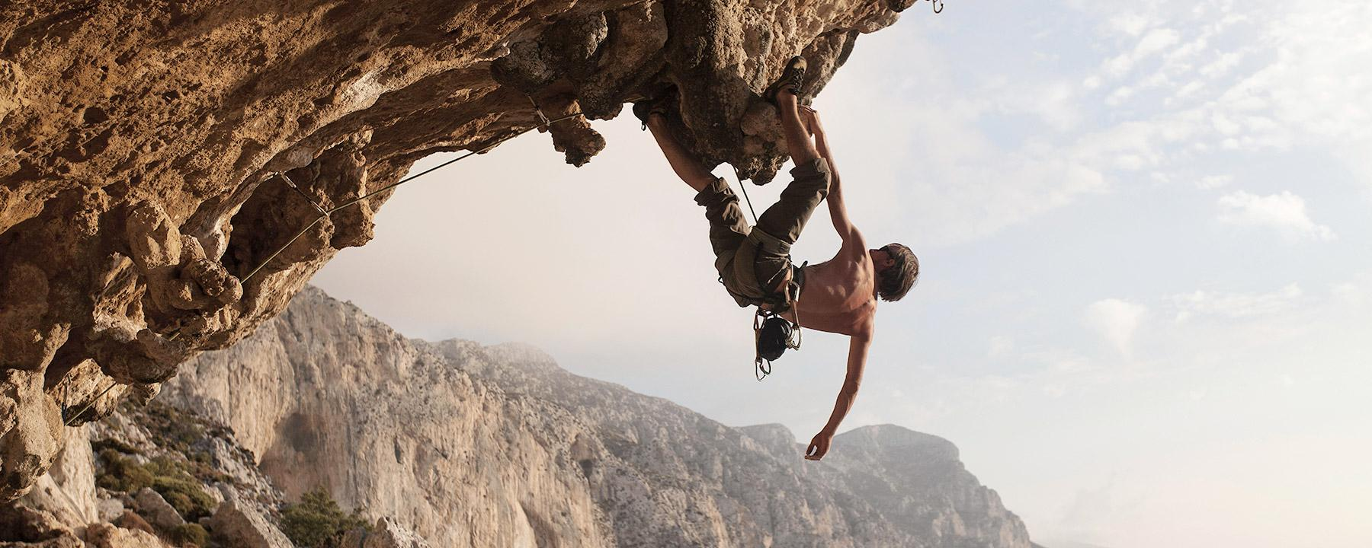
Free climbing. Free food. Free transportation.
What else could you want?!
When: November 6 – November 7 (9 PM – 9 AM)
Where: RockQuest Climbing Center
Look for an email containing a sign-up link!

Slide 14
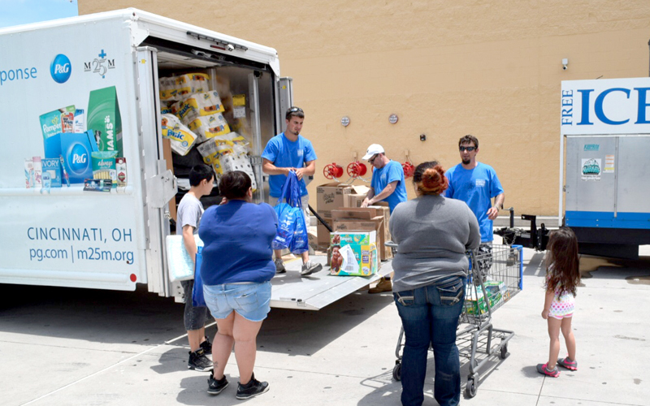
Earn Service Hours and help those in need!
Matthew 25 Ministries is an organization dedicated to relief efforts around the world.
Will be volunteering one weekend during November
Look for an email with Sign Up details in the coming weeks
Caring For A Needy World With The Things We Throw Away.
-Rev. Wendell Mettey

Slide 15
Involvement
WANT TO GET INVOLVED OR PLAN AN EVENT OF YOUR OWN?? JOIN MY COMMITTEE!
Contact Tom Burns
Special Events Chairman
Burnst3@mail.uc.edu

Slide 16
Public Affairs
Committee Chair:
Meredith Meads
Be the first to hear about upcoming events:
Follow us on Twitter @UCTribunal
Like our Facebook page The UC Engineering and Applied Science Tribunal
To get involved contact meadsmc@mail.uc.edu
To rent a Baldwin table go to tribunal.uc.edu/socc/table-reservation

Slide 17
Innovation Committee
Committee Chair:
Emily Demjanenko
Responsible for initiating projects and ideas to better the college and support CEAS students
Projects
3D Printing
Class shadow
Course survey audit
Committee meeting directly after general meeting today!
demjanes@mail.uc.edu

Slide 18
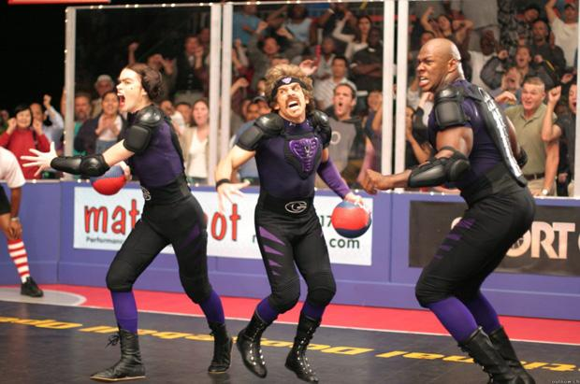
FELD
Chair:
Alexis Conway
FELD vs Tribunal Exec Dodgeball, Thursday, October 29th from 7pm-8pm
To be held in Rec
All are welcome
Free Food
Email conwayal@mail.uc.edu with questions or to be added to the mailing list.

Slide 19
Collegiate Affairs
Chair:
Khaled Aboumerhi
Open Forum Meeting
Wednesday October 21th
7:00pm – 8:00pm
ERC 405
We will discuss updates from Oct 7th Open Forum and other comments, concerns & opinions
Free pizza will be provided

Slide 20
SOCC
Chair:
Heath Palmer
Student Organization Communication Committee
Members of our Committee are:
Looking to increase collaboration between CEAS student groups
Looking to increase the impact each CEAS group has on the student body
Example: Student organization attendance
Second meeting coming up!
SAB presentation and Q/A session
Please email palmerha@mail.uc.edu if you are interested in holding a position within SOCC.

Slide 21
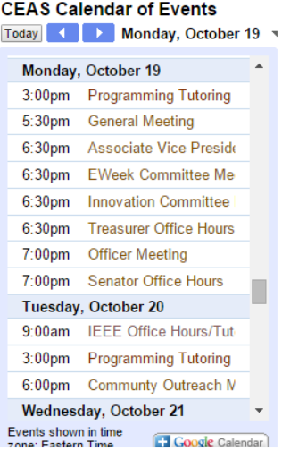
SOCC Calendar
Chair:
Heath Palmer
The SOCC Calendar is made up of meeting/event times for other engineering clubs
https://tribunal.uc.edu/socc
This is a resource for YOU!
We are still working on getting other club calendars
Please email palmerha@mail.uc.edu if you are not on the SOCC calendar.

Slide 22
SOCC Calendar
Chair:
Heath Palmer

Slide 23
EWeek
Chairs:
Andy Bachus
Alison Hayfer
What is it? A nationally celebrated week to celebrate engineers and all that we do!
What do we do? Have a fun week of competition and games and end the week with a banquet
When is it? February 21-27th
Questions? Email uc.eweek@gmail.com
Follow us on Twitter @UC_Eweek
Through the Herman Schneider Foundation, the first 85 seniors get free tickets for the banquet
Next committee meeting : Thursday @ 12:30PM in 650 Baldwin

Slide 24
Other Announcements

Slide 25
Peer Leader Position
Peer Leaders for Learning Communities Wanted!!!
Details
Paid position
lead your own LC
help first year students grow
Spring 2015
More info?
http://www.uc.edu/fye/learning_communities/pl.html
Questions? Contact Lauren Bosselait at lauren.bosselait@uc.edu
Notes:
Tom can’t make this meeting. Speak on his behalf.

Slide 26
VP for Research Search - Open Forums
UC is currently in the process of hiring a new VP for Research.
They have identified 4 candidates who will each be hosting a Q&A session that is open to all faculty, staff, and students:
Patrick A. Limbach - Thurs. 10/15, 10:15-11:15 in 427 ERC
Simin Nikbin Meydani - Fri. 10/16 3:30-4:30 in TUC Cinema
Jeffrey M. Zaleski - Tues. 10/20, 12:30-1:30 in 400B TUC
Name TBA - Tues. 10/27, 8:30-9:30 in 427 ERC
Visit http://www.uc.edu/president/priorities/search/search_vp-research.html for more details or email Dane at sowersdd@mail.uc.edu with any questions!

Slide 27
RAFFLE!

Slide 28
Constructive Criticism
What do you like/dislike about the college?
Comments / Questions?
questions.ceastribunal@gmail.com
What would you like to see Tribunal do next?

Slide 29
Next Meeting:
November 2, 2015
5:30PM
525 Old Chem

