Slide 1
Engineering and Applied Science Tribunal
General Meeting
November 2, 2015

Slide 2
Agenda:
ASSET Presentation by Dr. Bucks
Officer Reports
Committee Reports

Slide 3
Advancing Student Success in Engineering and Technology(ASSET)
Chair: Greg Bucks
Members: Tasos Angelopoulos, Kelly Cohen, Karen Davis, Todd Foley, Jason Heikenfeld, Margaret Kupferle, Richard Miller, Janet Ransom, David Rathburn, Virgil Reed, Eric Rozier, Eugene Rutz, Ken Simonson, George Suckarieh, Paul Talaga, David Wendell, Virginia Westheider

Slide 4
‹#›
What is ASSET?
ASSET is a group of faculty and staff in CEAS who wish to improve the quality of undergraduate engineering education at the University of Cincinnati
Formed during the summer of 2013
Faculty created and faculty led
Has grown from a handful of faculty to around 20 individuals from all disciplines in CEAS and staff from a variety of supporting programs

Slide 5
‹#›
GOALS
What if …
1) CEAS offered the BEST ENGINEERING EDUCATION IN OHIO, validated by real metrics and recognized across the state by students, employers, and legislators. Could we be the best in our primary competitive market?!
2) CEAS moved beyond ‘spires’ of excellence in education, to a rising tide that elevates teaching in ALL of our classes, by enacting for the first time pro-active and assessment-driven faculty development for all our educators?
3) CEAS Faculty and students educated non-engineering students to be technologically literate citizens by offering courses on the ‘frontiers of technology’, ‘creating a working prototype,’ ‘modern manufacturing,’ ‘grand technological challenges,’ or ‘technology ethics and policy?’

Slide 6
‹#›
Pilot Programs for 2014-2015 Academic Year
Peer Assist Program:
help newly hired faculty get on track to be effective educators
Midterm Feedback Survey:
provide feedback on the course in the middle of the term to allow for adjustments in content and delivery
EECS Co-op Feedback Course:
course designed to provide feedback on courses/program based on co-op experiences
Two New Courses in Development:
Summer Honors Experience: design content modules
Engineering for non-Engineers: course taught by engineering students to non-engineers on various technology topics

Slide 7
‹#›
Initiatives for 2015-2016 Academic Year
Redesign/Expand Peer Assist Program:
improve processes and continue to help new faculty
expand to help established faculty
Better Engagement with Engineering Tribunal
find ways to work with Engineering Tribunal to make the student voice heard in improving undergraduate engineering education
Expansion of Co-op Feedback Course:
adopt/adapt PD2050 course from EECS to other departments
Expansion of Engineering Honors Seminars:
Engineers currently make up 1/3 of the students in the honors program
CEAS offers very few honors seminars/experiences

Slide 8
‹#›
Why We’re Here
Have an open discussion about the strengths and weaknesses of CEAS
What are the overall strengths you see of CEAS?
What overall areas do you see for improvement in CEAS?
What specific issues have you experienced that ASSET might be able to help address?
What are your visions for what CEAS should be?
Identify ways that Tribunal and ASSET can partner to enact changes in undergraduate CEAS education
What avenues for feedback currently exist? How well do they work? How can they be improved?
What role would you like to see Tribunal take in defining curriculum?
What support can ASSET provide?

Slide 9
Officer Reports

Slide 10
Senators
Officer:
John Lewnard
Varun Nagarajan
Liaison between Student Government and CEAS Tribunal
Varun Nagarajan - nagaravn@mail.uc.edu
Office Hours:
Wednesdays 4:30PM-5:30PM
Baldwin 650
John Lewnard - lewnarjm@mail.uc.edu
Office Hours:
Mondays 7PM-8PM
Baldwin 650

Slide 11
Senator Report
Officer:
John Lewnard
Varun Nagarajan
Recent Senate Activity:
Passed a resolution to support a tobacco ban on campus
Passed a resolution to support State Senate Bill that requires a secondary means of egress for bedrooms above second floor in multi-family dwellings
Voted in a new at- Large Senator: Deepansh Pahwa (Computer Science, International Student, Sophomore)

Slide 12
Senator Report Cont.
Officer:
John Lewnard
Varun Nagarajan
Upcoming Events:
Senate Meeting: Nov. 4th 6:00 pm in 425 TUC
UC at the Zoo: Nov. 7th from 5-9 pm. Tickets are $5 and can be found at the link: https://www.uc.edu/zoo.html
Sibs Weekend: Nov 13th-15th
Have sibling live with you
Fun activities all weekend with RHA (Bubble Soccer, Fashion Show, Bingo Night, Yoga, Henna tattoos & more)
Sibling ages 9-17 welcome
Elect Her: November 7th for 4.5 hours.
Encourages and trains college women to run for student government and future leadership positions.
If interested here is the link: http://www.uc.edu/ucwc/we/ElectHer.html

Slide 13
The Siddall/Calhoun Mural Design Contest

Slide 15
To promote student engagement in the political process and raise awareness about the importance of off-year elections. Under the Steger Bridge

Slide 16
Committee Reports

Slide 17
Chair:
Tom Burns
This Friday!
Time/location: 8:10 PM in front of ERC
Transportation: Provided
Food: Pizza and light breakfast provided
What to bring:
Comfortable clothes to climb/sleep in
Sleeping bag and pillow, or something to sleep on
Board games, cards, or anything to play after climbing

Slide 18
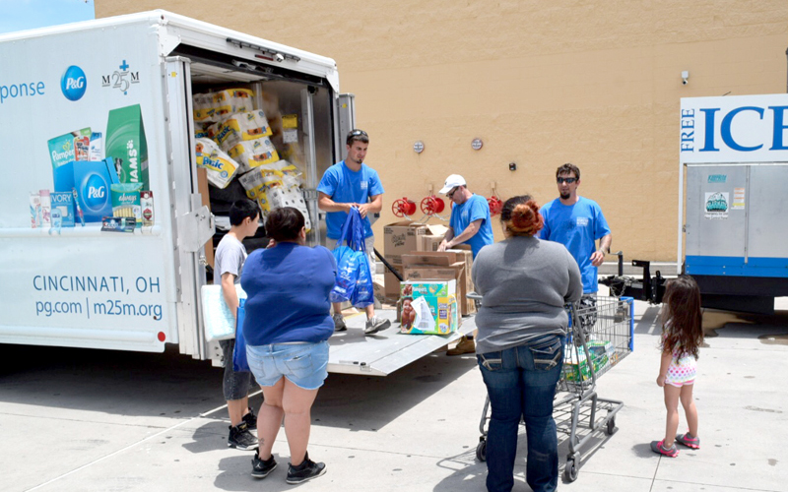
Chair:
Tom Burns
Earn Service Hours and help those in need!
Matthew 25 Ministries is an organization dedicated to relief efforts around the world.
Will be volunteering one THURSDAY NIGHT in November
Look for an email with Sign Up details in the coming weeks
Caring For A Needy World With The Things We Throw Away.
-Rev. Wendell Mettey

Slide 19
Cincinnati Cyclones Ga
Chair:
Tom Burns
Come with Tribunal to a Cyclones Game!
When? Tuesday December 1st, 2015 at 7:30 PM
Why? Free Hockey!
Transport will be provided
Look for signups in the coming weeks!

Slide 20
SOCC
Chair: Heath Palmer
Student Organization Communication Committee
Members of our Committee are:
Looking to increase collaboration between CEAS student groups
Looking to increase the impact each CEAS group has on the student body
Example: Student organization attendance
Second meeting was a success
SAB presentation and Q/A session – allowed for clarification on both sides
Please email palmerha@mail.uc.edu if you are interested in holding a position within SOCC.

Slide 21
Collegiate Affairs Committee
Chair:
Khaled Aboumerhi
What is it?
A committee comprised of student representatives from every CEAS department to discuss opinions, comments & concerns.
Interested in representing your department at the Collegiate Affairs Committee Meetings?
We need students who can voice the general opinion of their peers and actively work with the committee on fixing these issues & concerns
Notes:
Tom can’t make this meeting. Speak on his behalf.

Slide 22
Collegiate Affairs Committee
Chair:
Khaled Aboumerhi
We are looking for representatives from the following departments:
Aerospace Engineering & Engineering Mechanics
Civil & Architectural Engineering & Construction Management
Biomedical, Chemical & Environmental Engineering
Questions? Contact Khaled Aboumerhi @ aboumekd@mail.uc.edu

Slide 23
Recognition
Chair:
Jared Wood
Marathon Scholarship
Winner will be announced November 16th
Professor and TA of the Semester
Nominations due November 23rd
tribunal.uc.edu/recognition
Looking for committee members
Email me at wood2jt@mail.uc.edu if interested

Slide 24
Innovation Committee
Responsible for initiating projects and ideas to better the college and support CEAS students
Projects
3D Printing
Class shadow
Course survey audit
New meeting time: every other Tuesday at 6pm beginning 11/3. Meet in Tribunal office
demjanes@mail.uc.edu

Slide 25
EWeek
What is it? A nationally celebrated week to celebrate engineers and all that we do!
What do we do? Have a fun week of competition and games and end the week with a banquet
When is it? February 21-27th
Questions? Email uc.eweek@gmail.com
Follow us on Twitter @UC_Eweek
Through the Herman Schneider Foundation, the first 85 seniors get free tickets for the banquet
Next committee meeting : Thursday @ 12:30PM in 650 Baldwin

Slide 26
Other Announcements

Slide 27
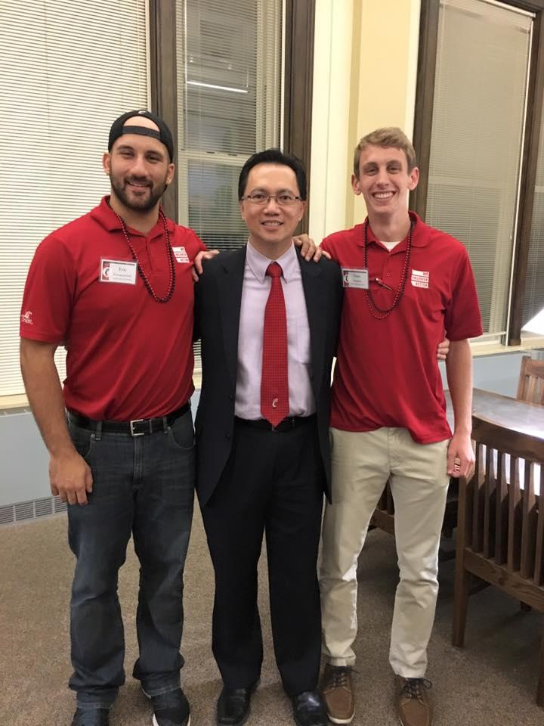
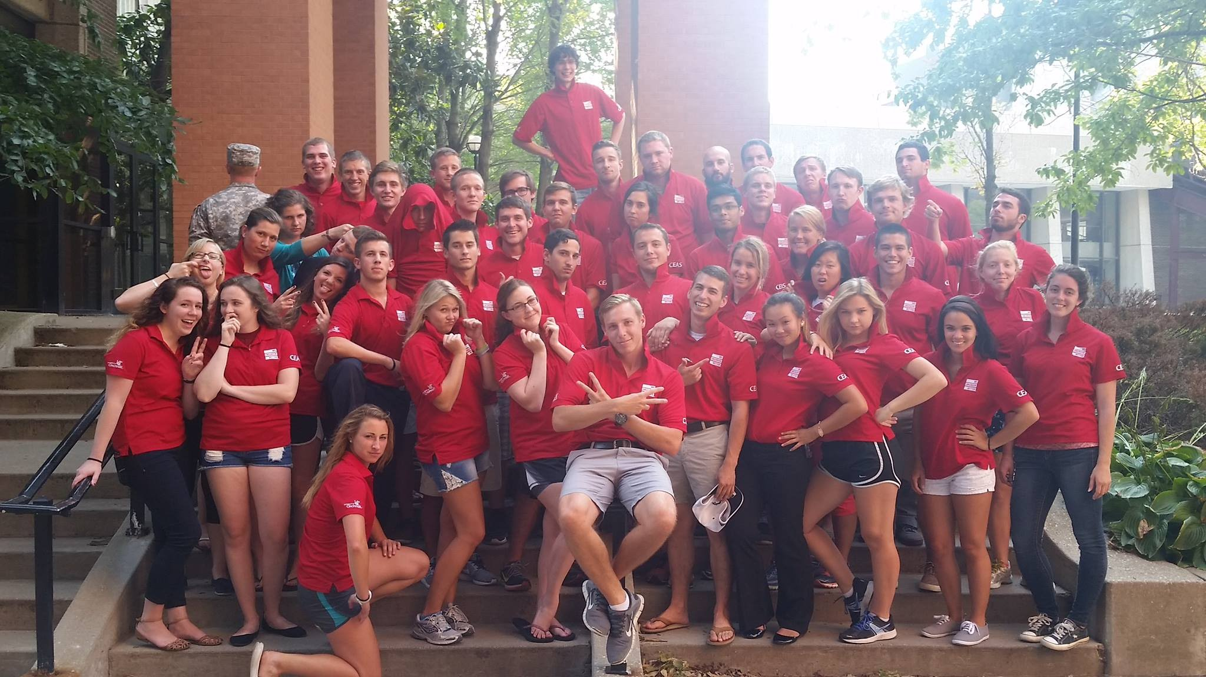
CEAS AMBASSADORS
What is CEAS Ambassadors?
Service organization
Works toward advancing the relationship between the students, alumni, faculty, staff and friends of CEAS.
Involved in various events/activities sponsored CEAS, primarily serve as tour guides for undergrad recruitment (red polo people)
Why join CEAS Ambassadors?
How to apply to Ambassadors
Fill out the online application: https://ucceasambassadors.com/apply
Send your resume to connelmt@mail.uc.edu

Slide 28
Constructive Criticism
What do you like/dislike about the college?
Comments / Questions?
questions.ceastribunal@gmail.com
What would you like to see Tribunal do next?

Slide 29
Next Meeting:
November 16, 2015
5:30PM
525 Old Chem

