Slide 1
Engineering and Applied Science Tribunal
General Meeting
September 21, 2015

Slide 2
Agenda:
Officer Reports
Committee Reports
Raffle

Slide 3
Purpose
What we are: CEAS Branch of Student Government
What we do:
Host programs for the college
Input on curriculum, grievances, and student/faculty relations
Improve student experience in the college

Slide 4
President
CEAS TRIBUNAL EXECUTIVE STRUCTURE
Secretary
Treasurer
Vice President
Associate Vice President
Senators (X2)
Technology
Innovation
Career Fair (X2)
Public Affairs
FELD
EWeek (X2)
Order of the Engineer
SOCC
Luau
Recognition
Special Events
Collegiate Affairs
OFFICERS are in black. COMMITTEE CHAIRS are in red.

Slide 5
Tribunal Officers
President: |  | Carlo Perottino
Vice President: |  | Nathan Ball
Associate Vice President: |  | Nathan Hamit
Treasurer: |  | Max Inniger
Secretary: |  | Spencer King
Senators: |  | John Lewnard Varun Nagarajan

Slide 6
Tribunal Executives
Career Fair: |  | Dane Sowers Tim Kemper Nick Stelzer
Collegiate Affairs: |  | Samantha Jarrett
EWeek: |  | Alison Hayfer Andrew Bachus
FELD: |  | Alexis Conway
Innovation: |  | Emily Demjanenko
Luau: |  | Andrew John Droesch
Order of the Engineer: |  | Sean Gleason
Public Affairs: |  | Meredith Meads
Recognition: |  | Jared Wood
SOCC: |  | Heath Palmer
Special Events: |  | Thomas Burns
Technology: |  | Michael Santacroce

Slide 7
Officer Reports

Slide 8
President
Officer:
Carlo Perottino
Office Hours:
Thursdays 12:00PM-1:45PM
Baldwin 650
perottca@mail.uc.edu

Slide 9
Vice President
Officer:
Nathan Ball
Office Hours:
Thursdays 4:30-5:30 PM
Baldwin 650
Willing to help with any issues you have pertaining to CEAS
ballnn@mail.uc.edu
Notes:
Nathan has a class conflict at this time, but is on-campus and available!

Slide 10
Associate Vice President
Officer:
Nathan Hamit
Office Hours:
Monday 6:30-7:30
Baldwin 650
hamitnt@mail.uc.edu

Slide 11
Treasurer
Officer:
Max Inniger
Office Hours:
Monday 6:30-7:30
Baldwin 650
innigemd@mail.uc.edu

Slide 12
Secretary
Officer:
Spencer King
Office Hours:
Thursdays 6:30PM-7:30PM
Baldwin 650
Please sign in at the back of the room
Must attend and sign in at minimum of 4 meetings each semester to having voting rights
Go to the following link for meeting minutes and slides:
https://tribunal.uc.edu/meeting-minutes
king2sd@mail.uc.edu

Slide 13
Senators
Officer:
John Lewnard
Varun Nagarajan
Liaison between Student Government and CEAS Tribunal
Varun Nagarajan - nagaravn@mail.uc.edu
Office Hours:
Wednesdays 4:30PM-5:30PM
Baldwin 650
John Lewnard - lewnarjm@mail.uc.edu
Office Hours:
Mondays 7PM-8PM
Baldwin 650

Slide 14
Senators Report (1/2)
Officer:
John Lewnard
Varun Nagarajan
E-learning survey – www.uc.edu/elearn
$50 gift card
www.insidethesenateroom.com
Clean Up Cincy
Saturday, October 3 2015
8:30 AM ~ 2:30 PM
UBSA (United black students association) privilege walk
4-6 pm at TUC great hall on September 22nd

Slide 15
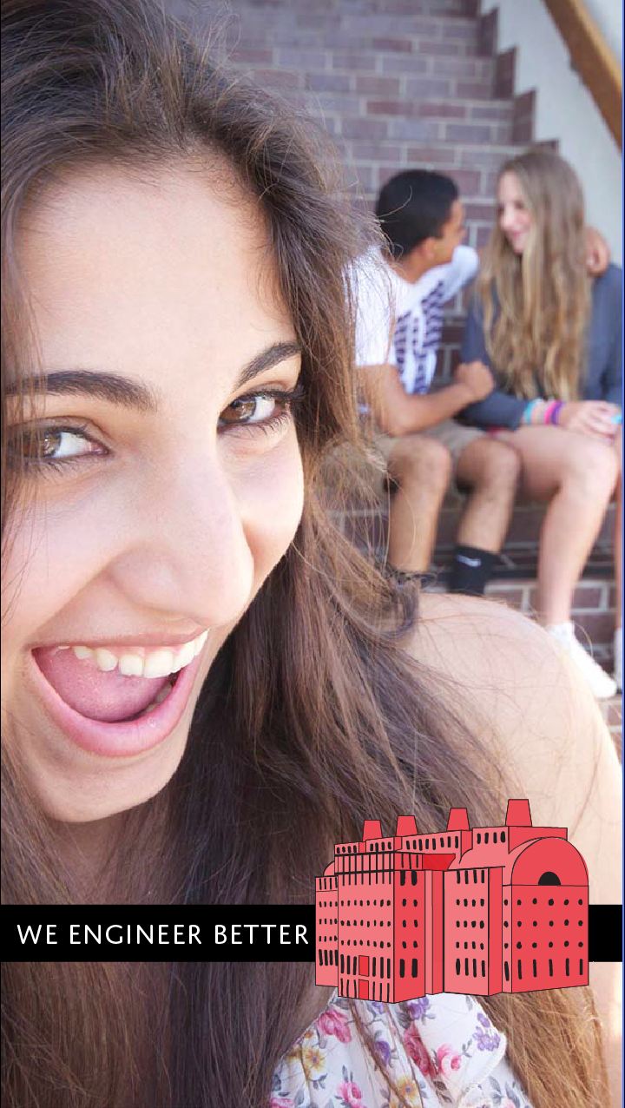
Senators report (2/2)
Officer:
John Lewnard
Varun Nagarajan

Slide 16
Committee Reports

Slide 17
Public Affairs
Committee Chair:
Meredith Meads
Be the first to hear about upcoming events:
Follow us on Twitter @UCTribunal
Like our Facebook page The UC Engineering and Applied Science Tribunal
To get involved contact meadsmc@mail.uc.edu
To rent a Baldwin table go to tribunal.uc.edu/socc/table-reservation
Notes:
Meredith can’t make this meeting. Speak on her behalf.

Slide 18
Special Events
Chair:
Tom Burns
Homecoming Tailgate:
October 24th on the Grid
Exact Location TBA
Ultimate Frisbee Team
Sign up on IMLeagues.com
Look for EAS Tribunal
Tribunal Video Game Night!
Thursday September 24th
Swift 808 7-9pm
Notes:
Tom can’t make this meeting. Speak on his behalf.

Slide 19
Innovation Committee
Committee Chair:
Emily Demjanenko
Responsible for initiating projects and ideas to better the college and support CEAS students
Currently looking for students to join the committee!
demjanes@mail.uc.edu

Slide 20
Recognition
Chair:
Jared Wood
Looking for members to vote on awards and scholarships.
Email me at wood2jt@mail.uc.edu if interested

Slide 21
EWeek
Chairs:
Andy Bachus
Alison Hayfer
What is it? A nationally celebrated week to celebrate engineers and all that we do!
What do we do? Have a fun week of competition and games and end the week with a banquet
When is it? February 21-27th
Questions? Email uc.eweek@gmail.com
Follow us on Twitter @UC_Eweek
Next committee meeting : Tonight!

Slide 22
FELD
Chair:
Alexis Conway
Next meeting, Thursday, September 24th from 7pm-8pm in Old Chem 605.
We will be discussing Volunteering Opportunities
All are welcome
Free Food
Email conwayal@mail.uc.edu with questions or to be added to the mailing list.

Slide 23
SOCC
Chair:
Heath Palmer
Student Organization Communication Committee
Members of our Committee are:
Looking to increase collaboration between CEAS student groups
Looking to increase the impact each CEAS group has on the student body
Example: Student organization attendance
First SOCC meeting: September 29th 7pm
Scheduled: Presentation from UFB representative
Please email palmerha@mail.uc.edu if you are interested in holding a position within SOCC.

Slide 24
Career Fair
Chairs:
Tim Kemper
Dane Sowers
Nick Stelzer
Thank you volunteers! We’re in the process of setting up the volunteer dinner.
Notes:
These guys will probably not be able to make it. Speak on their behalf.

Slide 25
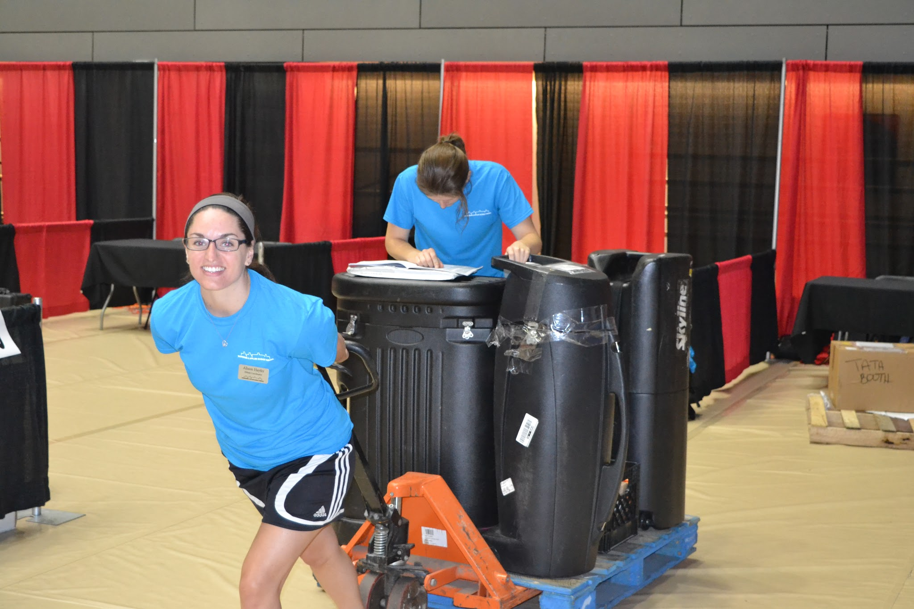
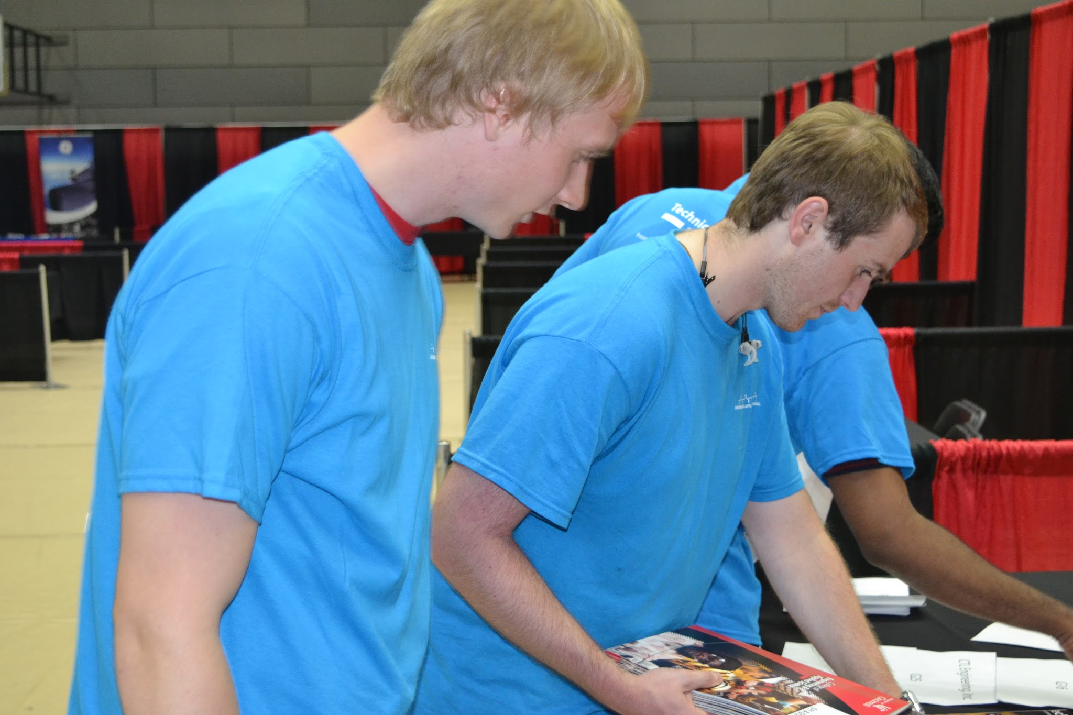
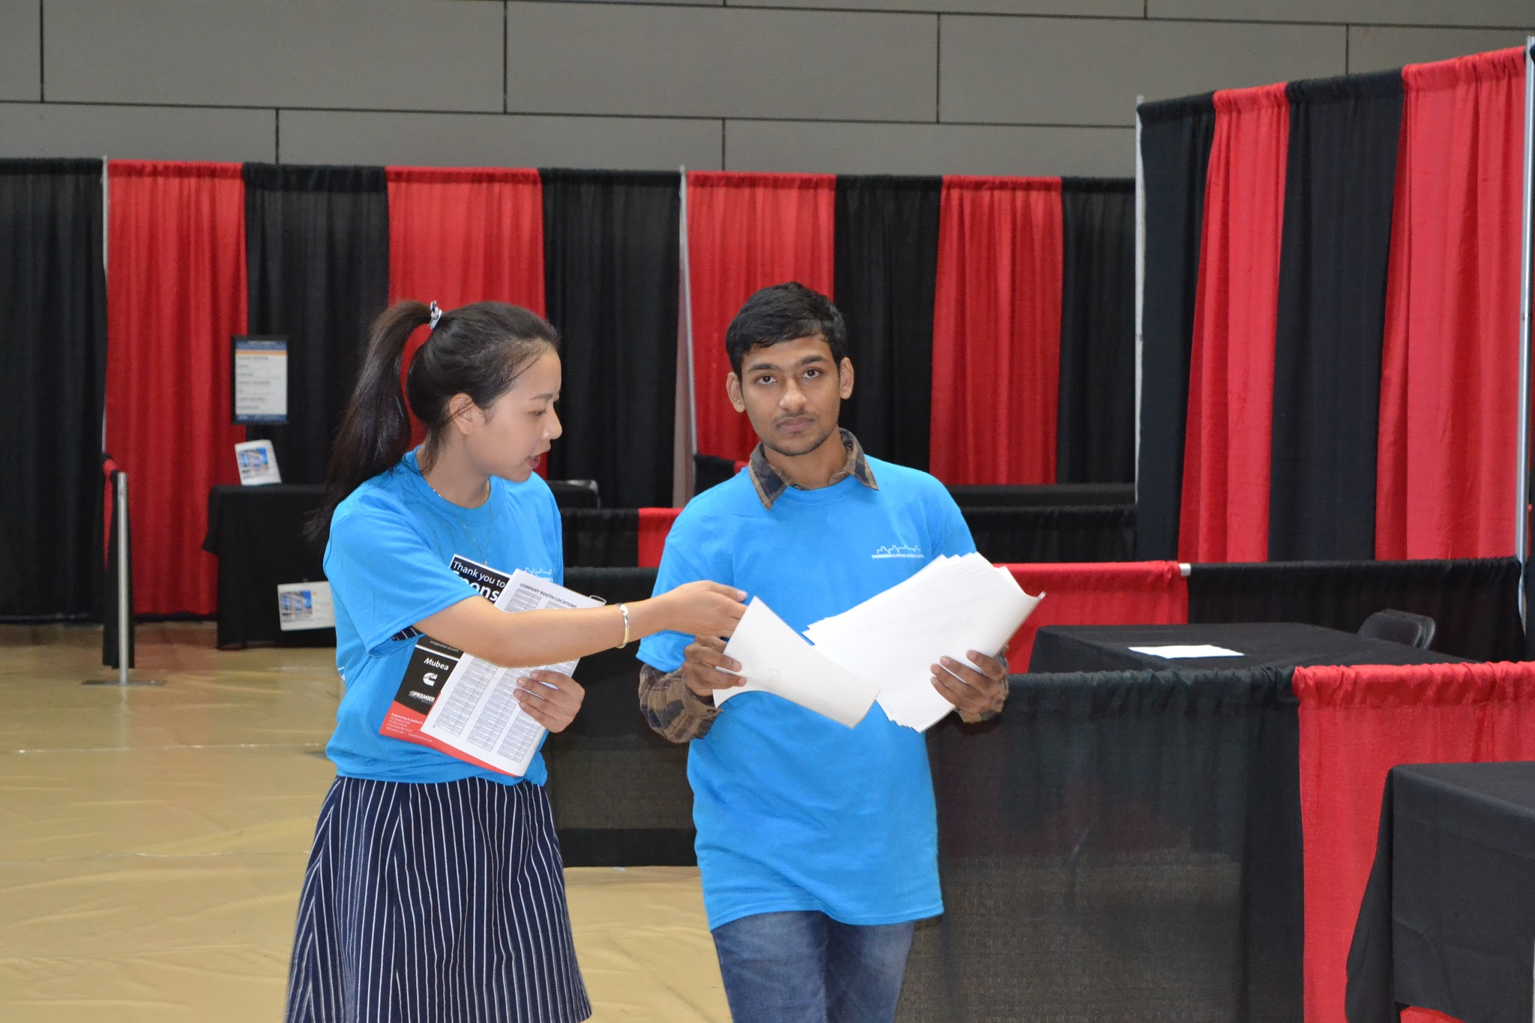
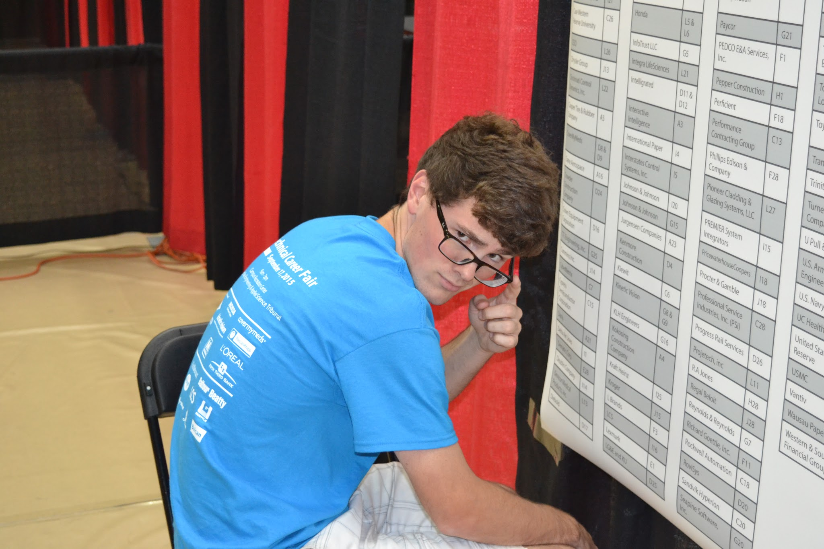
Career Fair Cont.
Chairs:
Tim Kemper
Dane Sowers
Nick Stelzer

Slide 26
Other Announcements

Slide 27
RAFFLE!

Slide 28
Constructive Criticism
What do you like/dislike about the college?
Comments / Questions?
questions.ceastribunal@gmail.com
What would you like to see Tribunal do next?

Slide 29
Next Meeting:
October 5, 2015
5:30PM
525 Old Chem

