Slide 1
Engineering and Applied Science Tribunal
General Meeting
October 5, 2015

Slide 2
Agenda:
Navy Presentation
Officer Reports
Committee Reports
Raffle

Slide 3
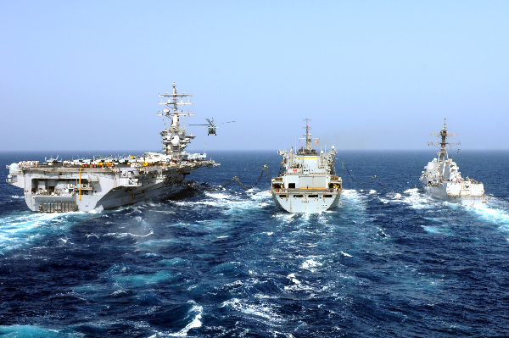
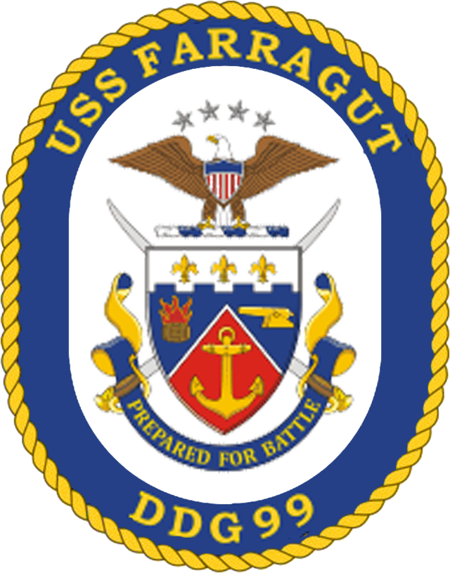
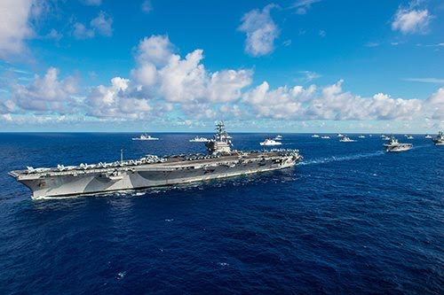
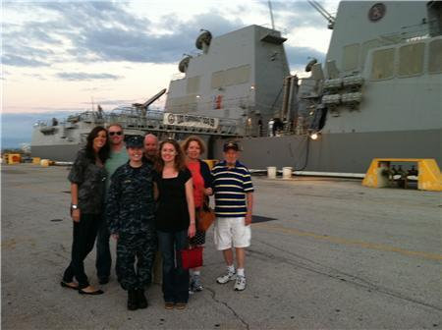
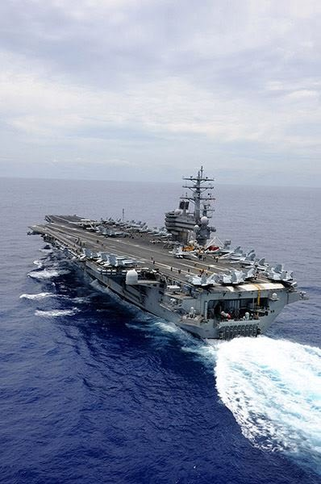
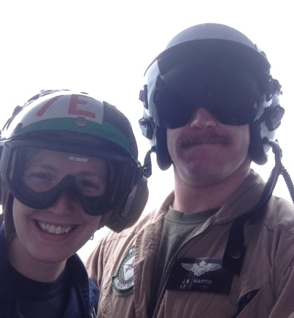
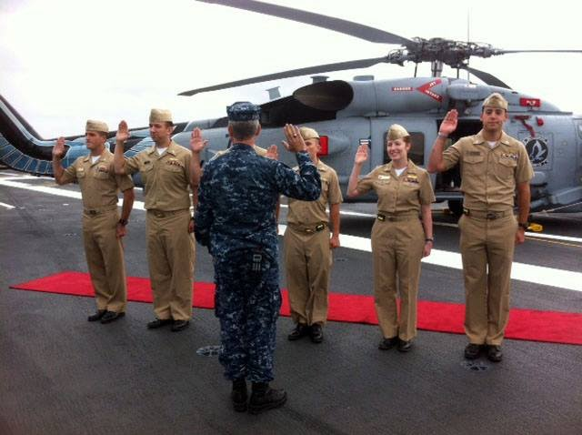
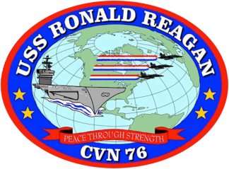
LT Allison Martin

Slide 5
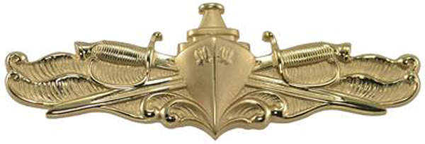
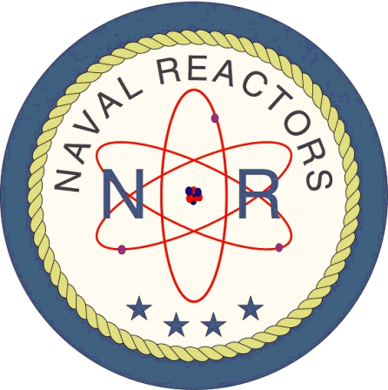
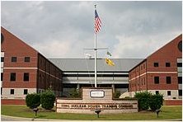
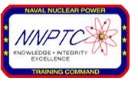
Nuclear Power Positions
Support
Nuclear Power School Instructor
Nuclear Prototype Instructor
Naval Reactors Engineer
Operational
Submarine Warfare Officer
Surface Warfare Officer
Notes:
A lot of opportunities for Engineering in the US Navy
Not all are deployable (USAJobs.gov)
Submarine Officer
Strategic Deterrence
Forward Operations
Surface Warfare Officer
Protection of Shipping
Drug Interdiction
Forward Presence
Humanitarian response
Instructor
No moving
No deploying
Just teach!
NR Engineer
Technical Oversight of Navy Nuclear Power
Live in Washington, DC!

Slide 6
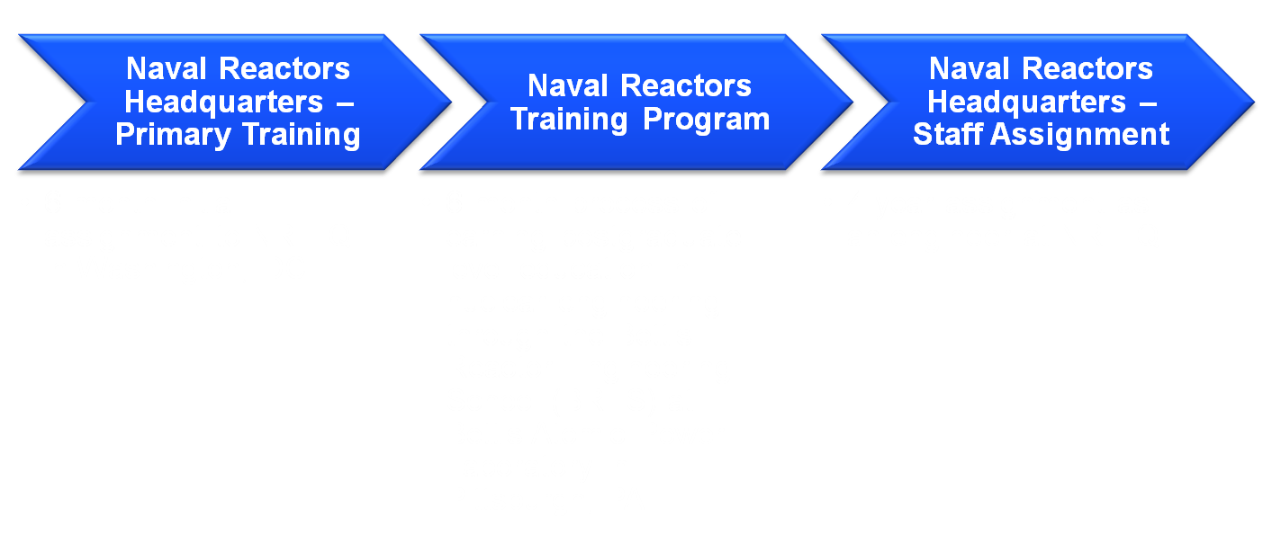
Naval Reactors Engineer
Part of a team of 380 engineers, 440 personnel total ; located in the Washington, D.C. area
Involved in providing technical oversight to shipboard nuclear power plants, shore-based prototype plants, and nuclear propulsion support facilities in the United States Navy
Manage/assess research projects through Naval Research Laboratory
5 years following Officer Development School
3.8 to 4.0 GPA preferred.
Notes:
Key Points
GPA is what will make you competitive
Job Description
From its location at the Navy Yard in Washington D.C., Naval Reactors (NR) has cradle-to-grave responsibility for all shipboard nuclear power plants, shore-based prototypes, and nuclear propulsion support facilities for America’s Navy. The wide array of technical areas involved in the Naval Nuclear Propulsion program include:
Reactor and fluid systems design Reactor physics Materials development
Component design (S/G, Pumps) Instrumentation and control of Testing and quality control
Shielding Chemistry and radiological controls
Working out of NR headquarters, there are approximately 250 engineers who technically manage the various areas of the Naval Nuclear Propulsion program. These are some of the brightest minds the Navy has to offer. Their intelligence, backgrounds and comprehensive training provide them with extensive knowledge of all aspects of nuclear propulsion, as well as the flexibility to move into other technical areas involved in nuclear propulsion work.
Specific Responsibilities
Even as junior level Nuclear Officers, Naval Reactors Engineers assume responsibility for key technical work in a variety of state-of-the-art facilities, including:
Two Department of Energy laboratories Two nuclear prototype/training sites
Nearly 100 nuclear-powered ships and submarines Six shipyards
More than 1,000 firms that support the Naval Reactors Program
As a Naval Reactors Engineer in the rapid-paced nuclear propulsion field, you will typically be in charge of several projects at once. Taking the lead in anything from designing nuclear reactors to developing refueling procedures to decommissioning of nuclear propulsion plants. Whatever the specific duties, it’s hands-on experience on a level beyond what you’ll typically find in the private sector.
Work Environment
Like the nuclear propulsion field itself, the working environment at Naval Reactors is both challenging and rewarding. Preliminary training and eventual staff assignments center around the NR headquarters in D.C. – where you’ll assume key responsibilities and have the chance to collaborate with the ultimate think tank of nuclear engineers. The process leading up to that will take you from earning a post-graduate level education in academic settings to training on prototype units.
Beyond that, you may travel to any of the facilities involved in the program – including site visits to the nuclear-powered vessels – to observe and inspect operations firsthand. The opportunity to work among industry leaders, in a primarily civilian-like environment, without having to wear a uniform every day can be appealing to the professionals in this community. Far more satisfying is the relevance of the work that goes on here, in and out of uniform, and the kind of unrivaled experience it offers.
Whatever your duties, wherever they take you, it’s important to note that much of the work is highly classified and demands the utmost discretion.
Training and Advancement
Upon graduation from college, the formal training process of becoming an Officer in the Naval Nuclear Propulsion program is officially underway. For those pursuing a Naval Reactors Engineer position, the first step is Officer Development School (ODS) – a five-week course in Newport, Rhode Island, that provides a comprehensive and intense introduction to the responsibilities of being a Navy Staff Corps Officer.
Upon completion of ODS, newly commissioned Officers move on to receive the advanced training that is at the core of Navy Nuclear Propulsion. Naval Reactors Engineers can expect to spend the next five years overseeing all the shipboard nuclear power plants, shore-based prototypes and nuclear propulsion support facilities in the Navy. The advanced training process they undergo prepares them to join some of the best and brightest technical experts in the country.
6. Naval Reactors Headquarters (NR) - Preliminary Training
Officers have an initial assignment of approximately four to five months receiving preliminary training at the Naval Reactors Headquarters in Washington, D.C.
This is followed by approximately two weeks spent gaining a working background at one of the Navy’s land-based prototypes in either Charleston, South Carolina, or Albany, New York.
7. Naval Reactors Training Program (NRTP)
The next step involves the six-month process of earning a postgraduate-level education in nuclear engineering through the Bettis Reactor Engineering School at the Bettis Atomic Power Laboratory in Pittsburgh, Pennsylvania.
8. Naval Reactors Headquarters (NR) – Staff Assignment
Following Naval Reactors Training, Naval Reactors Engineers are then assigned a Nuclear Engineer position with the group responsible for managing all technical aspects of the Naval Nuclear Propulsion program planning, approving and confirming the design, operation and maintenance of nearly 100 nuclear reactors.
Engineers start in a junior role under a supervisor and rapidly advance to take on increasingly more responsibilities.

Slide 7
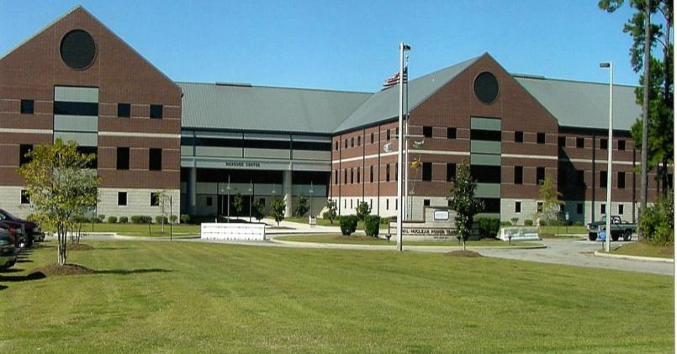
Nuclear Power School Instructor
Instruct all students in the Nuclear Power Pipeline in Calculus or Physics with the option to teach additional classes following the first year.
4 years on shore in Charleston, SC
100% selection for other Navy career fields following four year commitment.
3.4 to 4.0 GPA preferred.
Notes:
Key Points
100% Selection is based on historical data
EDO (Engineering Duty Officer)
HR (Human Resources)
Intel
Teach 1 to 2 classes per day (Physics, Math, Chemistry, Heat Transfer, Electrical Engineering, and Reactor Dynamics)
Secret Clearance
Graduate school opportunities funded by the NAVY
Job Description
Atomic physics. Thermodynamics. Integral calculus. Some students live for this kind of challenging subject matter. And among them are those rare few who find that teaching the material can be even more fulfilling than studying it. In a sense, their ability to apply what they learn is magnified through the many individuals they go on to inspire.
Today’s Naval Nuclear Power School Instructors train the future Navy nuclear community through a technologically advanced curriculum that is taught with a sole purpose in mind: to prepare Navy Sailors and Officers for their work in the fast-paced, competitive nuclear power field.
Specific Responsibilities
Specifically, Naval Nuclear Power School is a 24-week course in science and technology, designed to provide theoretical background knowledge of nuclear power. Naval Nuclear Power Instructors provide detailed knowledge of how to work the key aspects of a pressurized-water Navy nuclear power plant, which include:
Reactor core nuclear principles Heat transfer and fluid systems
Plant chemistry and materials Mechanical and electrical systems
Radiological control
For years, the Naval Nuclear Power School has been widely regarded as one of the most difficult academic programs in the country. In an instructor role, you will be at the heart of a world-class program and a legacy of excellence. Earning credentials and satisfaction that are impressive even by the standards of the most dedicated educators.
Work Environment
Like the nuclear propulsion field itself, the working environment at Naval Nuclear Power School (NNPS) in Charleston, South Carolina, is both challenging and rewarding. Much of your work will take place in an academic setting. You will study the same curriculum that you eventually teach, and facilitate the same collaborative learning environment that you first experienced in your own training.
Typically, there is one instructor per subject on duty each academic night, allowing students requiring additional assistance on their homework or studies to call upon you for mentoring. It is also important to note that much of the curriculum is highly classified and demands the utmost discretion.
Training and Advancement
Upon graduation from college, the formal training process of becoming an Officer in the Naval Nuclear Propulsion program is officially underway. For those pursuing a Naval Reactors Engineer position, the first step is Officer Development School (ODS) – a five-week course in Newport, Rhode Island, that provides a comprehensive and intense introduction to the responsibilities of being a Navy Staff Corps Officer.
Upon completion of ODS, newly commissioned Officers move on to receive the advanced training that is at the core of Navy Nuclear Propulsion. Naval Nuclear Power School Instructors can expect to spend the next four years teaching future nuclear-trained Officers and Enlisted personnel the theory and fundamentals behind the design and operation of Navy nuclear propulsion plants, after undergoing the same advanced curriculum and training that they will expertly instructs
Naval Nuclear Power School (NNPS)
Through Naval Nuclear Power Training Command (NNPTC), Officers attend Nuke Power School in Charleston, South Carolina. This four-month comprehensive course of intensive study in science and technology provides the foundation of knowledge necessary for a theoretical understanding of nuclear propulsion.
While at NNPS, Officers assume an intense workload. The subjects covered at NNPS include:
Mathematics (39 hours) – Ordinary and partial differential equations, integral calculus, and probability and distribution functions.
Physics (71 hours) – Atomic and nuclear physics, special relativity, reactor physics and neutron diffusion theory.
Chemistry (50 hours) – Basic chemistry, reaction kinetics, boiler chemistry, radiation induced reactions, gases and oxidation-reduction.
Thermodynamics (87 hours) – Heat transfer, fluid dynamics, steam thermodynamics, properties of water, Rankine cycle, and conduction and convection.
Electrical Engineering (basic and advanced – 138 hours) – Circuit analysis, inductance and capacitance, solid state amplifiers, AC and DC motors and generators, digital and analog integrated circuits, reactor plant instrumentation, safety circuits, and reactor control equipment design.
Materials (28 hours) – Strength of materials and complete development of the Nil Ductility Phenomenon. Fuel and clad alloy composition, pressure vessel design, development of neutron embrittlement and other material radiation effects, as well as corrosion and structure of materials.
Reactor Dynamics and Core Characteristics (86 hours) – Complete core design satisfying all requirements for power, temperature, control and radiation levels. Essentially, a course in nuclear engineering.
Reactor Plant Systems (13 hours) – Design of steam system and reactor plant parameters.
Shielding and Radiological Fundamentals (46 hours) – Study of materials, attenuation factors and geometry in shielding calculations.
Aspects of Reactor Plant Operations (115 hours) – Study of reactor plant operations integrating knowledge from all of the above courses.
Upon completion of NNPS, the student becomes the teacher. Power School Instructors then take the lead in administering the technologically advanced curriculum, working closely with both the Officer and Enlisted personnel who come through their classrooms.

Slide 8
Nuclear Prototype Instructor
Similar pipeline to majority of Nuclear Officers
Stay as a permanent instructor at Prototype in Charleston, S.C.
Notes:
Key Points
100% Selection is based on historical data
EDO (Engineering Duty Officer)
HR (Human Resources)
Intel
Teach 1 to 2 classes per day (Physics, Math, Chemistry, Heat Transfer, Electrical Engineering, and Reactor Dynamics)
Secret Clearance
Graduate school opportunities funded by the NAVY
Job Description
Atomic physics. Thermodynamics. Integral calculus. Some students live for this kind of challenging subject matter. And among them are those rare few who find that teaching the material can be even more fulfilling than studying it. In a sense, their ability to apply what they learn is magnified through the many individuals they go on to inspire.
Today’s Naval Nuclear Power School Instructors train the future Navy nuclear community through a technologically advanced curriculum that is taught with a sole purpose in mind: to prepare Navy Sailors and Officers for their work in the fast-paced, competitive nuclear power field.
Specific Responsibilities
Specifically, Naval Nuclear Power School is a 24-week course in science and technology, designed to provide theoretical background knowledge of nuclear power. Naval Nuclear Power Instructors provide detailed knowledge of how to work the key aspects of a pressurized-water Navy nuclear power plant, which include:
Reactor core nuclear principles Heat transfer and fluid systems
Plant chemistry and materials Mechanical and electrical systems
Radiological control
For years, the Naval Nuclear Power School has been widely regarded as one of the most difficult academic programs in the country. In an instructor role, you will be at the heart of a world-class program and a legacy of excellence. Earning credentials and satisfaction that are impressive even by the standards of the most dedicated educators.
Work Environment
Like the nuclear propulsion field itself, the working environment at Naval Nuclear Power School (NNPS) in Charleston, South Carolina, is both challenging and rewarding. Much of your work will take place in an academic setting. You will study the same curriculum that you eventually teach, and facilitate the same collaborative learning environment that you first experienced in your own training.
Typically, there is one instructor per subject on duty each academic night, allowing students requiring additional assistance on their homework or studies to call upon you for mentoring. It is also important to note that much of the curriculum is highly classified and demands the utmost discretion.
Training and Advancement
Upon graduation from college, the formal training process of becoming an Officer in the Naval Nuclear Propulsion program is officially underway. For those pursuing a Naval Reactors Engineer position, the first step is Officer Development School (ODS) – a five-week course in Newport, Rhode Island, that provides a comprehensive and intense introduction to the responsibilities of being a Navy Staff Corps Officer.
Upon completion of ODS, newly commissioned Officers move on to receive the advanced training that is at the core of Navy Nuclear Propulsion. Naval Nuclear Power School Instructors can expect to spend the next four years teaching future nuclear-trained Officers and Enlisted personnel the theory and fundamentals behind the design and operation of Navy nuclear propulsion plants, after undergoing the same advanced curriculum and training that they will expertly instructs
Naval Nuclear Power School (NNPS)
Through Naval Nuclear Power Training Command (NNPTC), Officers attend Nuke Power School in Charleston, South Carolina. This four-month comprehensive course of intensive study in science and technology provides the foundation of knowledge necessary for a theoretical understanding of nuclear propulsion.
While at NNPS, Officers assume an intense workload. The subjects covered at NNPS include:
Mathematics (39 hours) – Ordinary and partial differential equations, integral calculus, and probability and distribution functions.
Physics (71 hours) – Atomic and nuclear physics, special relativity, reactor physics and neutron diffusion theory.
Chemistry (50 hours) – Basic chemistry, reaction kinetics, boiler chemistry, radiation induced reactions, gases and oxidation-reduction.
Thermodynamics (87 hours) – Heat transfer, fluid dynamics, steam thermodynamics, properties of water, Rankine cycle, and conduction and convection.
Electrical Engineering (basic and advanced – 138 hours) – Circuit analysis, inductance and capacitance, solid state amplifiers, AC and DC motors and generators, digital and analog integrated circuits, reactor plant instrumentation, safety circuits, and reactor control equipment design.
Materials (28 hours) – Strength of materials and complete development of the Nil Ductility Phenomenon. Fuel and clad alloy composition, pressure vessel design, development of neutron embrittlement and other material radiation effects, as well as corrosion and structure of materials.
Reactor Dynamics and Core Characteristics (86 hours) – Complete core design satisfying all requirements for power, temperature, control and radiation levels. Essentially, a course in nuclear engineering.
Reactor Plant Systems (13 hours) – Design of steam system and reactor plant parameters.
Shielding and Radiological Fundamentals (46 hours) – Study of materials, attenuation factors and geometry in shielding calculations.
Aspects of Reactor Plant Operations (115 hours) – Study of reactor plant operations integrating knowledge from all of the above courses.
Upon completion of NNPS, the student becomes the teacher. Power School Instructors then take the lead in administering the technologically advanced curriculum, working closely with both the Officer and Enlisted personnel who come through their classrooms.

Slide 9
Nuclear Prototype Instructor
Notes:
Key Points
100% Selection is based on historical data
EDO (Engineering Duty Officer)
HR (Human Resources)
Intel
Teach 1 to 2 classes per day (Physics, Math, Chemistry, Heat Transfer, Electrical Engineering, and Reactor Dynamics)
Secret Clearance
Graduate school opportunities funded by the NAVY
Job Description
Atomic physics. Thermodynamics. Integral calculus. Some students live for this kind of challenging subject matter. And among them are those rare few who find that teaching the material can be even more fulfilling than studying it. In a sense, their ability to apply what they learn is magnified through the many individuals they go on to inspire.
Today’s Naval Nuclear Power School Instructors train the future Navy nuclear community through a technologically advanced curriculum that is taught with a sole purpose in mind: to prepare Navy Sailors and Officers for their work in the fast-paced, competitive nuclear power field.
Specific Responsibilities
Specifically, Naval Nuclear Power School is a 24-week course in science and technology, designed to provide theoretical background knowledge of nuclear power. Naval Nuclear Power Instructors provide detailed knowledge of how to work the key aspects of a pressurized-water Navy nuclear power plant, which include:
Reactor core nuclear principles Heat transfer and fluid systems
Plant chemistry and materials Mechanical and electrical systems
Radiological control
For years, the Naval Nuclear Power School has been widely regarded as one of the most difficult academic programs in the country. In an instructor role, you will be at the heart of a world-class program and a legacy of excellence. Earning credentials and satisfaction that are impressive even by the standards of the most dedicated educators.
Work Environment
Like the nuclear propulsion field itself, the working environment at Naval Nuclear Power School (NNPS) in Charleston, South Carolina, is both challenging and rewarding. Much of your work will take place in an academic setting. You will study the same curriculum that you eventually teach, and facilitate the same collaborative learning environment that you first experienced in your own training.
Typically, there is one instructor per subject on duty each academic night, allowing students requiring additional assistance on their homework or studies to call upon you for mentoring. It is also important to note that much of the curriculum is highly classified and demands the utmost discretion.
Training and Advancement
Upon graduation from college, the formal training process of becoming an Officer in the Naval Nuclear Propulsion program is officially underway. For those pursuing a Naval Reactors Engineer position, the first step is Officer Development School (ODS) – a five-week course in Newport, Rhode Island, that provides a comprehensive and intense introduction to the responsibilities of being a Navy Staff Corps Officer.
Upon completion of ODS, newly commissioned Officers move on to receive the advanced training that is at the core of Navy Nuclear Propulsion. Naval Nuclear Power School Instructors can expect to spend the next four years teaching future nuclear-trained Officers and Enlisted personnel the theory and fundamentals behind the design and operation of Navy nuclear propulsion plants, after undergoing the same advanced curriculum and training that they will expertly instructs
Naval Nuclear Power School (NNPS)
Through Naval Nuclear Power Training Command (NNPTC), Officers attend Nuke Power School in Charleston, South Carolina. This four-month comprehensive course of intensive study in science and technology provides the foundation of knowledge necessary for a theoretical understanding of nuclear propulsion.
While at NNPS, Officers assume an intense workload. The subjects covered at NNPS include:
Mathematics (39 hours) – Ordinary and partial differential equations, integral calculus, and probability and distribution functions.
Physics (71 hours) – Atomic and nuclear physics, special relativity, reactor physics and neutron diffusion theory.
Chemistry (50 hours) – Basic chemistry, reaction kinetics, boiler chemistry, radiation induced reactions, gases and oxidation-reduction.
Thermodynamics (87 hours) – Heat transfer, fluid dynamics, steam thermodynamics, properties of water, Rankine cycle, and conduction and convection.
Electrical Engineering (basic and advanced – 138 hours) – Circuit analysis, inductance and capacitance, solid state amplifiers, AC and DC motors and generators, digital and analog integrated circuits, reactor plant instrumentation, safety circuits, and reactor control equipment design.
Materials (28 hours) – Strength of materials and complete development of the Nil Ductility Phenomenon. Fuel and clad alloy composition, pressure vessel design, development of neutron embrittlement and other material radiation effects, as well as corrosion and structure of materials.
Reactor Dynamics and Core Characteristics (86 hours) – Complete core design satisfying all requirements for power, temperature, control and radiation levels. Essentially, a course in nuclear engineering.
Reactor Plant Systems (13 hours) – Design of steam system and reactor plant parameters.
Shielding and Radiological Fundamentals (46 hours) – Study of materials, attenuation factors and geometry in shielding calculations.
Aspects of Reactor Plant Operations (115 hours) – Study of reactor plant operations integrating knowledge from all of the above courses.
Upon completion of NNPS, the student becomes the teacher. Power School Instructors then take the lead in administering the technologically advanced curriculum, working closely with both the Officer and Enlisted personnel who come through their classrooms.

Slide 10
Leadership and graduate education opportunities
Attending Nuclear Power School and Prototype makes you eligible for several Masters Degrees:
Old Dominion University, Catholic University and Duke University all offer a Masters of Engineering Management that will take credits from Nuclear Power School.
Instructors are eligible for Tuition Assistance
Leadership experience-Lead sailors and officers on a daily basis in an environment very similar to that of the fleet.
Notes:
Key Points
100% Selection is based on historical data
EDO (Engineering Duty Officer)
HR (Human Resources)
Intel
Teach 1 to 2 classes per day (Physics, Math, Chemistry, Heat Transfer, Electrical Engineering, and Reactor Dynamics)
Secret Clearance
Graduate school opportunities funded by the NAVY
Job Description
Atomic physics. Thermodynamics. Integral calculus. Some students live for this kind of challenging subject matter. And among them are those rare few who find that teaching the material can be even more fulfilling than studying it. In a sense, their ability to apply what they learn is magnified through the many individuals they go on to inspire.
Today’s Naval Nuclear Power School Instructors train the future Navy nuclear community through a technologically advanced curriculum that is taught with a sole purpose in mind: to prepare Navy Sailors and Officers for their work in the fast-paced, competitive nuclear power field.
Specific Responsibilities
Specifically, Naval Nuclear Power School is a 24-week course in science and technology, designed to provide theoretical background knowledge of nuclear power. Naval Nuclear Power Instructors provide detailed knowledge of how to work the key aspects of a pressurized-water Navy nuclear power plant, which include:
Reactor core nuclear principles Heat transfer and fluid systems
Plant chemistry and materials Mechanical and electrical systems
Radiological control
For years, the Naval Nuclear Power School has been widely regarded as one of the most difficult academic programs in the country. In an instructor role, you will be at the heart of a world-class program and a legacy of excellence. Earning credentials and satisfaction that are impressive even by the standards of the most dedicated educators.
Work Environment
Like the nuclear propulsion field itself, the working environment at Naval Nuclear Power School (NNPS) in Charleston, South Carolina, is both challenging and rewarding. Much of your work will take place in an academic setting. You will study the same curriculum that you eventually teach, and facilitate the same collaborative learning environment that you first experienced in your own training.
Typically, there is one instructor per subject on duty each academic night, allowing students requiring additional assistance on their homework or studies to call upon you for mentoring. It is also important to note that much of the curriculum is highly classified and demands the utmost discretion.
Training and Advancement
Upon graduation from college, the formal training process of becoming an Officer in the Naval Nuclear Propulsion program is officially underway. For those pursuing a Naval Reactors Engineer position, the first step is Officer Development School (ODS) – a five-week course in Newport, Rhode Island, that provides a comprehensive and intense introduction to the responsibilities of being a Navy Staff Corps Officer.
Upon completion of ODS, newly commissioned Officers move on to receive the advanced training that is at the core of Navy Nuclear Propulsion. Naval Nuclear Power School Instructors can expect to spend the next four years teaching future nuclear-trained Officers and Enlisted personnel the theory and fundamentals behind the design and operation of Navy nuclear propulsion plants, after undergoing the same advanced curriculum and training that they will expertly instructs
Naval Nuclear Power School (NNPS)
Through Naval Nuclear Power Training Command (NNPTC), Officers attend Nuke Power School in Charleston, South Carolina. This four-month comprehensive course of intensive study in science and technology provides the foundation of knowledge necessary for a theoretical understanding of nuclear propulsion.
While at NNPS, Officers assume an intense workload. The subjects covered at NNPS include:
Mathematics (39 hours) – Ordinary and partial differential equations, integral calculus, and probability and distribution functions.
Physics (71 hours) – Atomic and nuclear physics, special relativity, reactor physics and neutron diffusion theory.
Chemistry (50 hours) – Basic chemistry, reaction kinetics, boiler chemistry, radiation induced reactions, gases and oxidation-reduction.
Thermodynamics (87 hours) – Heat transfer, fluid dynamics, steam thermodynamics, properties of water, Rankine cycle, and conduction and convection.
Electrical Engineering (basic and advanced – 138 hours) – Circuit analysis, inductance and capacitance, solid state amplifiers, AC and DC motors and generators, digital and analog integrated circuits, reactor plant instrumentation, safety circuits, and reactor control equipment design.
Materials (28 hours) – Strength of materials and complete development of the Nil Ductility Phenomenon. Fuel and clad alloy composition, pressure vessel design, development of neutron embrittlement and other material radiation effects, as well as corrosion and structure of materials.
Reactor Dynamics and Core Characteristics (86 hours) – Complete core design satisfying all requirements for power, temperature, control and radiation levels. Essentially, a course in nuclear engineering.
Reactor Plant Systems (13 hours) – Design of steam system and reactor plant parameters.
Shielding and Radiological Fundamentals (46 hours) – Study of materials, attenuation factors and geometry in shielding calculations.
Aspects of Reactor Plant Operations (115 hours) – Study of reactor plant operations integrating knowledge from all of the above courses.
Upon completion of NNPS, the student becomes the teacher. Power School Instructors then take the lead in administering the technologically advanced curriculum, working closely with both the Officer and Enlisted personnel who come through their classrooms.

Slide 11
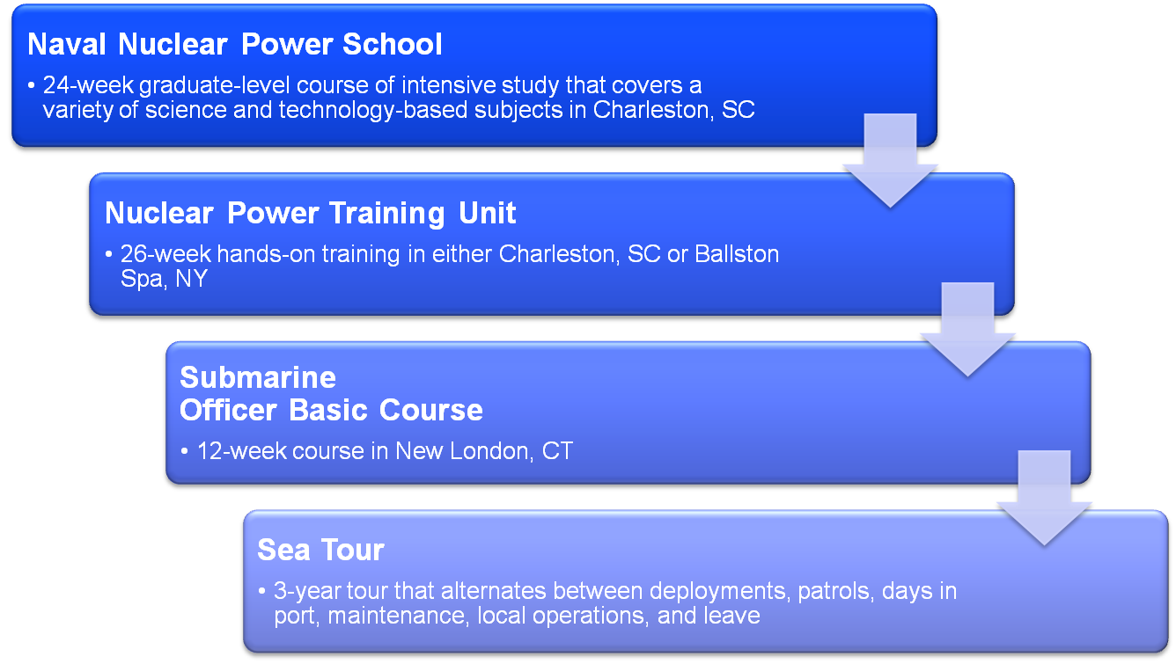
Submarine Officer

Slide 12
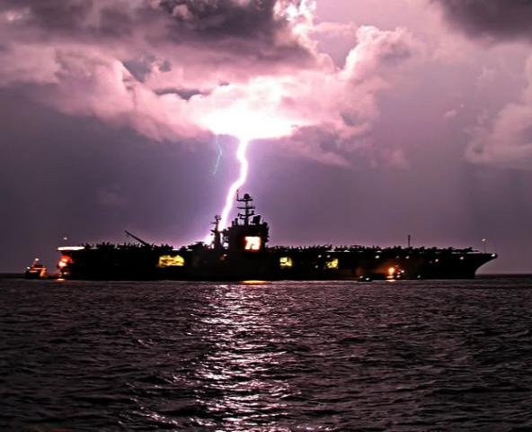
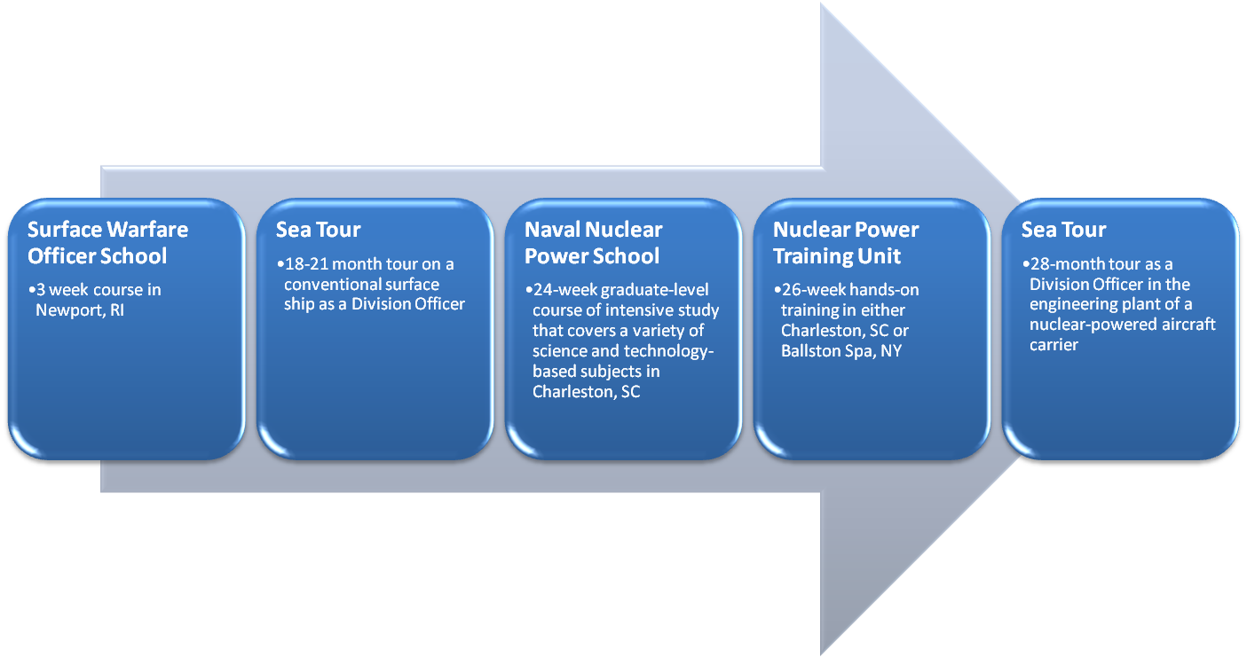
Surface Warfare Officer (Nuclear)
Officers on conventionally powered ships and propulsion officers on aircraft carriers.
5 year service commitment (4 year assigned to ships)
>3.0 GPA preferred.
8 week course BDOC
Notes:
BDOC – Basic Division Officer Course

Slide 13
NUPOC Program Highlights
Benefits while in college
Earn from $4,152 per month (without dependents)
Full medical/dental/insurance benefits
No military requirements with exception of physical standards while in school.
Time in college counts towards retirement
$15,000 Accession bonus upon acceptance into the program. Additional $2,000 bonus upon completion of nuclear power training.
Graduate school opportunities
Travel, Adventure, Service to country, and a World Class Education
Space “A” Travel on military flights around the world
Tax free shopping at Military Malls and Military Grocery Stores
Active Duty Obligation: 5 commissioning (depending on program).
Notes:
For more info, go online at www.navyjobs.com/college/html/sub_hotjobs.html
Base pay and BAH rates increase to E-7 rates ($4,249 monthly) for those NUPOC candidates who refer another student that also gets selected for the program.

Slide 14
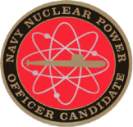
NUPOC Pay
Cincinnati, OH
Pay | Value | (With Dependents)
Base Pay (E6) | $2,404.61
Food/Subsistence Allowance (tax free) | $367.92
Housing Allowance (tax free) | $1380.00 | $1,842.00
Monthly Total | $4152.53 | $4,614.53
Medical Care | Priceless
30 Months | $115,215.90 | $138,435.90
Bonus | $15,000.00
Grand Total | $139,575.90 | $153,435.90
This is only what you’ll receive while finishing your degree!

Slide 15
NUPOC Program Eligibility
General Criteria:
Enrolled as a full time student at an accredited institution
US citizen
Strong technical majors (mathematics, physics, chemistry, or an engineering curriculum) are encouraged however not required
Minimum requirements are one year of Calculus and one year of calculus based Physics.
Within 30 months of graduation (Some restrictions apply)
Notes:
- Go on an NVIP!

Slide 16
How do I learn more?
Contact your local Navy officer recruiter:
LT Allison Martin
Email: allison.m.martin@navy.mil
Cell: 614-623-6472
Attend a Nuclear VIP (NVIP) trip!
Notes:
- Go on an NVIP!

Slide 17
Purpose
What we are: CEAS Branch of Student Government
What we do:
Host programs for the college
Input on curriculum, grievances, and student/faculty relations
Improve student experience in the college

Slide 18
President
CEAS TRIBUNAL EXECUTIVE STRUCTURE
Secretary
Treasurer
Vice President
Associate Vice President
Senators (X2)
Technology
Innovation
Career Fair (X2)
Public Affairs
FELD
EWeek (X2)
Order of the Engineer
SOCC
Luau
Recognition
Special Events
Collegiate Affairs
OFFICERS are in black. COMMITTEE CHAIRS are in red.

Slide 19
Tribunal Officers
President: |  | Carlo Perottino
Vice President: |  | Nathan Ball
Associate Vice President: |  | Nathan Hamit
Treasurer: |  | Max Inniger
Secretary: |  | Spencer King
Senators: |  | John Lewnard Varun Nagarajan

Slide 20
Tribunal Executives
Career Fair: |  | Dane Sowers Tim Kemper Nick Stelzer
Collegiate Affairs: |  | Khaled Aboumerhi
EWeek: |  | Alison Hayfer Andrew Bachus
FELD: |  | Alexis Conway
Innovation: |  | Emily Demjanenko
Luau: |  | Andrew John Droesch
Order of the Engineer: |  | Sean Gleason
Public Affairs: |  | Meredith Meads
Recognition: |  | Jared Wood
SOCC: |  | Heath Palmer
Special Events: |  | Thomas Burns
Technology: |  | Michael Santacroce

Slide 21
Officer Reports

Slide 22
President
Officer:
Carlo Perottino
Office Hours:
Thursdays 12:00PM-1:45PM
Baldwin 650
perottca@mail.uc.edu

Slide 23
Vice President
Officer:
Nathan Ball
Office Hours:
Thursdays 4:30-5:30 PM
Baldwin 650
Willing to help with any issues you have pertaining to CEAS
ballnn@mail.uc.edu
Notes:
Nathan has a class conflict at this time, but is on-campus and available!

Slide 24
Associate Vice President
Officer:
Nathan Hamit
Office Hours:
Monday 6:30-7:30
Baldwin 650
hamitnt@mail.uc.edu

Slide 25
Treasurer
Officer:
Max Inniger
Office Hours:
Monday 6:30-7:30
Baldwin 650
innigemd@mail.uc.edu

Slide 26
Secretary
Officer:
Spencer King
Office Hours:
Thursdays 6:30PM-7:30PM
Baldwin 650
Please sign in at the back of the room
Must attend and sign in at minimum of 4 meetings each semester to having voting rights
Go to the following link for meeting minutes and slides:
https://tribunal.uc.edu/meeting-minutes
king2sd@mail.uc.edu

Slide 27
Senators
Officer:
John Lewnard
Varun Nagarajan
Liaison between Student Government and CEAS Tribunal
Varun Nagarajan - nagaravn@mail.uc.edu
Office Hours:
Wednesdays 4:30PM-5:30PM
Baldwin 650
John Lewnard - lewnarjm@mail.uc.edu
Office Hours:
Mondays 7PM-8PM
Baldwin 650

Slide 28
Senator Report
Officers:
Varun Nagarajan
John Lewnard
Thursday, October 8th from 6:00 pm to 7:30 pm in TUC Great Hall: Harlan Cohen – A New York Time Best Selling Author of the Naked Roommate is coming
Wednesday, October 7th at 6:00 pm: Senate Meeting
Academic Affairs Committee is working on a grade forgiveness policy

Slide 29
Homecoming October 19th – 25th
Officers:
Varun Nagarajan
John Lewnard
Monday: Paint Uptown http://goo.gl/forms/57fUTjs8lz More details after sign up! Tuesday: T-Shirt Scavenger Hunt – Follow the clues and you will receive a Homecoming T-Shirt!
Wednesday: Cincinnatus Nearly Naked Mile – Dress up in a nearly naked outfit and race through campus
Thursday:
Car smash – Smash a car on Mainstreet with UCONN logo on it!
Sigma Phi Ball – All students welcome to come to Bogarts on Short Vine and celebrate homecoming with dancing and festivities
Friday: Pep Rally on Main Street
Saturday: Homecoming Football game against UCONN

Slide 30
Homecoming King and Queen!
Officers:
Varun Nagarajan
John Lewnard
Voting goes live this Wednesday!
Be sure to go on CampusLink and vote for who you think deserves this honor!
Top Five Homecoming King and Queens will be announced at Sigma Phi Fall Ball
Winners and Runner Ups will be announced at halftime during the UCONN game

Slide 31
Committee Reports

Slide 32
SPECIAL EVENTS
Chair:
Tom Burns

Slide 33
Homecoming 2015
Chair:
Tom Burns
Come celebrate the Bearcats 100th year at Nippert with Tribunal and the College of Engineering and Applied Science!
Where: The Grid Sections 106 & 107
When: 2-3 hours before kickoff
Why: Free food, Bearcats Football
Homecoming means alumnus!
YOU + ENGINEERING ALUM = NETWORKING
80% of jobs are landed through networking

Slide 34
Chair:
Tom Burns

Slide 35
Chair:
Tom Burns
Free climbing. Free food. Free transportation.
What else could you want?!
When: November 7 – November 8 (9 PM – 9 AM)
Where: RockQuest Climbing Center
Look for an email containing a sign-up link!

Slide 36
Chair:
Tom Burns
Earn Service Hours and help those in need!
Matthew 25 Ministries is an organization dedicated to relief efforts around the world.
Look for an email with Sign Up details in the coming weeks
Caring For A Needy World With The Things We Throw Away.
-Rev. Wendell Mettey

Slide 37
Involvement
Chair:
Tom Burns
WANT TO GET INVOLVED OR PLAN AN EVENT OF YOUR OWN?? JOIN MY COMMITTEE!
Contact Tom Burns
Special Events Chairman
Burnst3@mail.uc.edu

Slide 38
EWeek
Chairs:
Andy Bachus
Alison Hayfer
What is it? A nationally celebrated week to celebrate engineers and all that we do!
What do we do? Have a fun week of competition and games and end the week with a banquet
When is it? February 21-27th
Questions? Email uc.eweek@gmail.com
Follow us on Twitter @UC_Eweek
Next committee meeting : Tonight!

Slide 39
Collegiate Affairs
Officer:
Khaled Aboumerhi
Open Forum Meeting
Wednesday October 7th
7:00pm – 8:00pm
Baldwin 648
Voice any academic concerns
Free food will be provided

Slide 40
SOCC
Chair:
Heath Palmer
Student Organization Communication Committee
Members of our Committee are:
Looking to increase collaboration between CEAS student groups
Looking to increase the impact each CEAS group has on the student body
Example: Student organization attendance
First SOCC meeting was a success!
Already have ideas for the next meeting
Please email palmerha@mail.uc.edu if you are interested in holding a position within SOCC.

Slide 41
Innovation Committee
Committee Chair:
Emily Demjanenko
Responsible for initiating projects and ideas to better the college and support CEAS students
Currently looking for students to join the committee!
demjanes@mail.uc.edu

Slide 42
Other Announcements

Slide 43
RAFFLE!

Slide 44
Constructive Criticism
What do you like/dislike about the college?
Comments / Questions?
questions.ceastribunal@gmail.com
What would you like to see Tribunal do next?

Slide 45
Next Meeting:
October 19, 2015
5:30PM
525 Old Chem

