Slide 1
Engineering and Applied Science Tribunal
General Meeting
September 14, 2015

Slide 2
Agenda:
Clean Up Cincy Update
Officer Reports
Committee Reports

Slide 3
CLEAN UP CINCY
SATURDAY, OCTOBER 3RD
Notes:
Meredith is speaking for Katie.

Slide 4
WHAT IS IT?
CITY-WIDE BEAUTIFICATION PROJECT
WILL OCCUR ONCE EVERY SEMESTER
MISSION:
ENCOURAGE ALL TO KEEP OUR CITY SAFE & CLEAN​
ENGAGE EVERY NEIGHBORHOOD
UNIFY ALL THROUGH TEAMWORK AND SERVICE ​
SHOW WE CARE, THAT ALL NEIGHBORHOODS MATTER

Slide 5
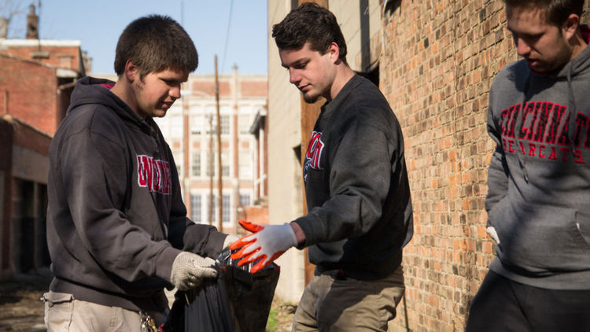
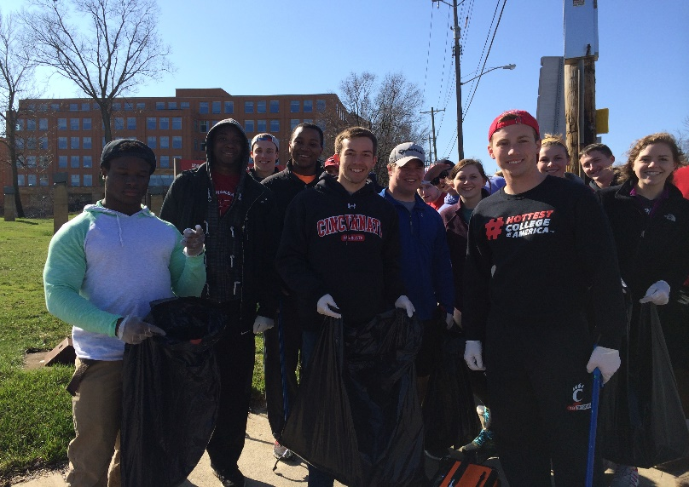
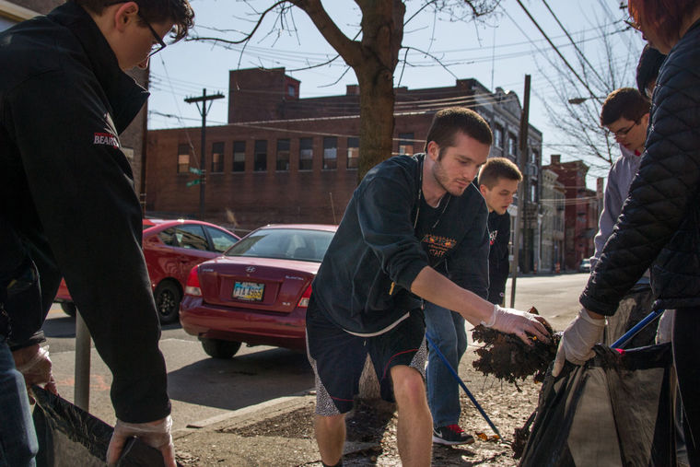
DIVERSITY
TEAMWORK
ENGAGEMENT

Slide 6
JOIN THE CREW
Volunteer
Crew Leader
Exec Board
REGISTER TODAY
HTTP://BIT.LY/CINCYCLEANUP2015
REGISTRATION CLOSES OCT 1ST​
Want to lead a clean-up crew? ​
Email cincycleanup@gmail.com
Join our leadership!
An opportunity to organize, network with city and business leaders, & grow our initiative
​

Slide 7
Purpose
What we are: CEAS Branch of Student Government
What we do:
Host programs for the college
Input on curriculum, grievances, and student/faculty relations
Improve student experience in the college

Slide 8
President
CEAS TRIBUNAL EXECUTIVE STRUCTURE
Secretary
Treasurer
Vice President
Associate Vice President
Senators (X2)
Technology
Innovation
Career Fair (X2)
Public Affairs
FELD
EWeek (X2)
Order of the Engineer
SOCC
Luau
Recognition
Special Events
Collegiate Affairs
OFFICERS are in black. COMMITTEE CHAIRS are in red.

Slide 9
Tribunal Officers
President: |  | Carlo Perottino
Vice President: |  | Nathan Ball
Associate Vice President: |  | Nathan Hamit
Treasurer: |  | Max Inniger
Secretary: |  | Spencer King
Senators: |  | John Lewnard Varun Nagarajan

Slide 10
Tribunal Executives
Career Fair: |  | Dane Sowers Tim Kemper Nick Stelzer
Collegiate Affairs: |  | Samantha Jarrett
EWeek: |  | Alison Hayfer Andrew Bachus
FELD: |  | Alexis Conway
Innovation: |  | Emily Demjanenko
Luau: |  | Andrew John Droesch
Order of the Engineer: |  | Sean Gleason
Public Affairs: |  | Meredith Meads
Recognition: |  | Jared Wood
SOCC: |  | Heath Palmer
Special Events: |  | Thomas Burns
Technology: |  | Michael Santacroce

Slide 11
Officer Reports

Slide 12
President
Officer:
Carlo Perottino
Office Hours:
Thursdays 12:00PM-1:45PM
Baldwin 650
perottca@mail.uc.edu

Slide 13
Vice President
Officer:
Nathan Ball
Office Hours:
Thursdays 4:30-5:30 PM
Baldwin 650
Willing to help with any issues you have pertaining to CEAS
ballnn@mail.uc.edu
Notes:
Nathan has a class conflict at this time, but is on-campus and available!

Slide 14
Associate Vice President
Officer:
Nathan Hamit
Office Hours:
Monday 6:30-7:30
Baldwin 650
hamitnt@mail.uc.edu

Slide 15
Treasurer
Officer:
Max Inniger
Office Hours:
Monday 6:30-7:30
Baldwin 650
innigemd@mail.uc.edu

Slide 16
Secretary
Officer:
Spencer King
Office Hours:
Thursdays 6:30PM-7:30PM
Baldwin 650
Please sign in at the back of the room
Must attend and sign in at minimum of 4 meetings each semester to having voting rights
Go to the following link for meeting minutes and slides:
https://tribunal.uc.edu/meeting-minutes
king2sd@mail.uc.edu

Slide 17
Senators
Officer:
John Lewnard
Varun Nagarajan
Liaison between Student Government and CEAS Tribunal
Varun Nagarajan - nagaravn@mail.uc.edu
Office Hours:
Wednesdays 4:30PM-5:30PM
Baldwin 650
John Lewnard - lewnarjm@mail.uc.edu
Office Hours:
Mondays 7PM-8PM
Baldwin 650

Slide 18
Senators report (1/3)
Officer:
John Lewnard
Varun Nagarajan
E-learning survey – www.uc.edu/elearn
$50 gift card
Sustainability summit – FREE
Applications due September 18th
Oct 2nd through Oct 4th
www.insidethesenateroom.com

Slide 19
Senators report (2/3)
Officer:
John Lewnard
Varun Nagarajan

Slide 20
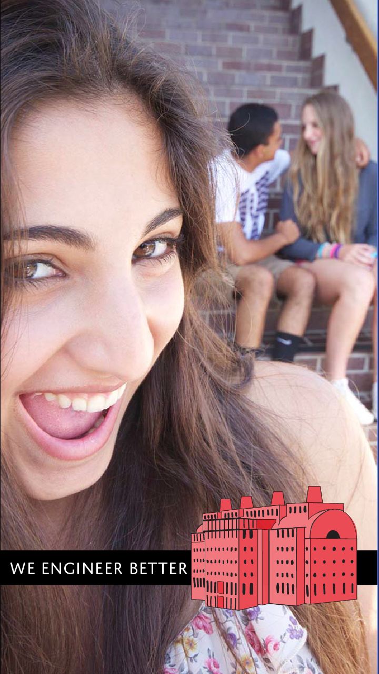
Senators report (3/3)
Officer:
John Lewnard
Varun Nagarajan

Slide 21
Committee Reports

Slide 22
Special Events
Chair:
Tom Burns
Homecoming Tailgate:
October 24th on the Grid
Exact Location TBA
Ultimate Frisbee Team
Sign up on IMLeagues.com
Look for EAS Tribunal
Tribunal Video Game Night!
Thursday September 24th
Swift 808 7-9pm

Slide 23
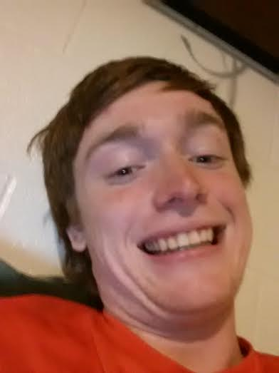
Special Events Cont.
Chair:
Thomas Burns
Tribunal has created an Intramural Ultimate team
Games are Wednesday nights
Email wood2jt@mail.uc.edu if interested
Or talk to Jared after the meeting

Slide 24
Recognition
Chair:
Jared Wood
Looking for members to vote on awards and scholarships.
Email me at wood2jt@mail.uc.edu if interested

Slide 25
Public Affairs
Committee Chair:
Meredith Meads
Be the first to hear about upcoming events:
Follow us on Twitter @UCTribunal
Like our Facebook page The UC Engineering and Applied Science Tribunal
To get involved contact meadsmc@mail.uc.edu
To rent a Baldwin table go to tribunal.uc.edu/socc/table-reservation

Slide 26
FELD
Chair:
Alexis Conway
Intern applications are due today! There is still time to fill one out.
Next meeting tomorrow, Thursday, September 24th from 7pm-8pm in Old Chem 605.
We will be discussing Volunteering Opportunites
All are welcome
Free Food
Email conwayal@mail.uc.edu with questions or to be added to the mailing list.

Slide 27
SOCC
Chair:
Heath Palmer
Student Organization Communication Committee
Members of our Committee are:
Looking to increase collaboration between CEAS student groups
Looking to increase the impact each CEAS group has on the student body
Example: Student organization attendance
First SOCC meeting: Tuesday, September 22nd 7pm
Scheduled: Presentation from UFB representative
Please email palmerha@mail.uc.edu if you are interested in holding a position within SOCC.

Slide 28
Innovation Committee
Committee Chair:
Emily Demjanenko
Responsible for initiating projects and ideas to better the college and support CEAS students
Short meeting directly after the general meeting ends
demjanes@mail.uc.edu

Slide 29
EWeek
Chairs:
Andy Bachus
Alison Hayfer
What is it? A nationally celebrated week to celebrate engineers and all that we do!
What do we do? Have a fun week of competition and games and end the week with a banquet
When is it? February 21-27th
Questions? Email uc.eweek@gmail.com
Follow us on Twitter @UC_Eweek
Next committee meeting : September 21st

Slide 31
Career Fair
Chairs:
Tim Kemper
Dane Sowers
Nick Stelzer
All fairs in the Rec Center, on the basketball courts
182 companies signed up for Technical Career Fair
Be prepared:
Visit the company listing
Research companies & apply online
Go to information sessions & prep events
Dress is business professional – no jeans or tennis shoes

Slide 32
Some companies…

Slide 33
We Need Volunteers!
Setup for career fair
Tuesday & Wednesday, September 15 & 16, late afternoon
Coat/bag check, helping companies, student sign-in
Thursday, September 17, 7am-4pm
Coordinating interviews, cleanup/tear-down
Friday, September 18, 8am-4pm
Why?
Meet and interact with company reps
Get to know Tribunal execs, gateway to getting more involved
Email Nathan Ball at ballnn@mail.uc.edu if you’re interested in helping out!

Slide 34
Constructive Criticism
What do you like/dislike about the college?
Comments / Questions?
questions.ceastribunal@gmail.com
What would you like to see Tribunal do next?

Slide 35
Next Meeting:
September 21, 2015
5:30PM
525 Old Chem

