Slide 1
Engineering and Applied Science Tribunal
General Meeting
November 16, 2015

Slide 2
Recognition
Chair:
Jared Wood
Marathon Scholarship
Winner is Alyssa Stoltz
Professor and TA of the Semester
Nominations due November 23rd
tribunal.uc.edu/recognition
Looking for committee members
Email me at wood2jt@mail.uc.edu if interested

Slide 3
Agenda:
Summer 2016 Nominations
Spring 2016 Senator Nominations
Spring 2016 Committee Chairs
Officer Reports
Committee Reports
Raffle

Slide 4
Summer 2016 Nominations
VP:
Dane Sowers
Spencer King
Max Inniger
AVP:
Nick Stelzer
Heath Palmer
Amanda Miller
Emily Demjanenko
Treasurer:
Jared Wood
Frazier Baker
Aswin Balasubramaniam
Secretary:
Nick Oslin
Austin Porter
Jason Forman
Himadri Pandey
Curtis King
Deepansh Pahwa

Slide 5
Spring 2016 Senator Nominations
Senator:
Tim Kemper
Chris Stone
Kibret Alem
Caleb Amstutz
Mark Gruenbacher
Emily Demjanenko
Himadri Pandey

Slide 6
Spring & Summer 2016 Nominations Cont.
Nominations will stay open till the elections on 11/30/2015.
Nominations can be emailed to perottca@mail.uc.edu
All nominations are conditional till eligibility is checked.

Slide 7
Spring 2016 Committee Chair Applications
Spring 2016 Committee Chair applications will soon be emailed out to the general body.
Applications are reviewed by the semester’s President, VP, and AVP.
Selections will be made before the Spring 2016 semester begins.

Slide 8
Officer Reports

Slide 9
Senators Report
Senate did not meet due to holiday – 2 more meeting in the semester
Tri-Governance Meeting – All three bodies (Graduate, Undergraduate, and Faculty Senate) all passed proposed bill.
Planning to discuss concealed and carry policy

Slide 10
The Siddall/Calhoun Mural Design Contest

Slide 12
Senators Report
Officer:
John Lewnard
Varun Nagarajan
Concealed Carry on Campus...
Tell us how you feel!

Slide 13
Committee Reports

Slide 14
Open Forum
Chair: Khaled Aboumerhi
The Collegiate Affairs Committee will be hosting a forum where students can voice their opinions & commentsabout their curriculum, professors and any other concerns relating to the college
When?
WEDNESDAY NOVEMBER 18 from 7pm-8pm
Free pizza? Yes
Questions? Contact Khaled Aboumerhi @ aboumekd@mail.uc.edu

Slide 15
Collegiate Affairs Committee
Chair: Khaled Aboumerhi
What is it?
A committee comprised of student representatives from every CEAS department to discuss opinions, comments & concerns.
Interested in representing your department at the Collegiate Affairs Committee Meetings?
We need students who can voice the general opinion of their peers and actively work with the committee on fixing these issues & concerns
Notes:
Tom can’t make this meeting. Speak on his behalf.

Slide 16
Collegiate Affairs Committee
Chair: Khaled Aboumerhi
We are looking for representatives from the following departments:
Aerospace Engineering & Engineering Mechanics
Civil & Architectural Engineering & Construction Management
Questions? Contact Khaled Aboumerhi @ aboumekd@mail.uc.edu

Slide 17
Innovation Committee
Responsible for initiating projects and ideas to better the college and support CEAS students
Projects
3D Printing
Class shadow
Course survey audit
Next meeting: Tuesday November 17 (tomorrow) at 6pm in the Tribunal office
demjanes@mail.uc.edu

Slide 18
Public Affairs
Committee Chair:
Meredith Meads
Be the first to hear about upcoming events:
Follow us on Twitter @UCTribunal
Like our Facebook page The UC Engineering and Applied Science Tribunal
To get involved contact meadsmc@mail.uc.edu
To rent a Baldwin table go to tribunal.uc.edu/socc/table-reservation

Slide 19
SOCC
Chair: Heath Palmer
Student Organization Communication Committee
Members of our Committee are:
Looking to increase collaboration between CEAS student groups
Looking to increase the impact each CEAS group has on the student body
Example: Student organization attendance
Third meeting coming up
College wide voting within the CEAS tribunal
We are looking for members to help brainstorm
PLEASE email palmerha@mail.uc.edu if you are interested in holding a position within SOCC.

Slide 20
EWeek
Chairs:
Alison Hayfer
Andy Bachus
What is it? A nationally celebrated week to celebrate engineers and all that we do!
What do we do? Have a fun week of competition and games and end the week with a banquet
When is it? February 21-27th
Questions? Email uc.eweek@gmail.com
Follow us on Twitter @UC_Eweek
Next committee meeting : November 19th

Slide 21
EWeek
Chairs:
Alison Hayfer
Andy Bachus
TICKET GIVEAWAY!
Star Wars Episode 7 @ Newport 9:30 PM Thursday December 16th
Tweet @UC_EWeek with #tixgiveaway saying what you are most excited about for Eweek 2016
Winner announced TOMORROW 5PM

Slide 22
EWeek
Chairs:
Alison Hayfer
Andy Bachus
T-Shirt Design Contest
Single color design for front, and outline for sponsors on back involving Star Wars
Must be PDF, EPS (InDesign), or AI (Illustrator)
Win a FREE ticket to the EWeek Banquet, and have your design on all promotional products
Submissions due January 21st @ noon to uc.eweek@gmail.com

Slide 23
SPECIAL EVENTS!

Slide 24
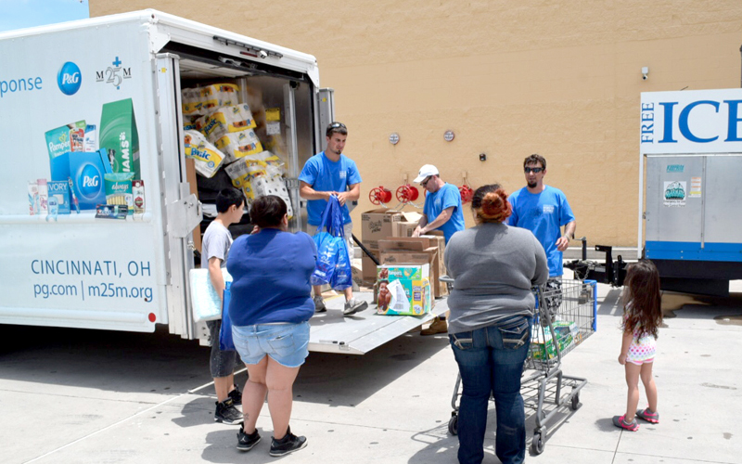
Earn Service Hours and help those in need!
Matthew 25 Ministries is an organization dedicated to relief efforts around the world.
Happening THIS THURSDAY! 4:30-7:30PM
Check Emails for signups if you havent already!
Caring For A Needy World With The Things We Throw Away.
-Rev. Wendell Mettey

Slide 25
Come with Tribunal to a Cyclones Game!
When? Tuesday December 1st, 2015 at 7:30 PM
30 Spots Available, First Come First Serve.
Look for signups in the following week!

Slide 26
Deck the Halls 2015: Santa is Coming to CEAS!
Create a team of six to decorate a section of Baldwin Hall to help usher in the holidays!
Decorating begins November 30th and ends December 3rd. Judging will be Friday December 4th.
A panel of judges from around the University will score decorations based on the following 3 categories: Bearcat Pride, Incorporation of the theme, and overall quality
The winning team will receive six $10 gift cards to Graeter’s as a prize!
Please email burnst3@mail.uc.edu to register your organizations team.

Slide 27
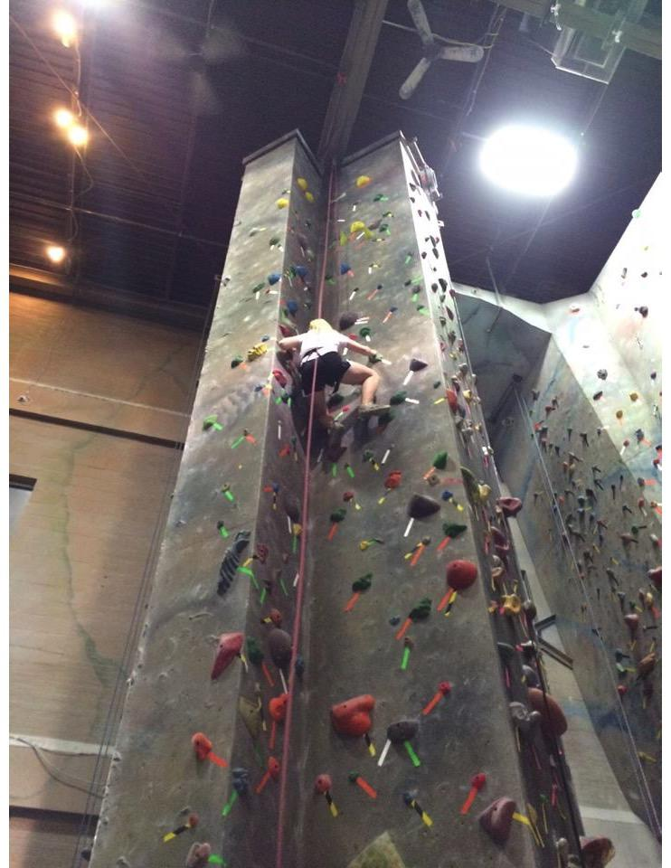
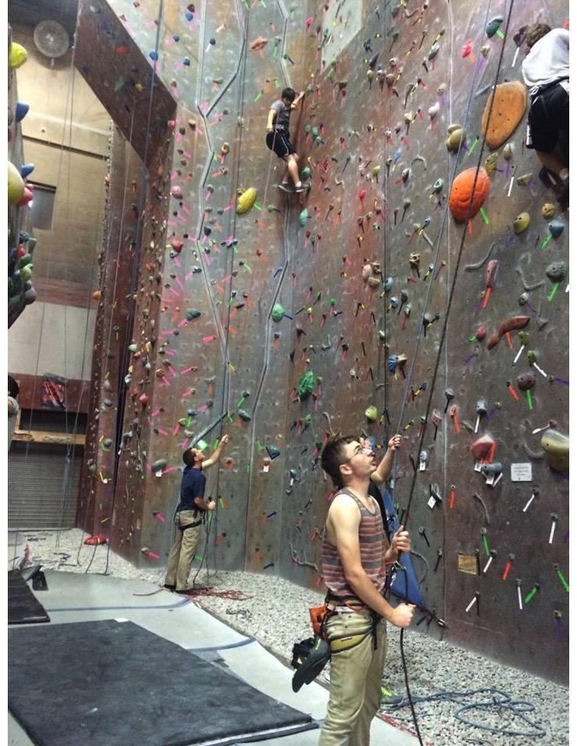
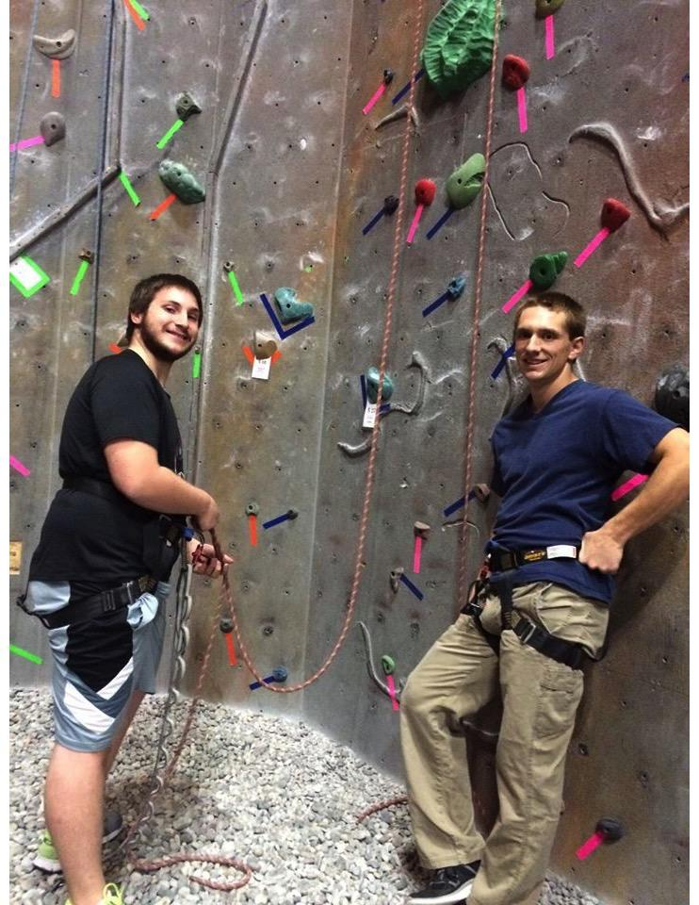
RockQuest
Thank you to everyone who came out and made this such a great event.

Slide 28
2016 Spring Career Fair
Committee Positions
Company Relations Director: Communication with companies before the career fair – answering questions via phone and/or email
Design Director: Responsible for the design of the booklet, banners, and volunteer t shirts. Experience with InDesign and/or Illustrator is preferred.
Resume Review Day Coordinator: Responsible for the operation of Spring Resume Review Day – contacting companies, ordering catering, managing the “day of” operations
Volunteer Coordinator: Manages the volunteer schedules for the week of the career fair (set up, day of, and clean up
Contact Tim Kemper (kemperta@mail.uc.edu) if interested

Slide 29
Other Announcements

Slide 30
Help Our Admissions Office Out!
How UC is a great supplier for co-op opportunities?
What working with your co-op advisor is like?
Why choosing UC got you ahead of the competition through your co-op?
Seeking submissions from 2nd and 3rd year students
Please send all content to Leslie.Wigger@UC.edu and provide your name, year, major.

Slide 31
RAFFLE!

Slide 32
Constructive Criticism
What do you like/dislike about the college?
Comments / Questions?
questions.ceastribunal@gmail.com
What would you like to see Tribunal do next?

Slide 33
Next Meeting:
November 30, 2015
5:30PM
525 Old Chem

