Slide 1
Engineering and Applied Science Tribunal
General Meeting
January 26th , 2015

Slide 2
SG Petitions

Slide 7
December 2014 Implementation Trip
Nyambogo, Tanzania

Slide 8
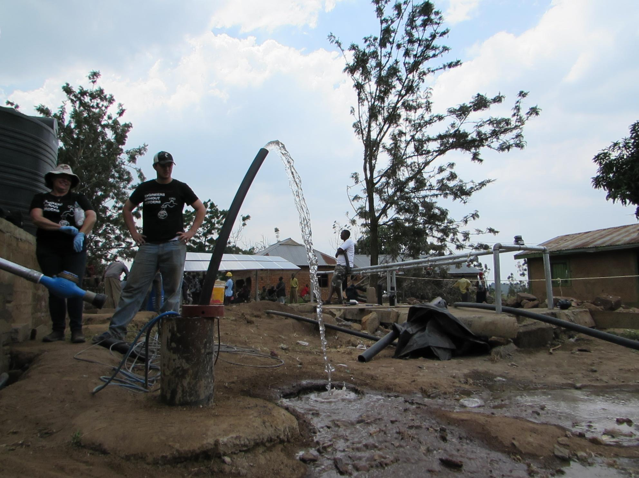
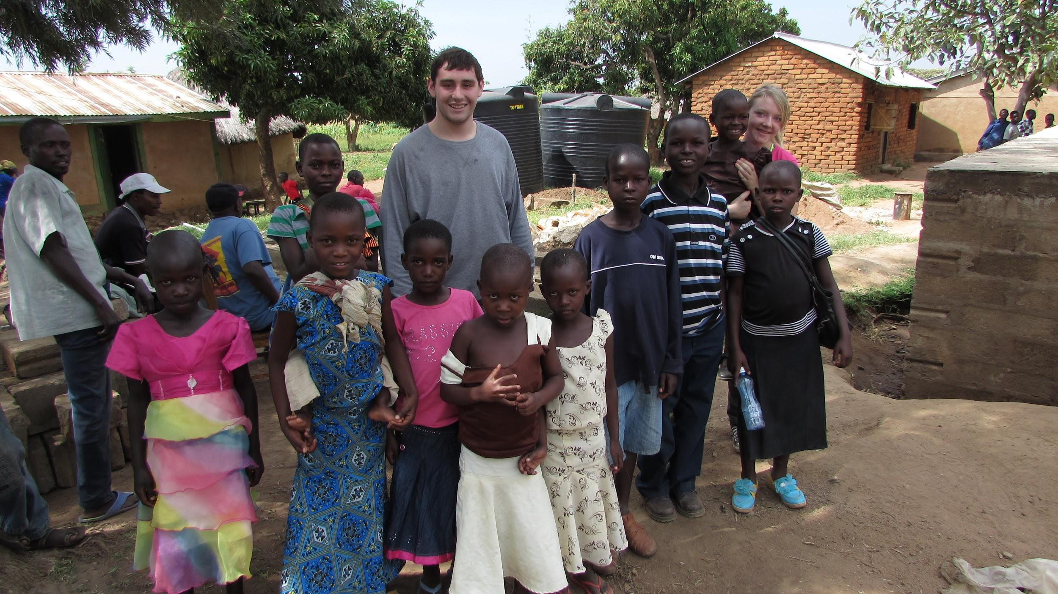
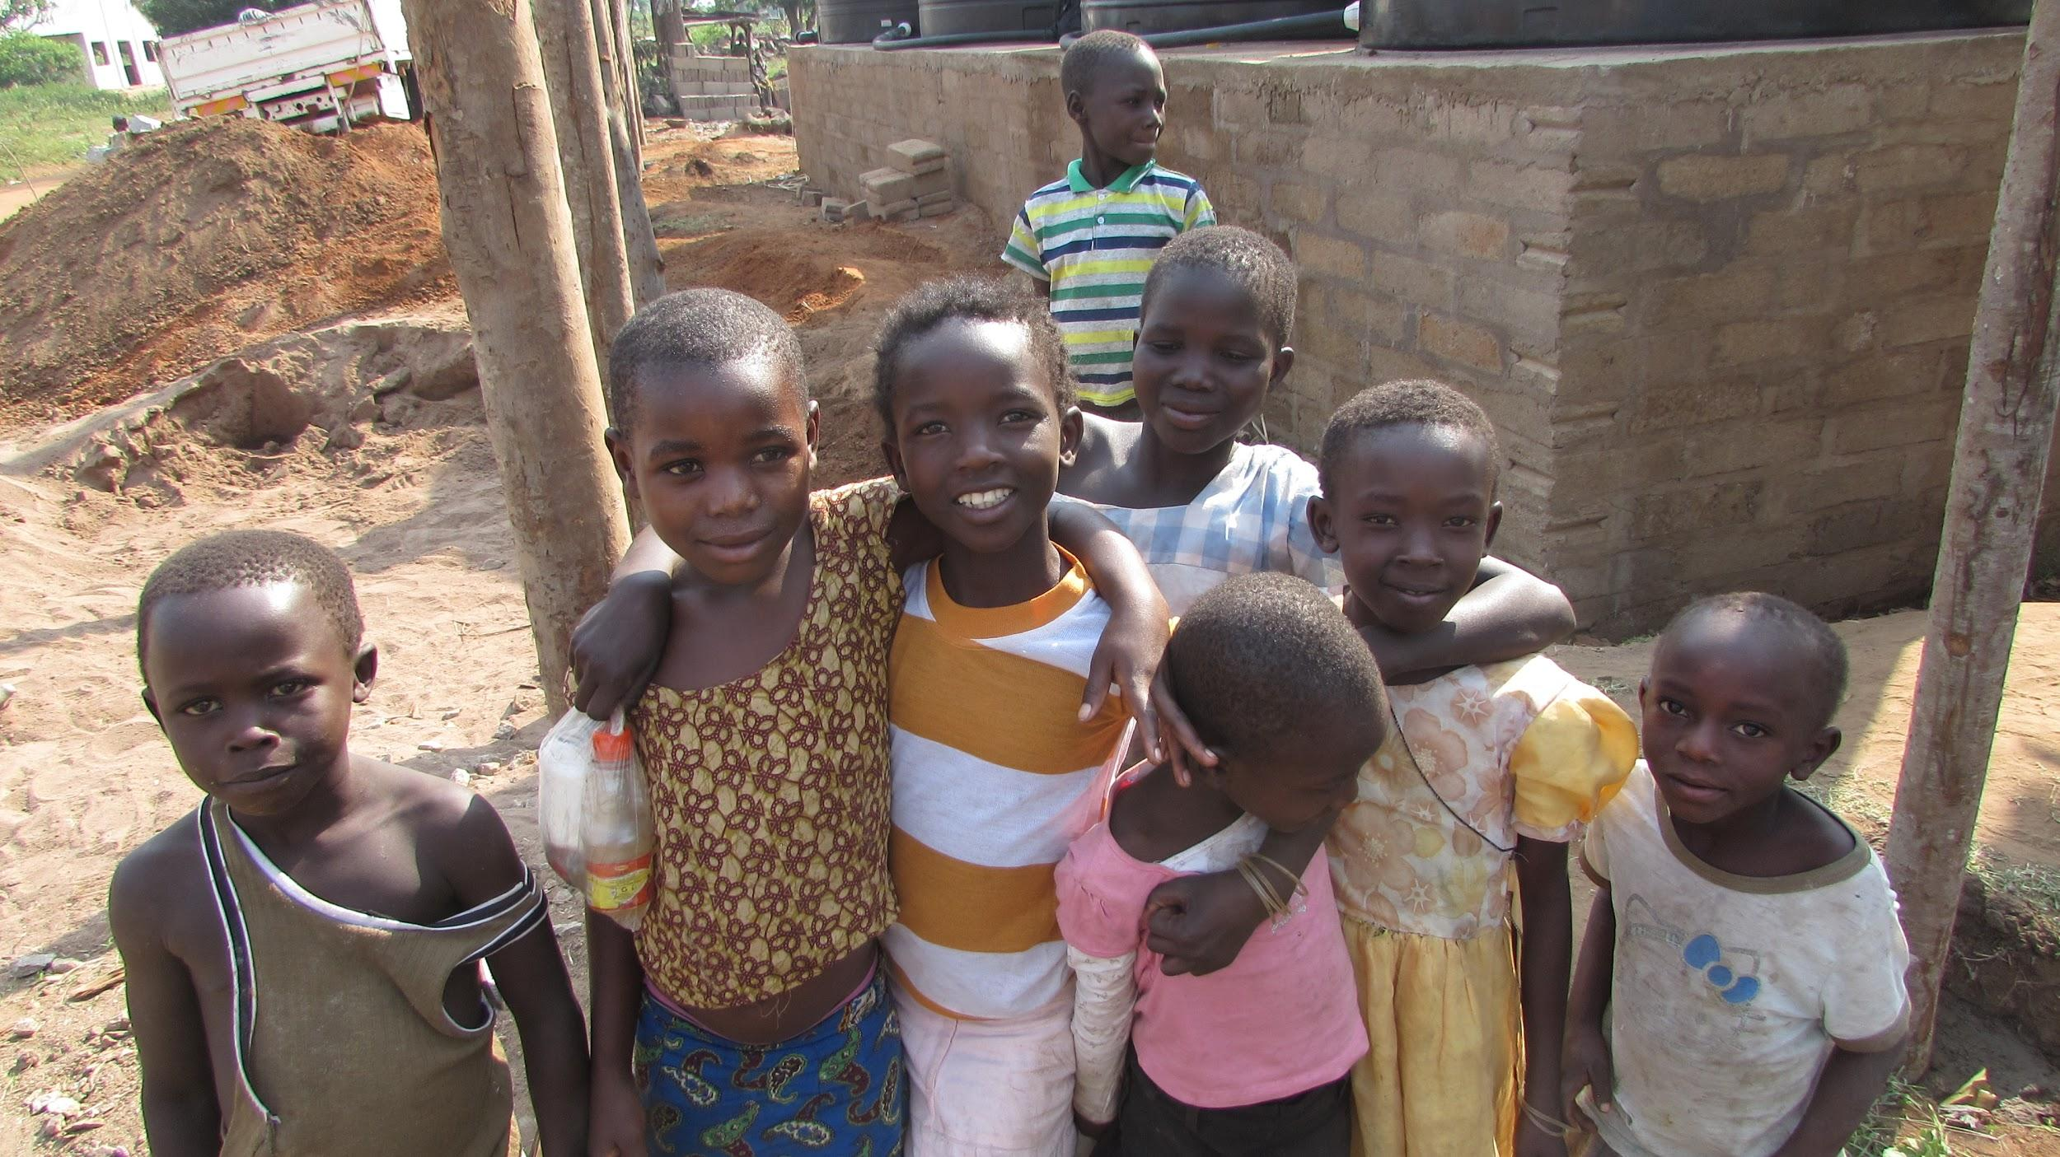
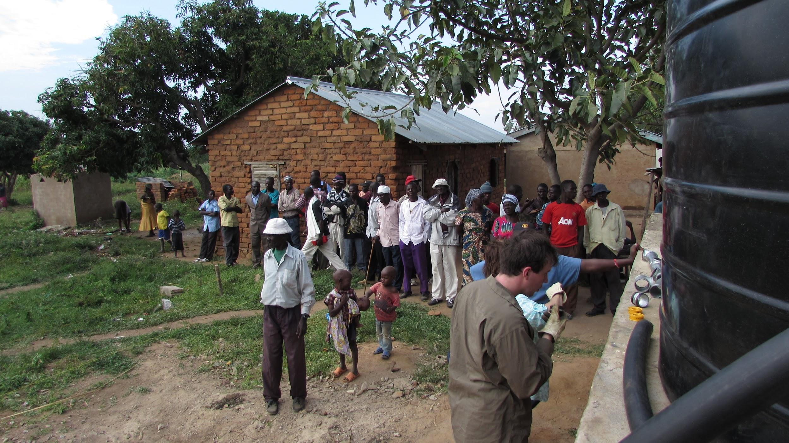
December 2014 Implementation Trip
Village of 7,000 without access to potable water
Installed four 10,000 L tanks, solar panels, pump, and tap stands
7 days on the ground
Nyambogo, Tanzania

Slide 9
Group Activity

Slide 10
Balloon Tower
Objective: To make the tallest balloon tower using the provided materials.
Rules:
​Each team will have 15 minutes to work on their tower. A 10, 5, and 1 minute time warning will be announced.
The base can be taped to the floor and balloons can be taped together.
No part of the tower should touch a wall or lean on any surrounding objects (should be completely free standing).

Slide 12
Purpose
What we are: CEAS Branch of Student Government
What we do:
Host programs for the college
Input on curriculum, grievances, and student/faculty relations
Improve student experience in the college

Slide 13
President
CEAS TRIBUNAL EXECUTIVE STRUCTURE
Secretary
Treasurer
Vice President
Associate Vice President
Senators (X2)
Technology
Career Fair
Public Affairs
FELD
EWeek
SOCC
Luau
Recognition
Special Events
Collegiate Affairs
OFFICERS are in black. COMMITTEE CHAIRS are in red.

Slide 14
Tribunal Officers
President: |  | Alison Hayfer
Vice President: |  | Carlo Perottino
Associate Vice President: |  | Matt Kitchen
Treasurer: |  | OPEN
Secretary: |  | Jared Wood
Senators: |  | Madeline Adams Hannah Kenny

Slide 15
Tribunal Executives
Career Fair: |  | Dane Sowers, Nick Stelzer
Collegiate Affairs: |  | Mark Gruenbacher
EWeek: |  | Alison Hayfer, Kitty DiFalco
FELD: |  | Alexis Conway
Luau: |  | Chris Katuscak
Recognition: |  | Christian Lipa
Public Affairs: |  | Logan Buck
SOCC: |  | Nathan Ball
Special Events: |  | Scott Blincoe
Technology: |  | Charlie Hinton

Slide 16
Officer Reports

Slide 17
President
Officer:
Alison Hayfer
New office!
Baldwin 650
Presenting at meetings
Office hours:
Mondays 6:30-7:30
Baldwin 650
Treasurer Election

Slide 18
Max Inniger
Hello everyone, I'm Max Inniger. I'm a 3rd year Chemical Engineering student currently cooping at AstraZeneca. I'm running for Treasurer for the spring because I'm currently going to hold the position in the summer, and having consistency in a position like treasurer is important. Some of the things I bring to the table for this role are strong organizational skills, experience in leadership in other organizations, and a passion for engineering at UC. I would enjoy serving the student body in this role and would do my best to perform the role. Thanks for your time.

Slide 19
Vice President
Officer:
Carlo Perottino
Office Hours:
Wednesdays 1:30-2:30 PM
Baldwin 650

Slide 20
Associate Vice President
Officer:
Matt Kitchen
Office Hours:
Tuesday/ Thursday 12:45-1:45 PM
Baldwin 652

Slide 21
Senators
Officers:
Maddie Adams
Hannah Kenny
Spring Committee Meetings
Student Rights and Interests: Mondays at 1:30pm
Campus Life: Mondays at 6pm
Academic Issues: Thursdays at 5:30pm
Governmental Affairs: Thursdays at 8pm
All meet in the Student Government Office

Slide 22
Senators
Officers:
Maddie Adams
Hannah Kenny
Academic Advising
The Ohio Senate has plans to change Academic Advising.
They are looking for student input to help with
Ways to improve graduation rates
Ways to be more accessible to students.
How to help students utilize credits already earned.
Keep your eyes open for a survey.

Slide 23
Joke of the week
Why did the capacitor kiss the diode?

Slide 24
Secretary
Officer:
Jared Wood
Please sign in at the back of the room
Must attend and sign in at minimum of 4 meetings each semester to having voting rights

Slide 25
Committee Reports

Slide 26
Public Affairs
Take photos of fun things going around the college and submit them to lenyjk@mail.uc.edu or bucklr@mail.uc.edu
If you’re interested in social media, photography, or graphic designing, come see us after the meeting!

Slide 27
EWeek
Chairs:
Kitty DiFalco
Alison Hayfer
February 22nd -28th
Date Auction will be Friday @ The Brass Tap
Proceeds request form will open to student groups Jan 26th
Banquet will be Saturday @ Newport Syndicate
Tickets will go on sale Feb. 16th
First 100 will receive tshirts
Event and Date Auction registration will open January 26th
Questions? Email uc.eweek@gmail.com

Slide 28
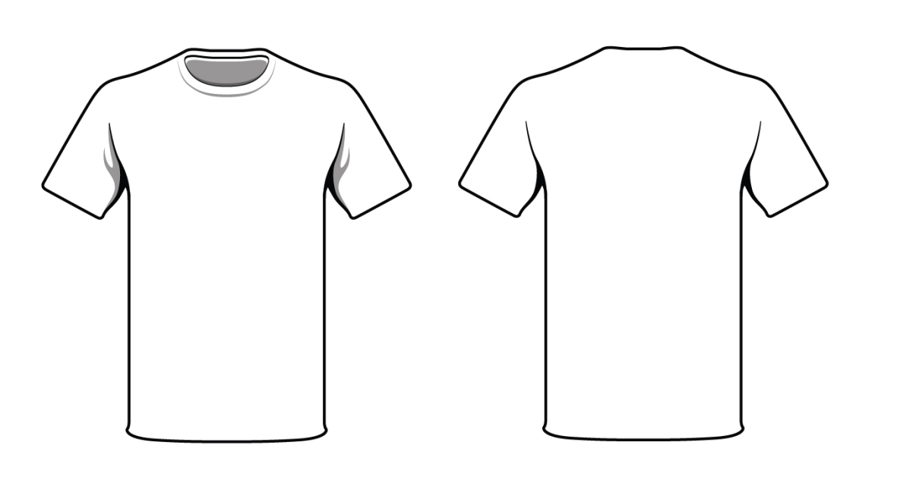
EWeek
Chairs:
Kitty DiFalco
Alison Hayfer
Competition for Eweek T-Shirt Design!
Needs to incorporate Harry Potter theme
Submit designs to uc.eweek@gmail.com
Due Feb. 4th
Winner gets free ticket to banquet!
YOUR
DESIGN
HERE!

Slide 29
Resume Review Day
Chairs:
Dane Sowers
Nick Stelzer
Resume Review Day is this Friday from 9am-3pm.
All slots are currently full, but we have a few reminders for those of you who have signed up:
Dress is business casual
Please arrive at least 5 minutes early for your scheduled time (We will give your space to someone else if you aren’t there)
Bring at least one paper copy of your resume
Email careerfair@uc.edu with any questions. We look forward to seeing you there!

Slide 30
FELD
Chair:
Alexis Conway
Next meeting will be on Tuesday, February 10th from 6:30pm-7:30pm in Baldwin 660.
We will be discussing the upcoming Career Fair and answering any questions you may have about it.
Food will be given as always
Email conwayal@mail.uc.edu with questions or to be added to the mailing list.

Slide 31
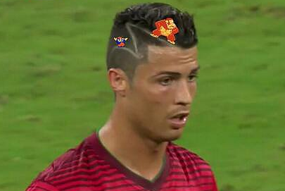
Special Events
Intramural soccer: Team Tribunaldo!
Co-ed team
Potentially male team
TSA-TEAMS High School Egg Drop competition
Wednesday, February 25th
Counts towards Cincinnatus!
Join the committee!
Egg Drop Competition
Sigma Sigma Carnival
Relay for Life
Community Service

Slide 32
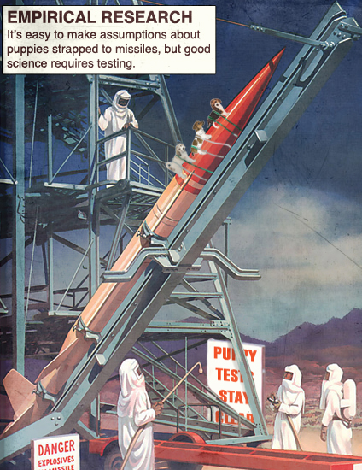
If you’re interested, see me after the meeting!
Or email Scott Blincoe (Special Events Chair):
blincosv@mail.uc.edu

Slide 33
Recognition
Chair: Christian Lipa
Applications can be found and submitted for Outstanding Senior Awards at https://tribunal.uc.edu/recognition
Any CEAS Senior can apply for one or all three awards: University, College, and Community
Applications are due February 15th at 11:59 P.M.
Interested in joining the Recognition Committee? Contact me at lipacc@mail.uc.edu and fulfill your committee requirement.

Slide 34
Other Announcements

Slide 35
TGIF
WHO: CEAS Students, Professors and Friends
WHAT: $5 wristband gets you unlimited access to Stella and Goose Island Urban Pale Ale (Until Kegs Run Dry) Professors Drink Free! Bring a professor and you both drink free!
WHEN: Friday Jan. 30th @ 5:30 p.m.
WHERE: Brass Tap at Usquare

Slide 36
Tau Beta Pi – The Engineering Honor Society
Oldest and largest engineering honor society
Recognize talented engineering students
Top 1/8th of Juniors
Top 1/5th of Seniors
Engineering Futures will be held on Saturday February 7th
10:00 am – 2:30pm
Lunch provided
Contact me with questions (glandojr@mail.uc.edu)

Slide 37
Generating ideas through brainstorming and creative thinking
Choosing the best idea to implement using specific evaluation techniques
Learn techniques to facilitate decision-making.

Slide 38
If you have any questions contact Jacob Wells 419-889-1858

Slide 39
Constructive Criticism
What do you like/dislike about the college?
Comments / Questions?
questions.ceastribunal@gmail.com
What would you like to see Tribunal do next?

Slide 40
Next Meeting:
Monday, February 9th
525 Old Chem
5:30

