Slide 1
Engineering and Applied
Science Tribunal
General Meeting
February 23rd , 2015

Slide 2
Agenda
LEONI
Officer Reports
Committee Reports
Raffle

Slide 3
Engineering Career Opportunities at
LEONI WIRING SYSTEMS

Slide 4
Agenda
Introduction
LEONI Group overview
LEONI Wiring Systems overview
The Americas Business Area
LCDP
Comments and Pictures
Questions

Slide 5

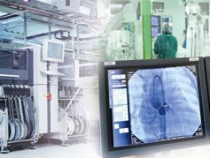
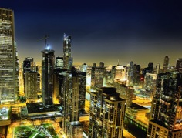



LEONI Group Markets and portfolio
Automotive
& Commercial Vehicles
Industry
& Healthcare
Communication
& Infrastructure
Electrical Appliances
Conductors
& Copper Solutions
After market services
R&D / engineering
Wiring systems / Cable systems
Power distribution, fuse systems
Components, connectors, sensors
Copper cables
Hybrid cables
Optical cables
Wire & strands
Optical fibers
5

Slide 6
LEONI Group Sales long-term overview
in million €
major acquisitions
estimated
Lucas Rists
sales about € 100 million
Valeo Wiring Systems
sales about € 574 m
Daekyeung
sales about € 87 m
Kerpen
sales about € 116 m
Studer Draht- und Kabelwerk AG
sales about € 84 m

Slide 7

LEONI Group Divisions
Divisions
Sales and employees
per division
Wiring Systems
Wiring Systems
Wiring systems and
electrical components
Total sales: € 2.31 billion
Employees: 51,651
Sales 2013: € 3.92 billion
$ 5.0 billion
Employees: 59,000+
Wire & Cable Solutions
Wire & Cable Solutions
Wires, cables
and cable systems
Total sales: € 1.61 billion
Employees: 8,010

Slide 8

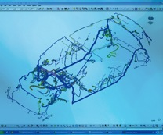
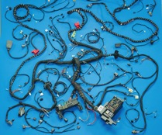
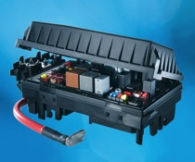
Wiring Systems

Slide 9

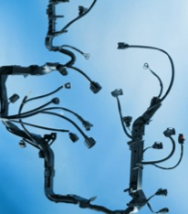


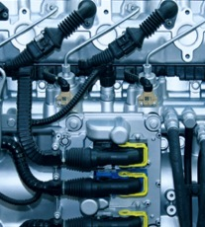

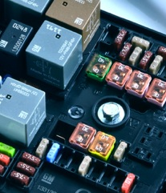
Wiring Systems Products and services
Wiring systems, fuse and junction boxes for
cars (all segments)
electric, hybrid and fuel cell powered vehicles
commercial vehicles
systems and component suppliers
Core areas of expertise
full service supply capability
E&EDS system optimisation
high voltage wiring systems
product design and development
global customer support
programme co-ordination
total value engineering
supply chain logistics

Slide 10
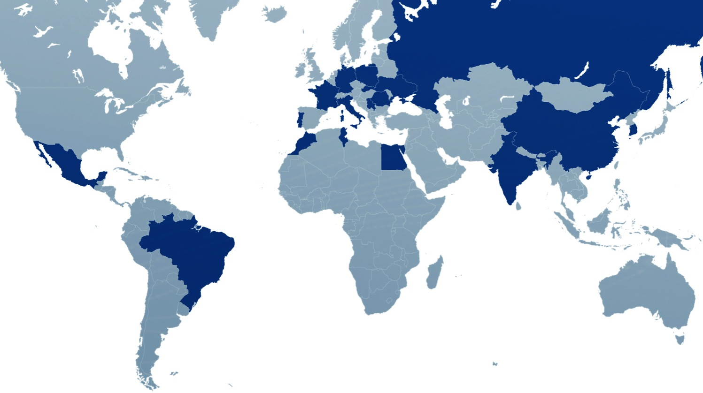
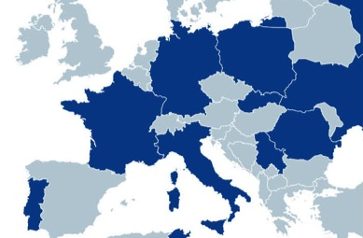

Wiring Systems Global network
Global headcount: 53,000 (as at 31st July 2012)
Production sites: 31
Countries: 18
Production space: about 550,000 m²
Wiring Systems production plants
Brazil
China
Egypt
France
Germany
R&D/customer service centres
India
Italy
Morocco
Mexico
Poland
Portugal
Romania
Russia
Serbia
Slovakia
South Korea
Tunisia
Ukraine
USA

Slide 11

























































Wiring Systems Customers
Passenger cars
Commercial vehicles
Suppliers

Slide 12
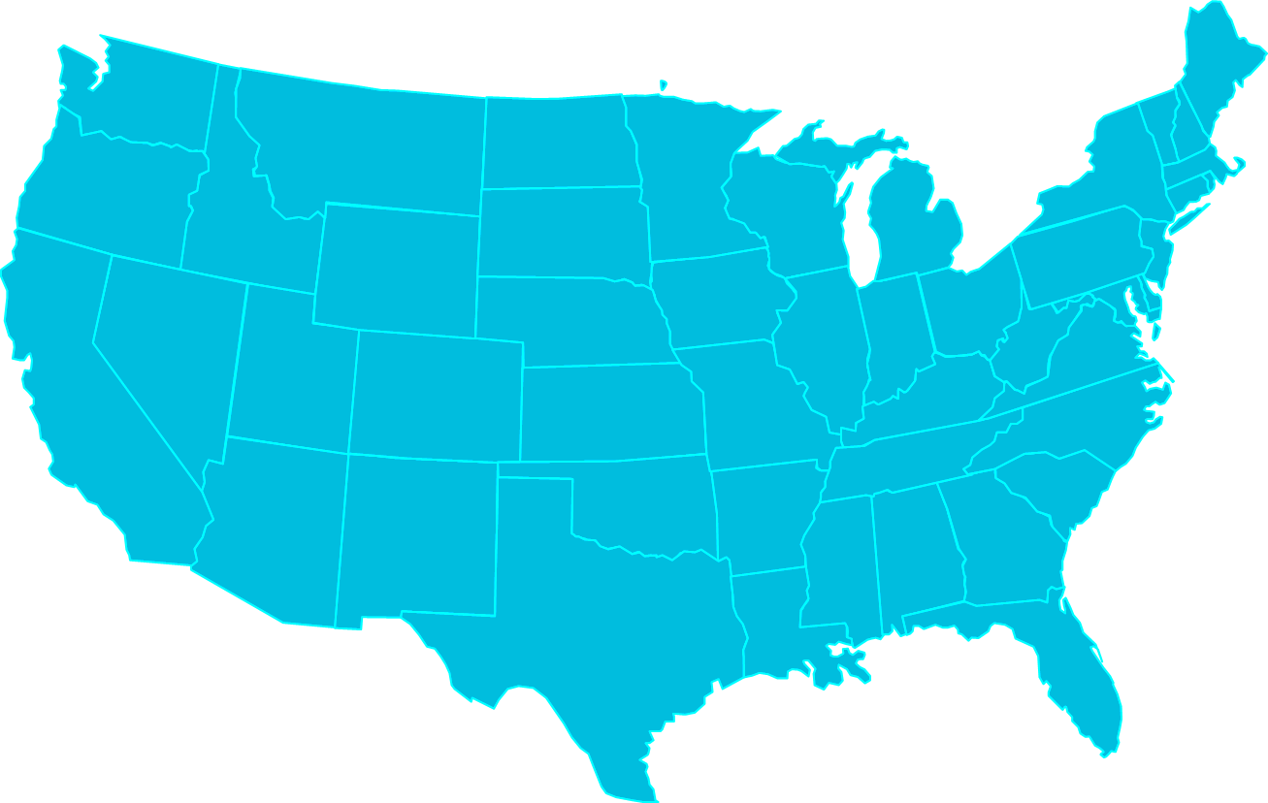
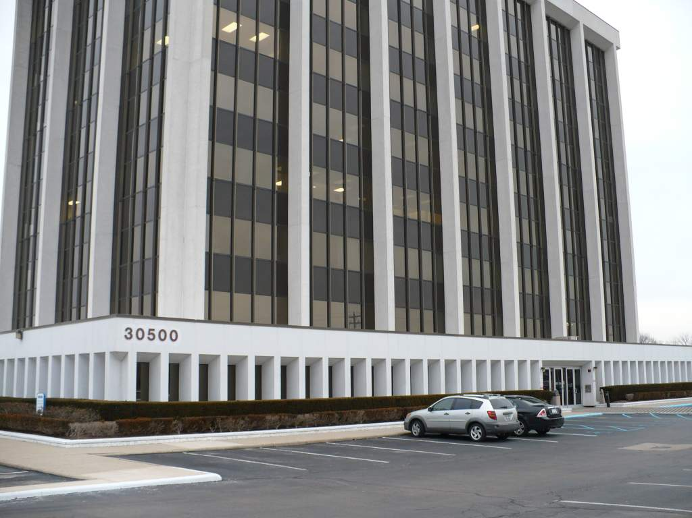
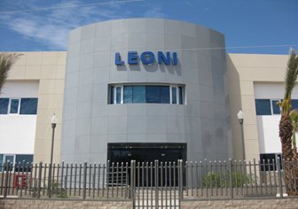
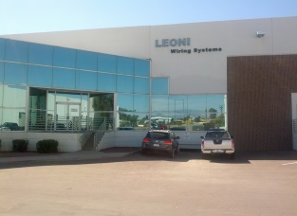
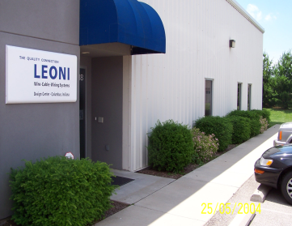
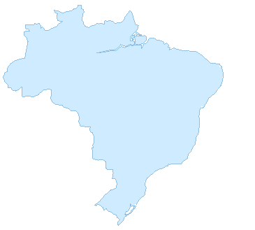
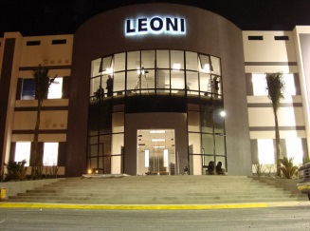
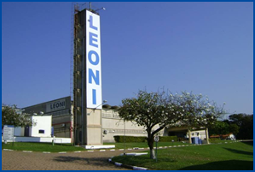
Business Area Americas Locations
Detroit, MI
LEONI Design Center
Columbus, IN
LEONI Design Center
Customer Service Center
Hermosillo, Mexico
Tucson, AZ
LEONI Wiring Systems, Inc.
(Sales, IT, Purchasing, Finance)
Durango, Mexico
ITU, Brazil
Manufacturing Locations
Administration Facilities

Slide 13
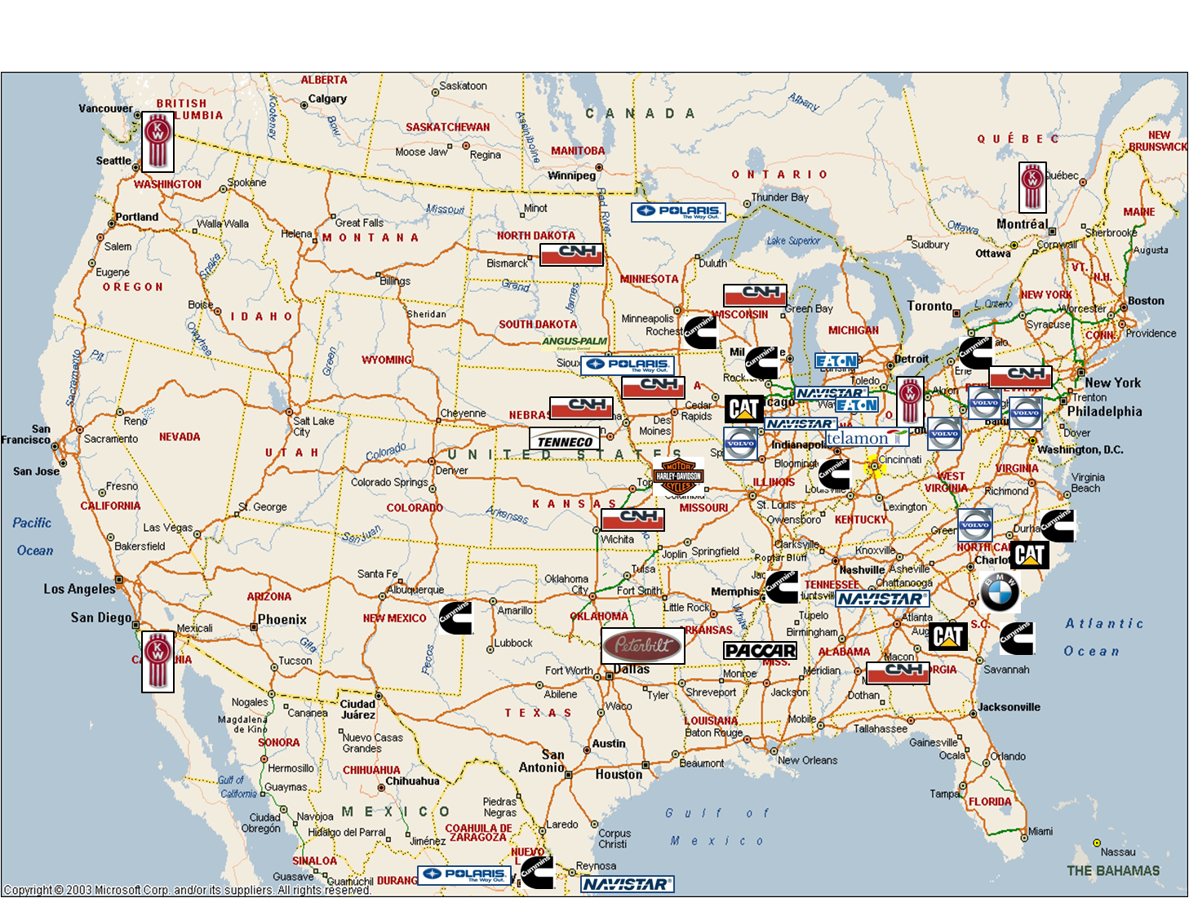



BA America‘s NA Customer Delivery Locations

Slide 14
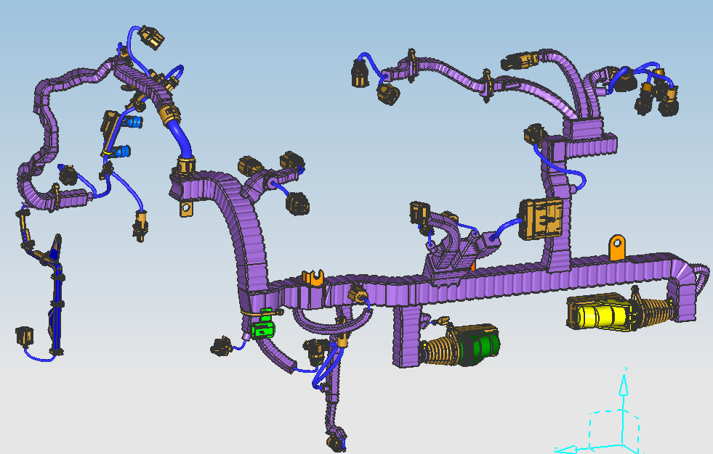
Wiring Systems Foamed Harness Model

Slide 15
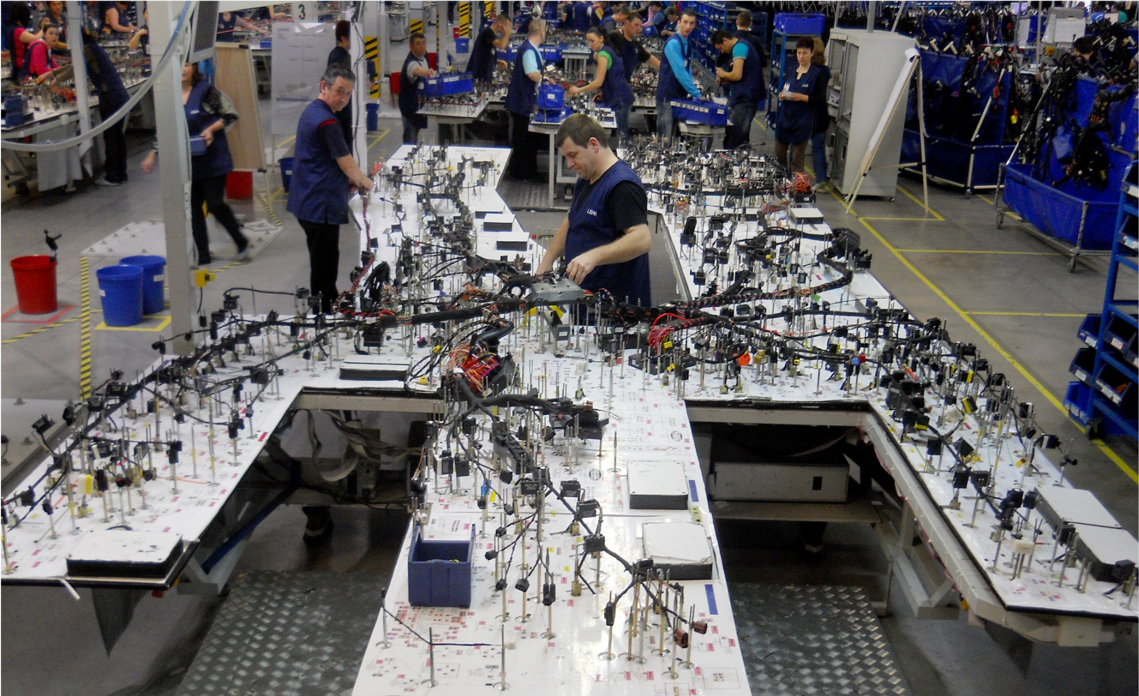
Wiring Systems Production

Slide 16
LCDP LEONI CO-OP Development Program
LCDP for Engineers is composed, ideally, of a term in each of the three major areas of development.
Design - Supports a customer engineering
Manufacturing –Supports production of customer parts
Research and Development – Supports development based on Market demand
1st term is as a Design Engineer, working closely with a particular customer usually managing multiple small programs. By the end of the term you are expected to understand the basics of component selection and routing design as well as be proficient an being able to manage and develop multiple timelines simultaneously
2nd term is as a Product Engineer, working closely with the manufacturing team to develop and manage the break down of the design to the start of production using the PPAP process. This rotation is at the plant location
3rd term is as an R&D Engineer, working on developing new components and concepts that come from market research as well as high level design issues from the different global locations. This rotation is a the Wiring Global headquarters in Germany.

Slide 17
LCDP Locations
Detroit, Michigan
Kitzingen, Germany
Columbus, Indiana
Tucson, Arizona
Newcastle-u-Lyme, England**
Hermosillo, Sonora, Mexico
Itu (Sao Paulo), Brazil**
** In Progress
Notes:
Currently three in progress and Four that have had Co-op students from the states

Slide 18
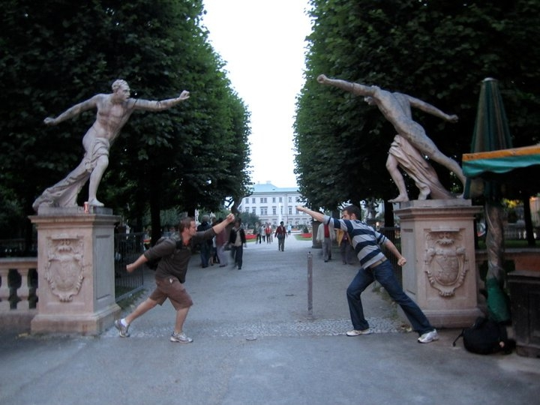
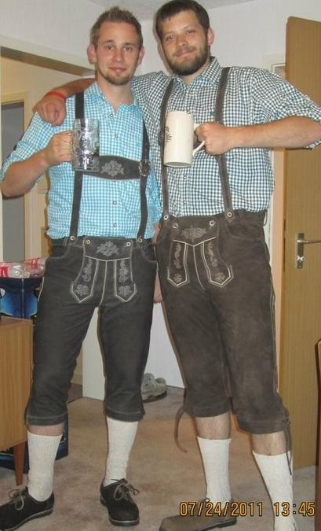
Pictures and Quotes
“The opportunity to experience such a wonderful culture and learn a new language while making a living in a different country is a chance to put yourself unequivocally above so many other students.”

Slide 19
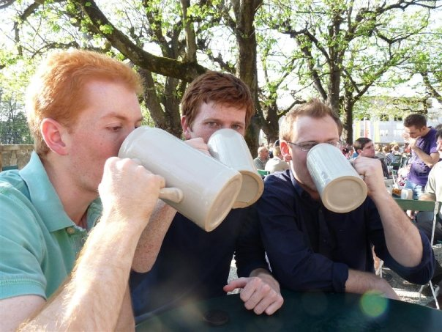
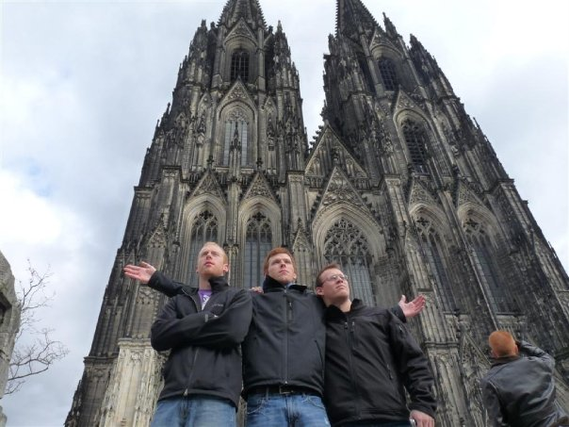
Pictures and Quotes
“Right off the bat, both in Columbus and
Detroit, I was given real responsibility.”

Slide 20
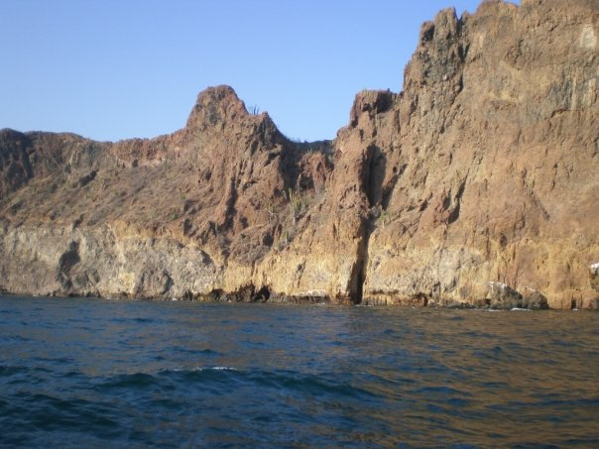
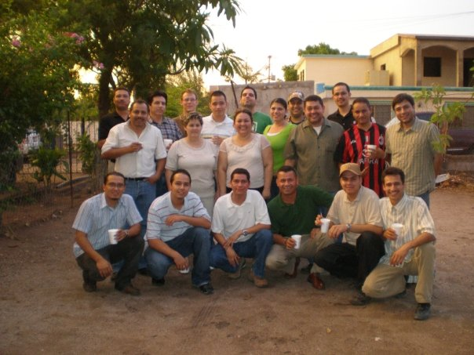
“Traveling not only helps create
opportunities in the future, but helps
develop relationships that span the globe.”

Slide 21
Purpose
What we are: CEAS Branch of Student Government
What we do:
  Host programs for the college
  Input on curriculum, grievances, and student/faculty relations
  Improve student experience in the college

Slide 22
President
CEAS TRIBUNAL EXECUTIVE STRUCTURE
Secretary
Treasurer
Vice President
Associate Vice President
Senators (X2)
Technology
Career Fair
Public Affairs
FELD
EWeek
SOCC
Luau
Recognition
Special Events
Collegiate Affairs
OFFICERS are in black. COMMITTEE CHAIRS are in red.

Slide 23
Tribunal Officers
President: |  | Alison Hayfer
Vice President: |  | Carlo Perottino
Associate Vice President: |  | Matt Kitchen
Treasurer: |  | Max Inniger
Secretary: |  | Jared Wood
Senators: |  | Madeline Adams Hannah Kenny

Slide 24
Tribunal Executives
Career Fair: |  | Dane Sowers, Nick Stelzer
Collegiate Affairs: |  | Mark Gruenbacher
EWeek: |  | Alison Hayfer, Kitty DiFalco
FELD: |  | Alexis Conway
Luau: |  | Chris Katuscak
Recognition: |  | Christian Lipa
Public Affairs: |  | Juliann Leny, Logan Buck
SOCC: |  | Nathan Ball
Special Events: |  | Scott Blincoe
Technology: |  | Charlie Hinton

Slide 25
Officer Reports

Slide 26
President
Officer:
Alison Hayfer
Office Hours:
  Mondays 6:30-7:30 PM
  Baldwin 650

Slide 27
Vice President
Officer:
Carlo Perottino
Office Hours:
  Wednesdays 1:30-2:30 PM
  Baldwin 650

Slide 28
Associate Vice President
Officer:
Matt Kitchen
Office Hours:
  Tuesday/ Thursday 12:45-1:45 PM
  Baldwin 650

Slide 29
Spring Committee Meetings
Student Rights and Interests: Mondays at 1:30pm
Campus Life: Mondays at 6pm
Academic Issues: Thursdays at 5:30pm
Governmental Affairs: Thursdays at 8pm
All meet in the Student Government Office

Slide 30
Student Trustee Position
Be the student’s voice on the board of trustees
Two year appointed position
Applications can be found in the student government office or on Campus LINK
Applications are due February 27th at 5pm

Slide 31
TEDx U Cincinnati
“Rise and Reimagine”
March 27, 2015 at UC
One slot for a student speaker
  Apply at tedxucincinnati.com

Slide 32
Joke of the Week
Why are fish so bad at tennis?

Slide 33
Secretary
Officer:
Jared Wood
Please sign in at the back of the room
Must attend and sign in at minimum of 4 meetings each semester to having voting rights

Slide 34
Committee Reports

Slide 35
EWeek
Chairs:
Kitty DiFalco
Alison Hayfer
THIS WEEK!!!!!!
Date Auction will be Friday @ The Brass Tap
  Still have a few slots to be auctioned off. SIGN UP!
Banquet will be Saturday @ Newport Syndicate
  Tickets can be picked up everyday 10-3 in the Tribunal office (Baldwin 650) or every night from 6-7
  Students must ride the bus to and from the Newport Syndicate
Tweet your pictures @UC_EWeek
Questions? Email uc.eweek@gmail.com

Slide 36
EWeek
Chairs:
Kitty DiFalco
Alison Hayfer
THIS WEEK!!!!!!
Scoring:
  1st Place- 10 points
  2nd Place- 7 points
  3rd Place- 5 points
  Signing in to an event- 1 point/member
  Bringing a professor to an event- 5 bonus points
  Tweeting pictures to @UC_Eweek (not counting Horcrux Hunt): 1 point (5 pts max/ day)
  Having a team member in the Date Auction: 5 points/ member
  Horcrux Hunt:
    5 points for first team to tweet with the item with the Herman Schneider Bust
    2 points for every other team following
    5 bonus points for picture with whole team
  Asking about the scores/ranking: -5 points
Questions? Email uc.eweek@gmail.com

Slide 37
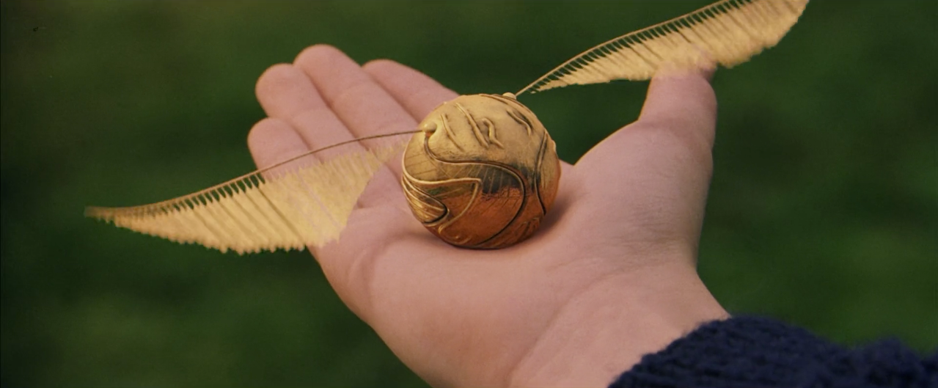
FIND THE SNITCH!
We will be hiding 5 snitches throughout Baldwin/Rhodes/ERC starting tomorrow
If you find one, tweet @UC_Eweek and @UCTribunal, and bring it to the office

Slide 38

Special Events
Upcoming Service Hour Opportunities!
  High School Egg Drop Competition
    February 25 (This Wednesday!)
    Time Shifts: 7:45 – 9; 12:30 – 3
    Questions? Contact Adam McCoy:
      mccoyad@mail.uc.edu
  Matthew 25 Ministries
    March 28
    Time: 11 – 3
    One spot left!
    Questions? Contact Jorge Benito Montejo:
      benitoje@mail.uc.edu

Slide 39

Special Events
Upcoming Service Hour Opportunities!
  Relay for Life
    April 10 - 11
    Time: 6 PM (Friday) – 12 PM (Saturday)
    Basically large party to fight cancer!
    Questions? Contact Meredith Meads:
      meadsmc@mail.uc.edu
  Cincy Clean-Up
    April 4
    Time: 9 AM – Noon
    Cleanup surrounding Cincinnati neighborhoods!
    Questions? Contact Scott Blincoe:
      blincosv@mail.uc.edu

Slide 40
Luau
What it is: Our yearly celebration for engineers at the beach waterpark that includes a day at the beach waterpark, food, and drinks for those of you of age
When is it: June 27th 2015
Want tickets: Tickets will be sold the last two weeks of the semester and in the Summer
Want to Help?: Student volunteers needed to sell tickets at the end of the semester.

Slide 41
Public Affairs
If you need to pick up supplies for Baldwin Hall decoration, see us after the meeting!
  Judging Wed, Feb 25th after the Duct Tape Competition
Like us on Facebook! Follow us on Twitter! @uctribunal
TAKE PICTURES OF EWEEK! Send them to us at lenyjk@mail.uc.edu or tweet them to us!
Will be taking down old posters in Baldwin after the meeting!

Slide 42
Other Announcements

Slide 43
RAFFLE!

Slide 44
Constructive Criticism
What do you like/dislike about the college?
Comments / Questions?
questions.ceastribunal@gmail.com
What would you like to see Tribunal do next?

Slide 45
Next Meeting:
Monday, March 9th
525 Old Chem
5:30

