Slide 1
Engineering and Applied Science Tribunal
General Meeting
March 9th, 2015

Slide 2
Agenda
College of A&S Tribunal
Officer Reports
Committee Reports
Raffle

Slide 3
Purpose
What we are: CEAS Branch of Student Government
What we do:
Host programs for the college
Input on curriculum, grievances, and student/faculty relations
Improve student experience in the college

Slide 4
President
CEAS TRIBUNAL EXECUTIVE STRUCTURE
Secretary
Treasurer
Vice President
Associate Vice President
Senators (X2)
Technology
Career Fair
Public Affairs
FELD
EWeek
SOCC
Luau
Recognition
Special Events
Collegiate Affairs
OFFICERS are in black. COMMITTEE CHAIRS are in red.

Slide 5
Tribunal Officers
President: |  | Alison Hayfer
Vice President: |  | Carlo Perottino
Associate Vice President: |  | Matt Kitchen
Treasurer: |  | Max Inniger
Secretary: |  | Jared Wood
Senators: |  | Madeline Adams Hannah Kenny

Slide 6
Tribunal Executives
Career Fair: |  | Dane Sowers, Nick Stelzer
Collegiate Affairs: |  | Mark Gruenbacher
EWeek: |  | Alison Hayfer, Kitty DiFalco
FELD: |  | Alexis Conway
Luau: |  | Chris Katuscak
Recognition: |  | Christian Lipa
Public Affairs: |  | Juliann Leny, Logan Buck
SOCC: |  | Nathan Ball
Special Events: |  | Scott Blincoe
Technology: |  | Charlie Hinton

Slide 7
Officer Reports

Slide 9
Joke of the Week!
What is the densest type of boat?

Slide 10
President
Officer:
Alison Hayfer
Office Hours:
Mondays 6:30-7:30 PM
Baldwin 650

Slide 11
Vice President
Officer:
Carlo Perottino
Office Hours:
Wednesdays 1:30-2:30 PM
Baldwin 650

Slide 12
Associate Vice President
Officer:
Matt Kitchen
Office Hours:
Tuesday/ Thursday 12:45-1:45 PM
Baldwin 650

Slide 13
Spring Committee Meetings
Student Rights and Interests: Mondays at 1:30pm
Campus Life: Mondays at 6pm
Academic Issues: Thursdays at 5:30pm
Governmental Affairs: Thursdays at 8pm
All meet in the Student Government Office

Slide 14
TEDx U Cincinnati
“Rise and Reimagine”
March 27, 2015 at UC
One slot for a student speaker
Apply at tedxucincinnati.com

Slide 15
Secretary
Officer:
Jared Wood
Please sign in at the back of the room
Must attend and sign in at minimum of 4 meetings each semester to having voting rights

Slide 16
Committee Reports

Slide 17
Career Fair
Chairs:
Dane Sowers
Nick Stelzer
Tim Kemper
Planning for fall career fair is starting up soon. Want to get involved? Here are the contacts for each of our volunteer areas:
Company Recruitment – McKenzie Kinzbach (kinzbame@mail.uc.edu)
Resume Review Day – Heath Palmer (palmerha@mail.uc.edu)
Day-of Volunteers – Maggie Connell (connelmt@mail.uc.edu)
Logistics and Marketing – Dane Sowers (sowersdd@mail.uc.edu) or Tim Kemper (kemperta@mail.uc.edu)
Questions? Email a coordinator at careerfair@uc.edu!

Slide 18
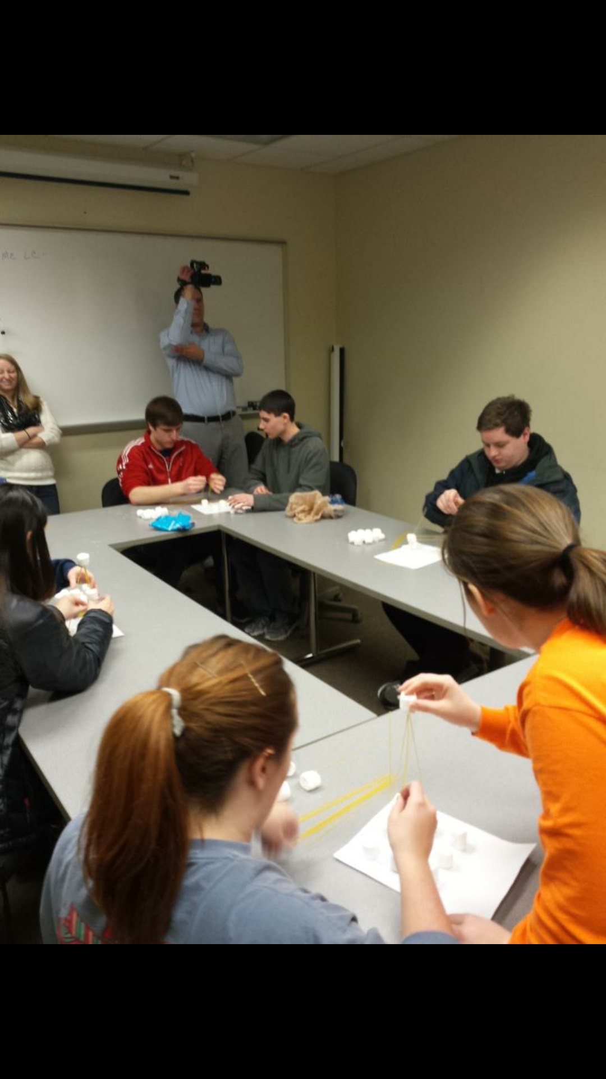
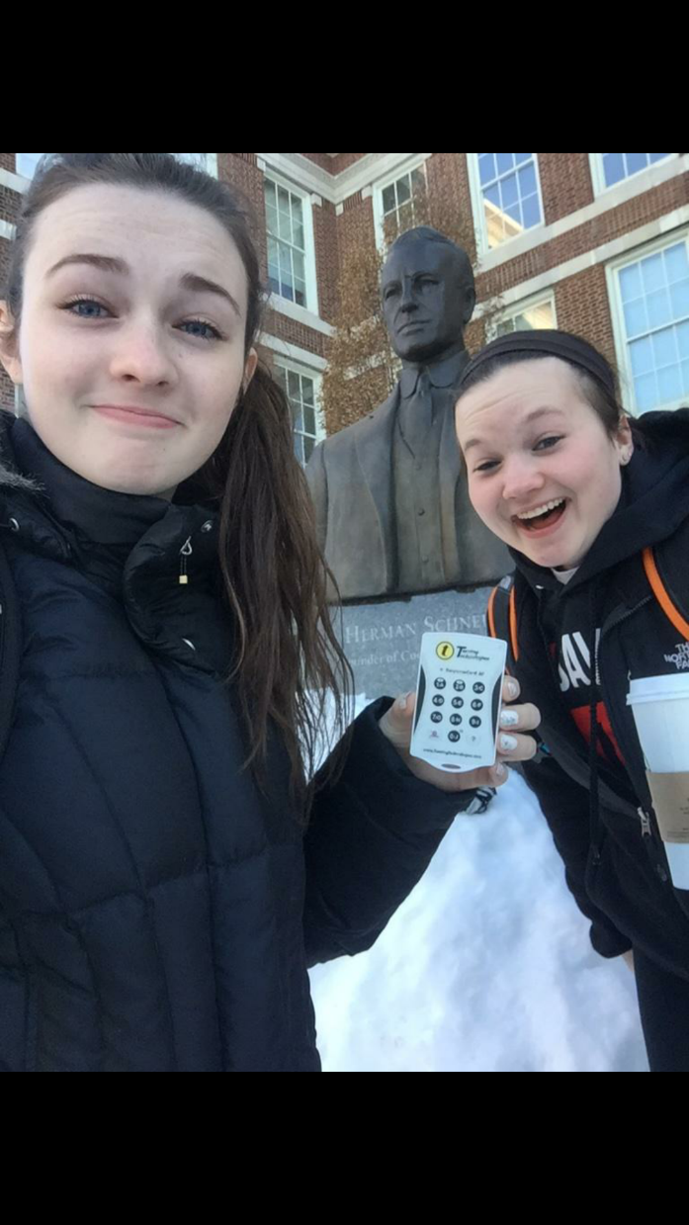
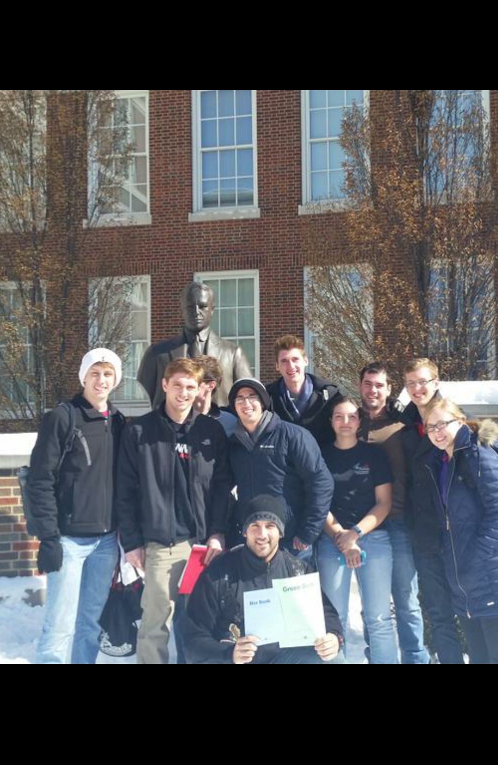

Slide 19
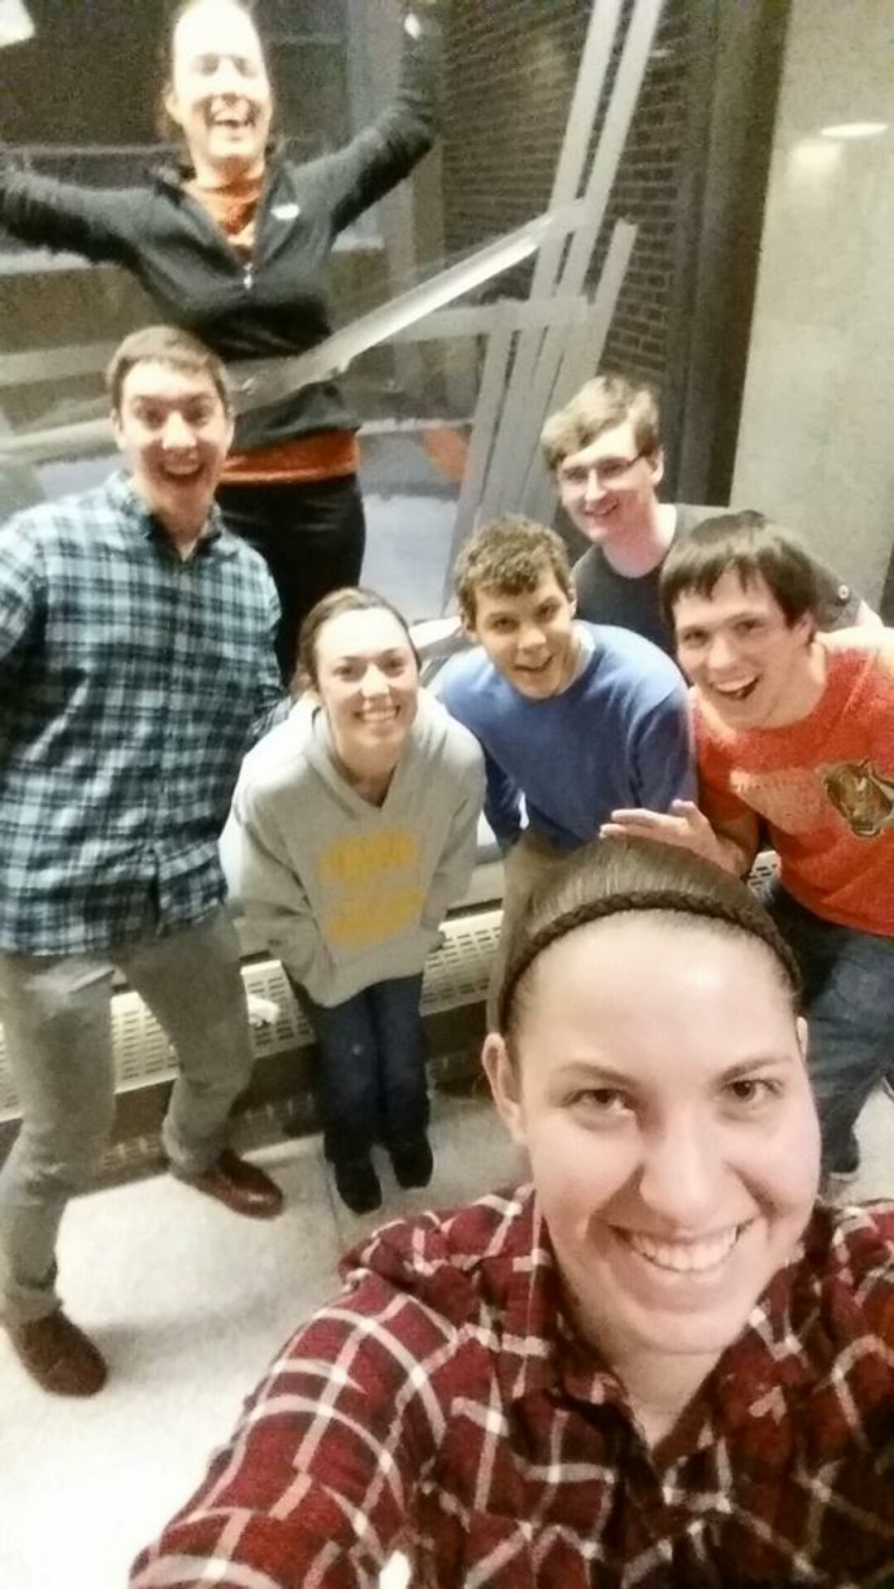
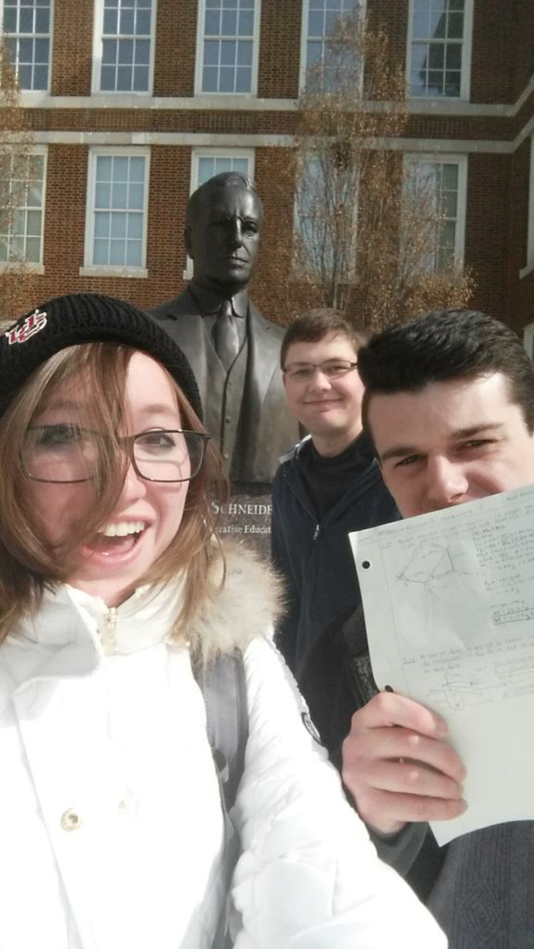

Slide 20
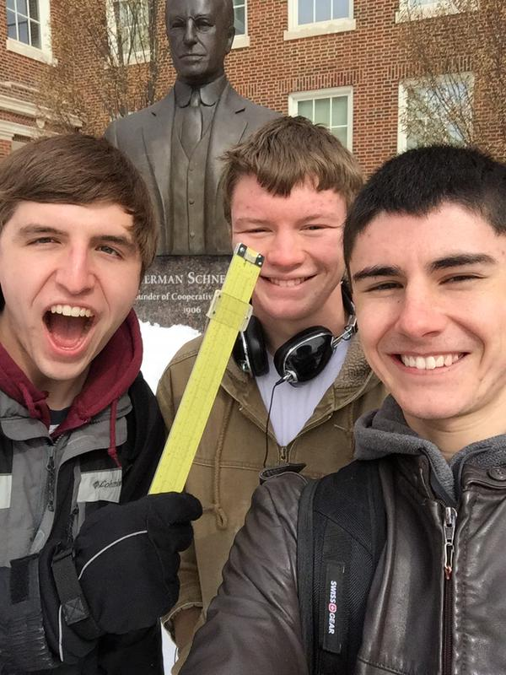

Slide 21
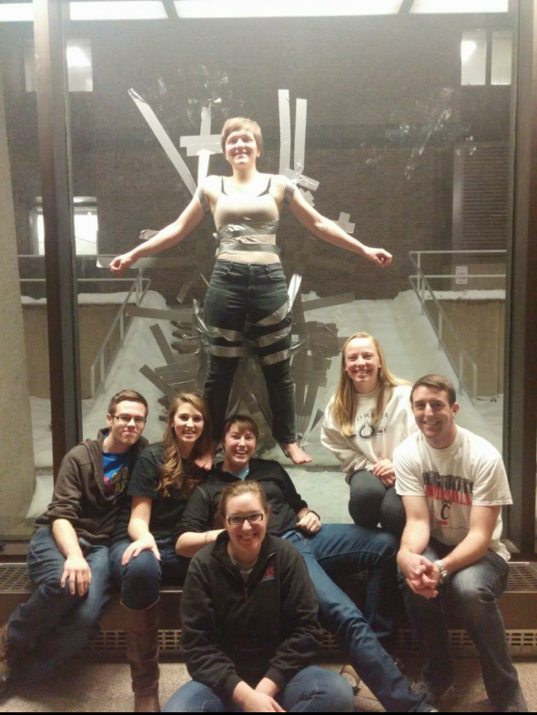
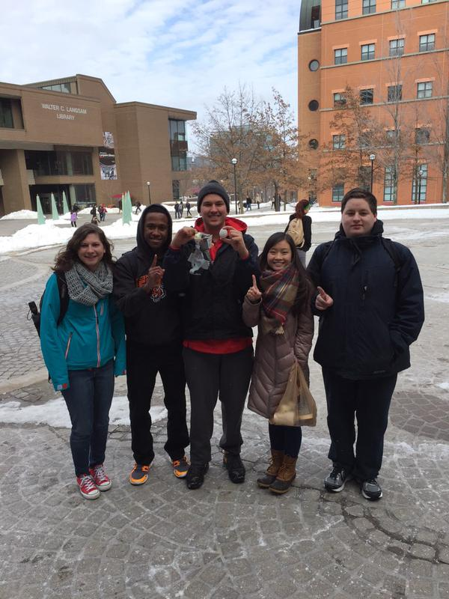

Slide 22
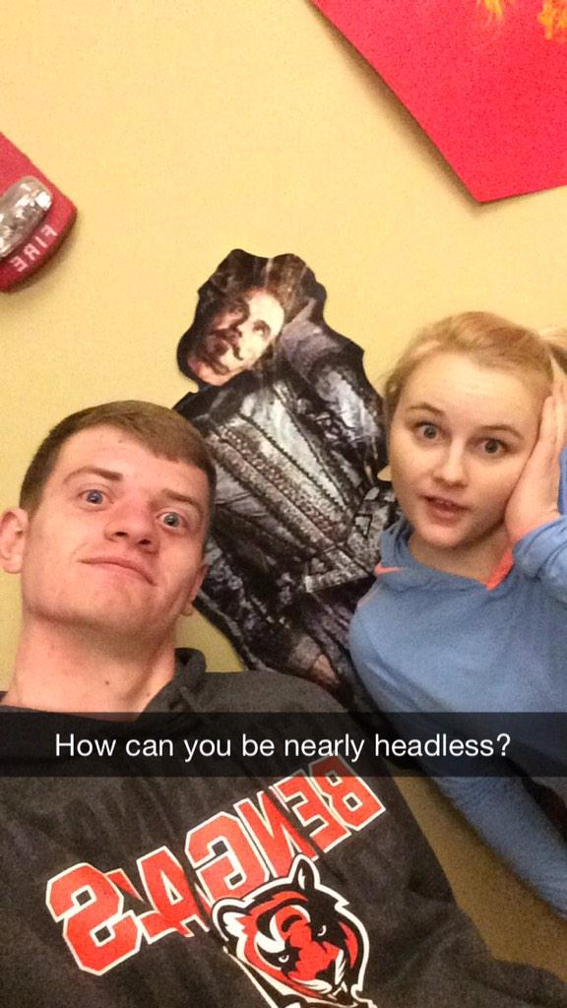
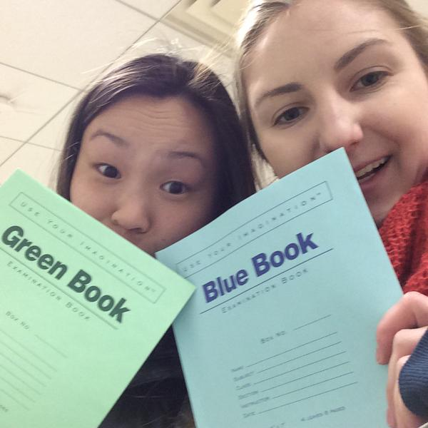

Slide 23
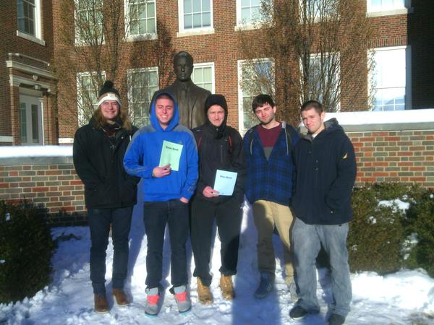
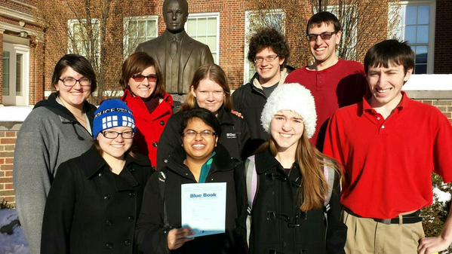

Slide 24
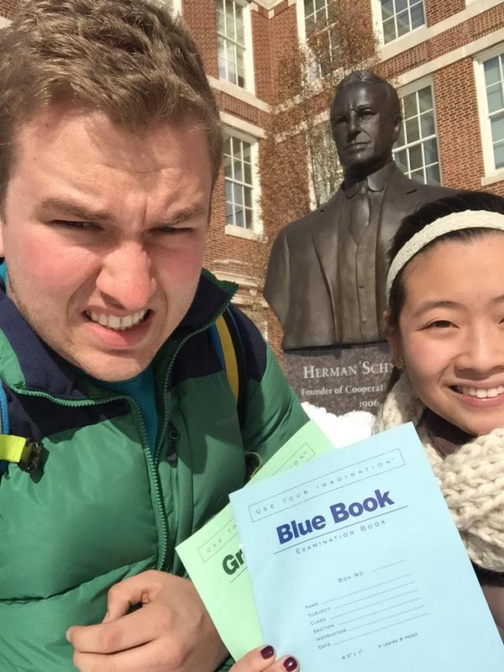
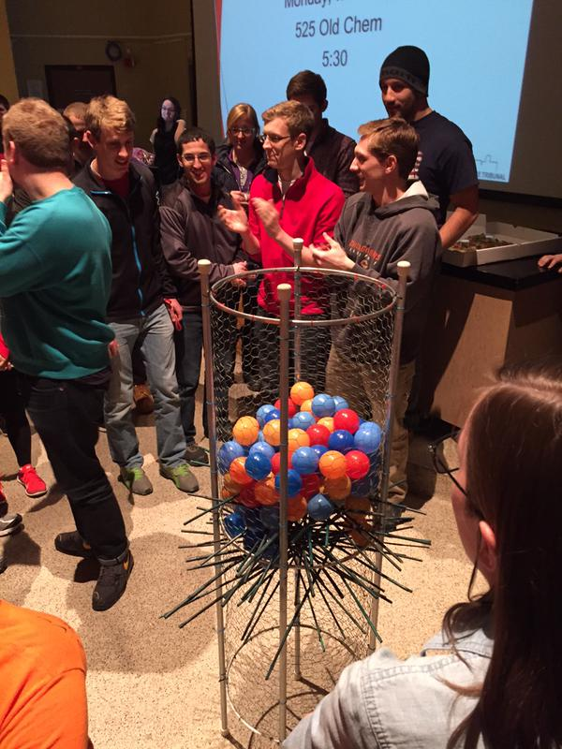

Slide 25
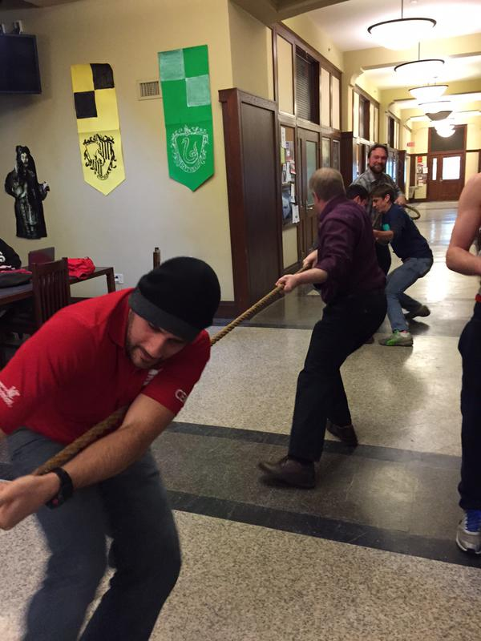
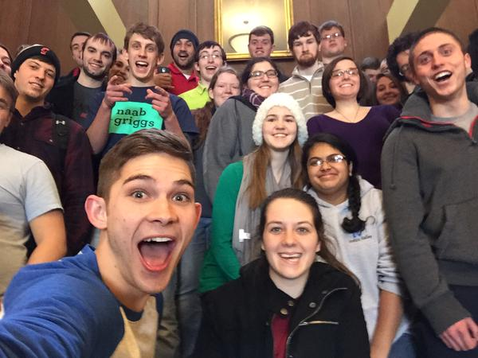

Slide 26
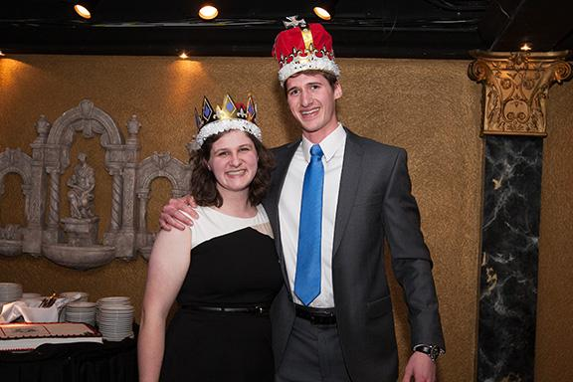
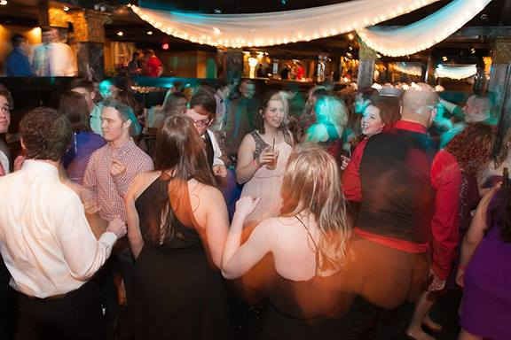

Slide 27
Luau
What it is: Our yearly celebration for engineers at the beach waterpark that includes a day at the beach waterpark, food, and drinks for those of you of age
When is it: June 27th 2015
Want tickets: Tickets will be sold the last two weeks of the semester and in the Summer
Want to Help?: Student volunteers needed to sell tickets at the end of the semester.

Slide 28
Public Affairs
There’s still a snitch on the loose! It’s still working hard and late on his engineering projects
Like us on Facebook! Follow us on Twitter! @uctribunal
Have pictures from Eweek? Send them to us at lenyjk@mail.uc.edu or tweet them to us!
Will be taking down old posters in Baldwin after the meeting!

Slide 29
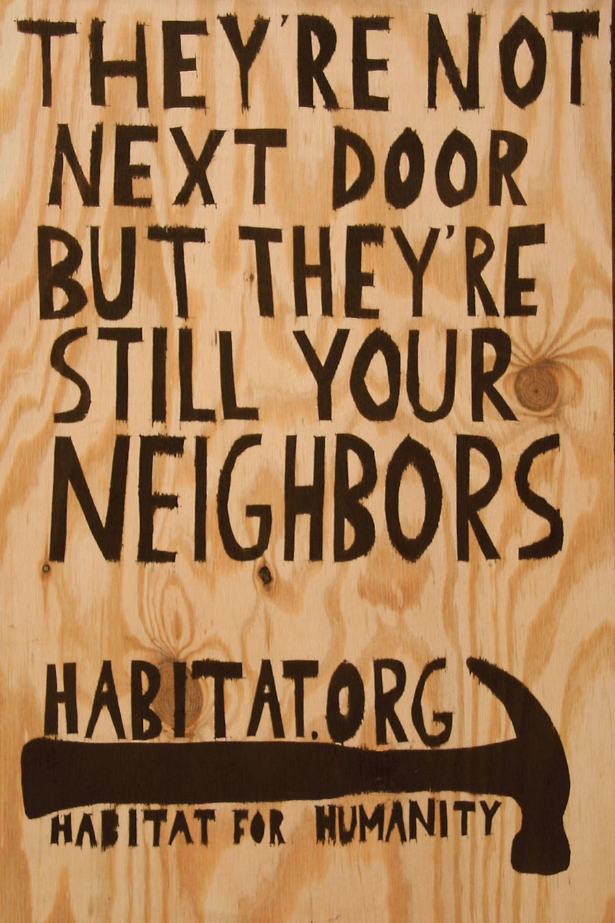
Special Events
Thanks to those who helped with Egg Drop!
Upcoming Service Hour Opportunities!
Habitat for Humanity
March 14
Time: 12:30 – 4
Food Provided!
One spot Left!
Questions? Contact Spencer Lewis:
lewis2s9@mail.uc.edu
Matthew 25 Ministries
March 28
Time: 11 – 3
Two spot left!
Questions? Contact Jorge Benito Montejo:
benitoje@mail.uc.edu

Slide 30
Special Events
Upcoming Service Hour Opportunities!
Relay for Life
April 10 - 11
Time: 6 PM (Friday) – 12 PM (Saturday)
Basically large party to fight cancer!
Questions? Contact Meredith Meads:
meadsmc@mail.uc.edu
Cincy Clean-Up
April 4
Time: 9 AM – Noon
Cleanup surrounding Cincinnati neighborhoods!
Questions? Contact Scott Blincoe:
blincosv@mail.uc.edu

Slide 31
Special Events
Sigma Sigma Carnival
April 11
Time: All night on Sigma Sigma Commons
Annual carnival and fireworks show for alumni and students!
Questions? Contact Chris Stone:
stonec5@mail.uc.edu

Slide 32
Order of the Engineer
Recognition for senior engineers
Ring sizing will be taking place March 30th to April 3rd
Ring Ceremony May 1st

Slide 33
Other Announcements

Slide 36
RAFFLE!

Slide 37
Constructive Criticism
What do you like/dislike about the college?
Comments / Questions?
questions.ceastribunal@gmail.com
What would you like to see Tribunal do next?

Slide 38
Next Meeting:
Monday, March 23rd
525 Old Chem
5:30pm

