Slide 1
Engineering and Applied Science Tribunal
General Meeting
January 11, 2016

Slide 2
Agenda:
Officer Introductions & Reports
Committee Introductions & Reports
Raffle

Slide 3
Purpose
What we are: CEAS Branch of Student Government
What we do:
Host programs for the college
Input on curriculum, grievances, and student/faculty relations
Improve student experience in the college

Slide 4
President
CEAS TRIBUNAL EXECUTIVE STRUCTURE
Secretary
Treasurer
Vice President
Associate Vice President
Senators (X2)
Technology
Innovation
Career Fair (X2)
Constitution & Bylaws
Public Affairs
Order of the Engineer
FELD
EWeek (X2)
SOCC
Luau
Recognition
Special Events
Collegiate Affairs
OFFICERS are in black. COMMITTEE CHAIRS are in red.

Slide 5
Tribunal Officers
President: |  | Carlo Perottino
Vice President: |  | Dane Sowers
Associate Vice President: |  | McKenzie Kinzbach
Treasurer: |  | Max Inniger
Secretary: |  | Frazier Baker
Senators: |  | John Lewnard Tim Kemper

Slide 6
Tribunal Executives
Career Fair: |  | Tim Kemper Nathan Hamit
Collegiate Affairs: |  | Khaled Aboumerhi
Constitution and Bylaws |  | Jared Wood
EWeek: |  | Alison Hayfer Andrew Bachus
FELD: |  | Paige Johnson
Innovation: |  | Emily Demjanenko
Luau: |  | Andrew John Droesch
Order of the Engineer: |  | Sean Gleason
Public Affairs: |  | Matt Morgann
Recognition: |  | Rugved Mavidpalli
SOCC: |  | Heath Palmer
Special Events: |  | Emma Lowe
Technology: |  | Michael Santacroce

Slide 7
Officer Reports

Slide 8
President
Officer:
Carlo Perottino
Office Hours:
Thursdays from 11:30am-1:30pm
650 Baldwin

Slide 9
Vice President
Officer:
Dane Sowers
Office Hours:
Mondays from 10:30am-11:30am
650 Baldwin

Slide 10
Associate Vice President
Officer:
McKenzie Kinzbach
Office Hours:
Tuesdays from 12:30pm-1:30pm
650 Baldwin

Slide 11
Treasurer
Officer:
Max Inniger
Office Hours:
Tuesdays from 11:00am-12:00pm
650 Baldwin

Slide 12
Secretary
Officer:
Frazier Baker
Office Hours:
Wednesdays from 6:00pm-7:00pm
650 Baldwin
Don’t forget to sign in! You need to sign in to 4 meetings to earn voting privileges.

Slide 13
Senators
Officer:
John Lewnard
Tim Kemper
John Lewnard - Office Hours:
Wednesdays from 4:30pm-5:30pm
650 Baldwin
Tim Kemper - Office Hours:
Wednesdays from 12:00pm-1:00pm
650 Baldwin

Slide 14
Senator Report
Officer:
John Lewnard
Tim Kemper
Senator Position
Senate Meeting: Wednesday, January 13th at 6:00 pm in 425 TUC
Main Topics/Initiatives:
Fossil Free UC – Karl Scheer (CIO) coming to discuss financial effects
Student Government Elections – Packet pick-up on January 25th
Notes:
FB - Corrected meeting room location per update in-meeting correction from John Lewnard

Slide 15
Committee Reports

Slide 16
EWeek
Committee Chair:
Alison Hayer
Andy Bachus
What is it? A nationally celebrated week to celebrate engineers and all that we do!
What do we do? Have a fun week of competition and games and end the week with a banquet
When is it? February 21-27th
Questions? Email uc.eweek@gmail.com
Follow us on Twitter @UC_Eweek
Through the Herman Schneider Foundation, the first 85 seniors get free tickets for the banquet
Next committee meeting : Friday at 1PM in 650 Baldwin!

Slide 17
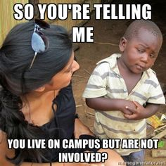
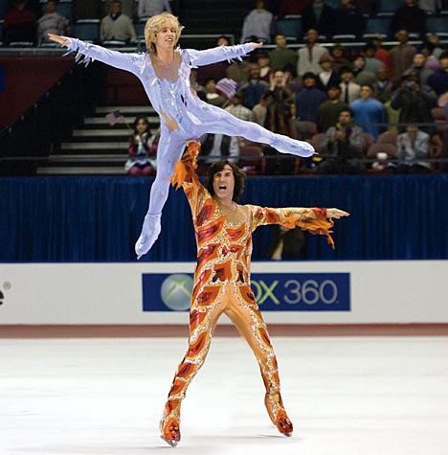
Special Events
Want to get involved on campus and gain great leadership experiences?
Do you want to help run fun events?
Join the Special Events Committee!!

Slide 18
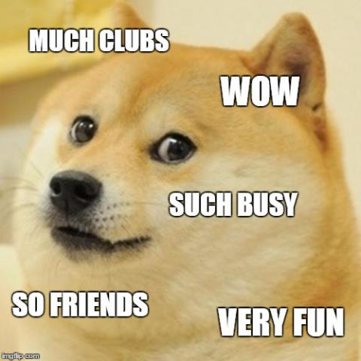
How to Get Involved?
See me after meeting!
Or email Emma Lowe
- loweea@mail.uc.edu

Slide 19
Recognition
Chair:
Rugved Mavidipalli
Rugved Mavidipalli (CS , Freshman)
What we do
Award Scholarships
Recognize professors and TA’s
Email me at mavidird@mail.uc.edu for questions or to join my committee.

Slide 20
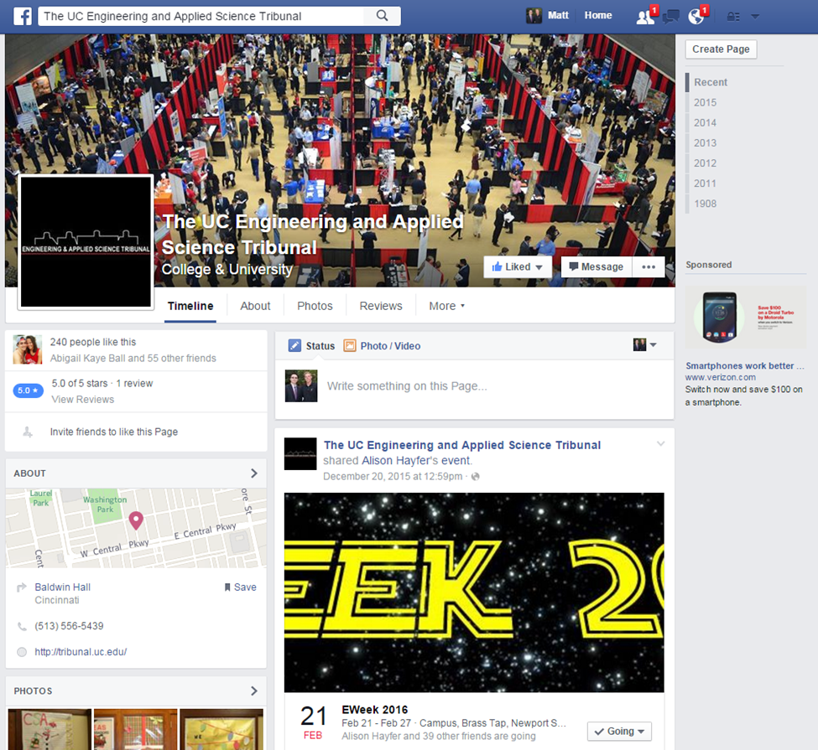
Public Affairs
Chair:
Matt Morgann
Matt Morgann and Meghna Gubta
Follow us on Twitter! @UCtribunal
Like us on Facebook!
Flyer Procedure
morganm9@mail.uc.edu

Slide 21
Order of the Engineer
Committee Chair:
Sean Gleason
Michelle Fordos
The Order of the Engineer is a ceremony to move senior undergraduate students to alumni and the work force
Ceremony will take place the day before CEAS Graduation
Looking for individuals to help plan and execute this ceremony
Sean Gleason
gleasose@mail.uc.edu
(937) 657-5196

Slide 22
Luau
Luau Chair:
Andrew Droesch
Luau is an annual end of year celebration for CEAS students at the Beach Waterpark.
Food & Beverages included in ticket price!
droescaj@mail.uc.edu

Slide 23
Innovation Committee
Committee Chair:
Emily Demjanenko
Responsible for initiating projects and ideas to better the college and support CEAS students
Projects:
Course surveys
3D Printer
Rhodes/Baldwin microwaves
Exploratory Week
demjanes@mail.uc.edu

Slide 24
FELD
Chair:
Paige Johnson
Next FELD Meeting, Thursday, January 21st from 7pm-8pm
648 Baldwin
FREE FOOD
Email johnsp8@mail.uc.edu with questions or to be added to the mailing list.

Slide 25
Collegiate Affairs
Committee Chair:
Khaled Aboumerhi
Collegiate Affairs serves as the medium of communication between YOU and the University (in particular, CEAS)
Problems with curriculum, course load, professors, facilities etc.
Open Forums once a month after General Body Meetings starting on February 8th 2016
Opinions? Comments? Concerns? Contact Khaled Aboumerhi at aboumekd@mail.uc.edu

Slide 26
Career Fair
Chairs:
Tim Kemper
Nathan Hamit
Spring Technical Career Fair will be Thursday February 11!
Planning for spring career fair has already started! Want to get involved? We need volunteers!
Questions or interested in helping out? Email a coordinator at careerfair@uc.edu!

Slide 27
Resume Review Day Friday, January 29th 9am-3pm 8th floor Rhodes Hall
Sit down with a professional of your choice
Example backgrounds: Siemens PLM Software, GE, Kinetic Vision, P&G, Speedway
20 minute resume critique and discussion
Student sign-up opens Wednesday January 13 (limit 2 spots)
Great opportunity to network
and prepare for the career fair!
Questions? Contact Khaled Aboumerhi at aboumekd@mail.uc.edu

Slide 28
Constitution and Bylaws
Chair:
Jared Wood
Maintain and edit the constitution and bylaws
Looking for committee members
Email me at wood2jt@mail.uc.edu if interested

Slide 29
Other Announcements

Slide 30
RAFFLE!

Slide 31
Constructive Criticism
What do you like/dislike about the college?
Comments / Questions?
questions.ceastribunal@gmail.com
What would you like to see Tribunal do next?

Slide 32
Next Meeting:
January 25, 2016
5:30pm
525 Old Chem

