Slide 1
Purpose
What we are: CEAS Branch of Student Government
What we do:
Host programs for the college
Input on curriculum, grievances, and student/faculty relations
Improve student experience in the college

Slide 2
President
CEAS TRIBUNAL EXECUTIVE STRUCTURE
Secretary
Treasurer
Vice President
Associate Vice President
Senators (X2)
Technology
Career Fair
Public Affairs
FELD
EWeek
SOCC
Luau
Recognition
Special Events
Collegiate Affairs
OFFICERS are in black. COMMITTEE CHAIRS are in red.

Slide 3
Tribunal Officers
President: |  | Alison Hayfer
Vice President: |  | Carlo Perottino
Associate Vice President: |  | Matt Kitchen
Treasurer: |  | Max Inniger
Secretary: |  | Jared Wood
Senators: |  | Madeline Adams Hannah Kenny

Slide 4
Tribunal Executives
Career Fair: |  | Dane Sowers, Nick Stelzer
Collegiate Affairs: |  | Mark Gruenbacher
EWeek: |  | Alison Hayfer, Kitty DiFalco
FELD: |  | Alexis Conway
Luau: |  | Chris Katuscak
Recognition: |  | Christian Lipa
Public Affairs: |  | Logan Buck
SOCC: |  | Nathan Ball
Special Events: |  | Scott Blincoe
Technology: |  | Charlie Hinton

Slide 5
Officer Reports

Slide 6
President
Officer:
Alison Hayfer
New office!
Baldwin 650
Presenting at meetings
Office hours:
Mondays 6:30-7:30
Baldwin 650

Slide 7
Vice President
Officer:
Carlo Perottino
Office Hours:
Wednesdays 1:30-2:30 PM
Baldwin 650

Slide 8
Senators
Officers:
Maddie Adams
Hannah Kenny
Spring Committee Meetings
Student Rights and Interests: Mondays at 1:30pm
Campus Life: Mondays at 6pm
Academic Issues: Thursdays at 5:30pm
Governmental Affairs: Thursdays at 8pm
All meet in the Student Government Office

Slide 9
Secretary
Officer:
Jared Wood
Please sign in at the back of the room
Must attend and sign in at minimum of 4 meetings each semester to having voting rights

Slide 10
Spring Committee Meetings
Student Rights and Interests: Mondays at 1:30pm
Campus Life: Mondays at 6pm
Academic Issues: Thursdays at 5:30pm
Governmental Affairs: Thursdays at 8pm
All meet in the Student Government Office

Slide 11
Student Trustee Position
Be the student’s voice on the board of trustees
Two year appointed position
Applications can be found in the student government office or on Campus LINK
Applications are due February 27th at 5pm

Slide 12
TEDx U Cincinnati
“Rise and Reimagine”
March 27, 2015 at UC
One slot for a student speaker
Apply at tedxucincinnati.com

Slide 13
Joke of the Week!
A programmer is sent to the supermarket with instructions to "buy butter and if they have eggs then buy a dozen."

Slide 14
Committee Reports

Slide 15
Public Affairs
Take photos of fun things going around the college and submit them to lenyjk@mail.uc.edu or bucklr@mail.uc.edu
If you’re interested in social media, photography, or graphic designing, come see us after the meeting!

Slide 16
EWeek
Chairs:
Kitty DiFalco
Alison Hayfer
February 22nd -28th
Date Auction will be Friday @ The Brass Tap
Banquet will be Saturday @ Newport Syndicate
Tickets will go on sale February 11
First 100 will receive tshirts
Event and Date Auction registration are OPEN!
Questions? Email uc.eweek@gmail.com

Slide 17
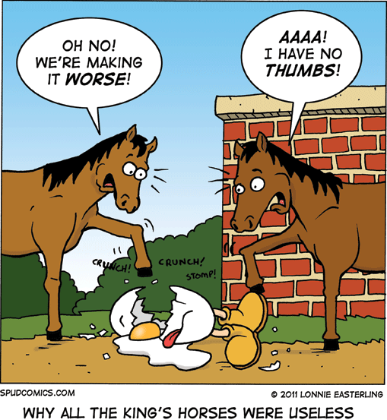
Special Events
Upcoming Service Hour Opportunities!
High School Egg Drop Competition
February 25
Time Shifts: 7:45 – 9; 12:30 – 3
Questions? Contact Adam McCoy:
mccoyad@mail.uc.edu
Habitat for Humanity
March 14
Time: 12:30 – 4
Food Provided!
15 people max
Questions? Contact Spencer Lewis:
lewis2s9@mail.uc.edu

Slide 18
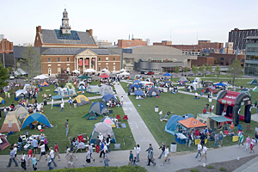
Special Events
Upcoming Service Hour Opportunities!
Matthew 25 Ministries
March 28
Time: 11 - 3
Questions? Contact Jorge Benito Montejo:
benitoje@mail.uc.edu
Relay for Life
April 10 - 11
Time: 6 PM (Friday) – 12 PM (Saturday)
Basically large party to fight cancer!
Questions? Contact Meredith Meads:
meadsmc@mail.uc.edu

Slide 19
Special Events
Upcoming Service Hour Opportunities!
Cleanup Cincy
April
Details to come!
Intramural Soccer
Expect email within the next week
Contact Nathan Ball if interested
ballnn@mail.uc.edu

Slide 20
Recognition
Chair: Christian Lipa
Applications can be found and submitted for Outstanding Senior Awards at https://tribunal.uc.edu/recognition
Any CEAS Senior can apply for one or all three awards: University, College, and Community
Applications are due February 15th at 11:59 P.M.
Interested in joining the Recognition Committee? Contact me at lipacc@mail.uc.edu and fulfill your committee requirement.

Slide 21
Other Announcements

Slide 22
Constructive Criticism
What do you like/dislike about the college?
Comments / Questions?
questions.ceastribunal@gmail.com
What would you like to see Tribunal do next?

Slide 23
Next Meeting:
Monday, February 23rd
525 Old Chem
5:30

