Slide 1
Engineering and Applied Science Tribunal
General Meeting
March 23rd, 2015

Slide 2
Purpose
What we are: CEAS Branch of Student Government
What we do:
Host programs for the college
Input on curriculum, grievances, and student/faculty relations
Improve student experience in the college

Slide 3
President
CEAS TRIBUNAL EXECUTIVE STRUCTURE
Secretary
Treasurer
Vice President
Associate Vice President
Senators (X2)
Technology
Career Fair
Public Affairs
FELD
EWeek
SOCC
Luau
Recognition
Special Events
Collegiate Affairs
OFFICERS are in black. COMMITTEE CHAIRS are in red.

Slide 4
Tribunal Officers
President: |  | Alison Hayfer
Vice President: |  | Carlo Perottino
Associate Vice President: |  | Matt Kitchen
Treasurer: |  | Max Inniger
Secretary: |  | Jared Wood
Senators: |  | Madeline Adams Hannah Kenny

Slide 5
Tribunal Executives
Career Fair: |  | Dane Sowers, Nick Stelzer
Collegiate Affairs: |  | Mark Gruenbacher
EWeek: |  | Alison Hayfer, Kitty DiFalco
FELD: |  | Alexis Conway
Luau: |  | Chris Katuscak
Recognition: |  | Christian Lipa
Public Affairs: |  | Juliann Leny, Logan Buck
SOCC: |  | Nathan Ball
Special Events: |  | Scott Blincoe
Technology: |  | Charlie Hinton

Slide 6
Officer Reports

Slide 7
President
Officer:
Alison Hayfer
Nominations for year long positions
President:
Carlo Perottino
Alison Hayfer
Senators (2):
John Lewnard
Dane Sowers
Kibret Alem

Slide 8
Vice President
Officer:
Carlo Perottino
Office Hours:
Wednesdays 1:30-2:30 PM
Baldwin 650

Slide 9
Associate Vice President
Officer:
Matt Kitchen
Office Hours:
Tuesday/ Thursday 12:45-1:45 PM
Baldwin 650

Slide 10
Senators
Constitution and Bylaws
Student Government Cabinet structure
Joke of the Week!
Why do you never see elephants hiding in trees?

Slide 11
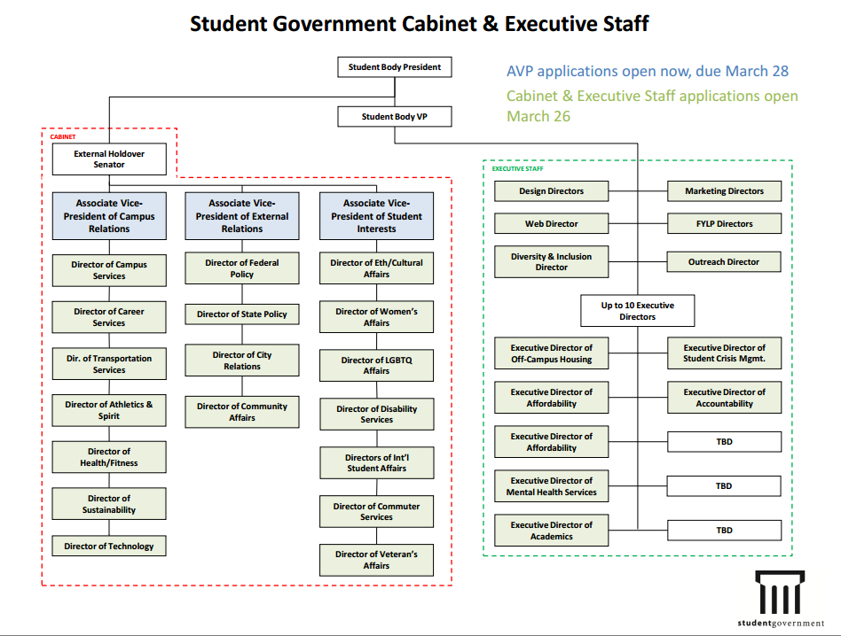
Officer:
Maddie Adams
Hannah Kenny
Senators

Slide 12
Secretary
Officer:
Jared Wood
Please sign in at the back of the room
Must attend and sign in at minimum of 4 meetings each semester to having voting rights

Slide 13
Committee Reports

Slide 14
Special Events
Thanks to those who helped with Habitat!
Matthew 25 Ministries
March 28
Time: 11 – 3
Two spot left!
Questions? Contact Jorge Benito Montejo:
benitoje@mail.uc.edu

Slide 15
Special Events
Upcoming Service Hour Opportunities!
Relay for Life
April 10 - 11
Time: 6 PM (Friday) – 12 PM (Saturday)
Basically large party to fight cancer!
Questions? Contact Meredith Meads:
meadsmc@mail.uc.edu
Cincy Clean-Up
April 4
Time: 9 AM – Noon
Cleanup surrounding Cincinnati neighborhoods!
Questions? Contact Scott Blincoe:
blincosv@mail.uc.edu

Slide 16
Special Events
Sigma Sigma Carnival
April 11
Time: All night on Sigma Sigma Commons
Annual carnival and fireworks show for alumni and students!
Questions? Contact Chris Stone:
stonec5@mail.uc.edu

Slide 17
Order of the Engineer
What’s this all about?
Foster a spirit of pride and responsibility in the engineering profession.
Bridge the gap between training and experience.
Present to the public a visible symbol identifying the engineer.
Any engineer is eligible for induction if he or she has graduated/within one academic year of graduation from an EAC of ABET program or holds a license as a Professional Engineer.
Got Questions? Want to help?
connelmt@mail.uc.edu

Slide 18
Order of the Engineer
ATTENTION ALL CEAS SENIORS:
Be part of a time honored tradition that celebrates the spirit of an engineer; Order of the Engineer
Ring sizing NEXT WEEK! (March 30th – April 3rd) in 650 Baldwin (Tribunal office)
Monday – Friday 11:30am – 2:00pm
Monday 9am- 10am
10$ cash or check made out to “CEAS Tribunal” to pay for ring
Ceremony will be on Friday, May 1st
Can’t make these times:
Email Maggie Connell: connelmt@mail.uc.edu
Notes:
Order of the Engineer is a ceremony that all CEAS seniors can take part in. Engineers take an oath and receive a ring during the ceremony. The ceremony is supposed to foster a spirit of pride and responsibility in the engineering profession and bridge the gap between training and experience.

Slide 19
Recognition
Chair:
Christian Lipa
Professor and TA of the Semester nominations
Due April 15 at 5:00 PM
Applications found and submitted at tribunal.uc.edu/recognition
Class of the winning TA and Professor will receive a food party on behalf of the tribunal
Freshman and Junior of the Year applications
Due April 15 at 5:00 PM
Applications found and submitted at tribunal.uc.edu/recognition
Winners receive a $500 scholarship on behalf of the tribunal
Join Recognition Committee!!!!
Read nominations to help select winner. Read scholarship applications.
MINIMUM commitment. Easy committee requirement!
Email lipacc@mail.uc.edu to join

Slide 20
Other Announcements

Slide 21
Egg Throw with Phi Rho!
Every team will compete against each other in series of Easter themed activities, including an egg hunt, egg painting, and an egg throw.
To enter:
Only $60 for a team of 4. Every participant receives a T-shirt!
Email ucphirho.philanthropy@gmail.com by April 8th to register.
Prizes:
1st Place: Receives an Easter basket and 15% of the proceeds will go to philanthropy of their choosing
2nd Place: Receives an Easter basket and 5% of the proceeds will go to philanthropy of their choosing
3rd Place: Receives an Easter basket
All other proceeds will go to the Leukemia & Lymphoma Society.

Slide 22
TEDx Cincinnati
Our own Maddie Adams will be the student speaker!!
Friday 3PM
Tickets are $15 for students

Slide 23
RAFFLE!

Slide 24
Constructive Criticism
What do you like/dislike about the college?
Comments / Questions?
questions.ceastribunal@gmail.com
What would you like to see Tribunal do next?

Slide 25
Next Meeting:
Monday, April 6th
525 Old Chem
5:30

