Slide 1
Engineering and Applied Science Tribunal
General Meeting
June 1, 2015

Slide 2
Agenda:
Dean Lim Presentation
Officer Reports
Committee Reports
Raffle

Slide 3
Dean Teik Lim!

Slide 4
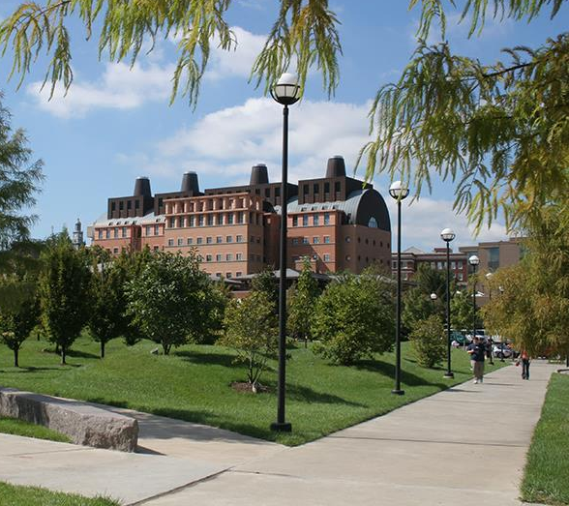
Teik C. Lim, Dean COLLEGE OF ENGINEERING & APPLIED SCIENCE
Enhancing Students’ experience
President’s 3rd Century initiative
Faculty hiring, 50 in 5 plan
Retention effort
ASSET (Advancing Student Success in Engrg & Tech)
Improve lab capabilities and capacities
Steady-state, 4000 undergrads & 1000 grads
Diversity (more female and minority students)
More undergraduate scholarships
More research & entrepreneurship opportunities
Global strategy, JCI, FUE, TUM, Bordeaux,…
More resources for CEAS
Opportunities for our students to learn globally
Build a reputation for CEAS

Slide 5
Purpose
What we are: CEAS Branch of Student Government
What we do:
Host programs for the college
Input on curriculum, grievances, and student/faculty relations
Improve student experience in the college

Slide 6
President
CEAS TRIBUNAL EXECUTIVE STRUCTURE
Secretary
Treasurer
Vice President
Associate Vice President
Senators (X2)
Technology
Career Fair
Public Affairs
FELD
EWeek
SOCC
Luau
Recognition
Special Events
Collegiate Affairs
OFFICERS are in black. COMMITTEE CHAIRS are in red.

Slide 7
Tribunal Officers
President: |  | Carlo Perottino
Vice President: |  | Maggie Connell
Associate Vice President: |  | Dane Sowers
Treasurer: |  | Max Inniger
Secretary: |  | McKenzie Kinzbach
Senators: |  | John Lewnard Varun Nagarajan

Slide 8
Tribunal Executives
Career Fair: |  | Dane Sowers Tim Kemper Nick Stelzer
Collegiate Affairs: |  | Mark Gruenbacher
EWeek: |  | Alison Hayfer Andrew Bachus
FELD: |  | Alexis Conway
Luau: |  | Chris Katuscak
Recognition: |  | Jared Wood
Public Affairs: |  | Meredith Meads
SOCC: |  | Juanita Dickhaus
Special Events: |  | Samantha Dunker
Technology: |  | Michael Santacroce

Slide 9
Officer Reports

Slide 10
President
Officer:
Carlo Perottino
Any questions or comments about the college or Tribunal? Email me!
perottca@mail.uc.edu

Slide 11
Vice President
Officer:
Maggie Connell
Office Hours:
Monday, 6pm-7pm
Baldwin 650

Slide 12
Associate Vice President
Officer:
Dane Sowers
Office Hours:
Tuesday, 1pm-2pm
Baldwin 650
Have questions and can’t make office hours? Email me at sowersdd@mail.uc.edu!

Slide 13
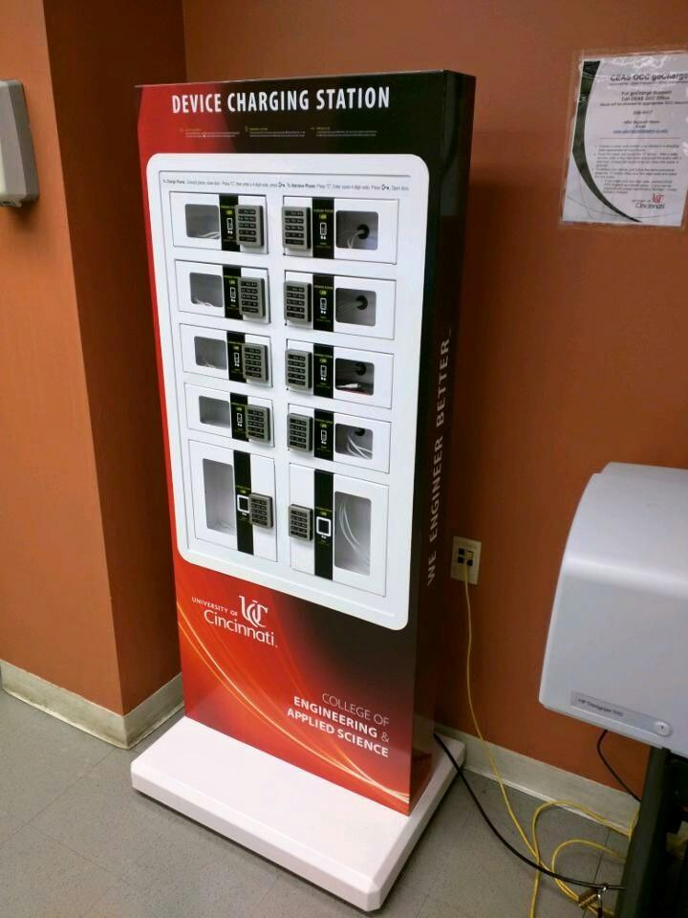
Associate Vice President
Officer:
Dane Sowers
GoCharge Station
Now located in 617 ERC over by the plotter
Tell your friends -- if this one gets used a lot we may look into purchasing additional units for other places in CEAS!

Slide 14
Treasurer
Officer:
Max Inniger
Office Hours:
Tuesday, 1pm-2pm
Baldwin 650

Slide 15
Secretary
Officer:
McKenzie Kinzbach
Please sign in at the back of the room
Must attend and sign in at minimum of 4 meetings each semester to having voting rights

Slide 16
Senators
Officers:
John Lewnard
Varun Nagarajan
John Lewnard
Office Hours:
Monday, 10:30am-11:30am, Baldwin 650
Varun Nagarajan
Office Hours:
Monday, 6pm-7pm, Baldwin 650

Slide 17
Senators Cont.
Officers:
John Lewnard
Varun Nagarajan
Bearcats at the ballpark – June 17
UC’s annual night at Reds; 800 students last year
Discounted tickets at reds.com/bearcats
Prez Ono plans to attend
American Society for Quality
Next Senate meeting – June 13 at 11am

Slide 18
Committee Reports

Slide 19
Luau
• What it is: Our yearly celebration for engineers at the beach waterpark that includes a day at the beach waterpark, food, and drinks for those of you of age
• When is it: June 27th 2015
• Want tickets: Tickets will be sold June 15th-26th in Baldwin Lobby from 10 am – 2 pm for $30
• Questions? katuscca@mail.uc.edu

Slide 20
Special Events
Committee Chair:
Samantha Dunker
Expect an email soon with possible dates for all events listed below
Events in the planning stages:
Community Service
Reds Game
Dayton Dragons Game
Columbus Crew Game
Downtown Day (Salsa on the Square)
Camping Trip to Red River Gorge
Email Sam Dunker: dunkerse@mail.uc.edu if you’d like to join!

Slide 21
Public Affairs
Committee Chair:
Meredith Meads
Be the first to hear about upcoming events:
Follow us on Twitter @UCTribunal
Like our Facebook page The UC Engineering and Applied Science Tribunal
New professional headshot day
To get involved contact meadsmc@mail.uc.edu

Slide 22
Other Announcements

Slide 23
RAFFLE!

Slide 24
Constructive Criticism
What do you like/dislike about the college?
Comments / Questions?
questions.ceastribunal@gmail.com
What would you like to see Tribunal do next?

Slide 25
Next Meeting:
June 15, 2015
5:30pm
525 Old Chem

