Slide 1
Engineering and Applied Science Tribunal
General Meeting
July 13, 2015

Slide 2
Agenda:
Spring 2016 Nominations
Fall 2015 Committee Chairs
Officer Reports
Committee Reports
Raffle

Slide 3
Spring 2016 Nominations
VP:
Dane Sowers
AVP:
Kenzie K.
Mark G.
Treasurer:
Max I.
Secretary:
Frazier Baker

Slide 4
Spring 2016 Nominations Cont.
Nominations will stay open till the elections on 7/27/2015.
Nominations can be emailed to perottca@mail.uc.edu
All nominations are conditional till eligibility is checked.

Slide 5
Fall 2015 Committee Chair Applications
Fall 2015 Committee Chair applications will soon be emailed out to the college.
Applications are reviewed by the semester’s President, VP, and AVP.
Selections will be made before the Fall 2015 semester begins.

Slide 6
Purpose
What we are: CEAS Branch of Student Government
What we do:
Host programs for the college
Input on curriculum, grievances, and student/faculty relations
Improve student experience in the college

Slide 7
President
CEAS TRIBUNAL EXECUTIVE STRUCTURE
Secretary
Treasurer
Vice President
Associate Vice President
Senators (X2)
Technology
Career Fair
Public Affairs
FELD
EWeek
SOCC
Luau
Recognition
Special Events
Collegiate Affairs
OFFICERS are in black. COMMITTEE CHAIRS are in red.

Slide 8
Tribunal Officers
President: |  | Carlo Perottino
Vice President: |  | Maggie Connell
Associate Vice President: |  | Dane Sowers
Treasurer: |  | Max Inniger
Secretary: |  | McKenzie Kinzbach
Senators: |  | John Lewnard Varun Nagarajan

Slide 9
Tribunal Executives
Career Fair: |  | Dane Sowers Tim Kemper Nick Stelzer
Collegiate Affairs: |  | Mark Gruenbacher
EWeek: |  | Alison Hayfer Andrew Bachus
FELD: |  | Alexis Conway
Luau: |  | Chris Katuscak
Recognition: |  | Jared Wood
Public Affairs: |  | Meredith Meads
SOCC: |  | Juanita Dickhaus
Special Events: |  | Samantha Dunker
Technology: |  | Michael Santacroce

Slide 10
Officer Reports

Slide 11
President
Officer:
Carlo Perottino
Any questions or comments about the college or Tribunal? Email me!
perottca@mail.uc.edu

Slide 12
Vice President
Officer:
Maggie Connell
Office Hours:
Monday, 6pm-7pm
Baldwin 650

Slide 13
Associate Vice President
Officer:
Dane Sowers
Office Hours:
Tuesday, 1pm-2pm
Baldwin 650

Slide 14
Treasurer
Officer:
Max Inniger
Office Hours:
Tuesday, 1pm-2pm
Baldwin 650

Slide 15
Secretary
Officer:
McKenzie Kinzbach
Please sign in at the back of the room
Must attend and sign in at minimum of 4 meetings each semester to having voting rights

Slide 16
Senators
Officers:
Jahn Lewnard
Varun Nagarajan
Jahn Lewnard
Office Hours:
Monday, 10:30am-11:30am, Baldwin 650
Varun Nagarajan
Office Hours:
Monday, 6pm-7pm, Baldwin 650

Slide 17
Senator Report Cont.
Officers:
Varun Nagarajan
Jahn Lewnard
Next Senate Meeting: July 18th, at 10 A.M, in 407 Teacher’s College (Annie Laws Conference Room)
SG Hackathon: Taking place after the Senate Meeting – will be developing action plans to address issues at UC

Slide 18
Committee Reports

Slide 19
Innovation Committee
Committee Chair:
Emily Demjanenko
New committee to initiate projects and ideas to better the college and support CEAS students
Committee is currently being formed!
Want to get involved?
demjanes@mail.uc.edu

Slide 20
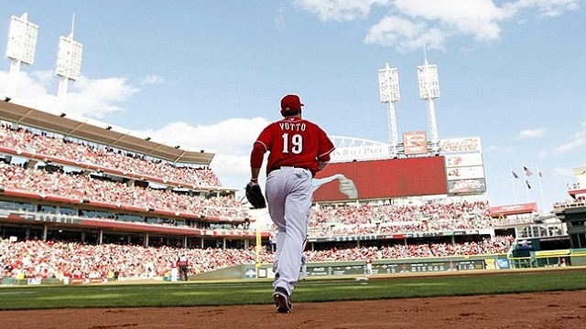
Reds Game
Committee Chair:
Sam Dunker
FREE TICKET for the game THIS FRIDAY!
First email wins the ticket
Email dunkerse@mail.uc.edu if you would like the ticket!

Slide 21
Recognition
Chair:
Jared Wood
Engineering Professor and TA of the Semester applications will close July 20th
Email wood2jt@mail.uc.edu if interested in joining Recognition Committee
Read award nominations to help select winners

Slide 22
Collegiate Affairs
Chair:
Mark Gruenbacher
Open Forum
What is it?
An opportunity for you to express your concerns and comments about anything relatable to the college (curriculum, co-op, faculty, etc…)
When?
After today’s general meeting
Where?
This room, at the bottom of the room

Slide 23
Public Affairs
Chair:
Meredith Meads
Be the first to hear about upcoming events:
Follow us on Twitter @UCTribunal
Like our Facebook page The UC Engineering and Applied Science Tribunal
To get involved contact meadsmc@mail.uc.edu
To rent a Baldwin table go to tribunal.uc.edu/socc/table-reservation
Survey regarding weekly newsletter

Slide 24
SOCC
Chair:
Juanita Dickhaus
Student Organizations Communications Committee (SOCC) is dedicated to helping CEAS student organizations.
Planning meeting: July 21st, 5:00 PM at Baldwin 650.
Next SOCC workshop: TBD; check for email soon!
If your organization isn't on the SOCC listserv or FB group, please email me to be added.
Email questions or comments at dickhajm@mail.uc.edu.

Slide 25
Other Announcements

Slide 26
RAFFLE!

Slide 27
Constructive Criticism
What do you like/dislike about the college?
Comments / Questions?
questions.ceastribunal@gmail.com
What would you like to see Tribunal do next?

Slide 28
Next Meeting:
July 27, 2015
5:30pm
525 Old Chem

