Slide 1
Engineering and Applied Science Tribunal
General Meeting
June 15, 2015

Slide 2
Agenda:
Officer Reports
Committee Reports
Raffle

Slide 3
Purpose
What we are: CEAS Branch of Student Government
What we do:
Host programs for the college
Input on curriculum, grievances, and student/faculty relations
Improve student experience in the college

Slide 4
President
CEAS TRIBUNAL EXECUTIVE STRUCTURE
Secretary
Treasurer
Vice President
Associate Vice President
Senators (X2)
Technology
Career Fair
Public Affairs
FELD
EWeek
SOCC
Luau
Recognition
Special Events
Collegiate Affairs
OFFICERS are in black. COMMITTEE CHAIRS are in red.

Slide 5
Tribunal Officers
President: |  | Carlo Perottino
Vice President: |  | Maggie Connell
Associate Vice President: |  | Dane Sowers
Treasurer: |  | Max Inniger
Secretary: |  | McKenzie Kinzbach
Senators: |  | John Lewnard Varun Nagarajan

Slide 6
Tribunal Executives
Career Fair: |  | Dane Sowers Tim Kemper Nick Stelzer
Collegiate Affairs: |  | Mark Gruenbacher
EWeek: |  | Alison Hayfer Andrew Bachus
FELD: |  | Alexis Conway
Luau: |  | Chris Katuscak
Recognition: |  | Jared Wood
Public Affairs: |  | Meredith Meads
SOCC: |  | Juanita Dickhaus
Special Events: |  | Samantha Dunker
Technology: |  | Michael Santacroce

Slide 7
Officer Reports

Slide 8
President
Officer:
Carlo Perottino
Any questions or comments about the college or Tribunal? Email me!
perottca@mail.uc.edu

Slide 9
Vice President
Officer:
Maggie Connell
Office Hours:
Monday, 6pm-7pm
Baldwin 650

Slide 10
Associate Vice President
Officer:
Great Dane Sowers
Office Hours:
Tuesday, 1pm-2pm
Baldwin 650

Slide 11
Treasurer
Officer:
Max Inniger
Office Hours:
Tuesday, 1pm-2pm
Baldwin 650

Slide 12
Secretary
Officer:
McKenzie Kinzbach
Please sign in at the back of the room
Must attend and sign in at minimum of 4 meetings each semester to having voting rights

Slide 13
Senators
Officers:
Jahn Lewnard
Varun Nagarajan
John Lewnard
Office Hours:
Monday, 10:30am-11:30am, Baldwin 650
Varun Nagarajan
Office Hours:
Monday, 6pm-7pm, Baldwin 650

Slide 14
Senator report
Officers:
Varun Nagarajan
Jahn Lewnard
Bearcats at the ballpark – June 17
UC’s annual night at Reds; 800 students last year
Discounted tickets at reds.com/bearcats
Prez Ono plans to attend
Meal equivalency bill passed
Swipes for Papa John’s in the spring
Langsam renovation
EFC – Elections facilitation committee
Next Senate meeting – July 18th

Slide 15
Senator Report
Officers:
Varun Nagarajan
Jahn Lewnardc
Grill Outs:
June 17: 5:00 pm to 6:30 pm in Schneider Quad
June 25: 5:00 pm to 6:30 pm in Schneider Quad
Selling Luau Tickets and taking suggestions for Tribunal and College
Freshmen Resume Update
Innovation Committee

Slide 16
Committee Reports

Slide 17
Luau
What it is: Our yearly celebration for engineers at the beach waterpark that includes a day at the beach waterpark, food, and drinks for those of you of age
When is it: Saturday, June 27th, 2015
Want tickets: Tickets will be sold every day this week and next week in Baldwin Lobby, from 10:00AM to 2:00PM
There will also be two evening sales, June 18th and June 23rd from 7:00-8:00PM
Any Questions? Please contact Andy Droesch at droescaj@mail.uc.edu or Chris Katuscak at katuscca@mail.uc.edu

Slide 18
SOCC
Chair:
Juanita Dickhaus
Student Organizations Communications Committee (SOCC) is a Tribunal committee dedicated to helping CEAS organizations and fostering collaboration between them.
Monthly planning meetings are the 3rd Tuesday of each month.
Next planning meeting: June 16th, 5:00 PM at Baldwin 650 (tomorrow, Tribunal's office).
Workshops are for organization presidents or their reps. We focus on student organization issues such as fall recruitment, retention, and funding.
First summer workshop: Thursday, June 26th, 6pm-7pm. Email will go out to SOCC listserv regarding location and food.
Email me with any questions or comments at dickhajm@mail.uc.edu.

Slide 19
Collegiate Affairs Open Forum
Chair:
Mark Gruenbacher
Any concerns or suggestions about the college?
Can range from:
Curriculum
Professors
Facilities
Co-op
Etc…
We are here to help you!
Forums will take place after each meeting beginning in two weeks!

Slide 20
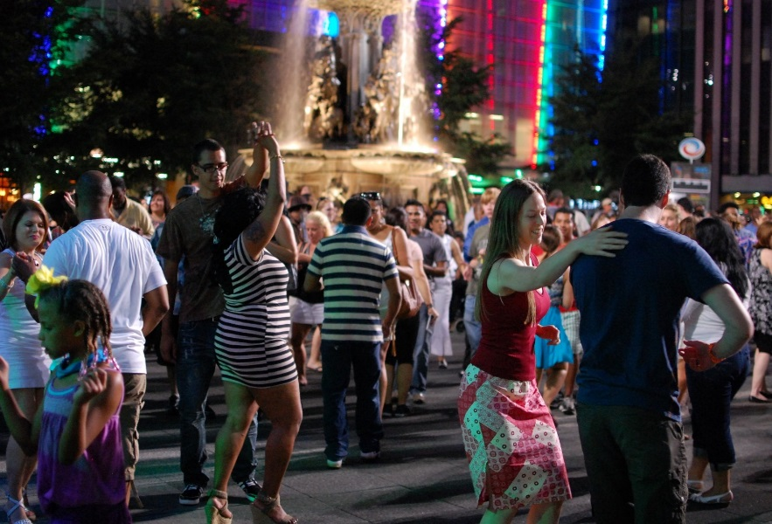
Special Events
Committee Chair:
Samantha Dunker
Reds Game
Date: July 17th at 7:10pm
Salsa on the Square
Dates: July 9th
Google document will be sent out tonight!

Slide 21
Public Affairs
Committee Chair:
Meredith Meads
Be the first to hear about upcoming events:
Follow us on Twitter @UCTribunal
Like our Facebook page The UC Engineering and Applied Science Tribunal
To get involved contact meadsmc@mail.uc.edu

Slide 22
Other Announcements

Slide 23
RAFFLE!

Slide 24
Constructive Criticism
What do you like/dislike about the college?
Comments / Questions?
questions.ceastribunal@gmail.com
What would you like to see Tribunal do next?

Slide 25
Next Meeting:
June 29, 2015
5:30pm
525 Old Chem

