Slide 1
CEAS Tribunal
General Meeting
July 17th, 2017

Slide 2
Agenda
Our Purpose
Committee Updates
Officer Nominations

Slide 3
Our Purpose
We serve as the CEAS Branch of Student Government
What we do:
Academic Representation
Fun Programs and Events
Initiatives that better student experience in CEAS

Slide 4
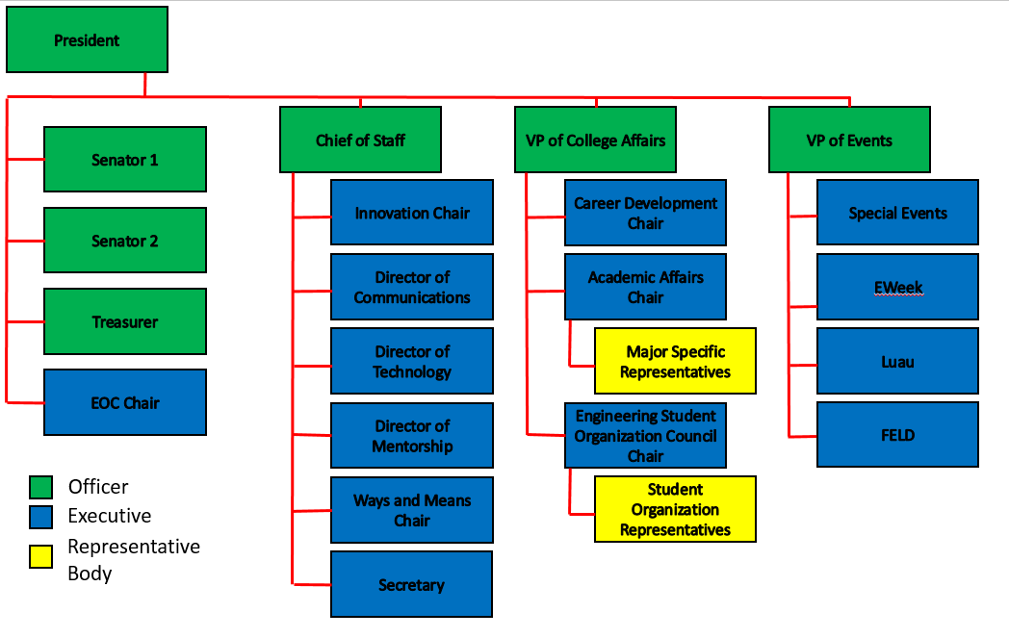
Organizational Chart

Slide 5
Officers
President Dane Sowers
VP of Collegiate Affairs Chris Stone
VP of Events Emma Lowe
Chief of Staff Ashley Ramsey
Treasurer Jim Ohler
Senators Chris Stone
Emma Lowe

Slide 6
Committee Chairs
Academic Affairs Katie Feeney
Career Development Nathan Hamit
Grant Schroeder
Communications Alex Hoffman
ESOC Ezra Babcock
EWeek Kristen Urasek
FELD Konnor Barnes
Innovation Elijah Ditchendorf
Luau Nick Oslin
Mentorship Emily Demjanenko
Kareem Elgafy
Special Events Hao Tran
Secretary Matthew Steinkirchner
Technology Rainor Tangvald

Slide 7
Senator Report
5 Student Court justices were confirmed at the last Senate meeting: Khaled Aboumerhi, Clement Coleman, Dominique Francisco, Catherine Reinhart, and Alyse Weinstein
Bearcat Card Expansion to OTR

Slide 8
Special Events
Tribunal Takes on Newport Aquarium
Date: July 22nd
Time: 9:30am-11:30am
Tickets are only $5!!!
Sign up at https://goo.gl/forms/1cP88hL7cmRaWRd53
Payments can be made to Venmo (@Aiden-Nguyen-3) or Baldwin 650 from 3pm-5pm

Slide 9
Luau
Nick Oslin
oslinnd@mail.uc.edu
Thank you to everyone who came to Luau, we hope everyone had a great time!
There are some lost-and-found items in the Tribunal office (650 Baldwin). You can also contact me if you think you lost something
I will be sending out a post-Luau survey this week.

Slide 10
Recognition Awards
Professor and TA of the Semester nomination forms are coming out this week, be on the lookout for an email with more details!

Slide 11
Officer Nominations
VP of Collegiate Affairs (Fall 2017)
- Chris Stone
- Emma Lowe
VP of Collegiate Affairs (Spring 2018)
Chris Stone
Nathan Hamit
VP of Events (Spring 2018)
Andy Droesch
- Christian Donovan
Treasurer (Spring 2018)
Jim Ohler

Slide 12
Social Media
Want to get updates about events and other things happening in CEAS, and also possibly win some cool prizes? Follow us on social media!
https://facebook.com/UCTribunal
@UCTribunal

Slide 13
We Want to Hear From You!
Do you have an idea, question, or concern? We want to be a resource for you! You can reach us in the following ways:
Engaging with our social media accounts
Emailing any one of our exec members (the full list is on our website at tribunal.uc.edu)
Stopping by our office in 650 Baldwin

Slide 14
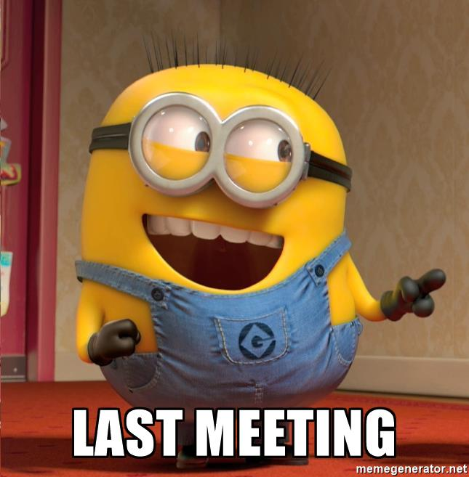
Next Meeting: July 31st!

