Slide 1
CEAS Tribunal
General Meeting
June 19th, 2017

Slide 2
Agenda
Hyperloop UC Presentation
Our Purpose
Committee Overviews
CEAS Tribunal Events

Slide 3
Hyperloop UC

Slide 4
Our Purpose
We serve as the CEAS Branch of Student Government
What we do:
Academic Representation
Fun Programs and Events
Initiatives that better student experience in CEAS

Slide 5
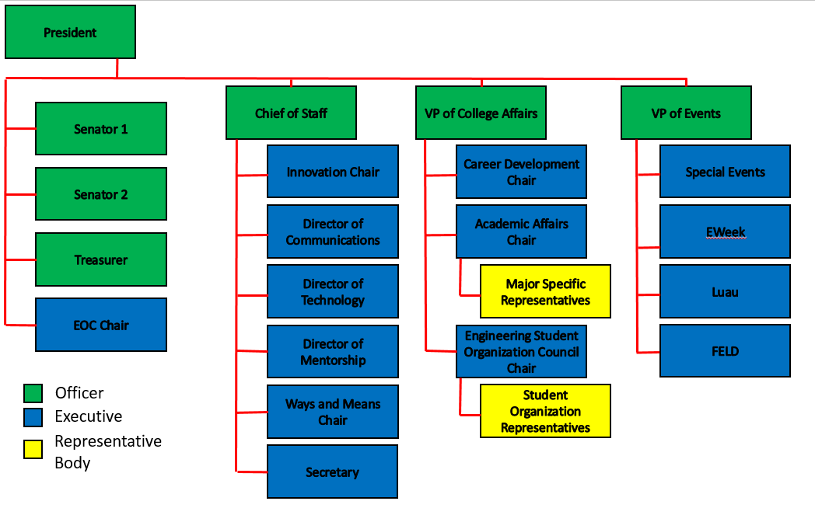
Organizational Chart

Slide 6
Officers
President Dane Sowers
VP of Collegiate Affairs Chris Stone
VP of Events Emma Lowe
Chief of Staff Ashley Ramsey
Treasurer Jim Ohler
Senators Chris Stone
Emma Lowe

Slide 7
Senate Report
Chris Stone and Emma Lowe
stonec5@mail.uc.edu
loweea@mail.uc.edu
Senate approved 6 bills at our meeting last week
Bearcountability: 10% Retreat Spending Cap
Bearcountability: $3000 Appropriation Notification
Constitution and By-laws Updates
New Website Appropriations Bill
Women in SG Resolution Bill
SG retreat Appropriations bill
Retreat will cost $4,572
July 22-23 in Columbus

Slide 8
Committee Chairs
Academic Affairs Katie Feeney
Career Development Nathan Hamit
Grant Schroeder
Communications Alex Hoffman
ESOC Ezra Babcock
EWeek Kristen Urasek
FELD Konnor Barnes
Innovation Elijah Ditchendorf
Luau Nick Oslin
Mentorship Emily Demjanenko
Kareem Elgafy
Special Events Hao Tran
Secretary Matthew Steinkirchner
Technology Rainor Tangvald

Slide 9
Luau
Nick Oslin
oslinnd@mail.uc.edu
Our yearly celebration for engineers at The Beach Waterpark that includes admission, a towel, food, and drinks for those of you of age
Saturday, July 8th 2017
Ticket Sales: ($25)
10am-2pm on June 26th-30th and July 3rd-7th in Baldwin Lobby
July 3rd-7th during any evening Tribunal events
Bus pickup:
McMicken Hall at 11 am and 12:30 pm
In addition to our event, The Beach is hosting their Sip and Slide event, complete with beer tasting and live music from The Naked Karate Girls!
Notes:
In case anyone has questions:
- From 4 - 6 pm, we will have our cookout in the pavilion area b/c the park will be closed at that time to set up for the Sip and Slide event
After that, the park will remain open to us and some others for their Sip and Slide event, which consists of beer tasting and live music from The Naked Karate Girls
Tickets for the beer tasting are not included in your Engineering Luau ticket
The Naked Karate Girls:
Cover band
Free concert with your Luau ticket
Everyone going must ride the busses there and back!
Note the change of pickup location due to Myers Alumni center being torn down!

Slide 10
Luau
Nick Oslin
oslinnd@mail.uc.edu
This Year’s Towel

Slide 11
Innovations Committee Meetings
Elijah Ditchendorf
ditcheeh@mail.uc.edu
Innovations is a branch of CEAS Tribunal that works to improve the college
If you are interested in making our college a better place come to our meetings.
Our first meeting will be this Thursday 06/22/17 at 6:30pm room TBD

Slide 12
Social Media
Want to get updates about events and other things happening in CEAS, and also possibly win some cool prizes? Follow us on social media!
https://facebook.com/UCTribunal
@UCTribunal

Slide 13
We Want to Hear From You!
Do you have an idea, question, or concern? We want to be a resource for you! You can reach us in the following ways:
Engaging with our social media accounts
Emailing any one of our exec members (the full list is on our website at tribunal.uc.edu)
Stopping by our office in 650 Baldwin

Slide 14
Meeting Food
Tribunal is know purchasing a variety of food for our meetings
We are trying to differentiate our food from many other clubs that have pizza at there meetings
If you have suggestions for food send them to uc.eas.tribunal@gmail.com

Slide 15
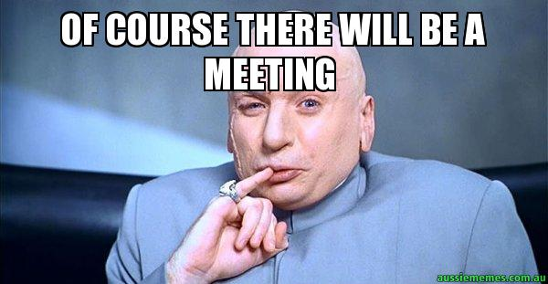
Next Meeting: July 17th!

