Slide 1
Engineering and Applied Science Tribunal
General Meeting
May 8, 2017

Slide 2
Agenda
Our Purpose
Committee Overviews
CEAS Tribunal Events

Slide 3
Our Purpose
We serve as the CEAS Branch of Student Government
What we do:
Academic Representation
Fun Programs and Events
Initiatives that better student experience in CEAS

Slide 4
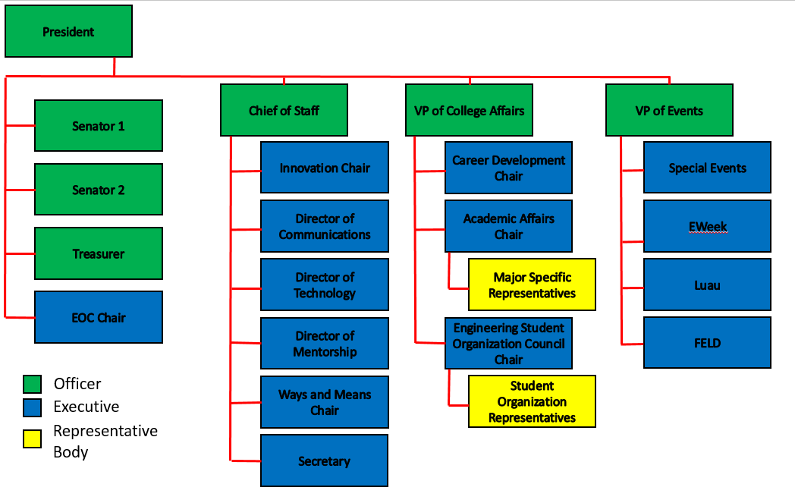
Organizational Chart

Slide 5
Officers
President Dane Sowers
VP of Collegiate Affairs Chris Stone
VP of Events Emma Lowe
Chief of Staff Ashley Ramsey
Treasurer Jim Ohler
Senators Chris Stone
Emma Lowe

Slide 6
Committee Chairs
Academic Affairs Katie Feeney
Career Development Nathan Hamit
Grant Schroeder
Communications Alex Hoffman
ESOC Ezra Babcock
EWeek Kristen Urasek
FELD Konnor Barnes
Innovation Elijah Ditchendorf
Luau Nick Oslin
Mentorship Emily Demjanenko
Kareem Elgafy
Special Events Hao Tran
Secretary Matthew Steinkirchner
Technology Rainor Tangvald

Slide 7
Senator Report
- First summer senate meeting Saturday, May 13th at Noon
- Will be discussing Bearcountability Bill
- If you are part of student organization and want your achievements to be recognized email me at stonec5@mail.uc.edu

Slide 8
Special Events
Purpose: Committee that hosts fun events and service events for members
Potential Events:
Reds Games
Kings Island
Different Festivals
Canoeing
Habitat For Humanity Project
Committee Meetings:
Time: TBD
Location: Baldwin 655
Contact: Hao Tran @ tranno@mail.uc.edu

Slide 9
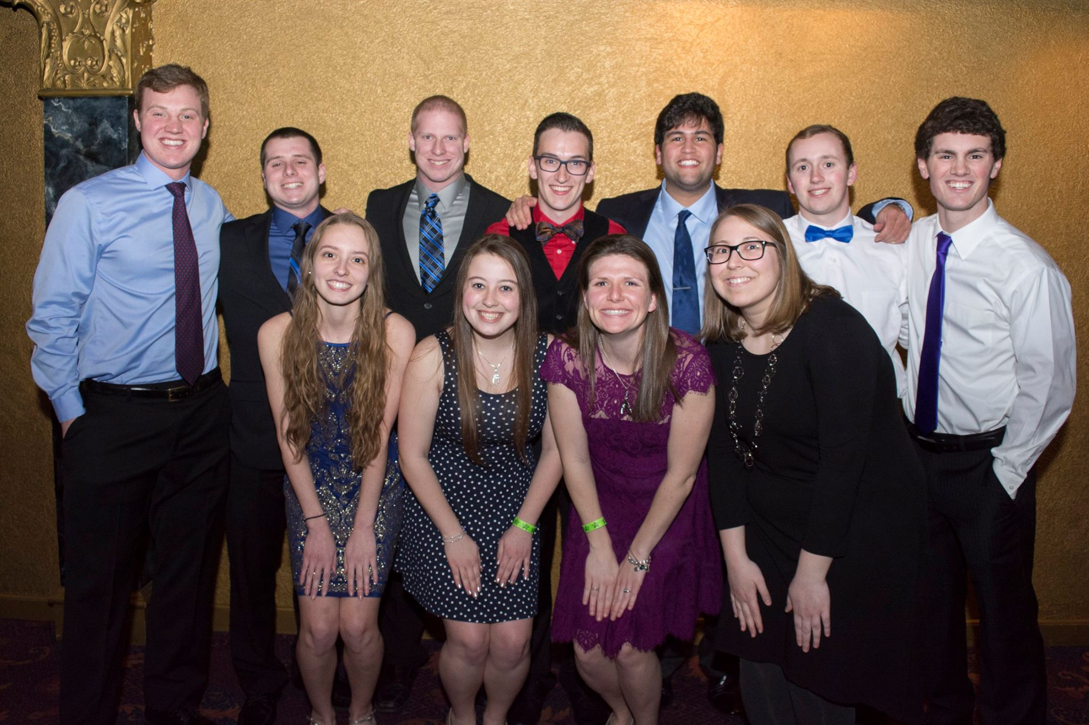
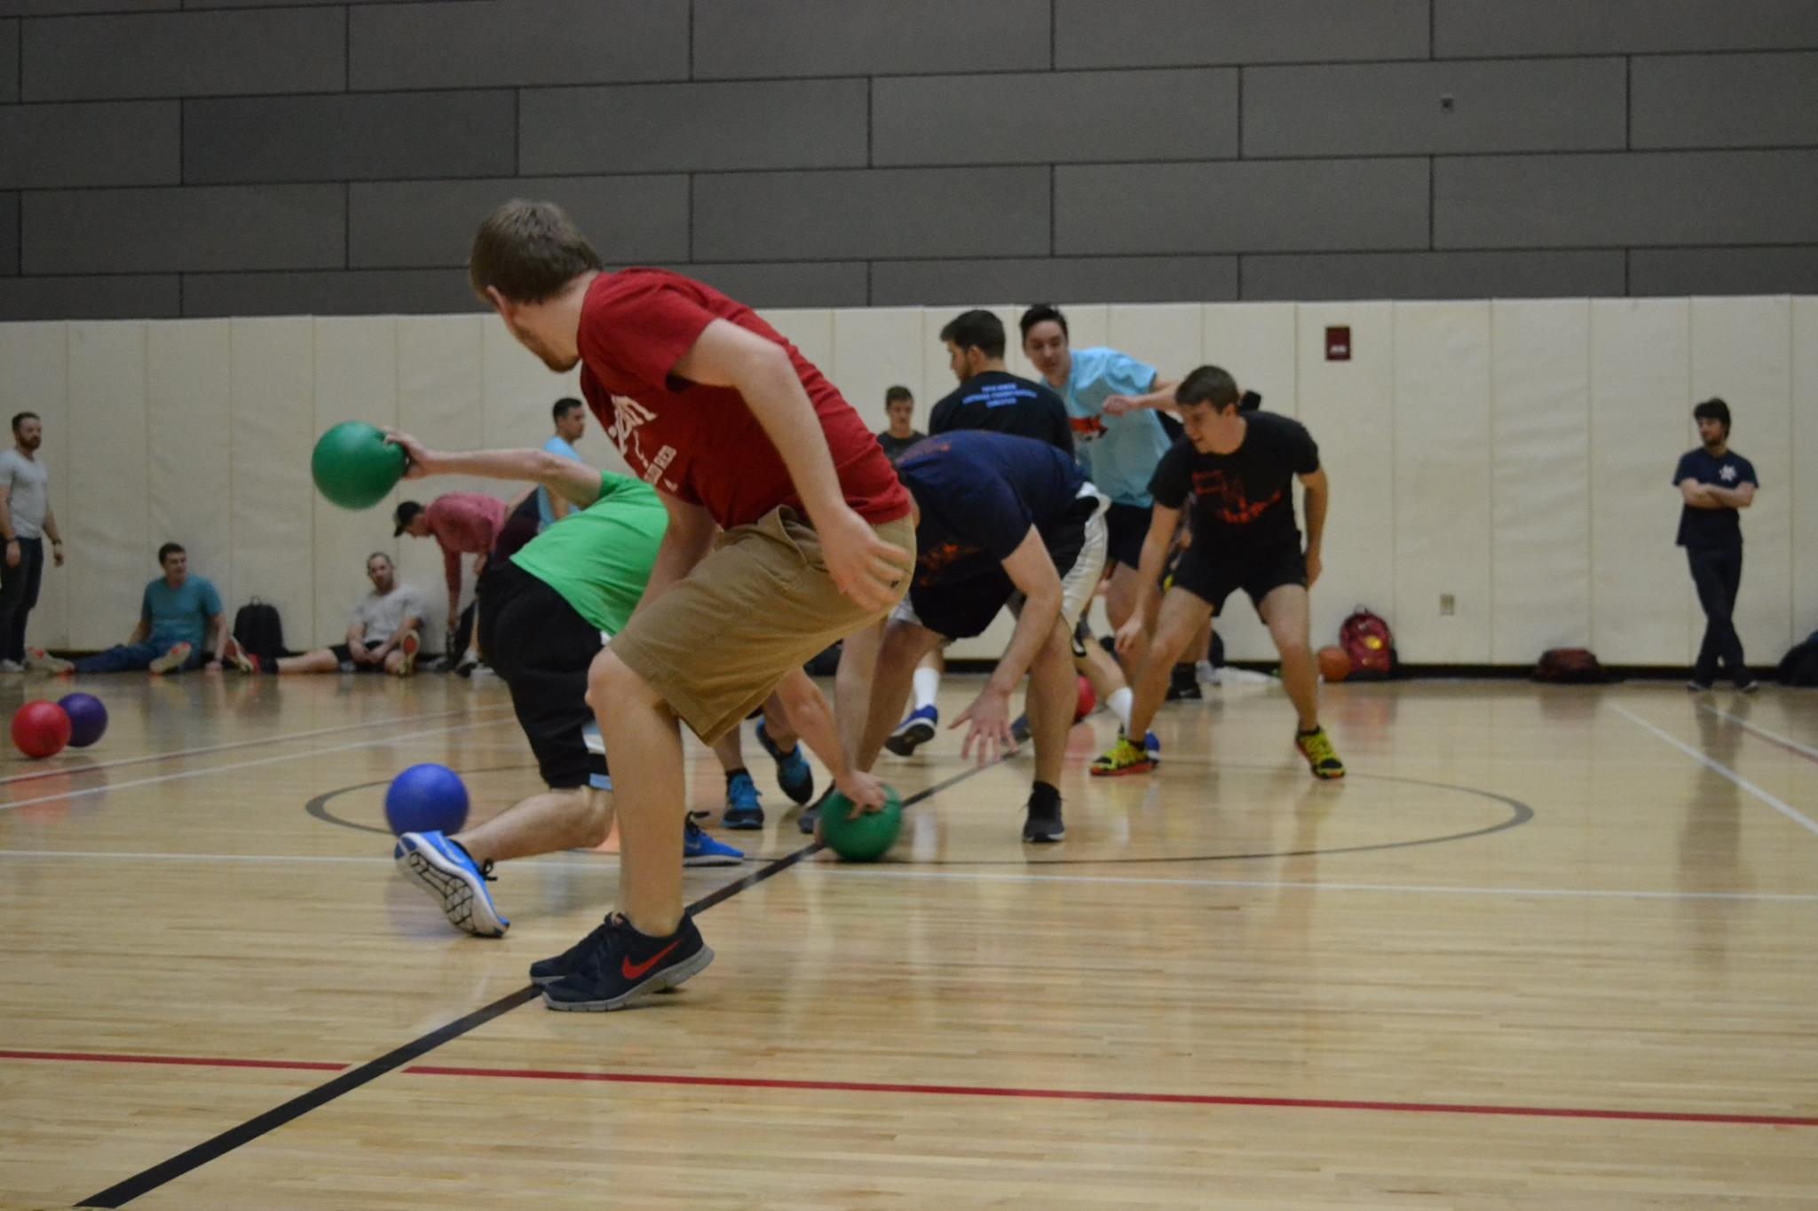
EWeek
Chair:
Kristen Urasek
urasekkm@mail.uc.edu
Did you attend EWeek this year? Please fill out our survey to help us gather feedback & improve for next year! https://tinyurl.com/uceweek2017
Although I am away for the summer, I am working on new ideas and trying to come up with next year’s theme. If you want to get involved, send an email to UC.EWeek@gmail.com and I’ll be in touch!

Slide 10
Luau
Chair:
Nick Oslin
oslinnd@mail.uc.edu
What it is: Our yearly celebration for engineers at The Beach Waterpark that includes admission, a towel, food, and drinks for those of you of age
When is it?
Saturday, July 8th 2017
How much?
$25
When are we selling tickets?
2 weeks prior to the event
If you want to submit a towel design, send me an email with the design. If your design wins, you get a free ticket!

Slide 11
Join Tribunal Technology Committee!
Do your part to better the student experience while gaining hands-on experience fields such as:
Website Development
3D Printing
Data Management Systems
… and so much more!
If interested, email Rainor Tangvald at tangvarl@mail.uc.edu

Slide 12
Social Media
Want to get updates about events and other things happening in CEAS? Follow us on social media!
https://facebook.com/UCTribunal
@UCTribunal

Slide 13
We Want to Hear From You!
Do you have an idea, question, or concern? We want to be a resource for you! You can reach us in the following ways:
Engaging with our social media accounts
Emailing any one of our exec members (the full list is on our website at tribunal.uc.edu)
Stopping by our office in 650 Baldwin

Slide 14
Resources Available to You
Tutoring Center
Baldwin 860 B
Women’s Center
Steger Student Life Center, Suite 571
Title IX Office
3115 Edwards 1
LGBTQ Center
565 Steger Student Life Center
AACRC
60 W. Charlton St
RAPP
455 Steger Student Life Center
Ethnic Programs and Services
555 Steger Student Life Center
Disability Services
210 University Pavilion
Veterans Programs and Services
230 University Pavilion
Wellness Center
Steger Student Life Center Room 675
CAPS
225 Calhoun Street, Suite 200

Slide 15
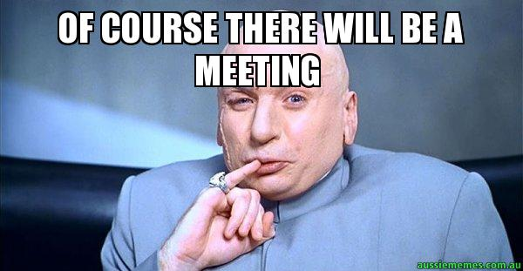
Next Meeting: May 22nd!

