Slide 1
CEAS Tribunal
General Meeting
May 22, 2017

Slide 2
Agenda
Engineering Diplomats Presentation
Our Purpose
Committee Overviews
CEAS Tribunal Events

Slide 3
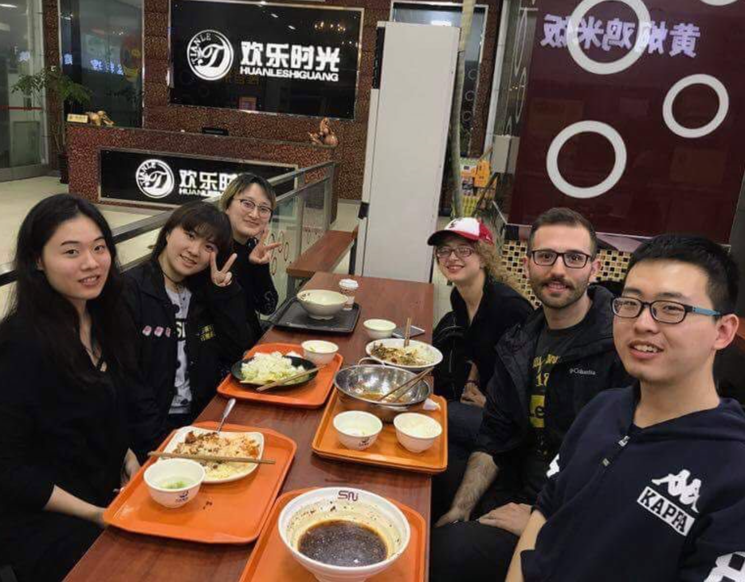
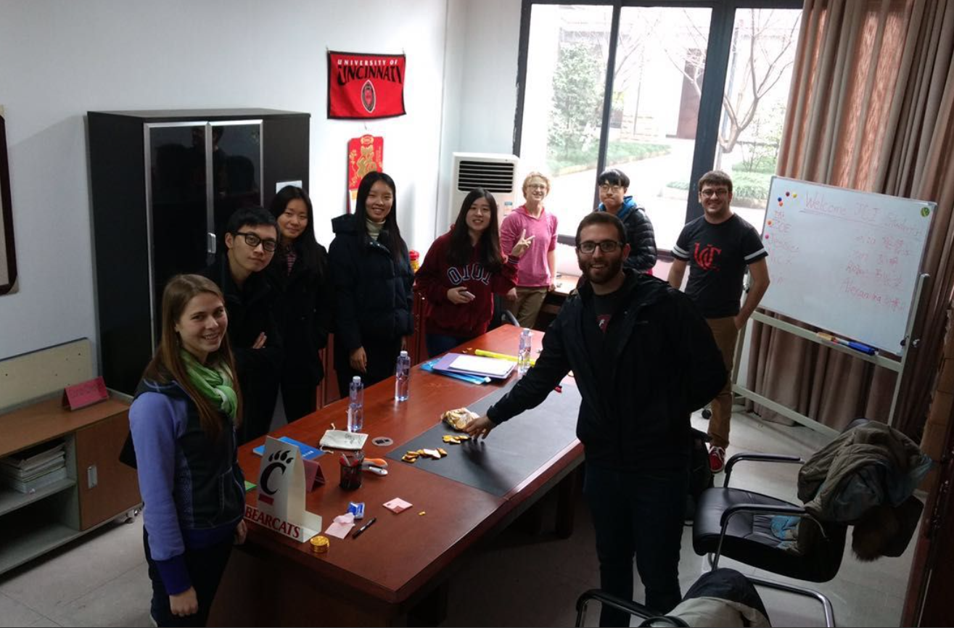
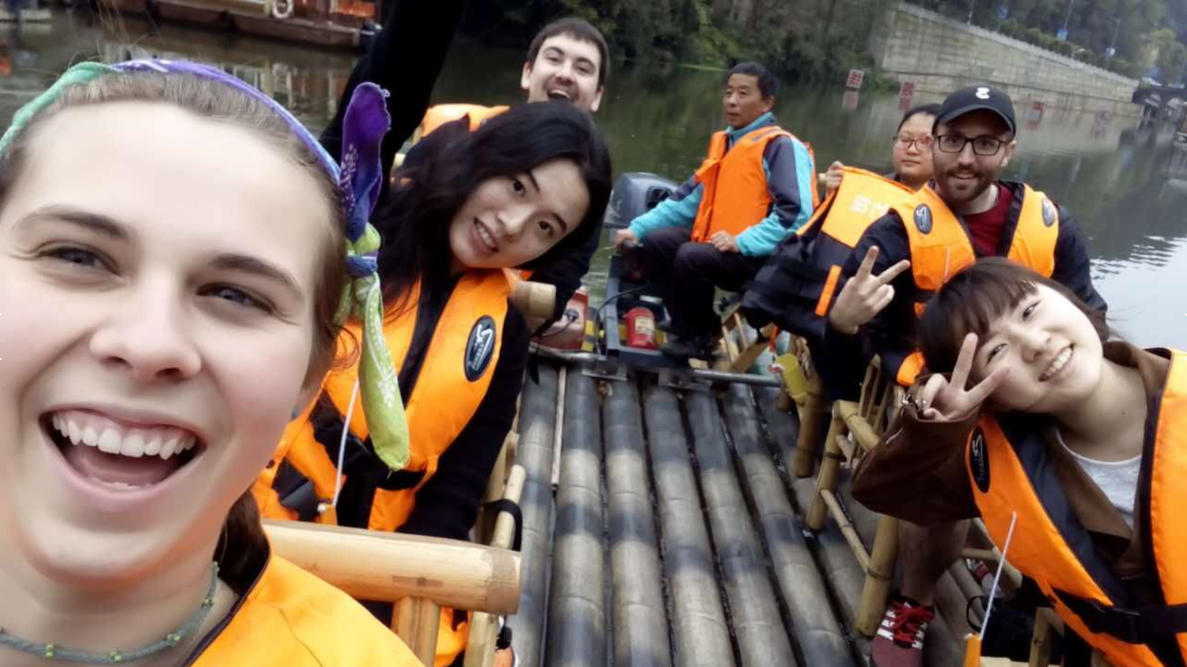
College of Engineering & Applied Science
Co-op in CHINA! (Fall 2017)
Interested in traveling the world?
FREE housing and airfare!
TA at Chongqing University
Job responsibilities:
Setup of lab experiences for students in the Engineering Models I and Engineering Foundations courses
Working with UC faculty in running the labs and helping other students with their assignments
Assist with experiments that touch upon various programs within engineering
Responsibility for a group of students regarding their lab exercises
Proper care of the experiments and returning them to their respective places
Grading for Engineering Foundations and Engineering Models
No foreign language necessary!
Interested?
Contact Sherry Liao
for more information or to apply!
liaoxn@ucmail.uc.edu

Slide 4
Our Purpose
We serve as the CEAS Branch of Student Government
What we do:
Academic Representation
Fun Programs and Events
Initiatives that better student experience in CEAS

Slide 5
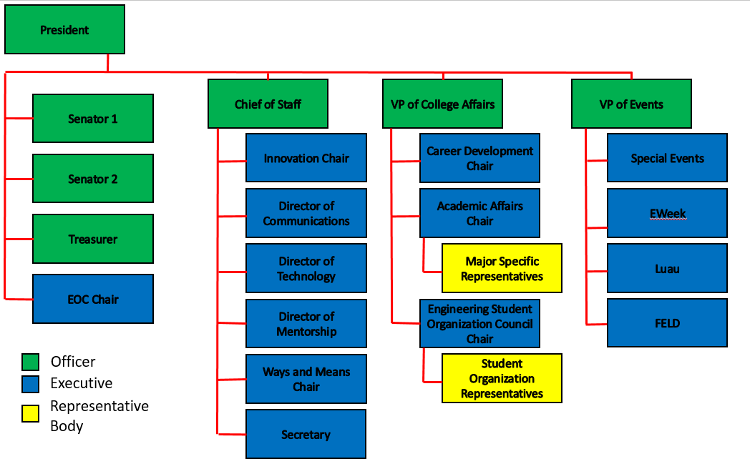
Organizational Chart

Slide 6
Officers
President Dane Sowers
VP of Collegiate Affairs Chris Stone
VP of Events Emma Lowe
Chief of Staff Ashley Ramsey
Treasurer Jim Ohler
Senators Chris Stone
Emma Lowe

Slide 7
Committee Chairs
Academic Affairs Katie Feeney
Career Development Nathan Hamit
Grant Schroeder
Communications Alex Hoffman
ESOC Ezra Babcock
EWeek Kristen Urasek
FELD Konnor Barnes
Innovation Elijah Ditchendorf
Luau Nick Oslin
Mentorship Emily Demjanenko
Kareem Elgafy
Special Events Hao Tran
Secretary Matthew Steinkirchner
Technology Rainor Tangvald

Slide 8
Senator Report

Slide 9
Special Events
Purpose: Committee that hosts fun events and service events for members
Potential Events:
Reds Games
Kings Island
Different Festivals
Canoeing
Habitat For Humanity Project
Committee Meetings:
Time: TBD
Location: Baldwin 655
Contact: Hao Tran @ tranno@mail.uc.edu

Slide 10
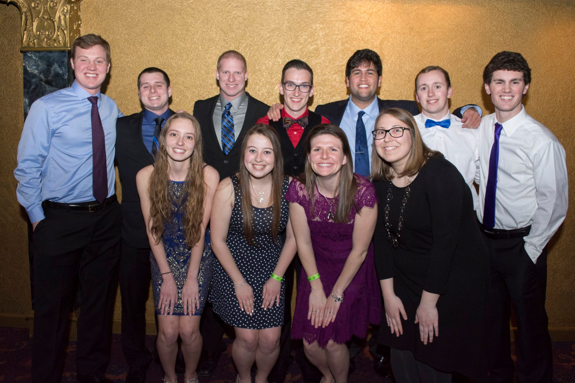
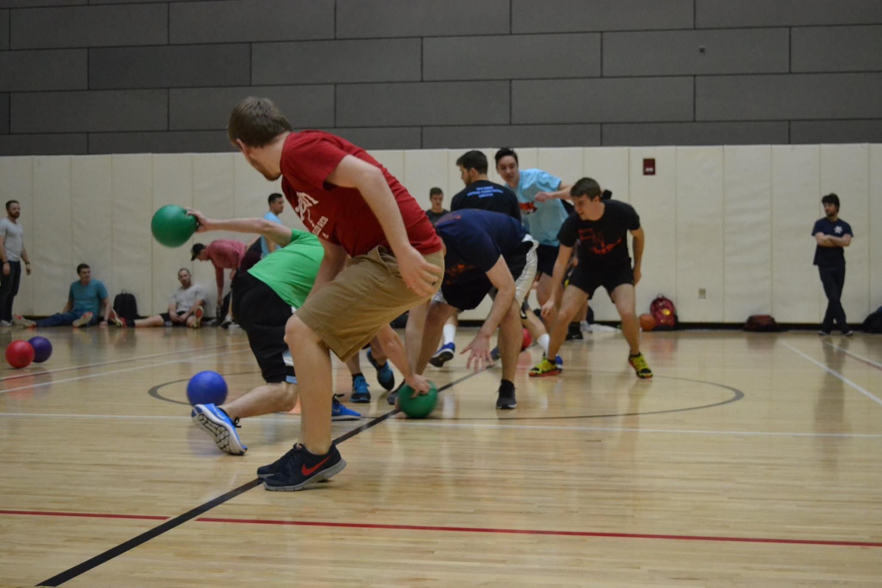
EWeek
Chair:
Kristen Urasek
urasekkm@mail.uc.edu
Did you attend EWeek this year? Please fill out our survey to help us gather feedback & improve for next year! https://tinyurl.com/uceweek2017
Although I am away for the summer, I am working on new ideas and trying to come up with next year’s theme. If you want to get involved, send an email to UC.EWeek@gmail.com and I’ll be in touch!

Slide 11
Luau
Nick Oslin
oslinnd@mail.uc.edu
Our yearly celebration for engineers at The Beach Waterpark that includes admission, a towel, food, and drinks for those of you of age
Saturday, July 8th 2017
We are selling tickets for $25 starting 2 weeks prior to the event.
Theme:
Guardians of The Beach
If you want to submit a towel design, send me an email with the design. If your design wins, you get a free ticket! Try to include the theme in your design.

Slide 12
Join Tribunal Technology Committee!
Do your part to better the student experience while gaining hands-on experience fields such as:
Website Development
3D Printing
Data Management Systems
… and so much more!
If interested, email Rainor Tangvald at tangvarl@mail.uc.edu

Slide 13
Social Media
Want to get updates about events and other things happening in CEAS? Follow us on social media!
https://facebook.com/UCTribunal
@UCTribunal

Slide 14
Provost Meeting – 5/24
Provost Landgren will be hosting a meeting with CEAS students “to learn from your individual perspective of the successes of the college in the recent past, and what you aspire for the college in the coming years.”
This Wednesday, 5/24, from 11:30-12:30
Baldwin 544/644

Slide 15
We Want to Hear From You!
Do you have an idea, question, or concern? We want to be a resource for you! You can reach us in the following ways:
Engaging with our social media accounts
Emailing any one of our exec members (the full list is on our website at tribunal.uc.edu)
Stopping by our office in 650 Baldwin

Slide 16
Resources Available to You
Tutoring Center
Baldwin 860 B
Women’s Center
Steger Student Life Center, Suite 571
Title IX Office
3115 Edwards 1
LGBTQ Center
565 Steger Student Life Center
AACRC
60 W. Charlton St
RAPP
455 Steger Student Life Center
Ethnic Programs and Services
555 Steger Student Life Center
Disability Services
210 University Pavilion
Veterans Programs and Services
230 University Pavilion
Wellness Center
Steger Student Life Center Room 675
CAPS
225 Calhoun Street, Suite 200

Slide 17
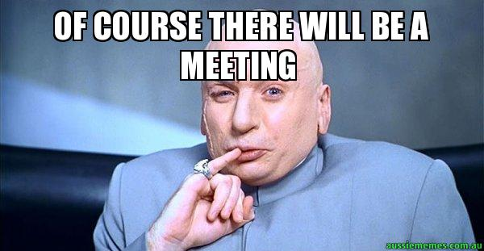
Next Meeting: June 5th!

