Slide 1
CEAS Tribunal
General Meeting
June 5th, 2017

Slide 2
Agenda
EnableUC Presentation
Our Purpose
Committee Overviews
CEAS Tribunal Events

Slide 3
EnableUC

Slide 4
Our Purpose
We serve as the CEAS Branch of Student Government
What we do:
Academic Representation
Fun Programs and Events
Initiatives that better student experience in CEAS

Slide 5
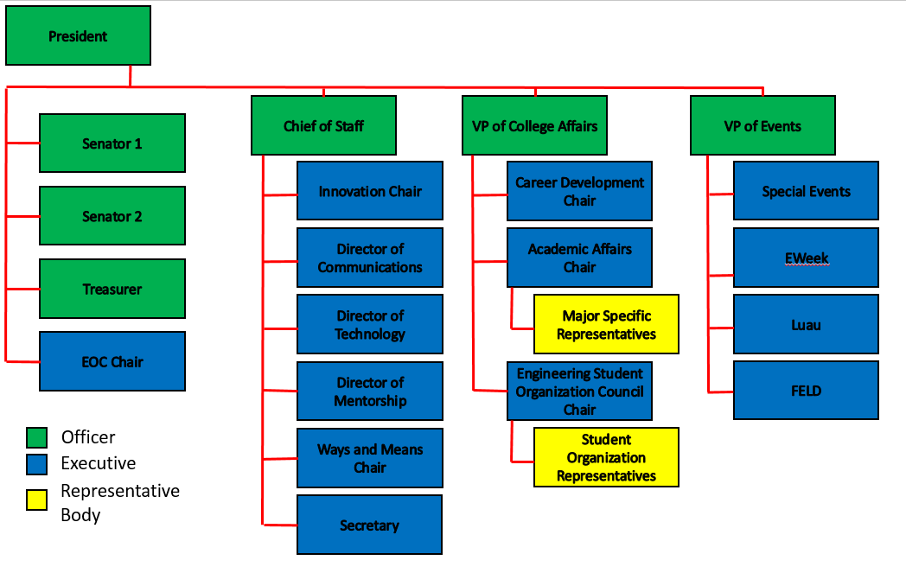
Organizational Chart

Slide 6
Officers
President Dane Sowers
VP of Collegiate Affairs Chris Stone
VP of Events Emma Lowe
Chief of Staff Ashley Ramsey
Treasurer Jim Ohler
Senators Chris Stone
Emma Lowe

Slide 7
Committee Chairs
Academic Affairs Katie Feeney
Career Development Nathan Hamit
Grant Schroeder
Communications Alex Hoffman
ESOC Ezra Babcock
EWeek Kristen Urasek
FELD Konnor Barnes
Innovation Elijah Ditchendorf
Luau Nick Oslin
Mentorship Emily Demjanenko
Kareem Elgafy
Special Events Hao Tran
Secretary Matthew Steinkirchner
Technology Rainor Tangvald

Slide 8
Senator Report

Slide 9
Special Events
Purpose: Committee that hosts fun events and service events for members
Potential Events:
Reds Games
Kings Island
Different Festivals
Canoeing
Habitat For Humanity Project
Committee Meetings:
Time: Thursday 6/8 at 4PM
Location: Baldwin 650
Contact: Hao Tran @ tranno@mail.uc.edu

Slide 10
Luau
Nick Oslin
oslinnd@mail.uc.edu
Our yearly celebration for engineers at The Beach Waterpark that includes admission, a towel, food, and drinks for those of you of age
Saturday, July 8th 2017
Ticket Sales ($25):
10am-2pm on June 26th-30th and July 3rd-7th in Baldwin Lobby
July 3rd-7th during any evening Tribunal events
Theme:
Guardians of The Beach
If you want to submit a towel design, send me an email with the design. If your design wins, you get a free ticket! Try to include the theme in your design.

Slide 11
Join Tribunal Technology Committee!
Do your part to better the student experience while gaining hands-on experience fields such as:
Website Development
3D Printing
Data Management Systems
… and so much more!
If interested, email Rainor Tangvald at tangvarl@mail.uc.edu

Slide 12
Social Media
Want to get updates about events and other things happening in CEAS, and also possibly win some cool prizes? Follow us on social media!
https://facebook.com/UCTribunal
@UCTribunal

Slide 13
We Want to Hear From You!
Do you have an idea, question, or concern? We want to be a resource for you! You can reach us in the following ways:
Engaging with our social media accounts
Emailing any one of our exec members (the full list is on our website at tribunal.uc.edu)
Stopping by our office in 650 Baldwin

Slide 14
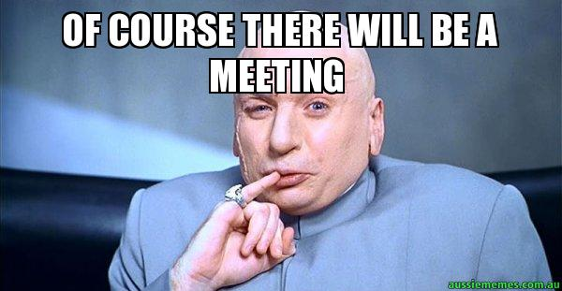
Next Meeting: June 19th!

