Slide 1
CEAS Tribunal
General Meeting
July 31st, 2017

Slide 2
Agenda
Our Purpose
Elections

Slide 3
Our Purpose
We serve as the CEAS Branch of Student Government
What we do:
Academic Representation
Fun Programs and Events
Initiatives that better student experience in CEAS

Slide 4
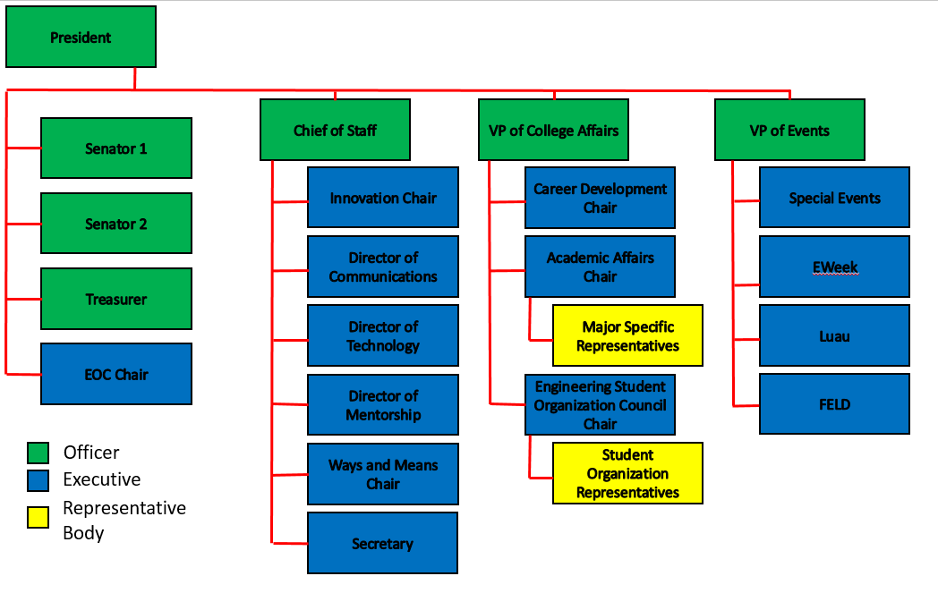
Organizational Chart

Slide 5
Officers
President Dane Sowers
VP of Collegiate Affairs Chris Stone
VP of Events Emma Lowe
Chief of Staff Ashley Ramsey
Treasurer Jim Ohler
Senators Chris Stone
Emma Lowe

Slide 6
Committee Chairs
Academic Affairs Katie Feeney
Career Development Nathan Hamit
Grant Schroeder
Communications Alex Hoffman
ESOC Ezra Babcock
EWeek Kristen Urasek
FELD Konnor Barnes
Innovation Elijah Ditchendorf
Luau Nick Oslin
Mentorship Emily Demjanenko
Kareem Elgafy
Special Events Hao Tran
Secretary Matthew Steinkirchner
Technology Rainor Tangvald

Slide 7
Elections – VP of CA (Fall 2017)
Chris Stone
Diana Pavlushyna

Slide 8
Christopher Stone VP of College Affairs
Background
ESOC Chair for Fall and Summer of 2016
External Vice President in AIChE
Regional Liaison for AIChE
Initiatives
Assessing Engineering Foundations
Increasing industry presence outside of Career Fair
Creating intra-college organizations recruiting event

Slide 9
Elections – VP of CA (Spring 2018)
Chris Stone
Nathan Hamit
Diana Pavlushyna

Slide 10
Christopher Stone VP of College Affairs
Background
ESOC Chair for Fall and Summer of 2016
External Vice President in AIChE
Regional Liaison for AIChE
Initiatives
Assessing Engineering Foundations
Increasing industry presence outside of Career Fair
Creating intra-college organizations recruiting event

Slide 11
Elections – VP of Events (Spring 2018)
Christian Donovan
Konnor Barnes
Megan Naber
Alex Branscome

Slide 12
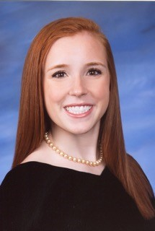
Megan Naber- VP of Events
- 2nd year studying Environmental Engineering (future co-op with GE Aviation)
- Began involvement through mentorship program
- Tribunal involvement
Career Fair
Senior Design Showcase
- Outside involvement
Social Chair of SEE
Secretary of Beekeeping Club
CEAS Ambassador

Slide 13
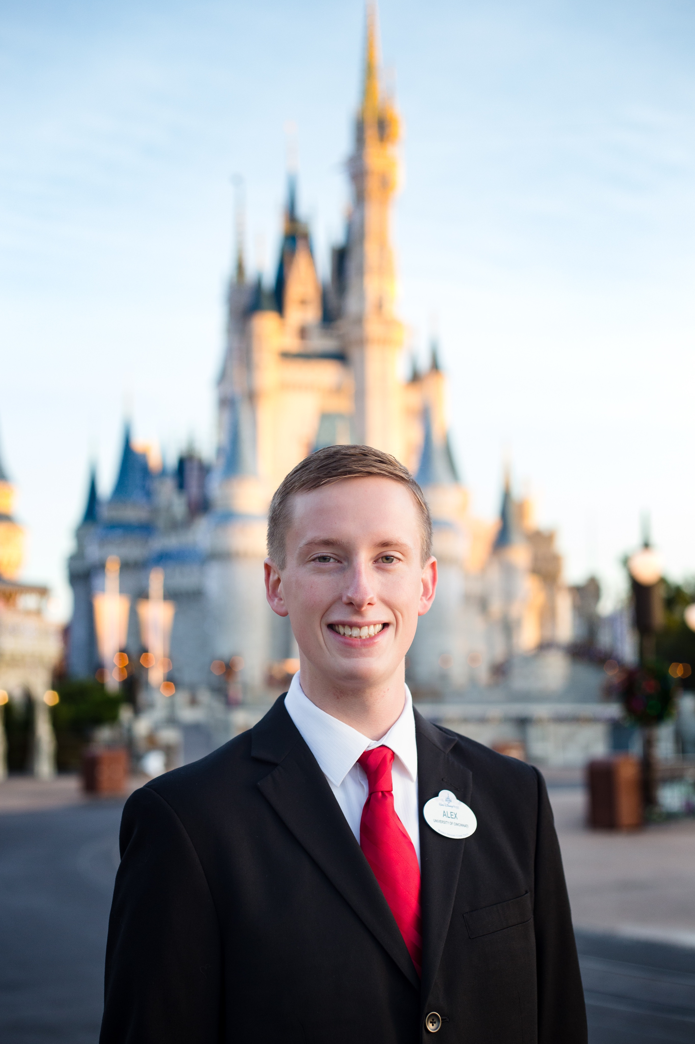
Who am I?
5th year in Civil Engineering
Fall Treasurer for Tribunal
Why do I want to be the VP of Events?
I enjoy planning events and coordinating with others to get jobs done
I want to work to get more CEAS students involved in events sponsored by Tribunal

Slide 14
What I want to do
Increase awareness and thus student participation in Tribunal events
Continue improving events we currently hold every year: Eweek, Luau, etc.
Why I’m qualified
Work experience:
I’ve planned and set up catering for a variety of events through my part time job for five years
I’ve done project management on co-op. I am very accustomed to coordinating with multiple people and ensuring tasks are completed when required.

Slide 15
Elections – Treasurer (Spring 2018)
Jim Ohler
Alex Branscome

Slide 16
Who am I?
5th year in Civil Engineering
Fall Treasurer for Tribunal
Why do I want to be treasurer in the spring?
I enjoy planning, budgeting, and accounting
I want to enhance your experience in CEAS
Implement new ideas learned at the national conference this past spring

Slide 17
What I want to do
Be efficient
Increase transparency
Find uses for surplus money
Aid our student groups in budget planning
Why I’m qualified
Co-op experience:
I’ve done project management on co-op. There I managed the finances on projects ranging from $50,000 to over $13,000,000. This included tracking purchase orders and contracts and analyzing our expenses to find any errors in the budgets
Course experience:
I’ve taken several accounting/finance classes. These include Financial Accounting, Managerial Accounting, Business Finance, and Investments
Life experience:
I’ve been managing my own money since elementary school. Today routinely create new budgets for myself, and always track my current and expected expenses

Slide 18
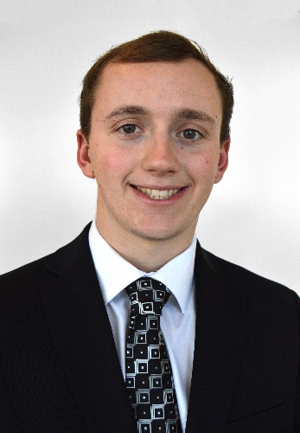
Jim Ohler
For Treasurer
The Fall 2017 and current treasurer for CEAS Tribunal
Created a new user-friendly spreadsheet to manage the budget for CEAS Tribunal
Served as Career Fair Intern of the 2015-2016 academic year
Helped manage the company payments for Career Fair
Assisted in managing the finances at RELC church in Hilliard, OH
Reimbursing expenses and managing budget sheets

Slide 19
Exam Week Breakfast
Enjoy a quick breakfast before heading off to exams.
Date: August 1st-3rd
Time: 8:00am – 11:00am
Location: Baldwin Lobby

Slide 20
Social Media
Want to get updates about events and other things happening in CEAS, and also possibly win some cool prizes? Follow us on social media!
https://facebook.com/UCTribunal
@UCTribunal

Slide 21
We Want to Hear From You!
Do you have an idea, question, or concern? We want to be a resource for you! You can reach us in the following ways:
Engaging with our social media accounts
Emailing any one of our exec members (the full list is on our website at tribunal.uc.edu)
Stopping by our office in 650 Baldwin

Slide 22
Next Meeting: August 21st! Location TBD 5:30PM

