Slide 1
Engineering and Applied Science Tribunal
General Meeting
September 27th, 2012

Slide 2
Purpose
To represent the students of the College of Engineering & Applied Science on all relevant issues, specifically with curriculum, academic and professional standards, and computing services. Engineering & Applied Science Tribunal will also attempt to assist the students with non-academic issues whenever possible.

Slide 3
Tribunal Officers
President: |  | Megan Fox
Vice President: |  | Brock Pleiman
Associate Vice President: |  | Hannah Kenny
Treasurer: |  | Peter Beaucage
Secretary: |  | Andrew Griggs
Senators: |  | Aaron Rumburg Cody Clark

Slide 4
Tribunal Executives
Career Fair: |  | Tim Schafermeyer, Megan Fox, Andrew Griggs, Vincent Notaro
Collegiate Affairs: |  | Mason Stout, Peter Beaucage
EWeek: |  | Zach Nieberding Maggy Zorc
FELD: |  | Joe Saunders Weston Ott
Homecoming: |  | Ashley Snead
Luau: |  | Megan Fox Aaron Rumburg
Recognition: |  | James Acosta
Public Affairs: |  | Hannah Kenny Karl Schubauer
SOCC: |  | Amanda LaCombe
Special Events: |  | Ken Okoye

Slide 5
Dean Teik Lim

Slide 6
Officer Reports

Slide 7
Secretary Report
Officer:
Andrew Griggs
Please sign in on your way into the meeting
In order to put UC Engineering and Applied Science Tribunal on your resume you must be an active member
To be considered an active member, each quarter you must attend at least 3 meetings and be involved with a committee

Slide 8
Senator’s Report
Senators:
Cody Clark
Aaron Rumburg
First Senate Meeting of the Quarter: Wednesday August 29th in 425 TUC. Open to everyone, come see if you'd be interested!
Interested in Student Government or Politics? Consider applying for FYLP: First Year Leadership Program

Slide 9
Committee Reports

Slide 10
Career Fair
Coordinators:
Megan Fox
Vincent Notaro
Tim Schafermeyer
Andrew Griggs
Fall Career Fair will be Thursday, September 27th
Hours are 10am-4pm in the Campus Recreation Center (on the basketball courts)
Part of Fall Career Fair Week:
Wednesday: LCB/CDC Professional & Creative Career Fair
Thursday: CEAS Tribunal Technical Career Fair
Friday: Interviews
Already 122 companies signed up!
Questions? Check uc.edu/careerfair or e-mail us at careerfair@uc.edu

Slide 11
Career Fair
Coordinators:
Megan Fox
Vincent Notaro
Tim Schafermeyer
Andrew Griggs
We need volunteers!
Satisfy your Tribunal committee requirement, meet Tribunal executives, get a behind-the-scenes look at company representatives
Need volunteers for setup Tuesday and Wednesday evenings as well as all day Thursday at the event
Meet at the back of the auditorium after the meeting for more information and sign-ups

Slide 12
EWeek: Feb 17-23
Zachary Nieberding
Maggy Zorc
Alison Hayfer
EWeek Team Events
Engineering Blood Drive
Date Auction
Banquet and Award Ceremony
Breakout session at bottom of auditorium
Interest/Questions?
uc.eweek@gmail.com

Slide 13
Advisors:
Joe Saunders
saundejw@mail.uc.edu
Weston Ott
ottwc@mail.uc.edu
W
FELD
Freshman Education and Leadership Development will meet Wednesday, Sept 5th at 5 p.m. in 544 Baldwin
Open to any freshman who wants to get more involved in the college and university
FELD is a great way to meet fellow freshman engineers and learn about CEAS
Fulfills Tribunal Committee requirement

Slide 14
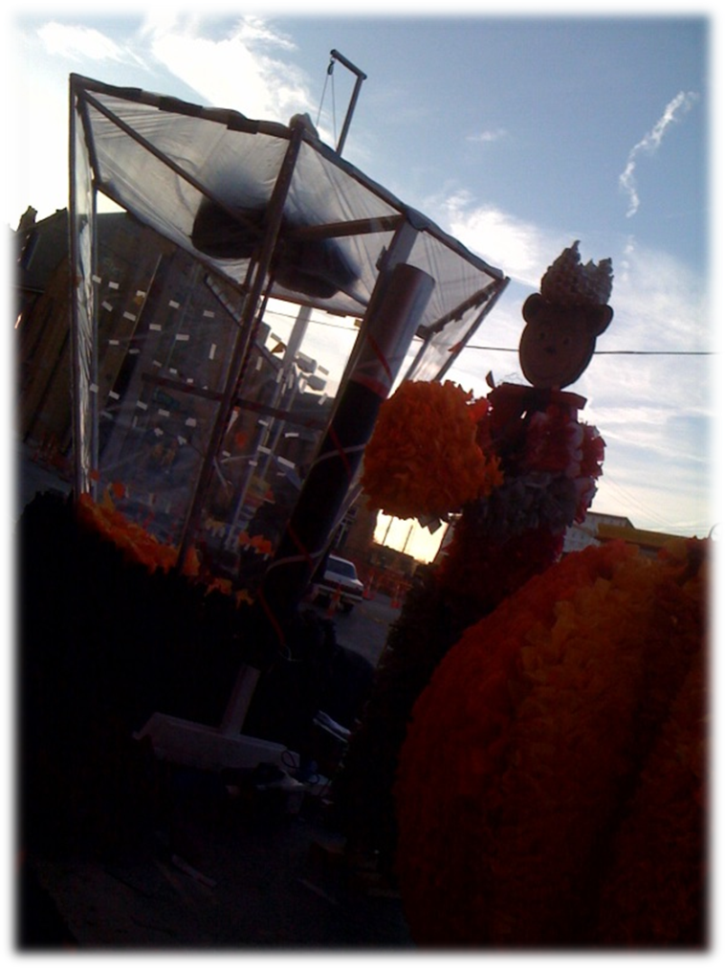
Homecoming
Chair:
Ashley Snead
Homecoming Float Competition
October 6
Parade starts at 3pm
Build will start 10 days before
Please Contact me:
Ashley Snead
sneadam@mail.uc.edu

Slide 15
Public Affairs
Chair:
Hannah Kenny
Karl Schubauer
Follow us on Twitter:
@UCTribunal
And add us on Facebook:
“The UC Engineering and Applied Science Tribunal”
Tribunal photos? Contact:
kennyhe@mail.uc.edu
schubaka@mail.uc.edu

Slide 16
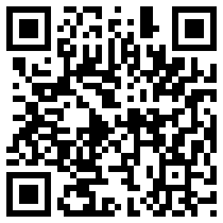
Collegiate Affairs
Chair:
Mason Stout
Peter Beaucage
Organize student participation on college governance committees.
Levels of participation range from two meetings/quarter to weekly.
Academic Standards
Professional Standards Review Committee
College Curriculum Committee
more information and sign-up:
tribunal.uc.edu/collegiate-affairs

Slide 17
Other Student Group Announcements
Know of something going on within the college?
Announce it now!
Notes:
17

Slide 18
Constructive Criticism
What do you like/dislike about the college?
Comments / Questions?

Slide 19
Next Meeting
September 10th, 2012
Location: Zimmer Auditorium
Visit us at our office – 652 Baldwin
www.tribunal.uc.edu
(513) 556-5439

