Slide 1
CEAS Tribunal
General Meeting
November 6, 2017
Sign in on the laptops on the front of the room and then feel free to grab food!

Slide 2
Agenda
Our Purpose
Senator Presentations
Committee Updates
HyperloopUC

Slide 3
Our Purpose
We serve as the CEAS Branch of Student Government
What we do:
Academic Representation
Fun Programs and Events
Initiatives that better student experience in CEAS

Slide 4
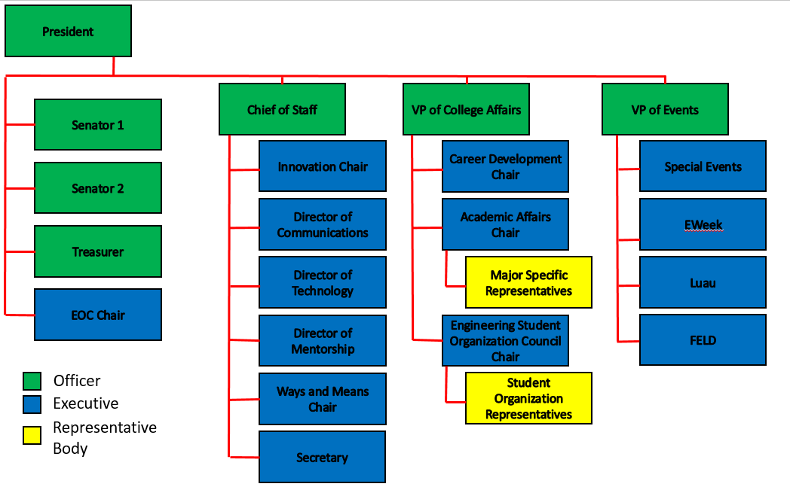
Organizational Chart

Slide 5
Officers
President Dane Sowers
VP of Collegiate Affairs Chris Stone
VP of Events Andy Droesch
Chief of Staff Ashley Ramsey
Treasurer Alex Branscome
Senators Chris Stone
Emma Lowe

Slide 6
Committee Chairs
Career Development Nathan Hamit
Grant Schroeder
Logan Lindsay
Communications Gracie Cadena
ESOC Ezra Babcock
EWeek Kristen Urasek
Bryan Keller
FELD Konnor Barnes
Innovation FG Williams
Mentorship Emily Demjanenko
Kareem Elgafy
Special Events Tom Burns
Secretary Phillip Stoll
Technology Achyut Anand

Slide 7
Michael Frederick for Senate
General Meeting
November 6th, 2017

Slide 8
Diversity
Require executives of ALL engineering-based organizations and extracurriculars to complete a comprehensive sensitivity training session before assuming office
Create an appropriate committee within tribunal dedicated to the inclusion of underrepresented student groups
Collaborate with the Office of Ethnic Programs and Services and the UC LGBTQ Center to plan tailored events that promotes participation of LGBTQ, female, and minority engineering students

Slide 9
Transparency
Create a module that enables professors to publish class reviews from other students as an informal performance review
Push the college administration to publish and make accessible relevant documents pertaining to administrative budgets, demographics of the college, and graduation/job placement rates

Slide 10
Accessability
Set up a rental program to provide wheelchairs and crutches for students who are physically disabled at little to no cost
Host semesterly mental health seminars for underclassmen students to learn the importance of mental health early in their academic careers and develop healthy methods of managing stress

Slide 11
Don’t be shy, give Mike a try!
Remember to vote for Michael Frederick to be your newest CEAS Tribunal Senator. Voting takes place November 15th – 17th, tell all of your friends!

Slide 12
Logan Lindsay
Second Year
Currently studying Computer Engineering
Background in CEAS:
CEAS Ambassadors
FYE Peer Leader
CEAS Tribunal | Mentee Program
Engineering Student Organization Committee
CEAS Tribunal | Career Development Chair
Alternate for several Senate Meetings.
Why am I running for Senator?
I am running for CEAS Senator because I believe through my experiences I can address the issues that this college faces.
Platform:
Represent students and organization leaders.
Raising awareness for the resources on campus.
Shooting at CPA.
Sexual Awareness mirror clings.
Execute ideas brought to me by students and tribunal members.

Slide 13
NAESC 2018 Regional Conference
We have been selected to host the NAESC Regional conference in November 2018!
Planning for this will be starting soon. Contact Dane if you would like to participate in that process!

Slide 14
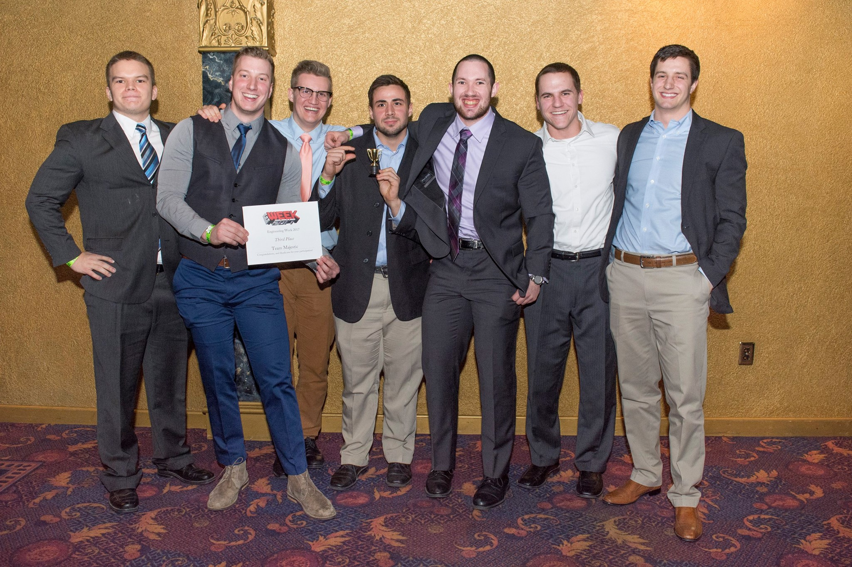
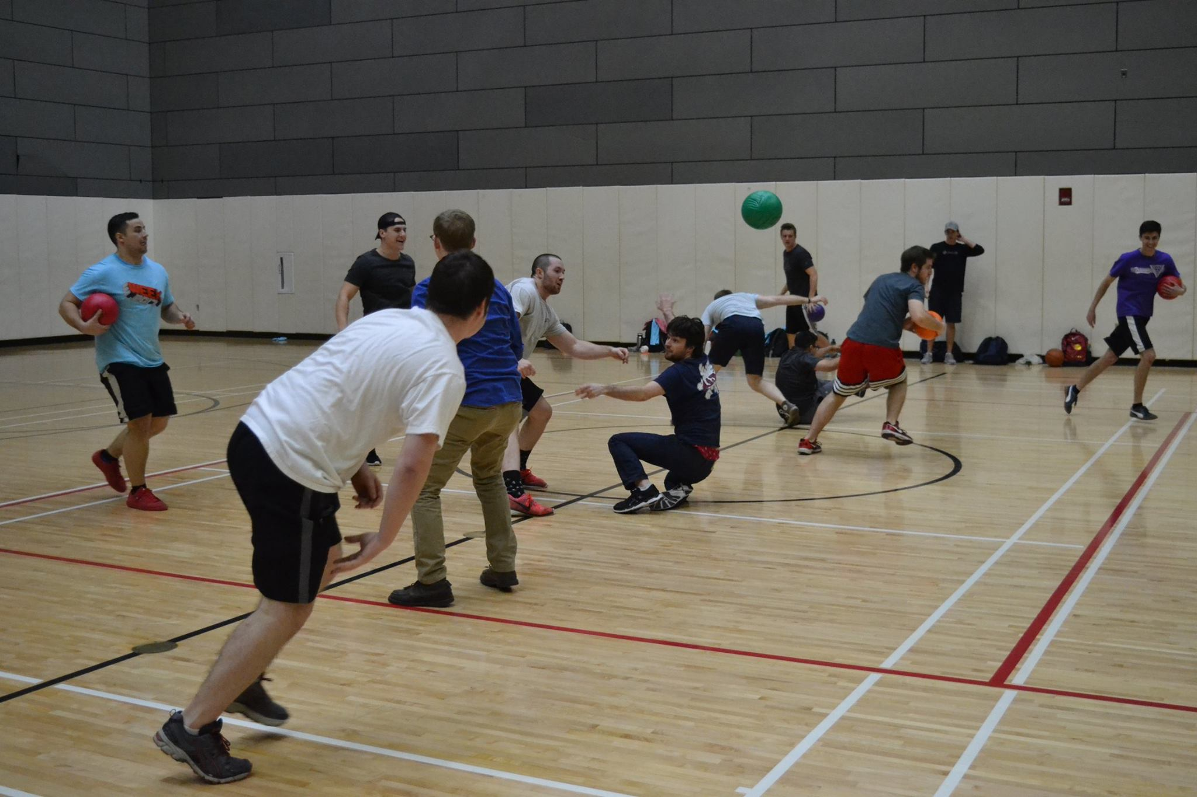
EWeek
Bryan Keller
kellerb9@mail.uc.edu
Kristen Urasek
urasekkm@mail.uc.edu
Fall Info Survey: Help us plan this year’s EWeek
by telling us about YOUR interests and what YOU
want to see (short with multiple choice questions!!)
https://tinyurl.com/fs17eweek

Slide 15
Special Events
RockQuest: This Saturday!
- Check emails for final details about this weekend
Tribunal Movie Night: November 17th
Thor: The Dark World
20 spots available, first come first serve
Email coming soon
Cyclones Game: November 29th
^{- Signups coming soon}

Slide 16
Innovation Committee
Do you have an idea on what to improve around campus or want to gain leadership experience? Then, the Innovation Crew is the place to be.
Committee Meetings:
- Thursday: 7:00 to 8:00 pm
- Location: Old Chem 602
Interested in being a part of the Crew, email FG Williams at okwubifv@mail.uc.edu for more info!
https://goo.gl/forms/8nbQlwkiX8ErCwnl1

Slide 17
Academic Affairs
Do you have an academic concern? Contact Dane at sowersdd@mail.uc.edu
Open Forum after General Meeting today!

Slide 18
Social Media
Want to get updates about events and other things happening in CEAS, and also possibly win some cool prizes? Follow us on social media!
https://facebook.com/UCTribunal
@UCTribunal

Slide 19
We Want to Hear From You!
Do you have an idea, question, or concern? We want to be a resource for you! You can reach us in the following ways:
Engaging with our social media accounts
Emailing any one of our exec members (the full list is on our website at tribunal.uc.edu)
Stopping by our office in 650 Baldwin

Slide 20
Hyperloop

Slide 21
Next Meeting: November 20th 5:30 PM Old Chem 525

