Slide 1
CEAS Tribunal
General Meeting
November 20, 2017
Sign in on the laptops on the front of the room and then feel free to grab food!

Slide 2
Agenda
Our Purpose
Senator Election Results
Officer Nominations
Committee Updates

Slide 3
Our Purpose
We serve as the CEAS Branch of Student Government
What we do:
Academic Representation
Fun Programs and Events
Initiatives that better student experience in CEAS

Slide 4
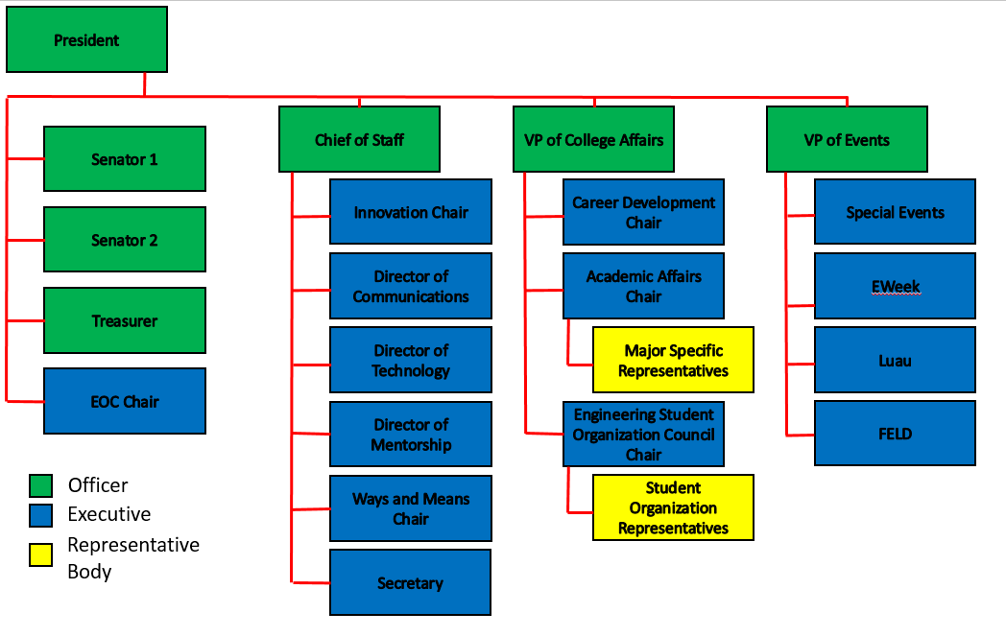
Organizational Chart

Slide 5
Officers
President Dane Sowers
VP of Collegiate Affairs Chris Stone
VP of Events Andy Droesch
Chief of Staff Ashley Ramsey
Treasurer Alex Branscome
Senators Chris Stone
Emma Lowe

Slide 6
Committee Chairs
Career Development Nathan Hamit
Grant Schroeder
Logan Lindsay
Communications Gracie Cadena
ESOC Ezra Babcock
EWeek Kristen Urasek
Bryan Keller
FELD Konnor Barnes
Innovation FG Williams
Mentorship Emily Demjanenko
Kareem Elgafy
Special Events Tom Burns
Secretary Phillip Stoll
Technology Achyut Anand

Slide 7
Senator Election Results
Congratulations to our newly elected Spring 2018 CEAS Senator…
Logan Lindsay

Slide 8
Officer Nominations
VP of Events (Spring 2018)
VP of Collegiate Affairs (Summer 2018)
VP of Events (Summer 2018)
VP of Events (Summer 2018)

Slide 9
Senator Report
Senators:
Chris Stone
Emma Lowe
Bills Approved in the Past 2 Weeks:
Bearcast Media Partnership
Intersectional Leadership Collaborative
Discussion/Bills to Vote on next Meeting:
Revisions to EFC Rules
If interested in being a part of EFC, contact Dillon Staub or Hannah Duckworth.

Slide 10
Senator Report
Senators:
Chris Stone
Emma Lowe
Other Important Information Discussed:
Microwaves coming to Langsam!
Provost Candidate Student Forum
Tuesday, Nov. 21st @11am
Calhoun Street Crosswalk Lights
International Student Fee Resolution
Nominations for Spring 2018 Positions:
At-Large Senator (2 open seats)
Treasurer

Slide 11
Senator Report
Senators:
Chris Stone
Emma Lowe
Questions, Concerns, Comments? Email/Talk to us!
Chris Stone: stonec5@mail.uc.edu
Emma Lowe: loweea@mail.uc.edu
Also, use our anonymous link to give your opinions or tell us what you want to see from SG & Tribunal!

Slide 12
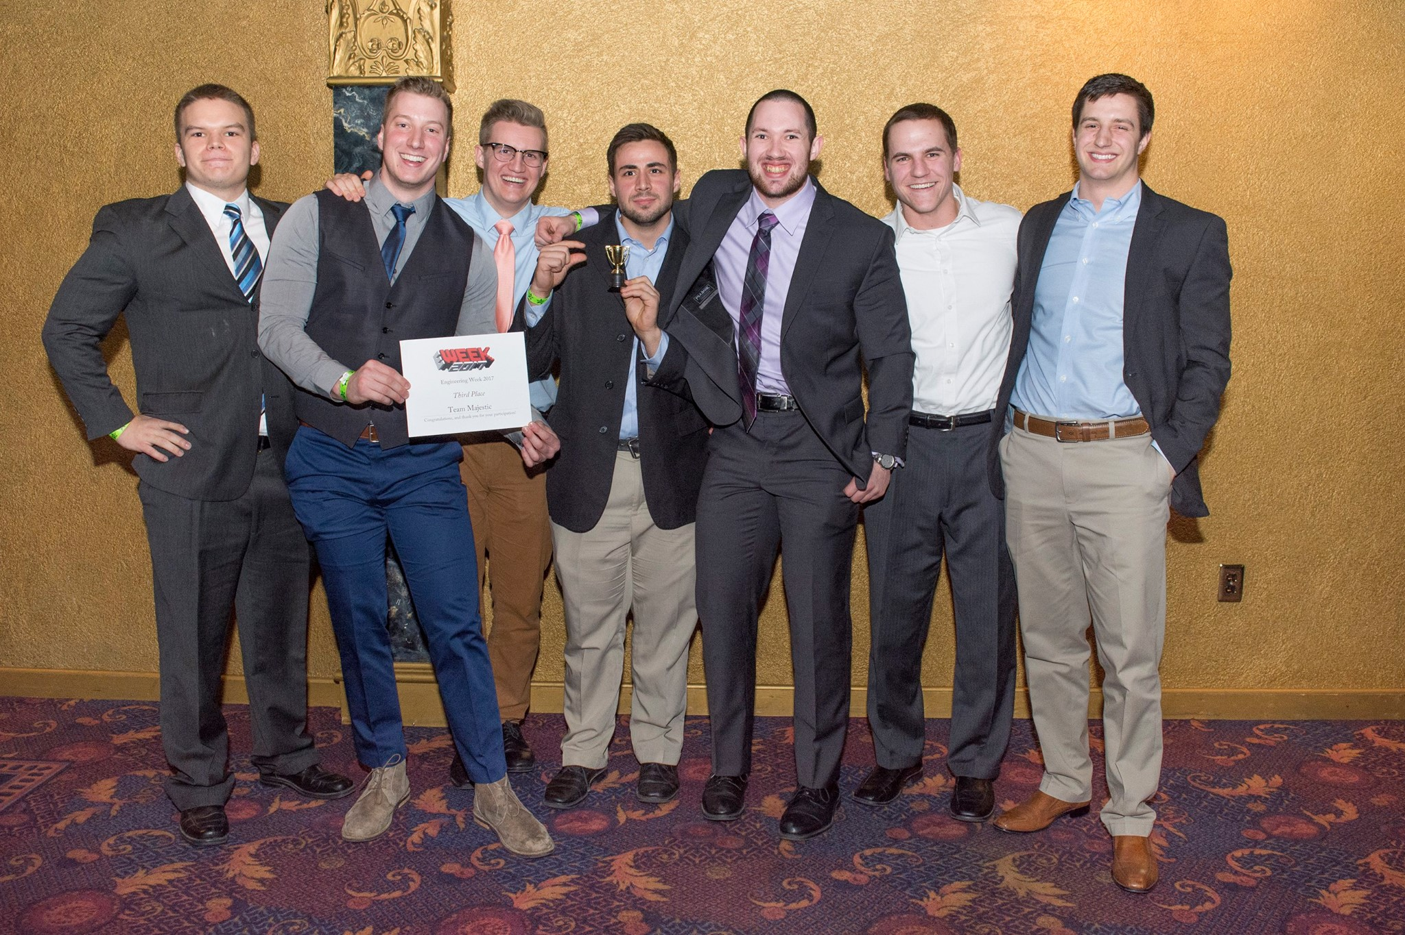
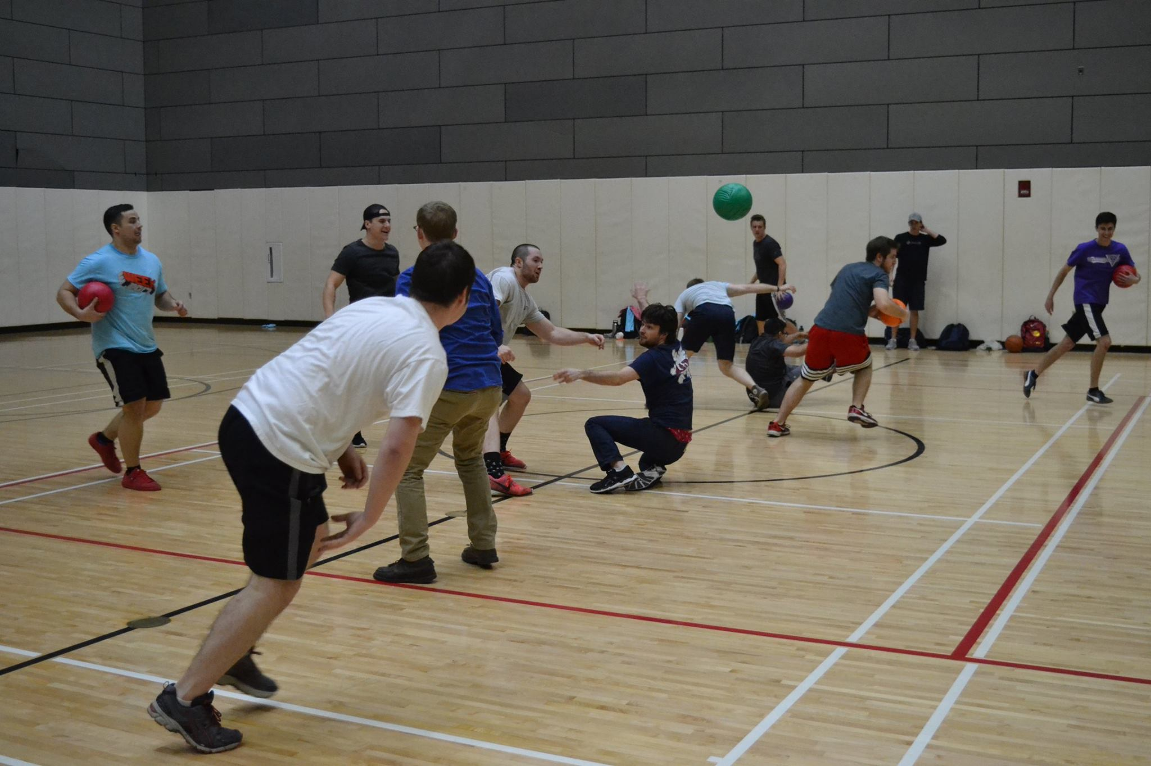
EWeek
Bryan Keller
kellerb9@mail.uc.edu
Kristen Urasek
urasekkm@mail.uc.edu
Fall Info Survey: Help us plan this year’s EWeek
by telling us about YOUR interests and what YOU
want to see (short with multiple choice questions!!)
https://tinyurl.com/fs17eweek

Slide 13
Special Events
Cyclones Game: November 29th
- Signups coming soon
Exam Week Breakfast
In Baldwin Lobby every morning till the food runs out
Interested in volunteering? Email burnst3@mail.uc.edu

Slide 14
Innovation Committee
Do you have an idea on what to improve around campus or want to gain leadership experience? Then, the Innovation Crew is the place to be.
Committee Meetings:
- Thursday: 7:00 to 8:00 pm
- Location: Old Chem 602
Interested in being a part of the Crew, email FG Williams at okwubifv@mail.uc.edu for more info!
https://goo.gl/forms/8nbQlwkiX8ErCwnl1

Slide 15
Academic Affairs
Do you have an academic concern? Contact Dane at sowersdd@mail.uc.edu

Slide 16
Social Media
Want to get updates about events and other things happening in CEAS, and also possibly win some cool prizes? Follow us on social media!
https://facebook.com/UCTribunal
@UCTribunal

Slide 17
We Want to Hear From You!
Do you have an idea, question, or concern? We want to be a resource for you! You can reach us in the following ways:
Engaging with our social media accounts
Emailing any one of our exec members (the full list is on our website at tribunal.uc.edu)
Stopping by our office in 650 Baldwin

Slide 18
Next Meeting: November 27th 5:30 PM Old Chem 525

