Slide 1
CEAS Tribunal
General Meeting
October 23, 2017
Sign in on the laptops on the front of the room and then feel free to grab pizza!

Slide 2
Agenda
Bearcat Guardian
CharitEweek
Our Purpose
Senator Nominations
Committee Updates

Slide 3
Bearcat Guardian

Slide 4
CharitEweek
Monday: Students Vs. Professors trivia night (Canes or Chipotle)
Tuesday: Blanket drive (Insomnia cookies)
Wednesday: Blood drive (Mac’s pizza)
Friday: TGIF/Similar event
Pie a Professor
Canned food drive

Slide 5
Our Purpose
We serve as the CEAS Branch of Student Government
What we do:
Academic Representation
Fun Programs and Events
Initiatives that better student experience in CEAS

Slide 6
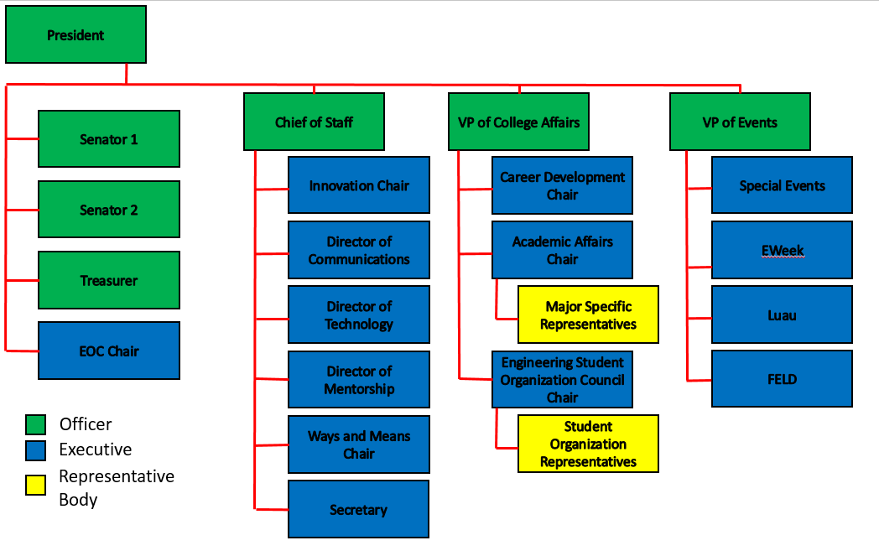
Organizational Chart

Slide 7
Officers
President Dane Sowers
VP of Collegiate Affairs Chris Stone
VP of Events Andy Droesch
Chief of Staff Ashley Ramsey
Treasurer Alex Branscome
Senators Chris Stone
Emma Lowe

Slide 8
Committee Chairs
Career Development Nathan Hamit
Grant Schroeder
Logan Lindsay
Communications Gracie Cadena
ESOC Ezra Babcock
EWeek Kristen Urasek
Bryan Keller
FELD Konnor Barnes
Innovation FG Williams
Mentorship Emily Demjanenko
Kareem Elgafy
Special Events Tom Burns
Secretary Phillip Stoll
Technology Achyut Anand

Slide 9
Senator Report
Senators:
Chris Stone
Emma Lowe
Bills Approved in the Past 2 Weeks:
Letter to federal legislators concerning new Title IX Guidelines.
Bearcat Card Expansion to OTR (Goodfellas, Coffee Emporium, Venice on Vine, Gomez Salsa, Nation, etc.)
Flu Shot Clinic – This Thursday, Oct. 26th , 11am – 2pm, TUC 400 Level
Other Appropriations Include:
UCDM ($800) – Nov. 4th
Gender Based Violence Snapchat Geofilter ($335.71)
Governmental Relations Summit ($6,336.38) - Nov. 16th,
4-6pm, 200 individuals
Discussion/Bills to Vote on this Week:
Discussing Ohio House Bill 363 – Campus Free Speech Act

Slide 10
Senator Report
Senators:
Chris Stone
Emma Lowe
Other Important Information Discussed:
Richard Spencer Response
President Pinto Presentation on UC’s Strategic Direction
uc.edu/strategicdirection
Red Flag Campaign & UC Its On Us
Monday - The Hunting Grounds @ 7pm in TUC 400A
Tuesday - Self Care Booth @ 6-7:30 pm Main Street
Wednesday - Consent Day (Information Sessions)
Thursday - TEAL THURSDAY (wear teal) and take the pledge day online
Friday - Self Defense Class @ 10am in CRC

Slide 11
Senator Report
Senators:
Chris Stone
Emma Lowe
Questions, Concerns, Comments? Email/Talk to us!
Chris Stone: stonec5@mail.uc.edu
Emma Lowe: loweea@mail.uc.edu
Also, use our anonymous link to give your opinions or tell us what you want to see from SG & Tribunal!

Slide 12
Academic Affairs
Do you have an academic concern? Contact Dane at sowersdd@mail.uc.edu
Open Forum after General Meeting on 11/6 (sorry for the confusion!)

Slide 13
Special Events
RockQuest Sign Up!
- Saturday November 11th to Sunday November 12th
- 30 people limit. So reserve spot with $5 deposit
- Deposits refunded the day of the event
- Sign Ups already sent out by Emma Lowe
Haunted House: U.S.S. Nightmare
Thursday October 26th
Meet at ERC Circle at 6:45PM
Sign ups coming shortly

Slide 14
Special Event – USS Nightmare
What: Taking a trip to Newport to go through USS Nightmare
When: This Thursday (October 26th) at 6:35pm
How much: Free
How to sign up: check your email for a link to a Google Form
Contact Alex Branscome with questions:
branscar@mail.uc.edu

Slide 15
Innovation Committee
Do you have an idea on what to improve around campus or want to gain leadership experience? Then, the Innovation Crew is the place to be.
Committee Meetings:
- Thursday: 7:00 to 8:00 pm
- Location: Old Chem 602
Interested in being a part of the Crew, email FG Williams at okwubifv@mail.uc.edu for more info!
https://goo.gl/forms/8nbQlwkiX8ErCwnl1

Slide 16
Social Media
Want to get updates about events and other things happening in CEAS, and also possibly win some cool prizes? Follow us on social media!
https://facebook.com/UCTribunal
@UCTribunal

Slide 17
We Want to Hear From You!
Do you have an idea, question, or concern? We want to be a resource for you! You can reach us in the following ways:
Engaging with our social media accounts
Emailing any one of our exec members (the full list is on our website at tribunal.uc.edu)
Stopping by our office in 650 Baldwin

Slide 18
Next Meeting: November 6th 5:30 PM Old Chem 525

