Slide 1
CEAS Tribunal
General Meeting
August 21, 2017
Sign in on the laptops on the front of the room and then feel free to grab pizza!

Slide 2
Agenda
Our Purpose
Committee Descriptions/Intros
Opportunities to Get Involved

Slide 3
Our Purpose
We serve as the CEAS Branch of Student Government
What we do:
Academic Representation
Fun Programs and Events
Initiatives that better student experience in CEAS

Slide 4
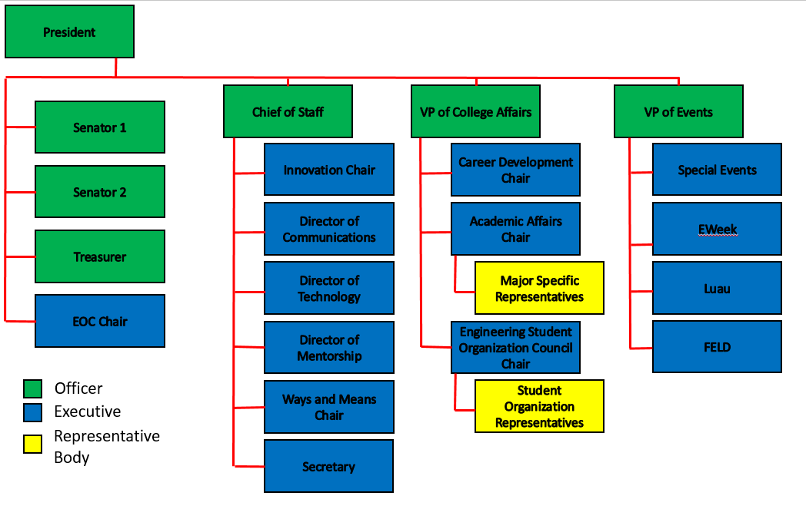
Organizational Chart

Slide 5
Officers
President Dane Sowers
VP of Collegiate Affairs Chris Stone
VP of Events Andy Droesch
Chief of Staff Ashley Ramsey
Treasurer Alex Branscome
Senators Chris Stone
Emma Lowe

Slide 6
Committee Chairs
Academic Affairs TBA
Career Development Nathan Hamit
Grant Schroeder
Logan Lindsay
Communications Gracie Cadena
ESOC Ezra Babcock
EWeek Kristen Urasek
Bryan Keller
FELD Konnor Barnes
Innovation FG Williams
Mentorship Emily Demjanenko
Kareem Elgafy
Special Events VACANT
Secretary Phillip Stoll
Technology Achyut Anand

Slide 7
President
Dane Sowers
sowersdd@mail.uc.edu
Oversee overall operations of the organization
Advocate for Tribunal and CEAS students to faculty, staff, administrators, and other student groups
Office Hour: Monday 2pm to 3pm

Slide 8
VP of College Affairs
Christopher Stone
stonec5@mail.uc.edu
440-454-1106
Responsible for three committees
Engineering Student Organization Council (ESOC)
Academic Affairs
Career Development
In charge of maintaining a strong relationship between students and faculty
Ensure collaboration between student organizations, tribunal and faculty
Office Hour: Tuesday 5:45pm to 6:45pm

Slide 9
VP of Events
Andy Droesch
droescaj@mail.uc.edu
Responsible for four committees:
Special Events
Luau
FELD
EWeek
In charge of supporting the operations of these four committees and helping out wherever possible

Slide 10
Chief of Staff
Ashley Ramsey
ramseya3@mail.uc.edu
Responsible for five committees:
Technology
Mentorship
Communications
Innovation
Secretary
In charge of supporting the operations of these five committees and helping out wherever possible

Slide 11
Treasurer
Officers:
Alex Branscome
branscar@mail.uc.edu
Manage funds for Tribunal
Responsible for reimbursements
Contact me with any questions regarding the budget

Slide 12
Senator Report
Officers:
Christopher Stone
Emma Lowe
This summer in SG:
Weekend retreat in Columbus
Senate met 3 times
SG Mentorship Program Applications!
Passed bills:
Created Undergraduate Student Court
Approved 5 Student Court Members
Added Director for AACRC to Committee of Equity & Inclusion
Approved Bearcountability Bill
Women of USG

Slide 13
Student Gov. Mentorship
Officers:
Christopher Stone
Emma Lowe
Pairs you with a member of large groups SG
Increases your involvement in total campus activities
Fast tracks you for committee and executive positions in SG
Apply at - http://www.uc.edu/sg/who-is-sg/mentorship-program.html
Deadline: August 25th at 11:59pm

Slide 14
Senator Report
Officers:
Christopher Stone
Emma Lowe
Have opinions about issues, an Initiative you want to start, or questions about Senate and Student Government?
Let us know!
Chris: stonec5@mail.uc.edu
Emma: loweea@mail.uc.edu

Slide 15
Academic Affairs
Our Academic Affairs Committee focuses on representing students on various college committees, including: College Curriculum Committee, Academic Standards Committee, and Professional Standards Review Committee.
We also handle concerns about professors, coursework, curriculum, etc – if you have a concern please contact Chris at stonec5@mail.uc.edu!

Slide 16
Engineering Student Organization Council (ESOC)
Purpose is to foster collaboration among the various engineering organizations.
Meeting Time: TBD
Contact Information: Ezra Babcock, babcoceb@mail.uc.edu

Slide 17
Career Fair
Chairs:
Grant Schroeder
Nathan Hamit
Logan Lindsay
All fairs in the Rec Center, on the basketball courts
182 companies signed up for Technical Career Fair
Be prepared:
Visit the company listing
Research companies & apply online
Go to information sessions & prep events
Dress is business professional – no jeans or tennis shoes
More information to come on volunteering

Slide 18
Resume Review Day Friday, September 1st 9a-3p 8th floor Rhodes Hall
Sit down with a professional of your choice
Example backgrounds: Siemens PLM Software, Speedway, Kinetic Vision, Turner Construction, Messer Construction
20 minute resume critique and discussion
Student sign-up opens next week (limit 2 spots)
Great opportunity to network
and prepare for the career fair!
Questions? Contact Logan Lindsay at careerfair@uc.edu

Slide 19
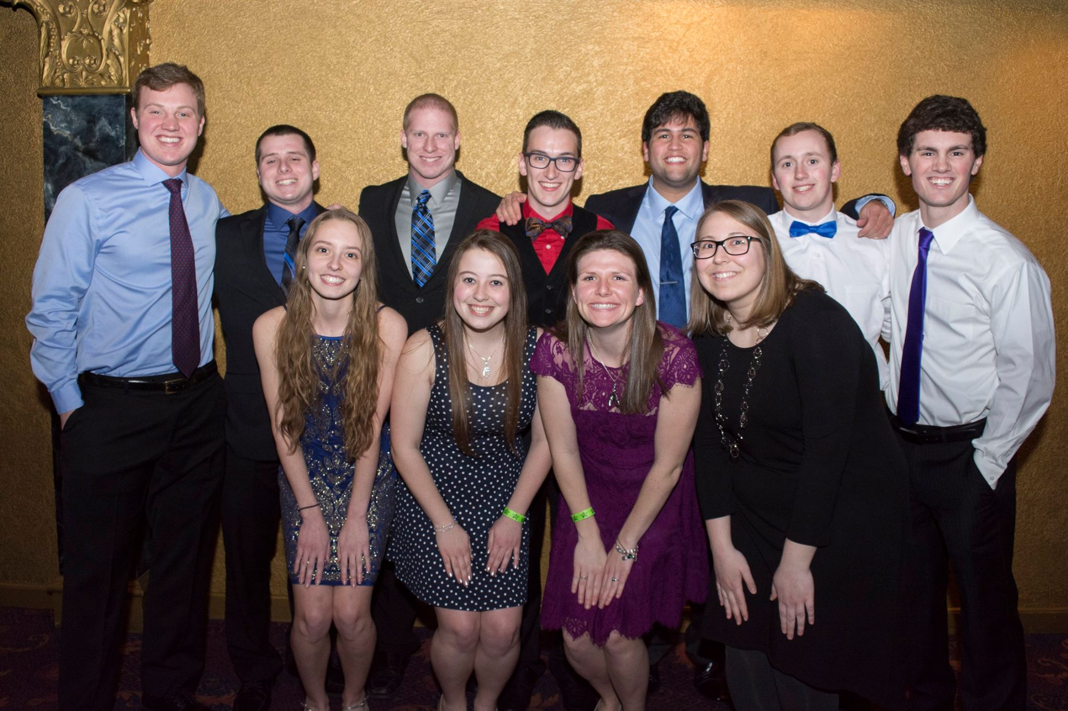
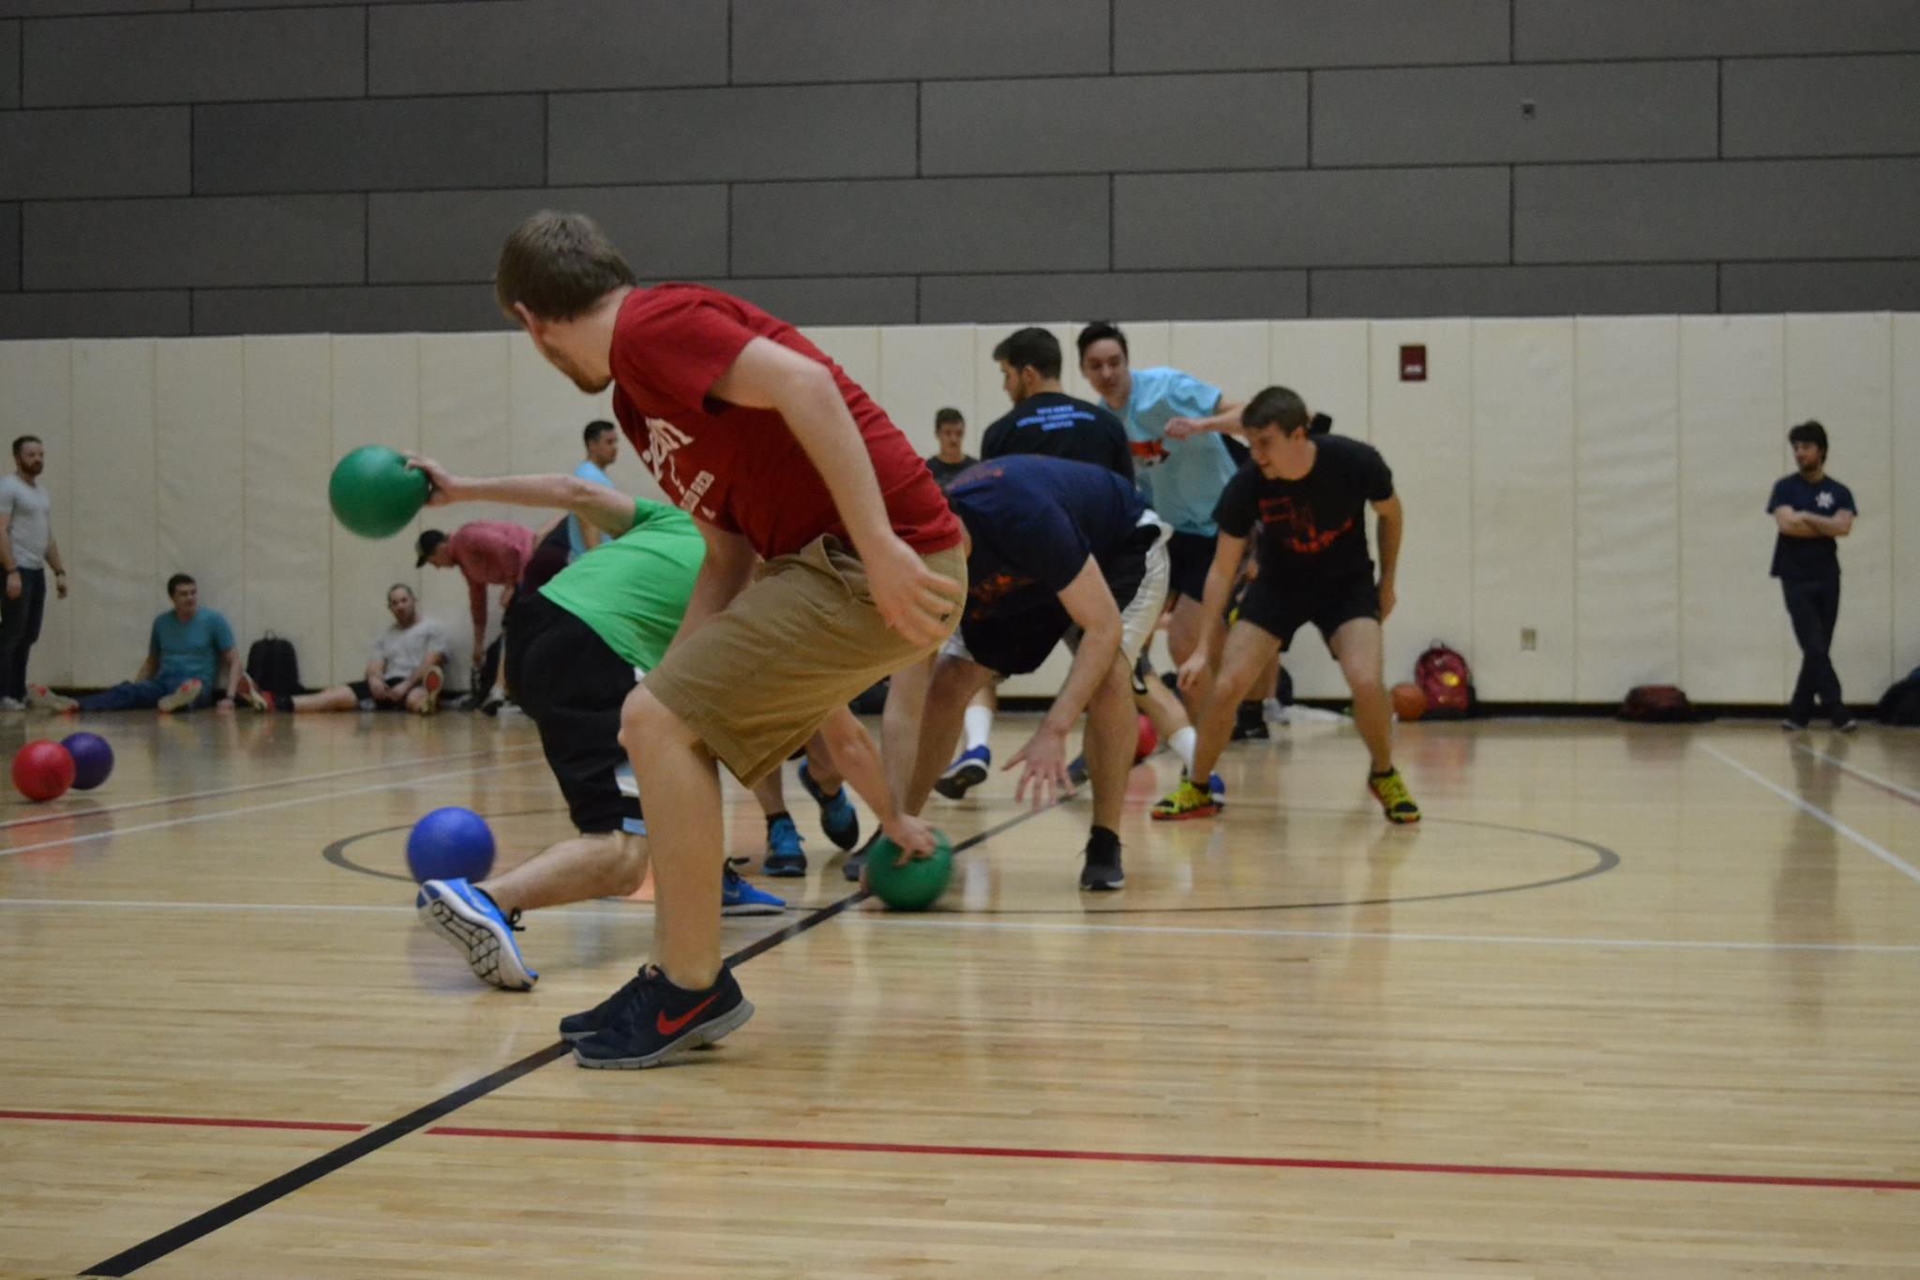
EWeek
Bryan Keller
kellerb9@mail.uc.edu
Kristen Urasek
urasekkm@mail.uc.edu
Who: Bryan Keller & Kristen Urasek
What: A banquet and fun filled week of events during nationally celebrated Engineering Week
When: February 18-24, 2018
Currently: Planning ahead. Help us make this the best year yet! Meeting dates & times are TBD based on interest

Slide 20
Special Events
Special Events committee is responsible for planning events for CEAS students throughout the semester.
Past events include Reds games, ski trip, RockQuest, Cyclones games, canoeing, Jungle Jim’s Cheese Festival
Want to chair this committee? Email Dane at sowersdd@mail.uc.edu (2nd year and above only)
Want to just help out? Email Andy at droescaj@mail.uc.edu

Slide 21
Communications
Run all social media accounts for tribunal
Goal is to increase the number of followers and follower engagement on social media this semester
If you have any further ideas on how to do this, feel free to reach out to me at cadenagr@mail.uc.edu

Slide 22
Secretary
Phillip Stoll
stollpa@mail.uc.edu
Make sure you sign in every meeting that you attend
You must attend 4 general body meeting to be a “voting member”
Meeting minutes and slides will be uploaded online
http://tribunal.uc.edu/meeting-minutes

Slide 23
Innovation Committee
Do you have an idea on what to improve around campus or want to gain leadership experience? Then, the Innovation Crew is the place to be.
Committee Meetings:
Thursday: 4:40 to 6:40pm
Location: TBD
Interested in being a part of the Crew, email FG Williams at okwubifv@mail.uc.edu for more info!

Slide 24
Technology
Achyut Anand
anandat@mail.uc.edu
Purpose: The Technology Committee is responsible for managing the technical assets of the organization and performing general maintenance tasks related to those assets.
Are you interested in gaining hands-on experience in any of the following fields?
Website Development
Mobile App Development
3D Printing
Data Management Systems
If so, then you should join the Technology Committee!

Slide 25
First-Year Opportunities to Get Involved

Slide 26
CEAS Tribunal Mentorship Program
About the Program
Students who are chosen for this program will be paired with a mentor (a current or recent Tribunal exec member) who can help connect you to projects and committees where you can make an impact even in your first semester (and this will look great on a resume for your first co-op)!
We will also be hosting weekly meetings for all mentees to allow you to network with one another and learn more about Tribunal and the college as a whole.
Application Info
Application Link: https://goo.gl/forms/u0dEcXdUKEaHQMHG2
Due date: Wednesday, September 6 at 5:00 pm
Want to learn more?
Engineering Tribunal General Meeting: Monday 8/21 at 5:30 pm in 544/644 Baldwin
Info Session: Monday 8/28 at 6:30 pm (location TBD- check uc email)
Questions? Contact Emily Demjanenko at demjanes@mail.uc.edu or Kareem Elgafy at elgafykk@mail.uc.edu!

Slide 27
FELD
President:
Konnor Barnes
Freshman Engineering Leadership Development (FELD) is a Tribunal committee open exclusively to freshmen students. It is great way to meet new people from your college and make a positive impact on your college and community as well.
Previous years: Cyclones game, Lazer Kraze, Sky Zone, Habitat for Humanity
First meeting: TBD – be on the lookout for an email!
Contact Konnor at barnesko@mail.uc.edu with questions

Slide 28
Social Media
Want to get updates about events and other things happening in CEAS, and also possibly win some cool prizes? Follow us on social media!
https://facebook.com/UCTribunal
@UCTribunal

Slide 29
We Want to Hear From You!
Do you have an idea, question, or concern? We want to be a resource for you! You can reach us in the following ways:
Engaging with our social media accounts
Emailing any one of our exec members (the full list is on our website at tribunal.uc.edu)
Stopping by our office in 650 Baldwin

Slide 30
Next Meeting: September 11th 5:30 PM Old Chem 525

